Slide 1


Slide 2
Unit
6
Preserving our heritage
Unit
FAMILY LIFE
LESSON 2
LANGUAGE

Slide 3
LESSON 2
LANGUAGE
WARM-UP
Watch a video
Task 1: Listen and repeat.
Task 2: Listen and mark the intonation in these sentences.
PRONUNCIATION
Task 1: Match the words with their meanings
Task 2: Complete the sentences using the words in Task 1
VOCABULARY
Task 1: Combine the sentences using to-infinitive clauses
Task 2. Ask and answer questions about heritage sites of traditions, using to-infinitive clauses.
GRAMMAR
Wrap-up
Homework
CONSOLIDATION

Slide 4
WARM-UP
WATCH A VIDEO
Work in 4 groups.
Watch the video and list out name the destinations and cultural heritage of Vietnam that they see in the video.
Stick the paper on the boards.
The group with the most correct answers is the winner.

Slide 5
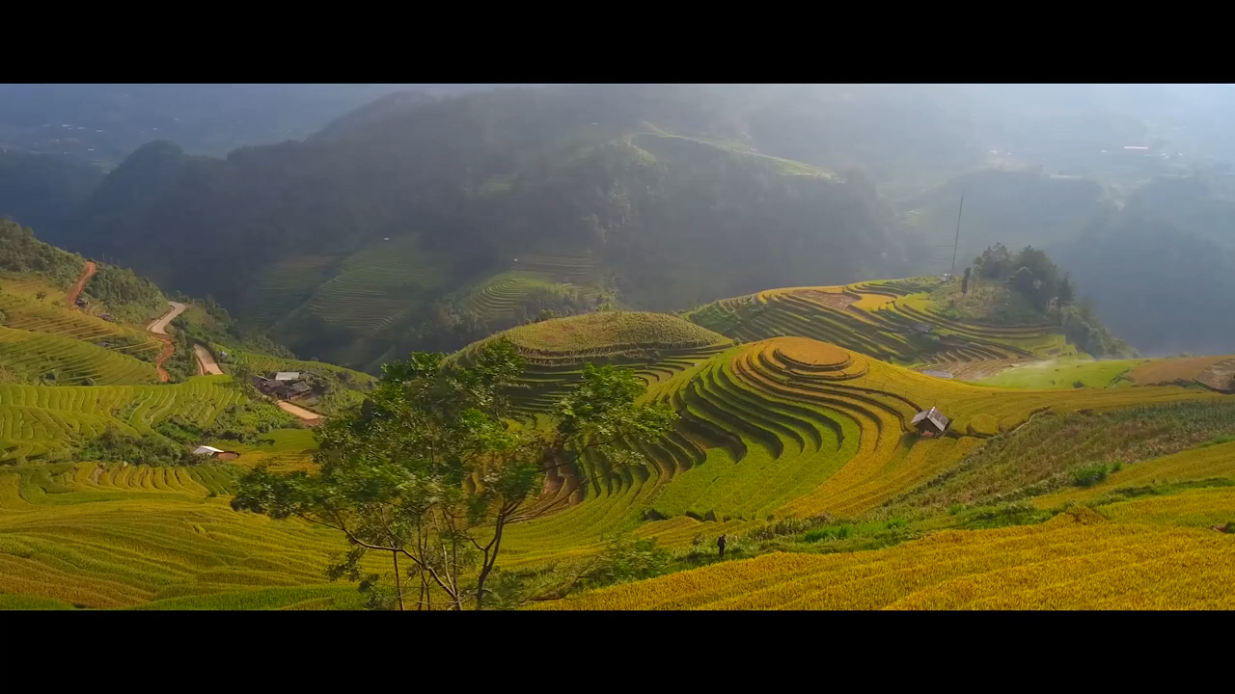
WARM-UP
WATCH A VIDEO

Slide 6
WARM-UP
Destinations and cultural heritage of Vietnam
- Complex of Huế Monuments
- Hội An Ancient Town
- Mỹ Sơn Sanctuary
- Hạ Long Bay
- Phong Nha – Kẻ Bàng National Park
- Imperial Citadel of Thăng Long
- Tràng An Scenic Landscape Complex
- Space of Gong Culture - Không gian văn hoá Cồng chiêng Tây Nguyên
- Vietnamese Court Music - Nhã Nhạc Cung Đình Huế
- Folk Songs - Quan họ Bắc Ninh
- Ca Tru Singing
- Art of Đờn ca tài tử music and song in southern Vietnam
- Practices related to Viet beliefs in the Mother Goddesses of Three Realms - Tín ngưỡng thờ Mẫu Tam Phủ

Slide 7
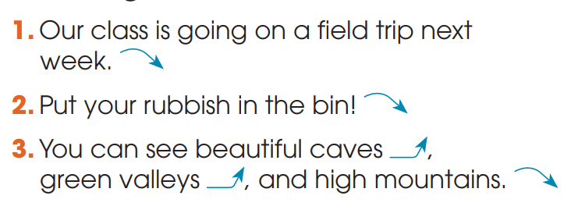
PRONUNCIATION
1
Listen and repeat. Pay attention to the falling intonation and level-rising intonation in the following sentences.

Slide 8


PRONUNCIATION
2
Listen and mark the intonation in these sentences, using falling intonation or level-rising intonation. Then practise saying them in pairs.
1. Hoi An Ancient Town became a world heritage site in 1999.
2. Please turn on the light. It’s dark in here.
3. Cultural heritage may include temples, pagodas and monuments.

Slide 9
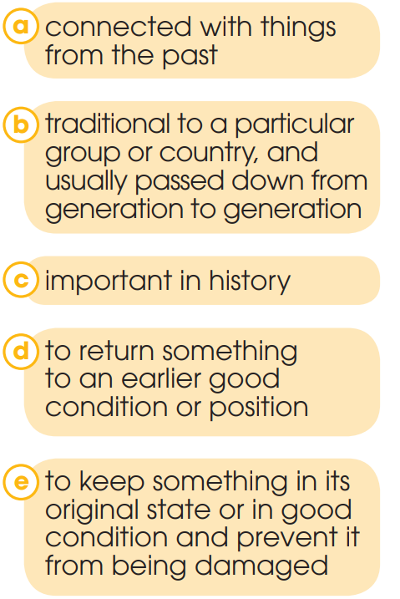
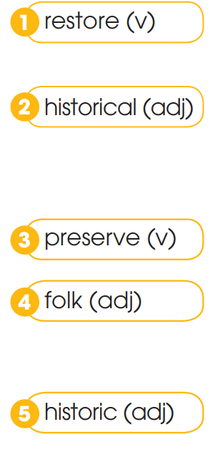
VOCABULARY
1
Match the words with their meanings

Slide 10
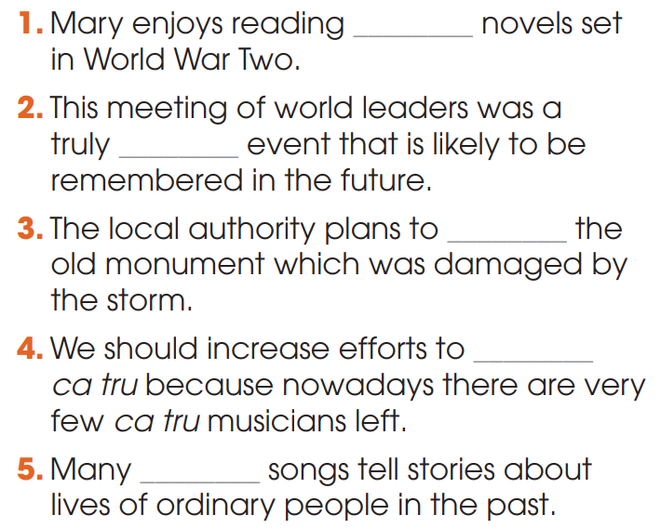
VOCABULARY
2
Complete the sentences using the words in Task 1
1. historical
2. historic
3. restore
4. preserve
5. folk

Slide 11
GRAMMAR
A to-infinitive clause can be used:
1. to express purpose | E.g: He studied hard to pass the exam. I bought some souvenirs to give to my parents.
2. to modify a noun or noun phrase that contain ordinal numbers (the first, the second, etc.), superlatives (the best, the most beautiful, etc.) and next, last, and only. | E.g. Ethan is usually the last person to understand the joke.

Slide 12
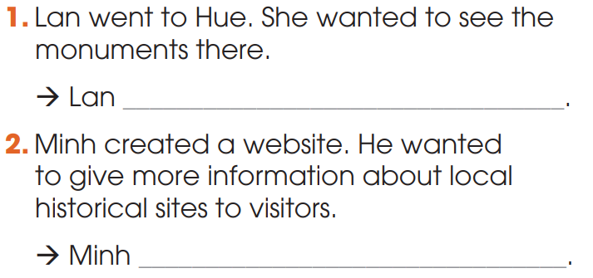
GRAMMAR
1
Combine the sentences using to-infinitive clauses
went to Hue to see the monuments there.
created a website to give more information about local historic sites to visitors.

Slide 13
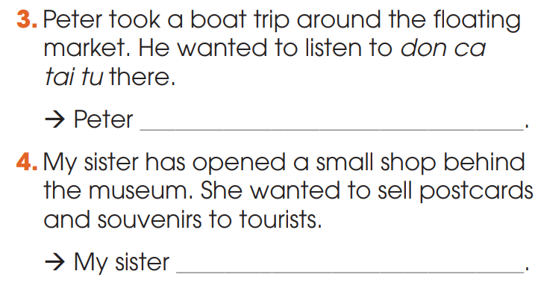
GRAMMAR
1
Combine the sentences using to-infinitive clauses
took a boat trip around the floating market to listen to Cai Luong there.
opened a small shop behind the museum to sell postcards and souvenirs to tourists.

Slide 14
GRAMMAR
2
Work in pairs. Ask and answer questions about heritage sites of traditions, using to-infinitive clauses.
Suggested answer:
1. The only thing to see at the Citadel of the Ho Dynasty is the stone walls.
2. The Complex of Hue Monuments was the first site in Viet Nam to be recognised as a World Heritage Site by UNESCO.
3. Bao Dai was the last king of the Nguyen Dynasty to rule Viet Nam.
4. My brother is the youngest person to win a folk song competition.

Slide 15
CONSOLIDATION
1
Wrap-up
What have you learnt today?
Some lexical items about heritage;
Intonation in statements, commands and lists;
To-infinitive clauses.

Slide 16
CONSOLIDATION
2
Homework
Do exercises in the workbook.
Prepare for Lesson 3 - Unit 6.

Slide 17

Website: hoclieu.vn
Fanpage: facebook.com/sachmem.vn/

