Slide 1


Slide 2


Unit
10
COMMUNICATION IN THE FUTURE
LESSON 2: A CLOSER LOOK 1

Slide 3
LESSON 2: A CLOSER LOOK 1
WARM-UP
Game: Jumbled words
Vocabulary
Task 1: Write the correct word or phrase.
Task 2: Choose the correct answer A, B, or C.
Task 3: Complete the sentences.
VOCABULARY
Task 4: Listen and repeat the words. Pay attention to the word stress.
Task 5: Mark the stress in the underlined words. Then listen and repeat.
PRONUNCIATION
CONSOLIDATION
Wrap-up
Homework

Slide 4
WARM-UP
1. devio receonnfc
2. atlbet
3. tinerent neitonccon
4. oomz ni
5. cebwam
→ video conference
→ tablet
JUMBLED WORDS
→ internet connection
→ zoom in
→ webcam

Slide 5
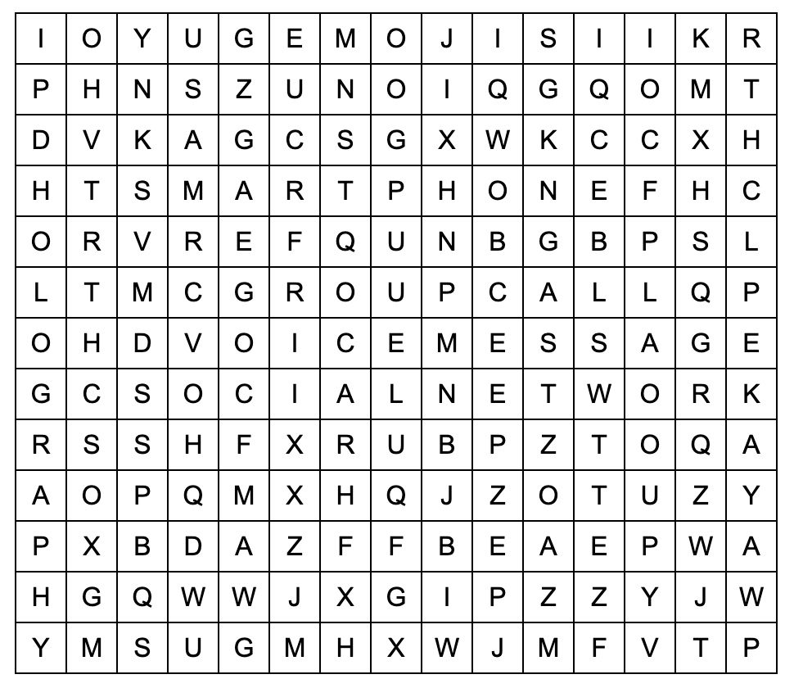
VOCABULARY
Work in pairs. Find the words in the word search.
voice message
social network
group call
smart phone
emojis
holography

Slide 6
VOCABULARY
New words | Pronunciation | Meaning
1. social network (n) | /ˌsəʊʃl ˈnetwɜːk/ | mạng xã hội
2. voice message (n) | /ˈvɔɪs mesɪdʒ/ | tin nhắn thoại
3. group call (n) | /ɡruːp kɔːl/ | cuộc gọi nhóm
4. smartphone (n) | /ˈsmɑːtfəʊn/ | điện thoại thông minh
5. emoji (n) | /ɪˈməʊdʒi/ | biểu tượng cảm xúc
6. holography (n) | /hɒlˈɒɡrəfi/ | hình chiếu 3 chiều

Slide 7
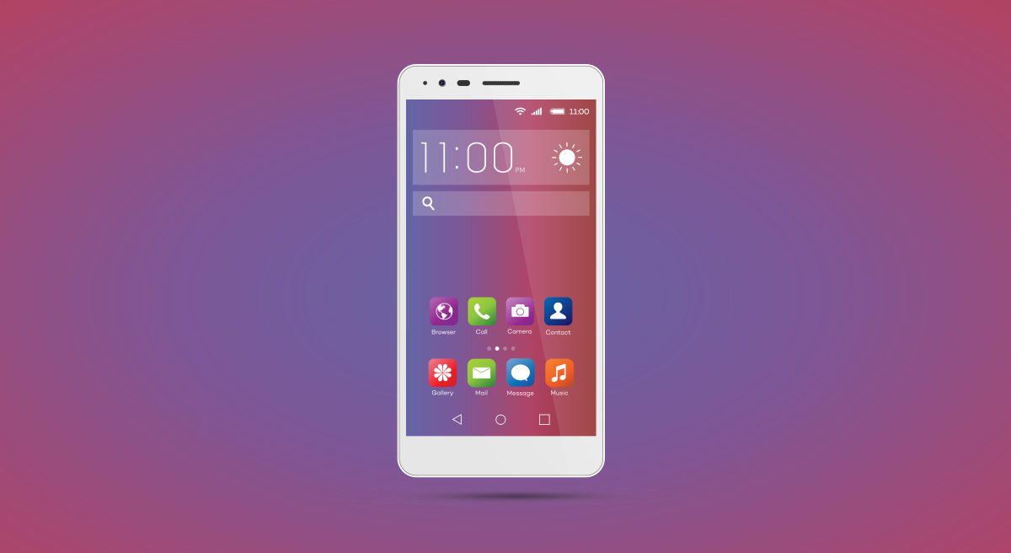
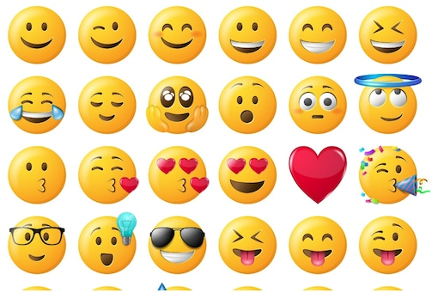
VOCABULARY
1
Write the correct word or phrase from the box under each picture.
voice message smartphone social network
emojis group call holography
1. ___________
emojis
smart phone
2. ___________

Slide 8
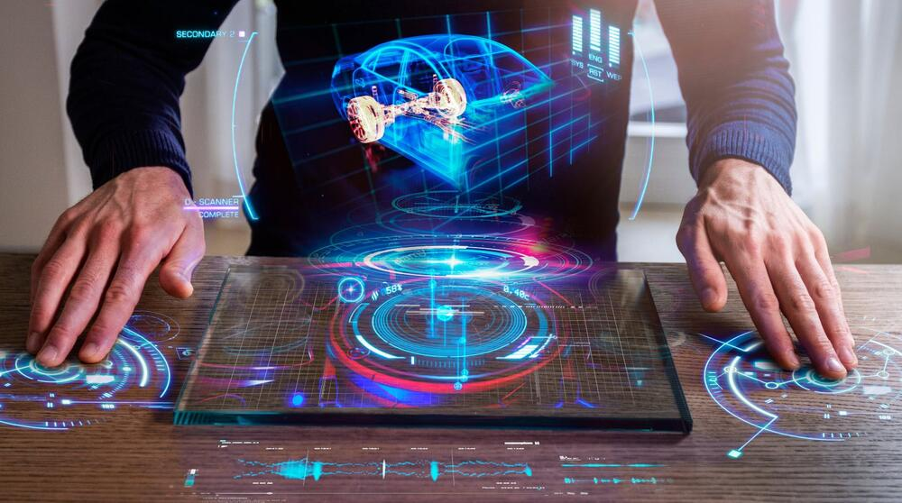
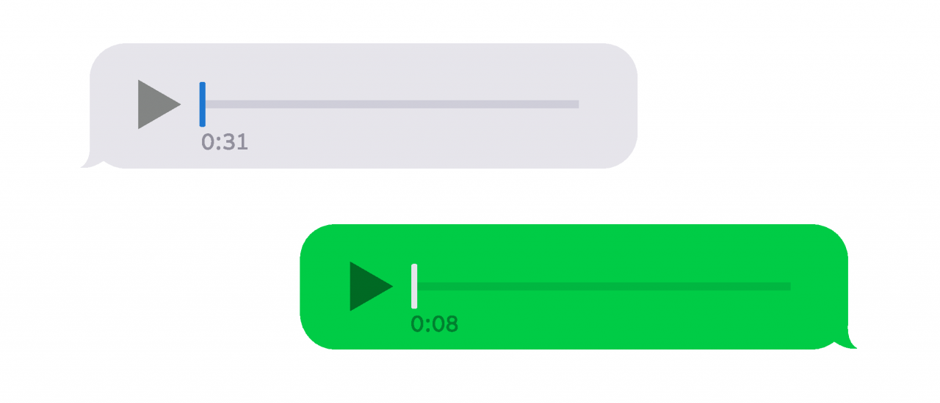
VOCABULARY
1
Write the correct word or phrase from the box under each picture.
voice message smartphone social network
emojis group call holography
3. _____________
4. ___________
voice message
holography

Slide 9
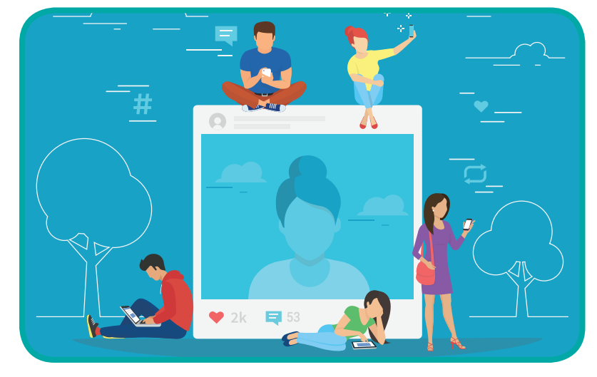
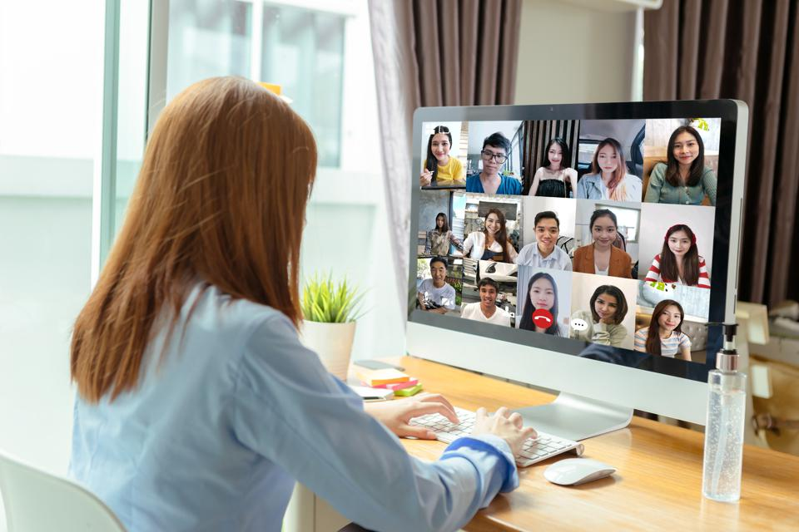
VOCABULARY
1
Write the correct word or phrase from the box under each picture.
voice message smartphone social network
emojis group call holography
5. ___________
smartphone
6. ___________
group call

Slide 10
VOCABULARY
2
Choose the correct answer A, B, or C.
1. Many people add ______ to their text messages to express their feelings.
A. emojis B. words C. letters
2. I send ______ messages when I don’t feel like typing.
A. group B. text C. voice
3. Many teenagers like to meet on social ______ rather than face to face.
A. television B. networks C. projects

Slide 11
VOCABULARY
2
Choose the correct answer A, B, or C.
4. In a ______, people in different places can join the conversation.
A. voice message B. group call C. system of emojis
5. By using ______, you can attend a meeting with your 3D image instead of being there in person.
A. holography B. voice messages C. social networks

Slide 12
PRACTICE
3
Complete the sentences with the words from the box.
translation real language instantly private
1. Do you often send _______ messages to your friends?
2. Can learning English help you overcome the _________ barrier when living abroad?
3. Telephone helps you communicate in _______ time.
4. Do you think translators will lose their jobs when ___________ machines become popular?
5. Many people reply to messages _________, but others take a long time to respond.
private
language
real
translations
instantly

Slide 13
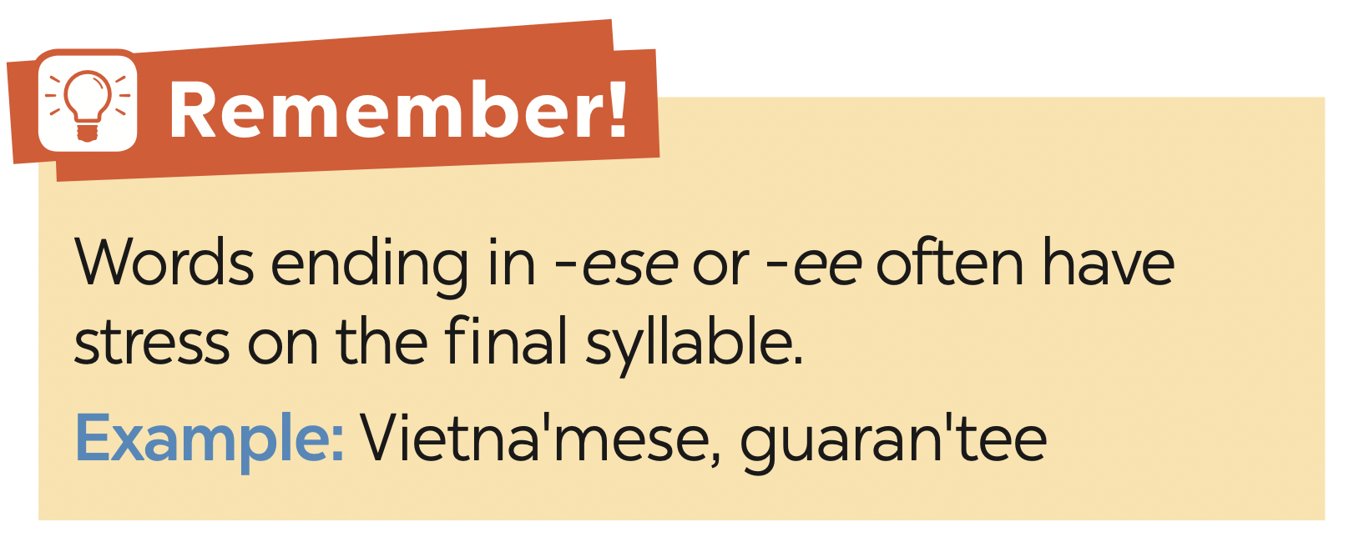
PRONUNCIATION

Slide 14

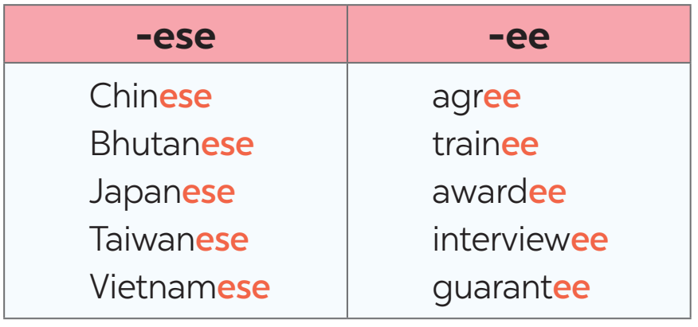
PRONUNCIATION
4
Listen and repeat the words. Pay attention to the word stress.

Slide 15
PRONUNCIATION
5
Mark the stress in the underlined words. Then listen and repeat the sentences.
1. The interviewees said that they were Taiwanese.
2. Joe agrees with me that learning Chinese is difficult.
3. She obtained a bachelor’s degree in Japanese.
4. The Taiwanese company gave each awardee a smartphone.
5. The Japanese teacher sent a video to the absentees on Monday.
‘
‘
‘
‘
‘
‘
‘
‘
‘
‘

Slide 16

CONSOLIDATION
1
Wrap-up
What have we learnt in this lesson?
Vocabulary: The lexical items related to Communication
Pronunciation: How to correctly stress words that ending in
-ese and -ee

Slide 17

CONSOLIDATION
2
Homework
- Do exercises in the Workbook

Slide 18

Website: hoclieu.vn
Fanpage: facebook.com/tienganhglobalsuccess.vn/

