Slide 1





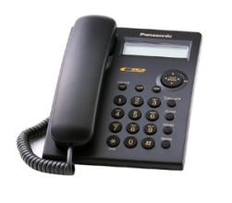

15 100,000
14 80,000
13 60,000
12 40,000
11 30,000
10 20,000
9 14,000
8 10,000
7 6,000
6 3,000
5 2,000
4 1000
3 600
2 400
1
200
Chơi
Bỏ qua

Slide 2
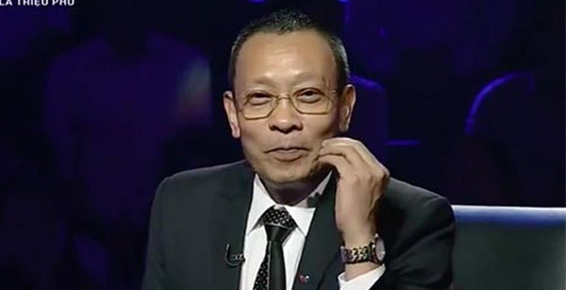




$200
1. The office …….. Close on the day before the holiday. It all depends how busy we are next week.
A
Will
B
Must
C
Might
D
Can
Trả lời

Slide 3
$400
2. Which alphabet is drink?
A
D
B
C
C
B
D
T
Trả lời

Slide 4
$600
3. If we keep…….. Like this, we should be done before the deadline
A
To work
B
Worked
C
Work
D
Working
Trả lời

Slide 5
$1000
4. What is the term of the President of the Vietnamese?
A
Three years
B
Four years
C
Five years
D
Six years
Trả lời

Slide 6
$2000
5. Which is the province where President HCM was born?
A
Quang Tri
B
Nghe An
C
Quang Binh
D
Ha Tinh
Trả lời

Slide 7
$3000
6. What was the first name of Vietnam?
A
Van Lang
B
Dai Viet
C
Dai Co Viet
D
Dai Nam
Trả lời

Slide 8
$4000
7. What has A hundered limbs, but cannot walk?
A
a centipede
C
a stick
B
a tree
D
a hedgehong
Trả lời

Slide 9
$6.000
8. The science classes at this…. difficult
A
school is
B
School are
C
school’s is
D
Schools are
Trả lời

Slide 10
$10.000
9. Which is the smallest province in Vietnam?
A
Ha Noi
B
Vung Tau
C
Hai Duong
D
Bac Ninh
Trả lời

Slide 11
$14.000
10. Which alphabet is a source of salt?
A
C
B
W
C
S
D
G
Trả lời

Slide 12
$20.000
11.Which Vietnamese city is famous for its silk lanterms?.
A
Ha Noi
B
Hue
C
Hoi An
D
Da Nang
Trả lời

Slide 13
$30.000
12. Telling somebody that …… is laid off is a very tought task?
A
him
B
he
C
they
D
his
Trả lời

Slide 14
$40.000
13. ……. Stamps, my brother collects coins?
A
Except
B
Beside
C
Near
D
Besides
Trả lời

Slide 15
$60.000
14. I’m really looking for word….. To university.
A
to going
B
go
C
To go
D
going
Trả lời

Slide 16
$80.000
15. “ Never be late for an interview,….. You can’t get the job
A
If not
B
Or so
C
other wise
D
unless
Trả lời

Slide 17
$100.000
9. Which is the smallest province in Vietnam?
A
Ha Noi
B
Vung Tau
C
Hai Duong
D
Bac Ninh
Trả lời

Slide 18

SƯU TẦM: ĐOÀN VĂN DOANH, NAM TRỰC, NAM ĐỊNH
LINK NHÓM DÀNH CHO GV BỘ MÔN VẬT LÝ TRAO ĐỔI TÀI LIỆU VÀ CHUYÊN MÔN CT 2018
https://www.facebook.com/groups/299257004355186

