Slide 1


Slide 2



Unit
7
TRAFFIC
LESSON 7: LOOKING BACK & PROJECT
VOCABULARY REVIEW
GRAMMAR REVIEW
PROJECT: TRAFFIC/ ROAD SIGNS
Unit

Slide 3

OBJECTIVES
By the end of the lesson, students will be able to:
review the vocabulary and grammar of Unit 7
apply what they have learnt (vocabulary and grammar) into practice through a project

Slide 4
LESSON 7: LOOKING BACK & PROJECT
WARM-UP
Quick revision
Task 1: Label each sign. What does each sign tell us to do?
Task 2: Fill in each gap with one word to complete the sentences.
VOCABULARY REVIEW
GRAMMAR REVIEW
Task 3: Write complete sentences, using these cues.
Task 4: Choose A, B, or C to complete the sentences.
PROJECT
Task 5: Traffic signs exhibition
CONSOLIDATION
Wrap-up
Homework

Slide 5
LESSON 7: LOOKING BACK & PROJECT
WARM-UP
Quick revision check
Aims of the stage:
To help students revise the vocabulary items they have learnt in the unit
To enhance students’ skills of cooperating with teammates.

Slide 6
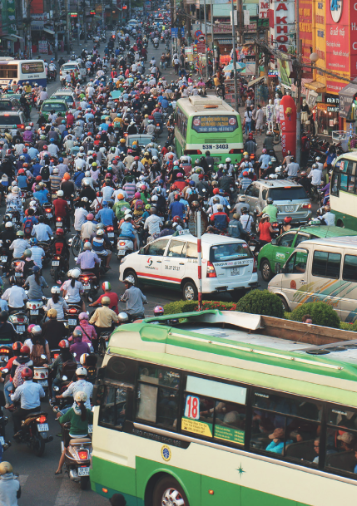


WARM-UP
QUICK REVISION

Slide 7
LESSON 7: LOOKING BACK & PROJECT
WARM-UP
Quick revision
Task 1: Label each sign. What does each sign tell us to do?
Task 2: Fill in each gap with one word to complete the sentences.
VOCABULARY REVIEW

Slide 8


VOCABULARY REVIEW
1
Label each sign. Work in pairs. What does each sign tell us to do?
School ahead
Hospital ahead
Red light
3. ________________
1. __________
2. ______________
No left turn
No cycling
Cycle lane
5. ____________
6. __________
4. __________

Slide 9
VOCABULARY REVIEW
1
Label each sign. Work in pairs. What does each sign tell us to do?
1. A ‘red light’ sign means you have to stop.
2. A ‘School ahead’ sign means you must go slowly.
3. A ‘Hospital ahead’ sign tells you that there is a hospital ahead.
4. A ‘Cycle lane’ sign means you can cycle there.
5. A ‘No left turn’ sign means you can’t turn left.
6. A ‘No cycling’ sign means you can’t cycle there.

Slide 10
VOCABULARY REVIEW
2
Fill in each gap with one word to complete the sentences.
1. A road ______ is anyone who uses a road, such as a pedestrian, cyclist or motorist.
2. Does your dad ______ his motorbike carefully?
3. A _________ is a person travelling in a car, bus, train, … but not driving.
4. My cousin wants to become a pilot. He is learning to _____ planes.
5. We should be careful when the ______ light turns yellow.
user
ride
passenger
fly
traffic

Slide 11
LESSON 7: LOOKING BACK & PROJECT
WARM-UP
Quick revision check
Task 1: Label each sign. What does each sign tell us to do?
Task 2: Fill in each gap with one word to complete the sentences.
VOCABULARY REVIEW
GRAMMAR REVIEW
Task 3: Write complete sentences, using these cues.
Task 4: Choose A, B, or C to complete the sentences.

Slide 12
GRAMMAR REVIEW
3
Write complete sentences, using these cues.
1. over 100 km / my home town / Ho Chi Minh City.
_________________________________________________
2. about 25 km / here / my grandparents’ house.
_________________________________________________
3. not very far / our school / the city museum.
_________________________________________________
4. how far / your house / the gym?
_________________________________________________
5. it / a long distance / Ha Noi / Ban Gioc Waterfall?
_________________________________________________
It is over 100 km from my home town to Ho Chi Minh City.
It is about 25 km from here to my grandparents’ house.
It is not very far from our school to the city museum.
How far is it from your house to the gym?
Is it a long distance from Ha Noi to Ban Gioc Waterfall?

Slide 13
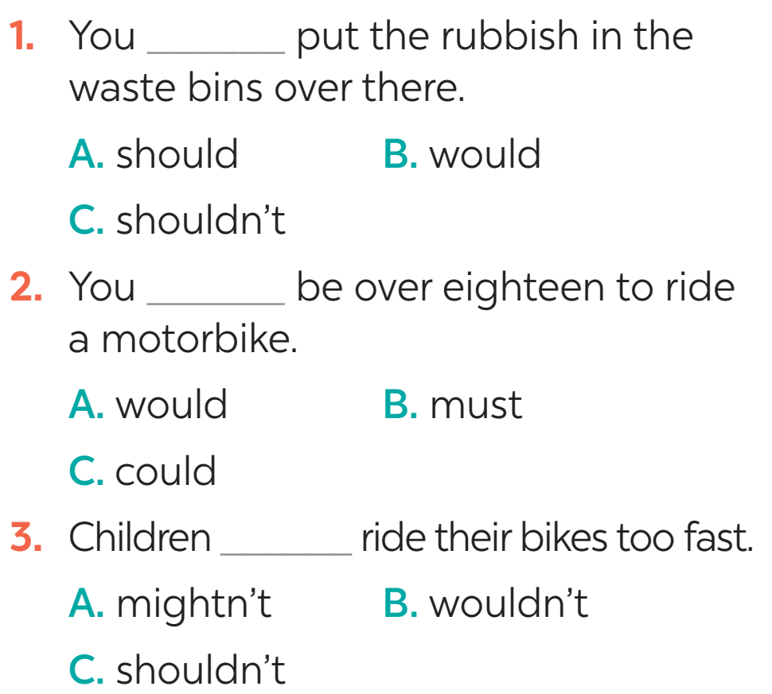
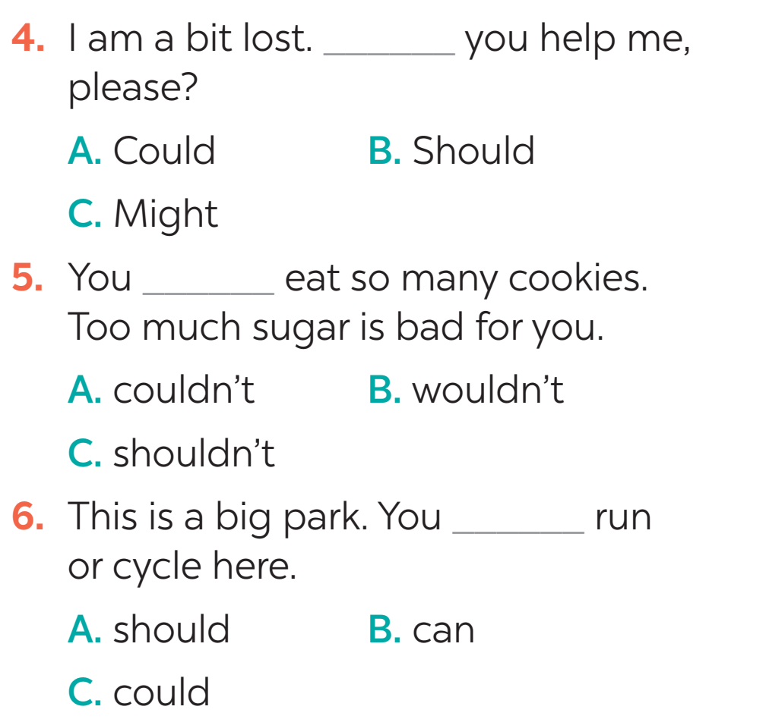
GRAMMAR REVIEW
4
Choose A, B, or C to complete the sentences.

Slide 14
LESSON 7: LOOKING BACK & PROJECT
WARM-UP
Quick revision check
Task 1: Label each sign. What does each sign tell us to do?
Task 2: Fill in each gap with one word to complete the sentences.
VOCABULARY REVIEW
GRAMMAR REVIEW
Task 3: Write complete sentences, using these cues.
Task 4: Choose A, B, or C to complete the sentences.
PROJECT
Task 5: Traffic signs exhibition

Slide 15
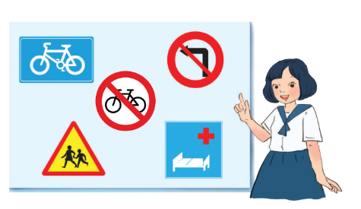
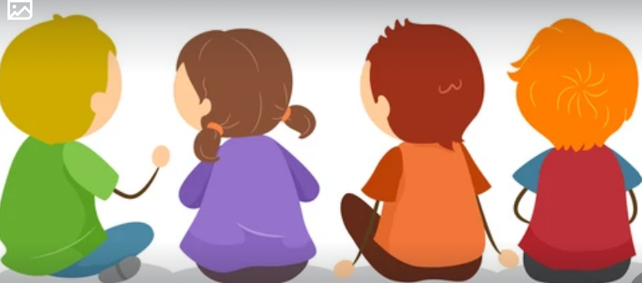
PROJECT
5
5
Traffic signs exhibition

Slide 16
LESSON 7: LOOKING BACK & PROJECT
WARM-UP
Quick revision
Task 1: Label each sign. What does each sign tell us to do?
Task 2: Fill in each gap with one word to complete the sentences.
VOCABULARY REVIEW
GRAMMAR REVIEW
Task 3: Write complete sentences, using these cues.
Task 4: Choose A, B, or C to complete the sentences.
PROJECT
Task 5: Traffic signs exhibition
CONSOLIDATION
Wrap-up
Homework

Slide 17
CONSOLIDATION
1
WRAP-UP
Vocabulary
Grammar
Project
Means of transport
It indicating distance
Traffic signs
Road signs
Should / Shouldn’t

Slide 18

CONSOLIDATION
2
HOMEWORK
Prepare for the next lesson:
Unit 8 – Lesson 1: Getting started

Slide 19

Website: hoclieu.vn
Fanpage: facebook.com/www.tienganhglobalsuccess.vn/

