Slide 1
C
1
C
P
U
2
M
O
O
N
I
T
O
R
3
M
M
E
M
O
R
Y
4
F
L
O
P
P
Y
D
I
S
K
P
5
M
O
U
U
S
E
6
E
S
K
T
O
P
D
T
7
K
E
Y
B
O
A
R
D
E
8
I
R
N
T
E
R
N
E
T
A computer screen or a device with a screen on which words orpictures can be shown.
A panel of keys that operate a computer or typewriter.
What is called “diskette”?
A small device that you move across a surface in order to move a cursor on your computer screen.
A machine that is connected to a computer and prints ontopaper using ink.
Something that you remember from the past.
The short form of Central Processing Unit
The large system of connected computers around the world.

Slide 2
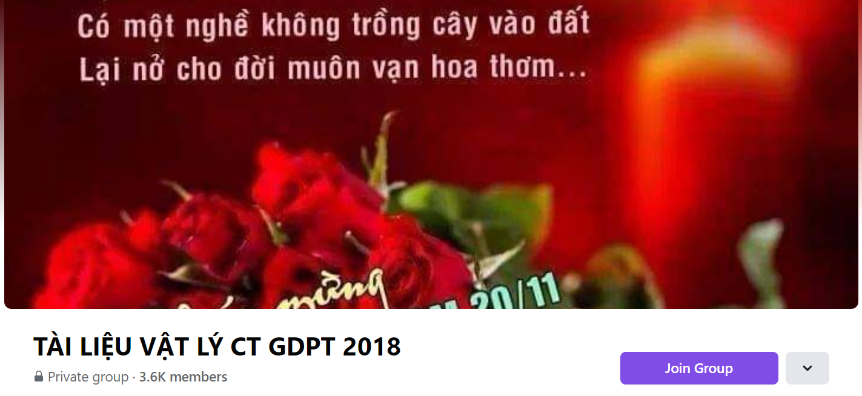
SƯU TẦM: ĐOÀN VĂN DOANH, NAM TRỰC, NAM ĐỊNH
LINK NHÓM DÀNH CHO GV BỘ MÔN VẬT LÝ TRAO ĐỔI TÀI LIỆU VÀ CHUYÊN MÔN CT 2018
https://www.facebook.com/groups/299257004355186

