Slide 1

Unit 3: All About Food
Lesson 3f: Skills
Page 62

Slide 2
Lesson Outline
Warm-up
Pre - reading
While - reading
Post - reading
Consolidation
Wrap-up

Slide 3
Objectives
By the end of this lesson, students will be able to…
read a text about street food.
practise reading skill (reading for specific information).

Slide 4

WARM-UP

Slide 5
PAIRWORK
Match the food with the countries they are popular in and say what you like.
Sushi
Pizza
Taco
Pho
Tteokbokki
Hamburger
South Korea
The USA
Italy
Japan
Mexico
Vietnam

Slide 6

It’s time to learn …

Slide 7

Pre-reading

Slide 8
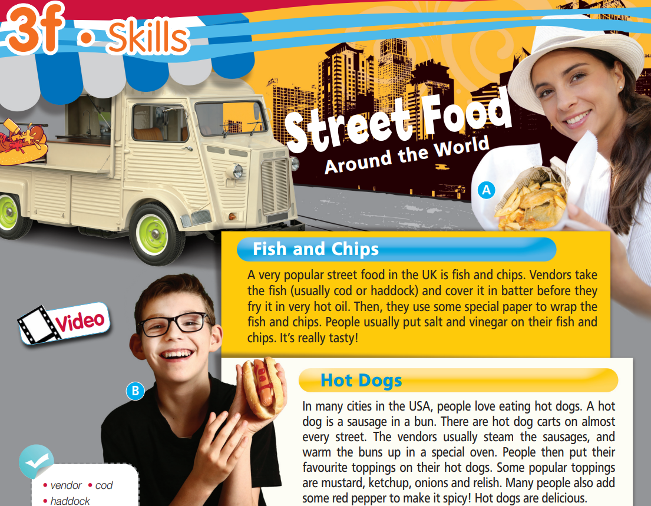

Read the title of the text and look at the pictures.
Which countries are these street foods popular in?
Listen and read to find out.
Fish and chips is popular in the UK, and hot dogs are popular in the USA.

Slide 9
Find these words and underline them. Can you guess their meanings?
vendor, cod, haddock, batter, fry, vinegar, cart, bun, steam, oven, relish
Fish and Chips
A very popular street food in the UK is fish and chips. Vendors take the fish (usually cod or haddock) and cover it in batter before they fry it in very hot oil. Then, they use some special paper to wrap the fish and chips. People usually put salt and vinegar on their fish and chips. It’s really tasty!
Hot Dogs
In many cities in the USA, people love eating hot dogs. A hot dog is a sausage in a bun. There are hot dog carts on almost every street. The vendors usually steam the sausages, and warm the buns up in a special oven. People then put their favourite toppings on their hot dogs. Some popular toppings are mustard, ketchup, onions and relish. Many people also add some red pepper to make it spicy! Hot dogs are delicious.

Slide 10
Vocabulary
Listen and repeat. Click on each word to hear the sound.
• vendor (n) /ˈvendə/: người bán dạo
• cod (n) /kɒd/: cá tuyết
• haddock (n) /ˈhædək/: cá êfin (cá tuyết chấm đen)
• batter (n) /ˈbætə/: bột nhão làm bánh
• fry (v) /fraɪ/: rán, chiên
• vinegar (n) /ˈvɪnɪɡə/: giấm

Slide 11
Vocabulary
Listen and repeat. Click on each word to hear the sound.
• cart (n) /kɑːt/: xe cút kít, xe kéo
• bun (n) /bʌn/: bánh sữa nhỏ
• steam (v) /stiːm/: hấp
• oven (n) /ˈʌvən/: lò nướng
• relish (n) /ˈrelɪʃ/: đồ gia vị

Slide 12
Make your own sentences, using the vocabulary you have learnt.
My mum usually steams vegetables for our meals because they are healthy for us.

Slide 13
While-reading

Slide 14
Read and underline the key words.
1 Vendors fry fish and chips in very hot oil.
2 Vendors use flour and water to make batter.
3 Vendors steam the buns in a cart.
4 Vinegar is a popular topping for hot dogs.

Slide 15
2 Read the text and decide if the sentences are R (right), W (wrong) or DS (doesn’t say).
1 Vendors fry fish and chips in very hot oil.
2 Vendors use flour and water to make batter.
R
DS
Vendors take the fish (usually cod or haddock) and cover it in batter before they fry it in very hot oil.

Slide 16
3 Vendors steam the buns in a cart.
W
The vendors usually steam the sausages, and warm the buns up in a special oven.
4 Vinegar is a popular topping for hot dogs.
W
Some popular toppings are mustard, ketchup, onions and relish.

Slide 17
Extra practise
Read the sentences and underline key words.
1 What fish do vendors use to make fish and chips?
2 What do people usually put on their fish and chips?
3 Where can you buy hot dogs in the USA?
4 What do people usually put on their hot dogs?

Slide 18
3 Answer the questions.
1 What fish do vendors use to make fish and chips?
Vendors use cod or haddock in fish and chips.
Vendors take the fish (usually cod or haddock) and cover it in batter before they fry it in very hot oil.
2 What do people usually put on their fish and chips?
People put salt and vinegar on their fish and chips.
People usually put salt and vinegar on their fish and chips.

Slide 19
3 Where can you buy hot dogs in the USA?
You can buy hot dogs on almost every street of many cities in the USA.
In many cities in the USA, people love eating hot dogs. There are hot dog carts on almost every street.
4 What do people usually put on their hot dogs?
People put mustard, ketchup, onions and relish on their hot dogs.
People then put their favourite toppings on their hot dogs. Some popular toppings are mustard, ketchup, onions and relish.

Slide 20
4 Find four adjectives that describe food and four verbs related to food preparation. Then list all types of food in the text. Which are vegetables? fish?
Adjectives that describe food:
Verbs related to food preparation:
Types of food:
popular, tasty, spicy, delicious
fry, steam, warm up, add
fish (fish), chips (vegetables), cod (fish), haddock (fish), oil, salt, vinegar, hot dog, sausage, bun, toppings, mustard, ketchup, onions (vegetables), relish, red pepper (vegetables)

Slide 21

Post-reading

Slide 22
Pair work
Ask and answer about the popular street foods in the UK and the USA.
What is the popular street food in the UK/the USA?
How can we make it?
What toppings do people usually put on it?

Slide 23

CONSOLIDATION

Slide 24
Write a summary (3 sentences) about the popular street food in the UK (fish and chips) or the popular street food in the USA (hot dogs), using the information in the text you have read.

Slide 25

WRAP-UP

Slide 26
Today’s lesson
Vocabularies
• vendor • cod
• haddock
• batter • fry
• vinegar • cart
• bun • steam
• oven • relish
Reading
Read a text about popular street food around the world

Slide 27
Homework
Practise making sentences using the vocabularies.
Do the exercises in TA 6 Right on WB (p. 33)
Prepare the next lesson (p. 63 SB)
Do Unit 3 Test 2 in Bài Tập Bổ Trợ TA 6 Right on (pp. 28-29)

Slide 28

Enjoy your day!

