Slide 1
TEMPLATES
DÀNH CHO
MÔN SINH HỌC
Here is where this template begins

Slide 2
ABOUT INTERACTIVE CLINICAL CASES SCENARIOS INFOGRAPHICS
Mẫu này chứa một loạt các tài nguyên đồ họa thông tin bổ sung cho bản trình bày Kịch bản các trường hợp lâm sàng tương tác.
Các infographics này được điều chỉnh theo phong cách của bản trình bày nói trên, vì vậy bạn có thể chèn chúng dễ dàng và tích hợp chúng hoàn toàn cùng một lúc. Bạn chỉ cần làm như sau:
Chọn phần tử mà bạn muốn sao chép
Nhấp chuột phải và chọn "Sao chép/COPY"
Đi tới trang chiếu nơi bạn muốn phần tử xuất hiện
Nhấp chuột phải và chọn "Dán/PASTE"

Slide 3
CLINICAL CASES: INFOGRAPHICS
MERCURY
JUPITER
Mercury is the closest planet to the Sun
Jupiter is the biggest planet of them all
SATURN
MARS
Saturn is a gas giant and has several rings
Mars is actually a very cold place
VENUS
NEPTUNE
Venus is the second planet from the Sun
Neptune is far away from the Sun

Slide 4
CLINICAL CASES: INFOGRAPHICS
NAME:
MARIE JONES
AGE:
25 YEARS OLD
GENDER:
FEMALE
20XX
20XX
20XX
MARS
VENUS
SATURN
Mars is actually a very cold place
Venus is the second planet from the Sun
Saturn is a gas giant and has several rings

Slide 5
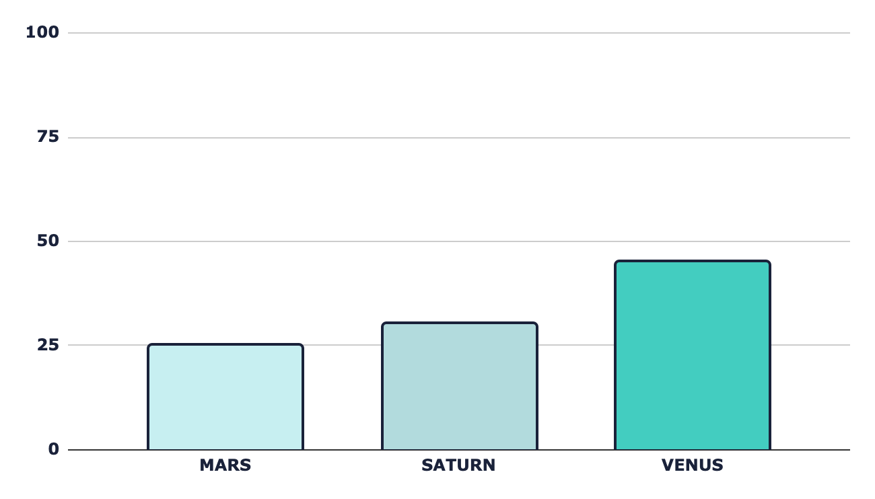
CLINICAL CASES: INFOGRAPHICS
MARS
25%
30%
45%
Mars is actually a very cold place
SATURN
It’s composed of hydrogen and helium
VENUS
Venus is the second planet from the Sun
Follow the link in the graph to modify its data and then paste the new one here. For more info, click here

Slide 6
CLINICAL CASES: INFOGRAPHICS
MERCURY
MARS
Mercury is the closest planet to the Sun
Despite being red, Mars is a very cold place
VENUS
NEPTUNE
Venus is the second planet from the Sun
Neptune is the farthest planet from the Sun

Slide 7
CLINICAL CASES: INFOGRAPHICS
01
02
03
04
MARS
VENUS
MERCURY
SATURN
Despite being red, Mars is actually a very cold place
Venus is the second planet from the Sun
Mercury is the smallest planet in the Solar System
Saturn is a gas giant and has several rings

Slide 8
CLINICAL CASES: INFOGRAPHICS
WEEK 1
WEEK 2
Venus has a nice name, but is hot
25%
Jupiter is a gas giant and is big
50%
50%
25%
WEEK 3
WEEK 4
Despite being red, Mars is cold
100%
Saturn is a planet that has rings
100%
75%
50%

Slide 9
CLINICAL CASES: INFOGRAPHICS
CHECK TABLE
TREATMENT | DURABLE | SURGERY | INVASIVE | COSTLY
Treatment 1 | X
Treatment 2 |  | X | X | X
Treatment 3 | X |  | X
Treatment 4 | X |  |  | X

Slide 10
CLINICAL CASES: INFOGRAPHICS
MERCURY
Mercury is the closest planet to the Sun and the smallest in the Solar System
VENUS
Venus has a beautiful name and is the second planet from the Sun
MARS
Despite being red, Mars is actually a cold place. It’s full of iron oxide dust

Slide 11
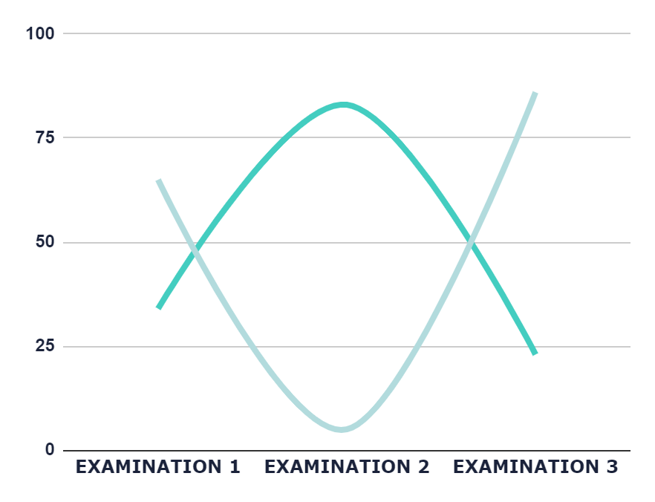
CLINICAL CASES: INFOGRAPHICS
45%
55%
VENUS
MERCURY
Venus has a beautiful name
Mercury is a very small planet
Follow the link in the graph to modify its data and then paste the new one here. For more info, click here

Slide 12
CLINICAL CASES: INFOGRAPHICS
20XX
Venus has a beautiful name
20XX
Mercury is close to the Sun
20XX
Jupiter is a very big planet
20XX
Saturn is a gas giant
AGE:
40
20XX
Mars is actually a cold place
GENDER:
Male
ALLERGIES:
None
20XX
Neptune is far away from us
LOCATION:
Florida

Slide 13
CLINICAL CASES: INFOGRAPHICS
35%
JUPITER
25%
Jupiter is a gas giant and a very big planet
40%
SATURN
MARS
Saturn is a gas giant and has several rings
Despite being red, Mars is actually a cold place

Slide 14
CLINICAL CASES: INFOGRAPHICS
WEEK | PHASE 1 | PHASE 2 | PHASE 3
WEEK 1
WEEK 2
WEEK 3
WEEK 4
MERCURY
It’s the smallest planet of them all
VENUS
Venus has a nice name, but is hot
SATURN
Saturn is a gas giant and has rings

Slide 15
CLINICAL CASES: INFOGRAPHICS
Mercury is the closest planet to the Sun
01
MERCURY
NEPTUNE
02
Neptune is the farthest planet from the Sun
Saturn is composed of hydrogen and helium
03
SATURN
JUPITER
04
Jupiter is the biggest planet of them all
Despite being red, Mars is actually a cold place
05
MARS

Slide 16
CLINICAL CASES: INFOGRAPHICS
NEPTUNE
SATURN
It’s the farthest planet from the Sun
Saturn is a gas giant and has rings
JUPITER
VENUS
It’s the biggest planet of them all
Venus is the second planet from the Sun
MERCURY
It’s the smallest planet of them all

Slide 17
CLINICAL CASES: INFOGRAPHICS
NAME | ABOUT | IMAGE
Josh Smith | Neptune is the farthest planet from the Sun
AGE | GENDER | ALLERGIES
26 | Male | None
OBSERVATIONS |  | Mars is full of iron oxide dust
20XX
Jupiter is a huge planet
20XX
Mercury is a small planet
20XX
Saturn has several rings

Slide 18
CLINICAL CASES: INFOGRAPHICS
VENUS
Venus has a beautiful name
EARTH
MERCURY
Mercury is close to the Sun
DISEASE
NEPTUNE
JUPITER
Jupiter is a very big planet
MARS
Mars is actually a cold place

Slide 19
CLINICAL CASES: INFOGRAPHICS
MERCURY
CONSEQUENCES
Mercury is the closest planet to the Sun and the smallest in the Solar System
Pluto is considered a dwarf planet
Ceres is located in the main asteroid belt
The Moon is Earth’s only natural satellite
Despite being red, Mars is a cold place
EARTH
Earth is the third planet from the Sun and the only one that harbors life

Slide 20
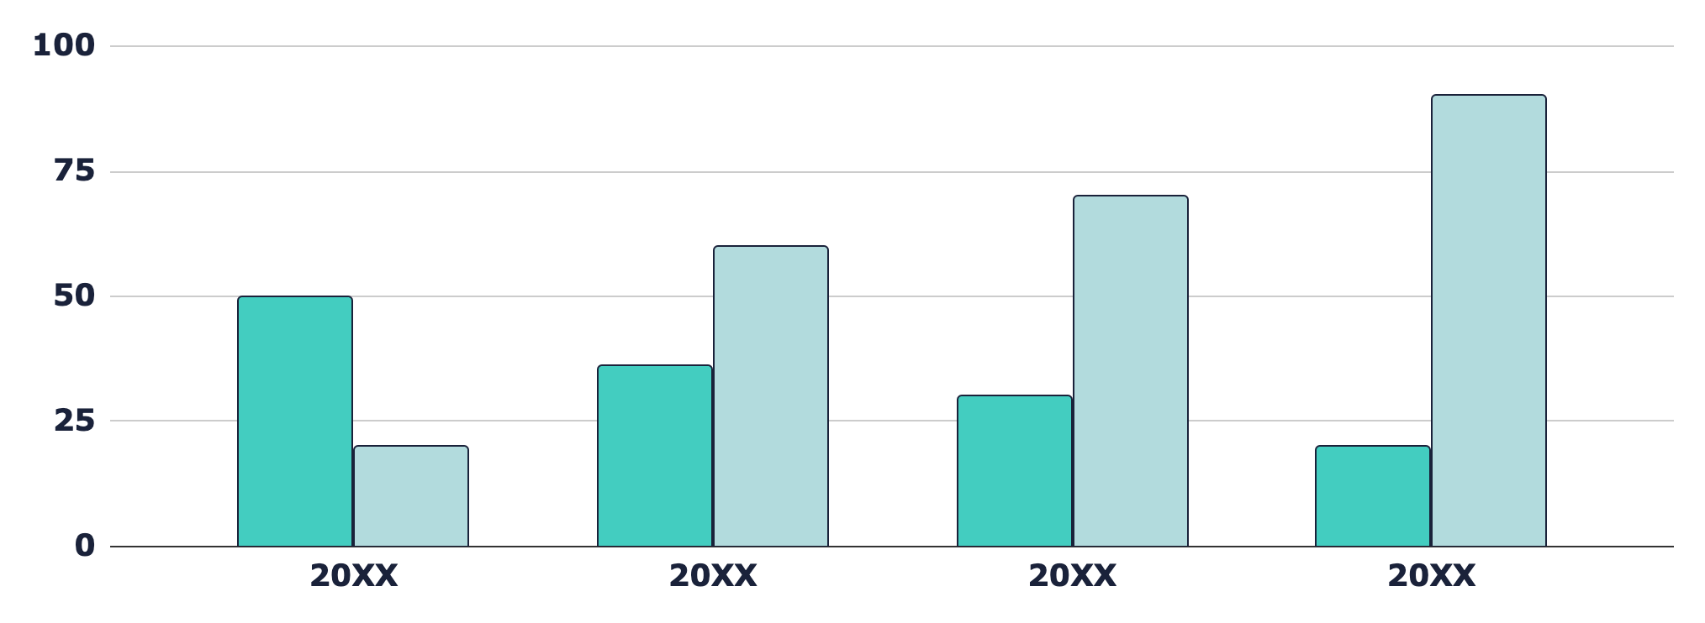
CLINICAL CASES: INFOGRAPHICS
MERCURY
MARS
Mercury is a small planet
Mars is a cold place
Follow the link in the graph to modify its data and then paste the new one here. For more info, click here

Slide 21
CLINICAL CASES: INFOGRAPHICS
Saturn is a gas giant and has rings
Mercury is very close to the Sun
Venus has a nice name, but is hot
Mars is actually a cold planet
Neptune is far away from the Sun
2XXX
2XXX
2XXX
2XXX
2XXX

Slide 22
CLINICAL CASES: INFOGRAPHICS
 | MONTHS 1-2 | MONTHS 3-6 | MONTHS 7-12
Stage 1 | Mercury is very close to the Sun | Neptune is far away from the Sun | Earth is the third planet from the Sun
Stage 2 | Despite being red, Mars is a cold place | Jupiter is the biggest planet of them all | Venus is the second planet to the Sun
Stage 3 | Saturn is a gas giant and has rings | Mars is actually a very cold place | The Sun is the closest star to Earth
Stage 4 | Uranus is the seventh planet from the Sun | The Moon is Earth’s natural satellite | Pluto is now considered a dwarf planet

Slide 23
CLINICAL CASES: INFOGRAPHICS
WEEK 1
WEEK 2
WEEK 3
WEEK 4
Venus has a beautiful name
Mercury is a very small planet
Mars is actually a very cold place
Jupiter is a very big planet
35%
70%
30%
65%
50%
100%
45%
90%

Slide 24
CLINICAL CASES: INFOGRAPHICS
RISK FACTORS AND PREVENTION
The Sun is the closest star to Earth
RISK 1
RISK 2
RISK 3
Venus has a nice name
Neptune is far away
Mars is a cold place
Mercury is a small planet
Earth is where we all live on
Mars is a very cold place
Jupiter is a huge gas giant
Saturn has several rings

Slide 25
CLINICAL CASES: INFOGRAPHICS
01
02
MERCURY
MARS
01
02
Mercury is very close to the Sun
Despite being red,
Mars is a cold place
03
04
04
SATURN
NEPTUNE
03
Saturn is a gas giant and has rings
Neptune is far away from the Sun

Slide 26
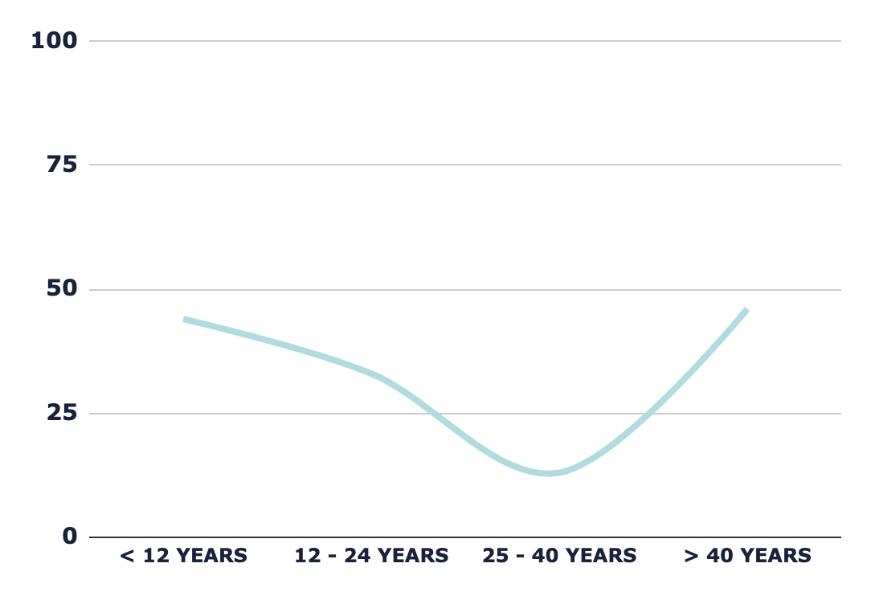
CLINICAL CASES: INFOGRAPHICS
VENUS
Venus has a beautiful name
MARS
Mars is actually a very cold place
Follow the link in the graph to modify its data and then paste the new one here. For more info, click here

Slide 27
CLINICAL CASES: INFOGRAPHICS
WEEK 1
WEEK 3
Mars is a cold place
Mercury is very small
50%
60%
Venus has a nice name
Jupiter is very big
75%
70%
WEEK 2
WEEK 4
Mars
50%
Venus
1st phase
2nd phase
90%
70%
30%

Slide 28
CLINICAL CASES: INFOGRAPHICS
DAY 1
Venus is the second planet from the Sun
DAY 3
Saturn is a gas giant and has several rings
Despite being red, Mars is a very cold place
Mercury is the smallest planet in the Solar System
DAY 2
DAY 4

Slide 29
CLINICAL CASES: INFOGRAPHICS
CASE 1 | CASE 2
Mercury is the closest planet to the Sun and the smallest one: It’s a small planet It’s close to the Sun It was named after a Roman god | Venus has a beautiful name and it the second planet from the Sun: It has a beautiful name It’s very hot It has a toxic atmosphere
40% | 60%
Mercury is a very small planet | Venus has a beautiful name

Slide 30
CLINICAL CASES: INFOGRAPHICS
TEST 1
TEST 2
TEST 3
Despite being red, Mars is a very cold place
Venus has a beautiful name, but is very hot
Saturn is a gas giant and has several rings
TEST 1
TEST 2
TEST 3
Neptune is the farthest planet from the Sun
Jupiter is the biggest planet in the Solar System
Mercury is the smallest planet in the Solar System

Slide 31
CLINICAL CASES: INFOGRAPHICS
WEEK 1
WEEK 2
Mercury is the closest planet to the Sun and the smallest one of them all—it’s a bit larger than the Moon
Venus
Mars
45%
55%
Topic 1
60%
WEEK 3
Topic 2
70%
Topic 1
30%
Topic 3
80%
Topic 4
40%
Topic 2
50%

Slide 32
CLINICAL CASES: INFOGRAPHICS
TREATMENT
PHASE 1
PHASE 2
PHASE 3
Mars is actually a very cold place
Mercury is the smallest planet of them all
Venus is the second planet from the Sun
30%
10%
60%

