Slide 2


Unit
3
MY FRIENDS
LESSON 2: A CLOSER LOOK 1
1

Slide 3
LESSON 2: A CLOSER LOOK 1
LESSON 1: GETTING STARTED
WARM-UP
Game: Simon says
Task 1: Match the adjectives to the pictures.
Vocabulary teaching
Task 2: Use the adjectives in the box to complete the sentences.
Task 3: Game: Friendship ﬂower.
VOCABULARY
PRONUNCIATION
Task 4: Listen and circle the words you hear. Then repeat.
Task 5: Listen. Then practise the chant. Notice the rhyme.
CONSOLIDATION
Wrap-up
Homework

Slide 4
WARM-UP
“Simon says” game
Rules:
Students have to touch the body parts that teacher calls out.
Who does wrong actions is out of the game.
Simon says

Slide 5
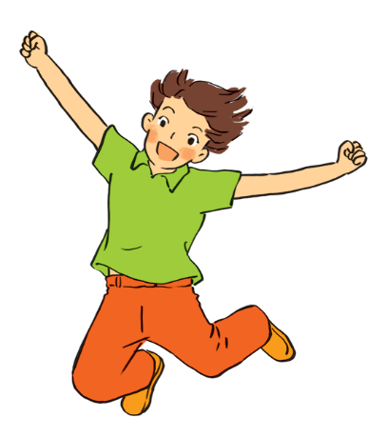
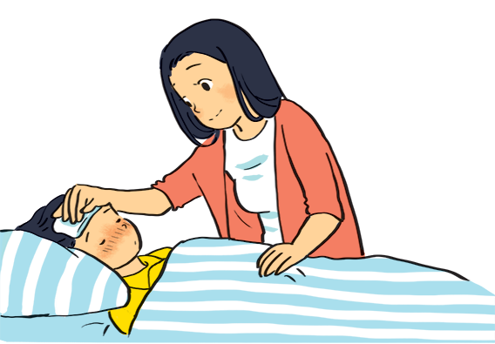

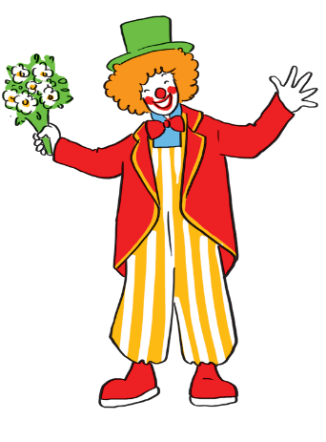
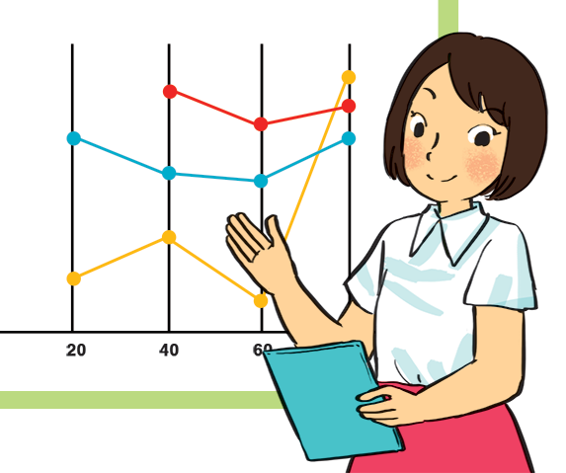
VOCABULARY
1
Match the adjectives to the pictures.
a
b
1. hard-working
2. confident
4. caring
5. active
4. caring
3. funny
5. active
c
d
e
1. hard-working
3. funny
2. confident

Slide 6
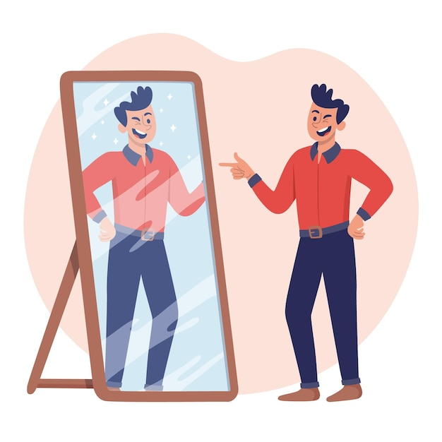

VOCABULARY
confident (adj)
/ˈkɒnfɪdənt/
tự tin

Slide 7
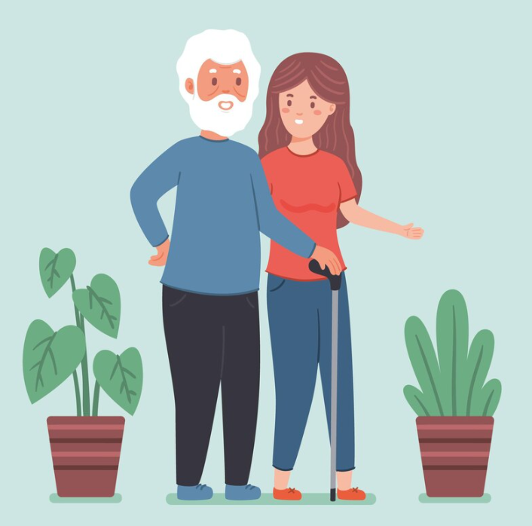
VOCABULARY
caring (adj)
/ˈkeərɪŋ/
quan tâm

Slide 8
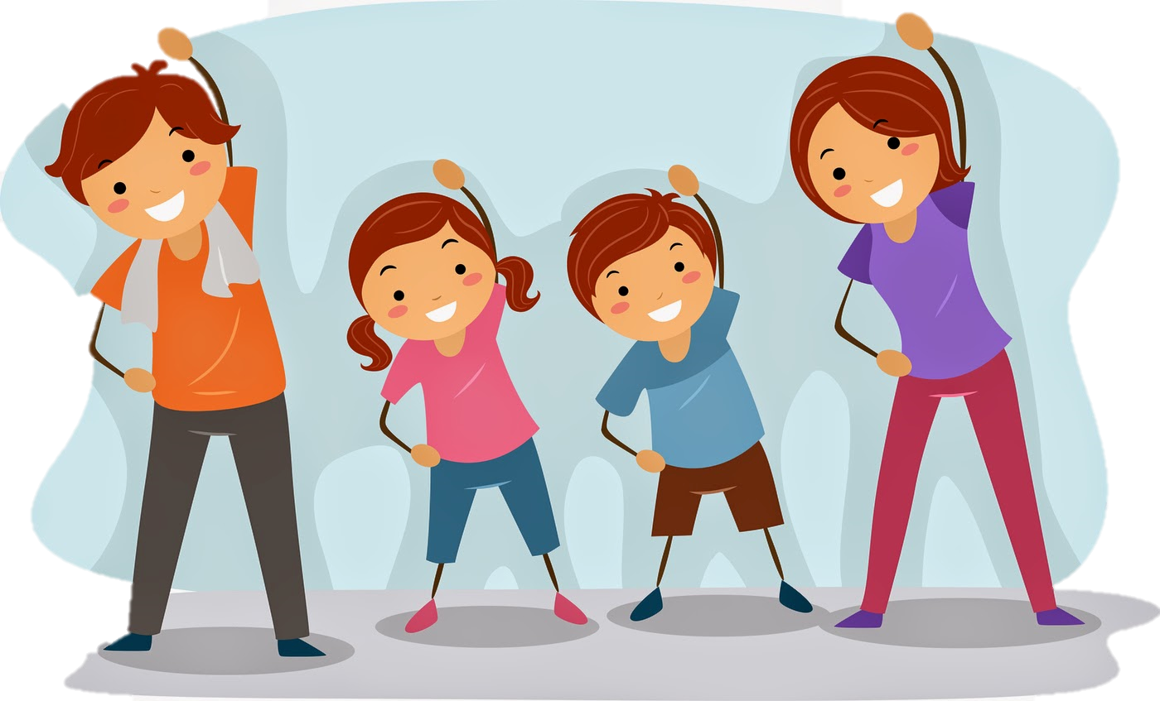
VOCABULARY
active (adj)
/ˈæktɪv/
năng động

Slide 9

VOCABULARY
careful (adj)
/ˈkeəfl/
cẩn thận

Slide 10

VOCABULARY
creative (adj)
/kriˈeɪtɪv/
sáng tạo

Slide 11
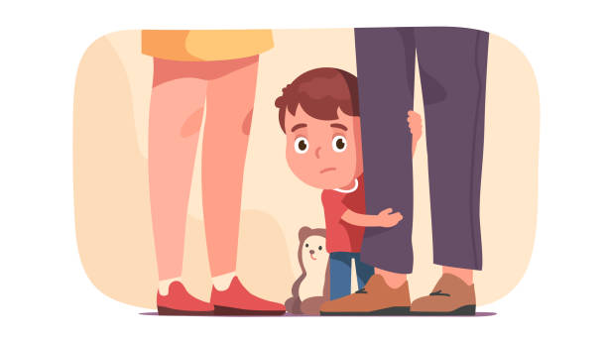
VOCABULARY
shy (adj)
/ʃaɪ/
nhút nhát

Slide 12
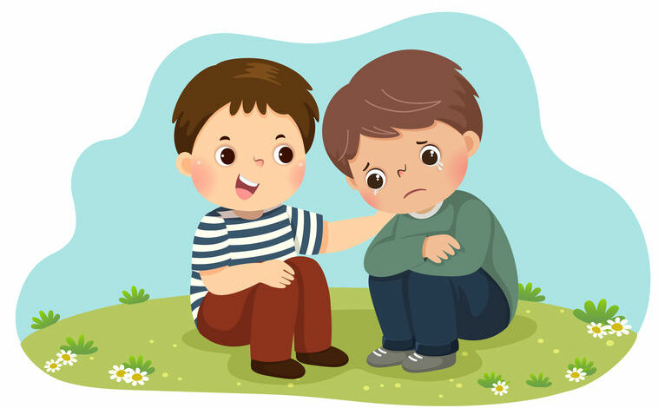
VOCABULARY
kind (adj)
/kaɪnd/
tốt bụng

Slide 13

VOCABULARY
clever (adj)
/ˈklevə(r)/
thông minh

Slide 14
VOCABULARY
New words | Pronunciation | Meaning
1. confident (adj) | /ˈkɒnfɪd(ə)nt/ | tự tin
2. caring (adj) | /ˈkeərɪŋ/ | quan tâm
3. active (adj) | /ˈæktɪv/ | năng động
4. careful (adj) | /ˈkeəfl/ | cẩn thận
5. creative (adj) | /kriˈeɪtɪv/ | sáng tạo
6. shy (adj) | /ʃaɪ/ | nhút nhát
7. kind (adj) | /kaɪnd/ | tốt bụng
8. clever (adj) | /ˈklevə(r)/ | thông minh

Slide 15

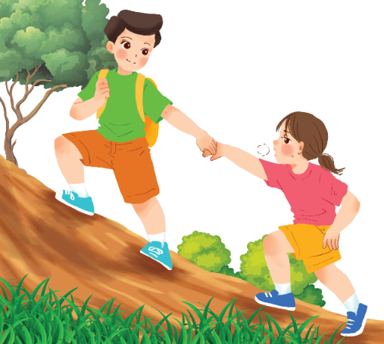
VOCABULARY
2
Use the adjectives in the box to complete the sentences.
Pay attention to the highlighted words / phrases.
careful
clever
shy
kind
creative
friendly
1.
Mina is very _______ . She likes drawing pictures. She always has lots of new ideas.
creative
kind
2.
Nam is _____ .
He likes helping his friends.

Slide 16
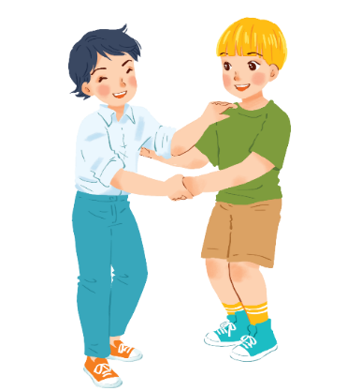
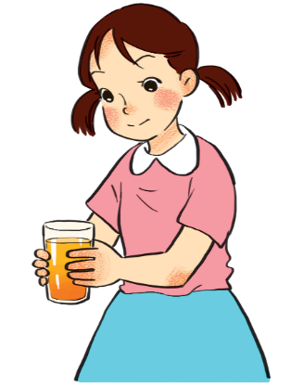
VOCABULARY
2
Use the adjectives in the box to complete the sentences.
Pay attention to the highlighted words / phrases.
careful
clever
shy
kind
creative
friendly
3.
Minh Duc is ________.
He likes meeting new people.
friendly
careful
4.
Kim is very ______ .
She pays attention to what she’s doing.

Slide 17
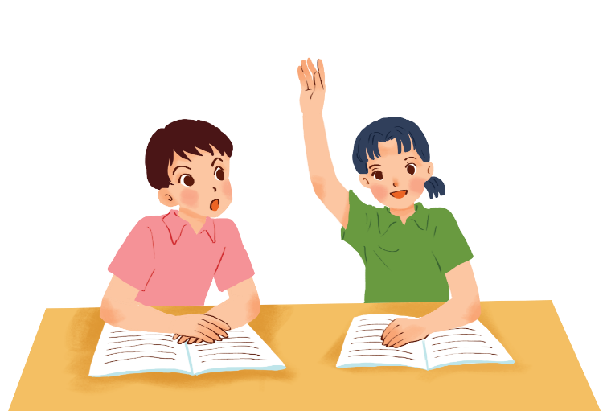
F
T
T
T
VOCABULARY
F
2
Use the adjectives in the box to complete the sentences.
Pay attention to the highlighted words / phrases.
careful
clever
shy
kind
creative
friendly
Mai is ______ .
She learns things quickly and easily.
5.
clever

Slide 18


VOCABULARY
3
  Friendship ﬂower.
Work in groups. Write two personality adjectives for each group member.
Minh: kind funny

Slide 19
PRONUNCIATION
4
Listen and circle the words you hear. Then repeat.
 | /b/ | /p/
1. | big | pig
2. | bear | pear
3. | buy | pie
4. | robe | rope

Slide 20

PRONUNCIATION
5
Listen. Then practise the chant. Notice the rhyme.
We’re having a picnic
We’re having a picnic
Fun! Fun! Fun!
We’re bringing some biscuits
We’re bringing some biscuits
Yum! Yum! Yum!
We’re playing together
We’re playing together
Hurrah! Hurrah! Hurrah!

Slide 21

CONSOLIDATION
1
Wrap-up
What have we learnt in this lesson?
use lexical items related to body parts, appearance and personality
correctly pronounce the sound /p/ and /b/ in isolation and in context

Slide 22

CONSOLIDATION
2
Homework
Do the exercises in the workbook.

Slide 23






Website: hoclieu.vn
Fanpage: facebook.com/www.tienganhglobalsuccess.vn/

