Slide 1

Unit 7: Movies
Lesson 2.1: Vocabulary & Listening
Page 57

Slide 2
Lesson Outline
Warm-up
Vocabulary
Reading
Consolidation
Wrap-up

Slide 3

Objectives
By the end of this lesson, students will be able to…
- Learn adjectives about movies: fantastic, funny, great, exciting, terrible, awful, boring, sad
- Express opinions and exchange information about movies

Slide 4

WARM-UP

Slide 5
Work in groups of 3-4
Students spend 5 minutes to work in groups to brainstorm all the adjectives to describe their feelings when they watch movies. E.g.
interesting
sad
boring
MOVIES
happy
funny
great
scary
exciting

Slide 6

New words
terrible
fantastic
sad
funny
awful
boring
great
exciting

Slide 7
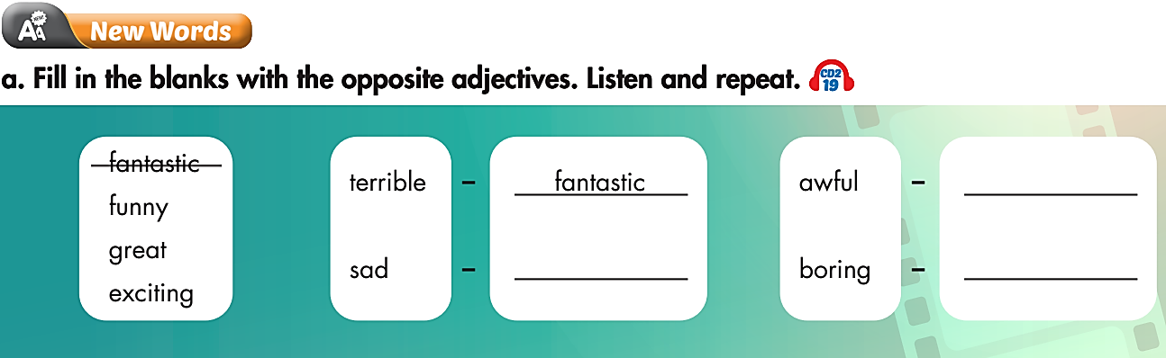

great
funny
exciting

Slide 8

Listen and repeat. Click each phrase to hear the sound.
terrible (adj) /ˈterəbl/ khủng khiếp
fantastic (adj) /fænˈtæstɪk/ tuyệt vời
sad (adj) /sæd/ buồn
funny (adj) /ˈfʌni/ hài hước
awful (adj) /ˈaːﬂ/ kinh khủng
great (adj) /ɡreɪt/ tuyệt vời
boring (adj) /ˈbɔːrɪŋ/ chán
exciting (adj) /ɪkˈsaɪtɪŋ/ thú vị

Slide 9
Please circle the correct words to complete each sentence:
I did not laugh throughout the comedy. It was really great / boring.
2. The events of the film didn’t happen in a logical way, and the actors did not have much experience. I think it’s so awful / funny.
3. I could not move my eyes away from the film with a lot of car chases. Wow the film was so exciting / terrible.
4. The main actor and actress were wonderful. The setting was beautifully designed. It was awful / fantastic.
5. The unlucky small child was taken away from his mom and lived in bad condition. I felt very sad / great when watching this film.

Slide 10
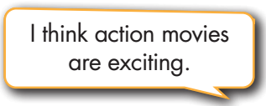

Slide 11
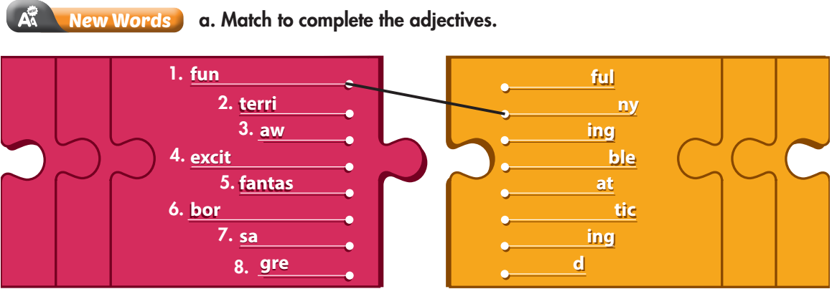
Extra Practice
WB page 40

Slide 12
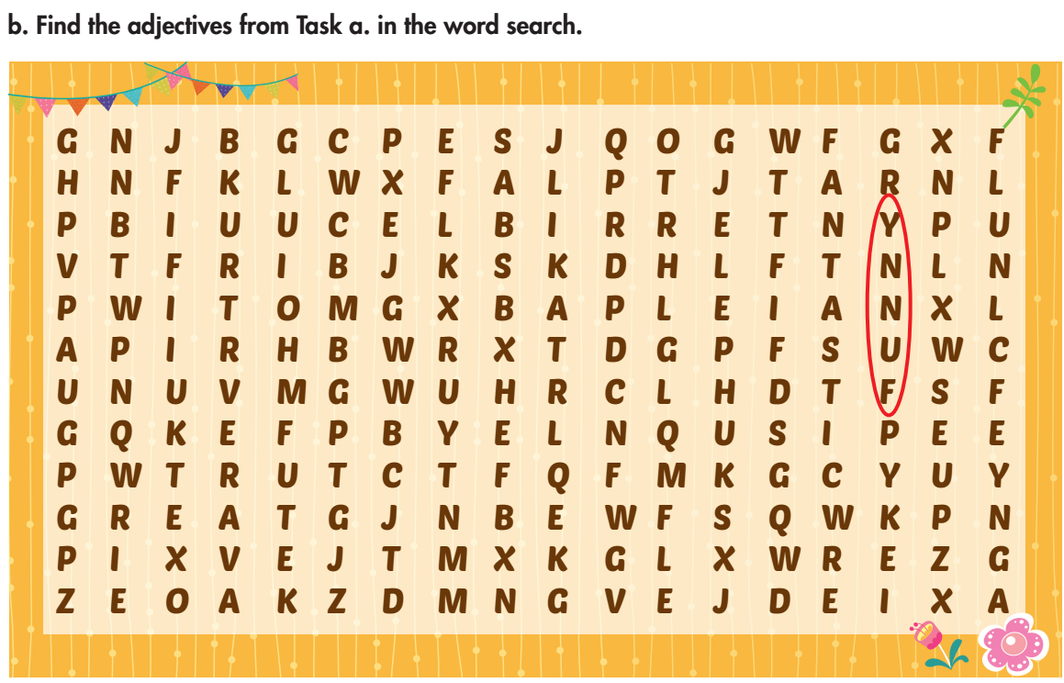
Extra Practice
WB page 40

Slide 13
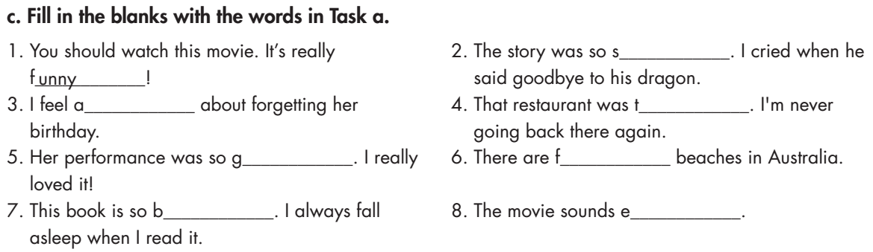
Extra Practice
WB page 40
ad
wful
errible
reat
antastic
oring
xciting

Slide 14

Reading

Slide 15
Pre-Reading
Read the instruction quickly. Underline the key words. What are we going to do?
Tina wrote two movie reviews for her blog. Underline the correct final sentences.

Slide 16
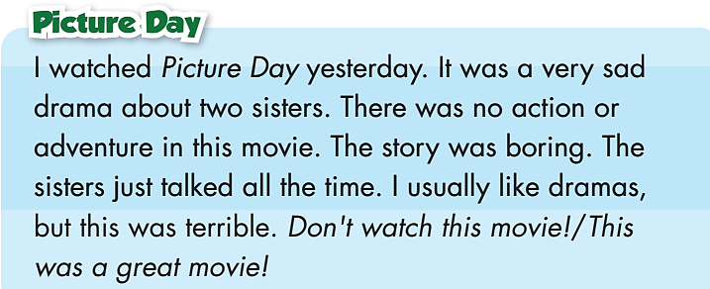
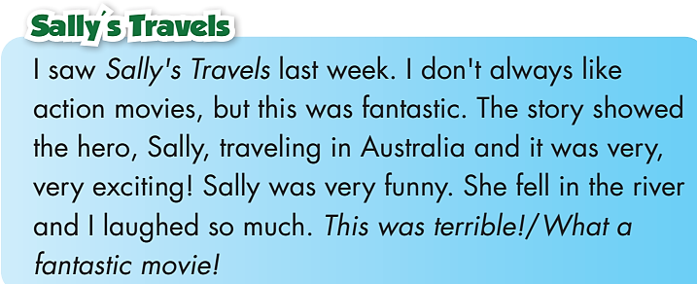
Pre-Reading
Look at the two movie reviews. Quickly read the information.
Underline the correct final sentences.
Don't watch this movie!
What a fantastic movie!

Slide 17
Read the reviews quickly. What are we going to do?
Read the reviews again and answer the questions.

Slide 18

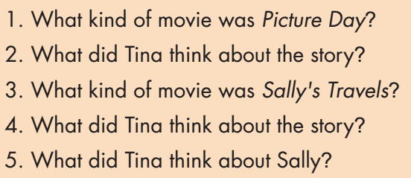
While-Reading

Slide 19
While-Reading
Scan the text. Answer the questions.
A sad drama

Slide 20
While-Reading
Scan the text. Answer the questions.
It was boring.

Slide 21
While-Reading
Scan the text. Answer the questions.
An action movie

Slide 22
While-Reading
Scan the text. Answer the questions.
It was exciting.

Slide 23
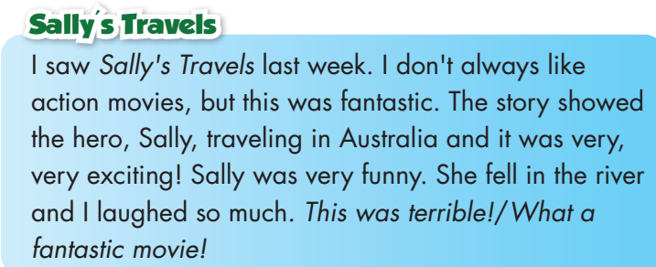
While-Reading
Scan the text. Answer the questions.
She was very funny.

Slide 24
Post-Reading
Work in pairs
Discuss your favorite movie. Include the type of movie, your feelings when watching it, one special thing about it (e.g. the story, actors, actresses, events, etc.).
I like Slumdog Millionaire. It’s a drama about the life of a poor boy who was a good person. After many bad events, he was successful in a competition, became rich, and had a happy ending. It was fantastic.
What’s your favorite movie?

Slide 25

CONSOLIDATION

Slide 26
Describe your favorite movie. Include the name and type of movie, your feelings when watching it, and what makes you like it (e.g. the story, actors, actresses, events, etc.). Please write at least 40 words.
E.g.
My favorite movie is Slumdog Millionaire. It is a drama with an exciting story about a poor and good boy. After many sad things in his life, he became rich and found happiness. The actors and actresses were excellent. The music was also wonderful.

Slide 27

WRAP-UP

Slide 28
Today’s lesson
Reading:
- Understanding instructions.
- Skimming and scanning for general and specific information.
Speaking:
- Express opinions and exchange information about movies.
Vocabularies
terrible
fantastic
sad
funny
awful
boring
great
exciting

Slide 29
Homework
Learn by heart vocabularies and make sentences using them.
Do the exercises on page 40 WB.
Do the exercises in Tiếng Anh 6 i-Learn Smart World Notebook on page 42.
Prepare the next lesson (page 58 - SB).
Play the consolidation games in Tiếng Anh 6 i-Learn Smart World DHA App on www.eduhome.com.vn.

Slide 30

Enjoy your day!

