Slide 1


Slide 2



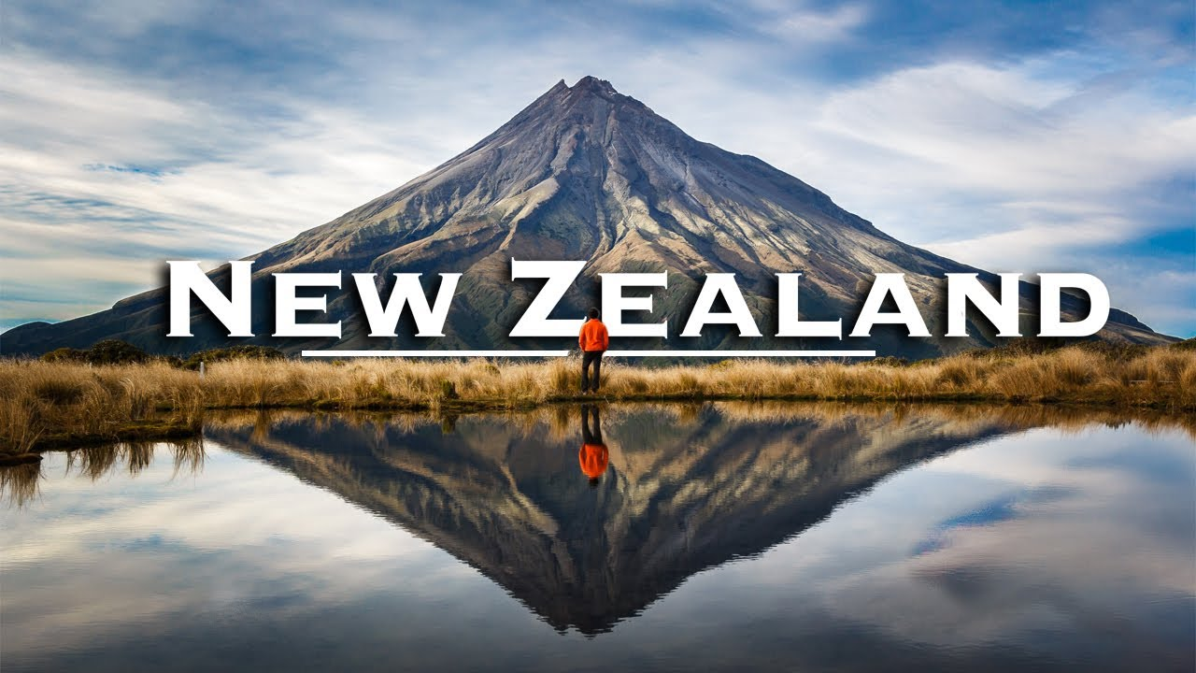
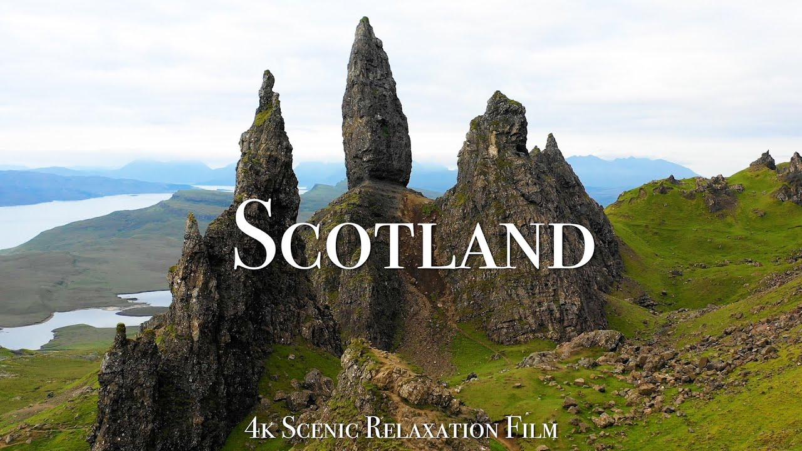
Unit
12
ENGLISH-SPEAKING COUNTRIES
LESSON 5: SKILLS 1
Unit

Slide 3

OBJECTIVES
By the end of the lesson, students will be able to:
develop reading skill for specific information about New Zealand
develop speaking skill: talk about Scotland

Slide 4
LESSON 5: SKILLS 1
WARM-UP
Guessing: What country is it?
* Vocabulary
Task 1: Discuss and choose the correct answer.
Task 2: Read the passage and match the words with their meanings.
Task 3: Read the passage again and choose the correct answer.
READING
Task 4: Note two things you like about New Zealand. Share them.
Task 5: Prepare a short introduction of Scotland and present it to the class.
SPEAKING
POST-READING & SPEAKING
Evaluation
CONSOLIDATION
Wrap-up
Homework

Slide 5

WARM-UP
Notes:
Note: Play from the 7th second.
Link: https://www.youtube.com/watch?v=jP3x7pcKIPY

Slide 6


READING - VOCABULARY
shining (adj)
/ˈʃaɪnɪŋ/
lấp lánh, tỏa sáng

Slide 7
READING - VOCABULARY
important or likely to be important in history
historic (adj)
/hɪˈstɒrɪk/
có tính chất lịch sử,
nổi tiếng trong lịch sử

Slide 8
READING - VOCABULARY
rich (adj)
having or containing a large amount of something desirable or valuable
/rɪtʃ/
có nhiều

Slide 9
READING - VOCABULARY
New words | Pronunciation | Meaning
shining (adj) | /ˈʃaɪnɪŋ/ | lấp lánh, tỏa sáng
historic (adj) | /hɪˈstɒrɪk/ | có tính chất lịch sử, nổi tiếng trong lịch sử
rich (adj) | /rɪtʃ/ | có nhiều

Slide 10
READING
1
Work in pairs. Discuss and choose the correct answer A, B, or C.
1. New Zealand is near ______.
A. Australia
B. the USA
C. the UK
2. New Zealand is famous for its _____.
A. film industry
B. beautiful nature
C. modern cities

Slide 11
READING
2
Read the passage and match the words in bold from the passage (1-4) with their meanings (a-d).
NEW ZEALAND
New Zealand is an island country in the Pacific Ocean. It is one of the most interesting countries in the world.
Everywhere you go, you can see amazing natural landscapes: green mountains, shining beaches, high waterfalls, and ancient forests. You can visit the beautiful place where they filmed The Lord of the Rings, or historic Queenstown. This is also a great country for lovers of outdoor activities. You can always find something to do here: skiing, boating, bushwalking.
New Zealand is rich in culture. Most visitors to New Zealand love its unique Maori culture. The Maori are the native people of this country. They are famous for their unique tattoos and haka dance. A visit to this beautiful country will be an experience you will never forget.
1. shining | a. connected with the past
2. ancient | b. having a lot
3. historic | c. bright and sunny
4. rich | d. very, very old

Slide 12
READING
3
Read the passage again and choose the correct answer A, B, or C.
1. New Zealand is a ______ country.
A. strange B. rich C. beautiful
2. A natural attraction of New Zealand is its ______.
A. Maori culture
B. shining beaches
C. outdoor activities
3. New Zealanders love ______.
A. haka dancing
B. sports and games
C. indoor activities
4. The haka dance is an example of ______.
A. the Maori culture
B. New Zealand’s history
C. outdoor activities
5. The writer mentioned ______ as
one of New Zealand’s attractions.
A. traditional food
B. hard-working people
C. rich culture

Slide 13
SPEAKING
4
Work in pairs. Note two things you like about New Zealand. Share them with your partner.
You can start with:
There are two things I like about New Zealand. They are ...

Slide 14
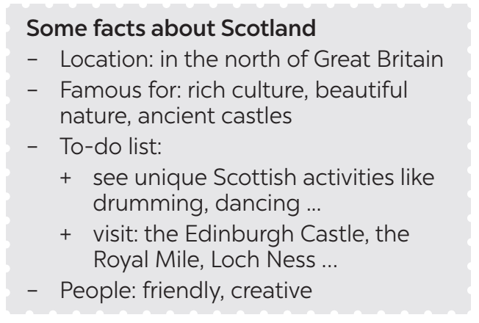
SPEAKING
5
Work in groups. Prepare a short introduction of Scotland and present it to the class.

Slide 15

POST-READING & SPEAKING
Let’s give comments for your friends and vote for the most interesting and informative presentation.

Slide 16
CONSOLIDATION
1
Wrap-up
READING
SPEAKING

Slide 17

CONSOLIDATION
2
Homework
Prepare short phrases/ sentences to describe the photos of your favourite English-speaking country.

Slide 18

Website: hoclieu.vn
Fanpage: facebook.com/www.tienganhglobalsuccess.vn/

