Slide 1

UNIT 1: FAMILY LIFE
Lesson 3.1 – Listening & Reading
Page 10

Slide 2



Lesson .
LESSSON OUTLINE
Consolidation

Slide 3
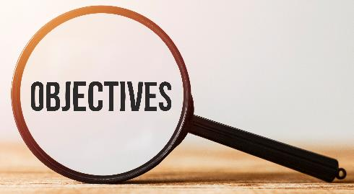
By the end of this lesson,
students will be able to:
know the history of the SMS (the text message).
understand and use some of the text language.
improve their listening as well as reading skills.

Slide 4
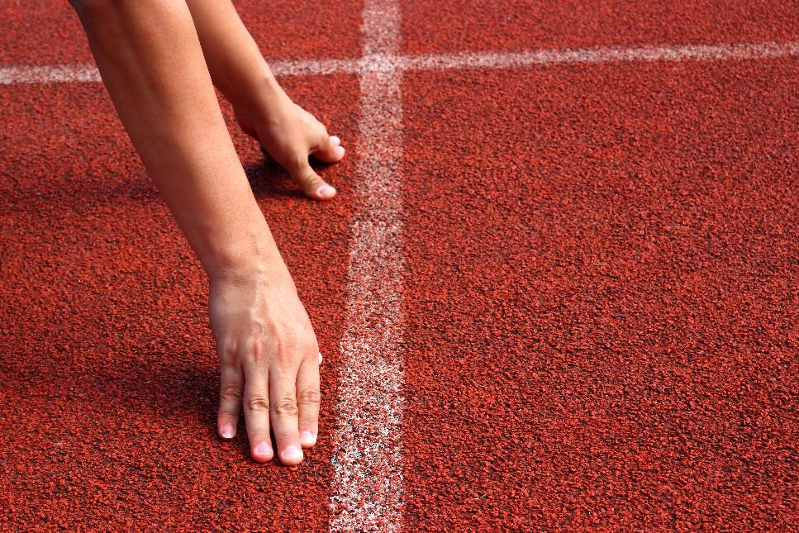


Slide 5
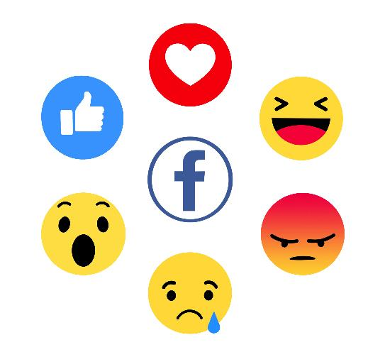
What can you see?
Facebook emojis

Slide 6
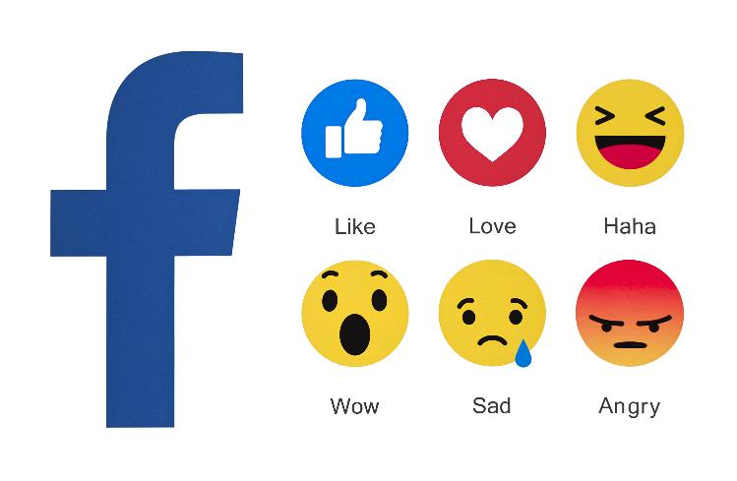
What do these emojis mean?
1 2 3
like
love
haha
sad
4 5 6
wow
angry

Slide 7

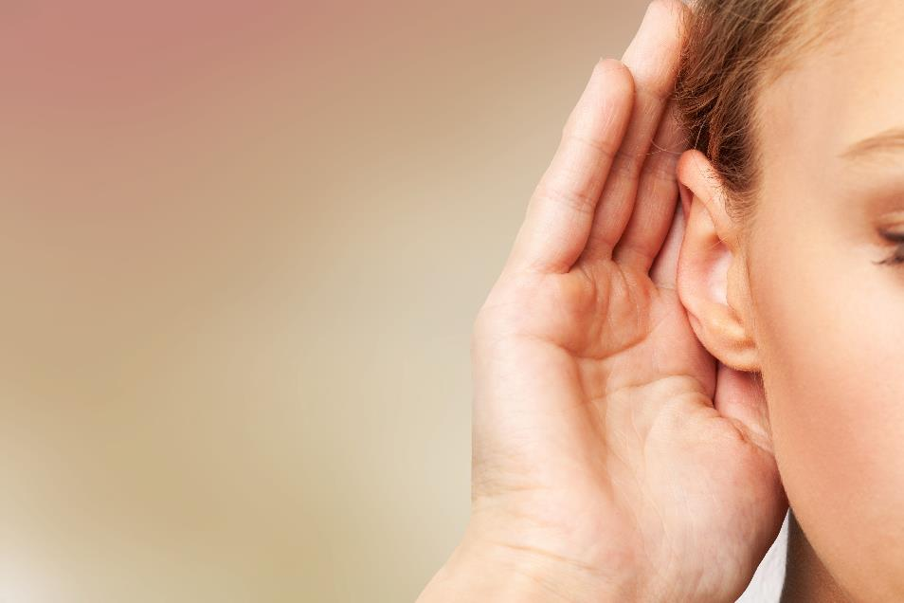

Slide 8

Pre-listening
WORK IN PAIRS.
How often do you send text messages and
who do you send them to?
What do you write about?

Slide 9

While-listening


Slide 10



While-listening
1. In what year was the first text message sent?
a. 1992 b. 1982
2. What did it say?
a. Merry Christmas b. Happy Birthday
3. Why wasn't SMS popular at first?
a. Cell phones were expensive. b. Cell phones didn't send messages.
4. In 2012, how many text messages did American teenagers send a day?
a. 16 b. 60
5. What do parents think texting makes teenagers become?
a. lazy b. bad writers

Slide 11
Post-listening
Listen and complete the talk.

Slide 12

M: On December third, 1992, a software
engineer called Neil Papworth sent the first text message to his ______. It simply said "Merry Christmas." Now, millions of text messages are sent all over the world every day.
At first, SMS (Short Messaging _______)
was not very popular. Cell phones were
expensive, and not everyone had an
SMS service provider. But by the late
_____ and early 2000s, cell phones were
much _______.
Today, people use text messaging in
business and as a way to ___________
quickly with their family and friends.
Texting even has its own language. It
uses letters and symbols instead of full
words and sentences. LOL (______ ____
____) and ikr (I know, right?) are in the
Cambridge and Oxford dictionaries.
Text messaging is very _______ among
young people.
In 2012, American teenagers sent an
average of sixty texts a day. Many
parents are not happy with the amount
of texting their children do.
They think texting makes teenagers
write ______ because they don't use
capital letters or put periods at the
ends of sentences.


Slide 13
M: On December third, 1992, a software
engineer called Neil Papworth sent the
first text message to his boss. It simply
said "Merry Christmas." Now, millions of
text messages are sent all over the
world every day.
At first, SMS (Short Messaging Service)
was not very popular. Cell phones were
expensive, and not everyone had an
SMS service provider. But by the late
1990s and early 2000s, cell phones were
much cheaper.
Today, people use text messaging in
business and as a way to communicate
quickly with their family and friends.
Texting even has its own language. It
uses letters and symbols instead of full
words and sentences. LOL (laugh out
loud) and ikr (I know, right?) are in the
Cambridge and Oxford dictionaries.
Text messaging is very popular among
young people.
In 2012, American teenagers sent an
average of sixty texts a day. Many
parents are not happy with the amount
of texting their children do.
They think texting makes teenagers
write badly because they don't use
capital letters or put periods at the
ends of sentences.

Slide 14

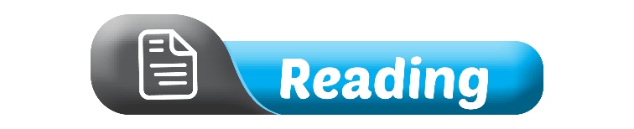

Slide 15
What can you see?
Pre-reading
ttyl
oic
ss
bbl
g9
asap
the text language

Slide 16
What does each phrase mean?
Pre-reading
ttyl
oic
ss
bbl
g9
asap
talk to you later
oh, I see
so sorry
be back later
goodnight
as soon as possible

Slide 17
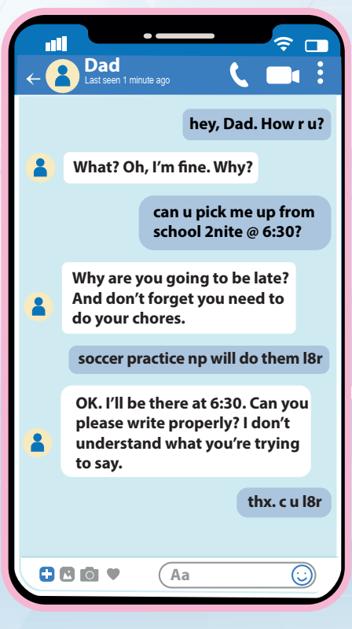

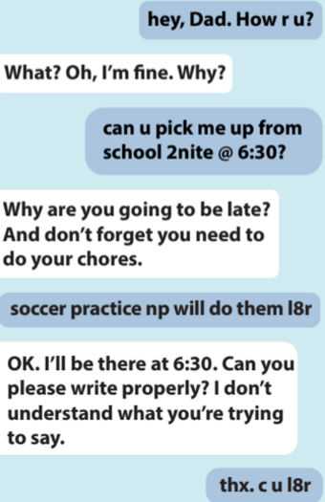
While-reading

Slide 18
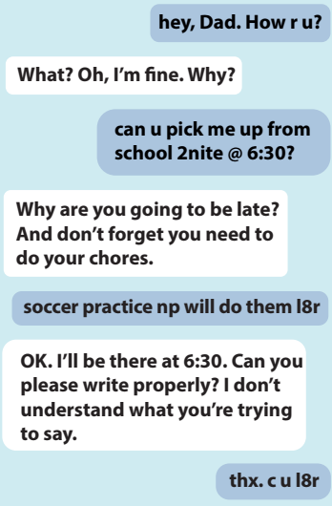
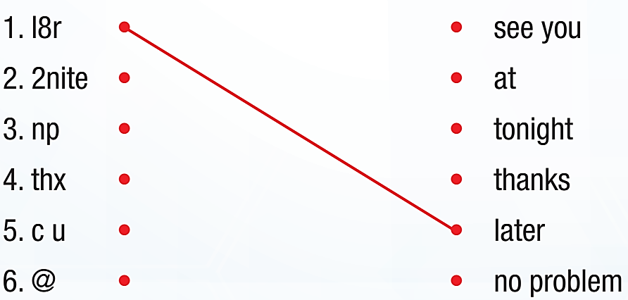
b. Now, read and match the text language to its meaning.

Slide 19
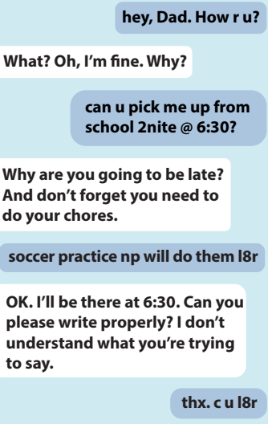
1. Where is Adam going to be at 6:30?
___________________________________
2. Why is Adam going to be late?
___________________________________
3. What does Adam's dad remind him to do?
___________________________________
4. What does Adam's dad ask him to do?
___________________________________
He’s going to be at school.
He has soccer practice.
He reminds him to do his chores.
He asks him to write properly.

Slide 20
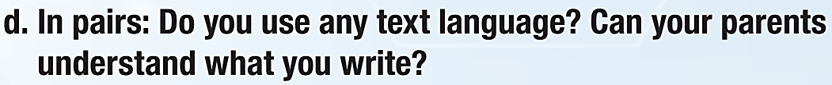

Post-reading

Slide 21
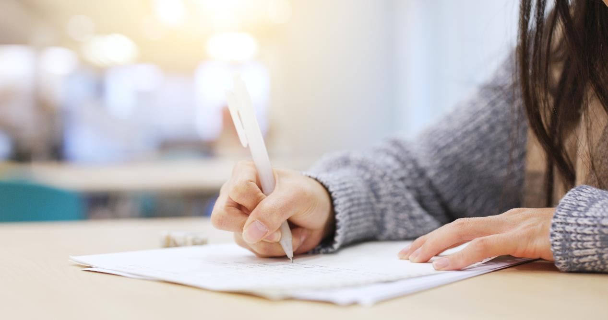
Consolidation

Slide 22

Work in pairs.
Share ideas about the text message and text language.
1. About how many text messages have you sent so far today?
2. Who do you sent most text messages to?
3. Have you ever sent text messages in class?
4. How often do you use the text language? Please write down some text language phrases you know.

Slide 23
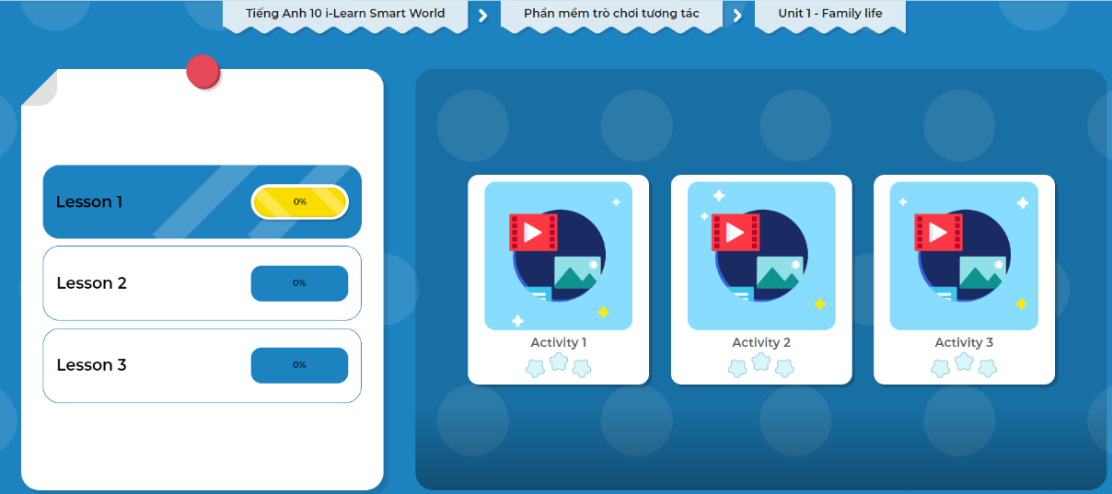
Click the picture below to play the games.

Slide 24
Today’s lesson
Wrap-up
Listening & Reading for gist and specific information about the text message and text language.
Speaking about the text message and text language.

Slide 25
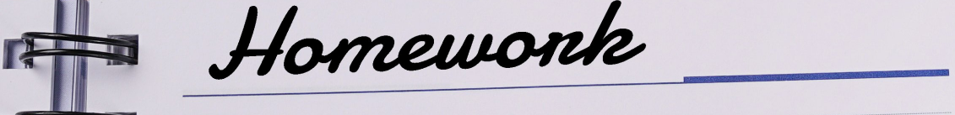
Finish page 16, WB.
Do the exercises in Tiếng Anh 10 i-Learn Smart World Notebook on page 6.
Prepare the next lesson on page 11, SB.
Play the consolidation games in Tiếng Anh 10 i-Learn Smart World DHA App on www.eduhome.com.vn

Slide 26
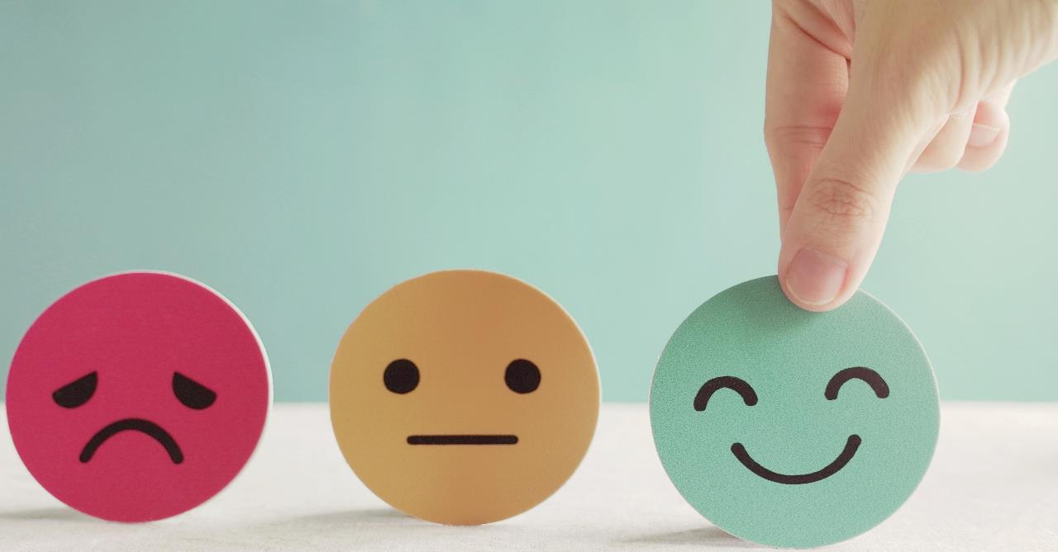
Have a nice day!

