Slide 1


Slide 2
Unit
7
Education options for school-leavers
Unit
FAMILY LIFE
LESSON 2
LANGUAGE

Slide 3
LESSON 2
LANGUAGE
Watch a video
WARM-UP
Task 1: Listen and repeat.
Task 2: Listen and mark the intonation in these questions
PRONUNCIATION
Task 1: Match the words and phrases with their meanings.
Task 2: Complete the sentences using the correct forms of the words
VOCABULARY
Task 1. Find and correct the mistakes in the following sentences.
Task 2. Rewrite these sentences using perfect participle clauses.
Task 3. Work in pairs. Make sentences, using perfect gerunds and perfect participle clauses.
GRAMMAR
CONSOLIDATION
Wrap-up
Homework

Slide 4
WARM-UP
Watch a video
- Watch the video and pay attention to the rules of intonation in Wh- and Yes/ No questions

Slide 5
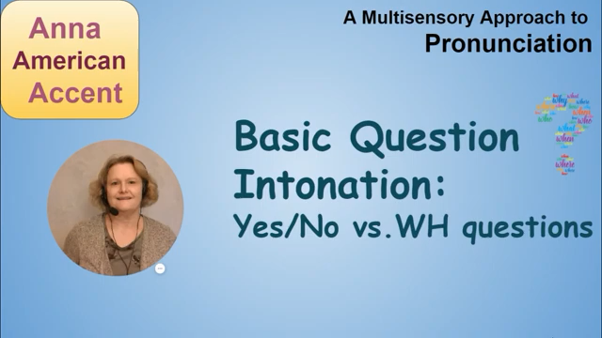
WARM-UP
Watch a video

Slide 6

PRONUNCIATION
1
Listen and repeat. Pay attention to the falling or rising intonation in each of the following questions.
1. Did anyone go?
2. Is academic education important nowadays?
3. What are your plans for the future?
4. When does the course start?

Slide 7
PRONUNCIATION
2
Listen and mark the intonation in these questions, using (rising intonation) or (falling intonation). Then practise saying them in pairs.
1. Do you want to go to university?
2. Have you talked with your parents about your plans?
3. How much does it cost to study at university?
4. What’s your favourite subject at school?

Slide 8
VOCABULARY
1
Match the words and phrases with their meanings.
1. 1 school-leaver (n)
a. education at a college or university
2. vocational education (np)
b. the act of completing a university degree or a course of study
3. higher education
(n)
c. a person who has just left school
4. qualification (n)
d. education that prepares students for work in a specific trade
5. graduation (n)
e. an official record showing that you have finished a training course or have the necessary skills, etc.

Slide 9
VOCABULARY
2
Complete the sentences using the correct forms of the words and phrases in 1.
higher education
1. Many parents nowadays want their children to pursue _____________ at universities after leaving school.
2. He didn’t get the job he wanted because he didn’t have the right _________________.
3. Many _________________ choose to go to university to study academic subjects.
4. More and more young people prefer ___________________ because they like to learn practical skills.
5. Many young people find it hard to get a job immediately after ____________.
qualifications
school-leavers
vocational education
graduation

Slide 10
GRAMMAR
Perfect gerunds
The perfect gerund (having done) always refers to a time before that of the verb in the main clause. It is used to emphasise that the action was completed in the past.
It can be used as:
• the subject of a sentence.
Example: Having studied science subjects made it easy for me to choose a university degree.
• an object after some verbs, e.g. admit, deny, forget, mention, regret, and remember or after prepositions.
Example: My friend didn’t remember having lent me his English textbook.
My cousin often talked about having studied for five years at a top university.

Slide 11
GRAMMAR
1
Find and correct the mistakes in the following sentences.
I forgot have discussed this topic with you.
Had won many maths competitions helped me to win a place at university.
3. Nam regretted not having choose a more interesting course at university.
4. He was proud of had won the first place at the Biology Olympiad.
→ having
→Having
→ chosen
→ having

Slide 12
GRAMMAR
Perfect participle clauses
The perfect participle has the same form as the perfect gerund, e.g. having asked, having studied.
We can use perfect participle clauses to:
• describe an action that happened before the action in the main clause.
Example: Having finished their course, they started looking for jobs.
• talk about the reason for the action in the main clause.
Example: Not having read the book, he can’t give us his opinion.

Slide 13
GRAMMAR
2
Rewrite these sentences using perfect participle clauses.
1. After we listened to an introduction to the course, we asked some questions.
-> ___________________________________________, we asked some questions.
2. He failed the university entrance exams, then he decided to train to become a car mechanic.
-> ________________________________________, he decided to train to become a car mechanic.
3. His brother had not studied hard enough, so he failed the exams.
-> _______________________, his brother failed the exams.
4. After I answered the job interview questions, I was asked to prepare a short presentation.
-> ________________________________________, I was asked to prepare a short presentation.
Having listened to an introduction about the course
Having studied the available courses carefully
Not having studied enough
Having answered the job interview questions

Slide 14

GRAMMAR
3
Work in pairs. Make sentences, using perfect gerunds and perfect participle clauses.
Having finished school, I can apply to university.
Having completed the project gave us a feeling of satisfaction.

Slide 15
CONSOLIDATION
1
Wrap-up
What have you learnt today?
Some lexical items about education after leaving school
Intonation in Wh- and Yes/ No questions
Perfect gerunds and. Perfect participle clauses

Slide 16
CONSOLIDATION
2
Homework
Do exercises in the workbook.
Prepare for Lesson 3 - Unit 7.

Slide 17

Website: hoclieu.vn
Fanpage: facebook.com/sachmem.vn/

