Slide 1
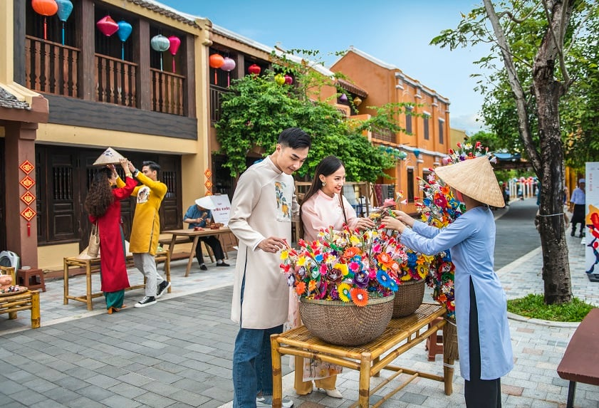
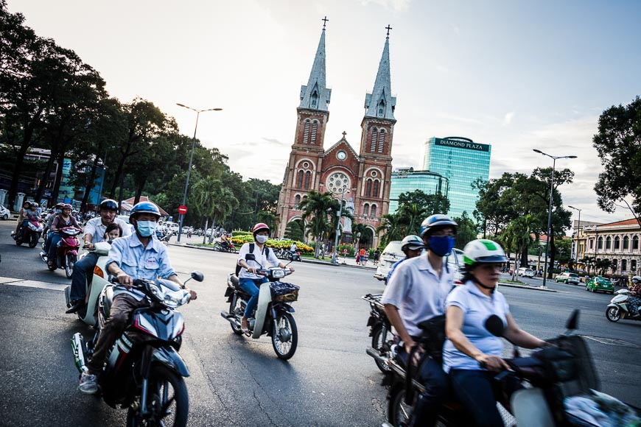


Slide 2


Unit
VIETNAMESE LIFESTYLE:
THEN AND NOW
6
LESSON 4: COMMUNICATION

Slide 3

OBJECTIVES
By the end of the lesson, students will be able to:
Know how to make promises;
Talk about Changes in Lifestyle.

Slide 4
LESSON 4: COMMUNICATION
LESSON 1: GETTING STARTED
Option 1: Promise Chain
Option 2: Promise Role-play
WARM-UP
Task 1: Listen and read the conversations. Pay attention to the highlighted parts.
Task 2: Work in pairs. Make promises for the following situations.
EVERYDAY ENGLISH
Task 3: Read the passage about changes. Then match the people with the topics they are talking about.
Task 4: Work in groups. Read the passages in 3 again and discuss.
Task 5: Work in pairs. Read the list below. Tell your partners which of them has remained the same and which has changed over the past five years. Take notes of your partner’s answers and report them to the class.
CHANGES AROUND YOU
CONSOLIDATION
Wrap-up
Homework

Slide 5
WARM-UP
OPTION 1
Promise chain
- Work in teams.
- The first student from each team listen to the teacher.
- The student must then turn to their teammate and repeat the sentence exactly as they heard it.
- The next student in line must repeat the sentence to their teammate, and so on, until the sentence reaches the end of the line.
- The first team to correctly repeat the entire sentence wins points.

Slide 6
WARM-UP
OPTION 1
LET’S PLAY

Slide 7
WARM-UP
OPTION 1
Promise:
I promise to be nice.
I promise to give you the PS5.
I promise not to trick you.
I promise not to cheat in the test.

Slide 8
WARM-UP
OPTION 2
Promise Role-play

Slide 9
WARM-UP
OPTION 2
How to play:
- Work in pairs.
- Each students will have their roles , such as parent and a child, teacher and student, or friend and friend.
- Each pairs has a scenario that involves making
a promise.
- Act out the scenario.

Slide 10
WARM-UP
OPTION 2
Scenario
A child promising to clean their room
A student promising to study for a test
A friend promising to keep a secret

Slide 11

EVERYDAY ENGLISH
1
Listen and read the conversations. Pay attention to the highlighted parts.
Mike: I will share with you the links about the ancient village of Duong Lam.
Phong: Thank you.
Mi: I promise not to bring my dog to the picnic.
Ann: Great! I appreciate it.

Slide 12
EVERYDAY ENGLISH
Structures
Making promises:
I will …
I promise to / not to …
Responding:
Thank you.
I (highly) appreciate it.
Great!

Slide 13
EVERYDAY ENGLISH
2
Work in pairs. Make promises for the following situations.
- Work in pairs to make similar dialogues, using the language you have learnt.
1. You are going out with friends. Promise your parents to return before 9 p.m.
2. Promise your friend that you will be on time for the performance.
I will return / I promise to return before 9p.m.

Slide 14
EVERYDAY ENGLISH
Suggested dialogues:
I will return / I promise to return before 9 p.m.
I will be / I promise to be on time for the performance.
I appreciate it.

Slide 15
EVERYDAY ENGLISH
Suggested dialogues:
I will be / I promise to be on time for the performance.
I highly appreciate it.

Slide 16
EXTRA ACTIVITY
Some promises you usually make in life.
Example:
I’ll finish all my homework before I go out, Mum. I promise not to let you down.

Slide 17
LESSON 4: COMMUNICATION
LESSON 1: GETTING STARTED
Option 1: Promise Chain
Option 2: Promise Role-play
WARM-UP
Task 1: Listen and read the conversations. Pay attention to the highlighted parts.
Task 2: Work in pairs. Make promises for the following situations.
EVERYDAY ENGLISH
Task 3: Read the passage about changes. Then match the people with the topics they are talking about.
Task 4: Work in groups. Read the passages in 3 again and discuss.
Task 5: Work in pairs. Read the list below. Tell your partners which of them has remained the same and which has changed over the past five years. Take notes of your partner’s answers and report them to the class.
CHANGES AROUND YOU

Slide 18
CHANGES AROUND YOU
3
Read the passage about changes. Then match the people with the topics they are talking about.
1. Aki from Tokyo
Children used to go to temple schools. Monks, samurai, doctors, and people of other professions served as teachers. Nowadays, children study in modern schools with teachers who get professional training in the subjects they teach.
2. Sanjay from New Delhi
Once, it was easy to say which country a person was from because people wore their own traditional costumes. Now, trends, comfort, and style are more important. More people are wearing western clothes like jeans and T-shirts instead.

Slide 19
1. Aki from Tokyo
Children used to go to temple schools. Monks, samurai, doctors, and people of other professions served as teachers. Nowadays, children study in modern schools with teachers who get professional training in the subjects they teach.
CHANGES AROUND YOU
3
Read the passage about changes. Then match the people with the topics they are talking about.
2. Sanjay from New Delhi
Once, it was easy to say which country a person was from because people wore their own traditional costumes. Now, trends, comfort, and style are more important. More people are wearing western clothes like jeans and T-shirts instead.
3. Asim from Cairo
In the past, people used animals such as horses and camels for travelling. Now, airplanes, ships, and trains have replaced them. Transportation has become faster and easier.

Slide 20
2. Sanjay from New Delhi
Once, it was easy to say which country a person was from because people wore their own traditional costumes. Now, trends, comfort, and style are more important. More people are wearing western clothes like jeans and T-shirts instead.
CHANGES AROUND YOU
3. Asim from Cairo
In the past, people used animals such as horses and camels for travelling. Now, airplanes, ships, and trains have replaced them. Transportation has become faster and easier.
PEOPLE | TOPICS
1. Aki | a. Transportation
2. Sanjay | b. Education
3. Asim | c. Clothes

Slide 21
CHANGES AROUND YOU
4
Work in groups. Read the passages in 3 again and discuss.
- Work in groups.
- Look at two suggested questions and express your idea.
1) focus on aspects of life in the past and choose the
one they would like to experience.
2) Choose the change which they think is for the
better and explain why.

Slide 22
There have been some changes in Lan’s lifestyle. The first change is her…. However, her … has / have not changed over the past five years.
CHANGES AROUND YOU
Work in pairs. Read the list below. Tell your partners which of them has remained the same and which has changed over the past five years. Take notes of your partner’s answers and report them to the class.
5
- Work in pairs.
- Talk and take notes of their partner’s ideas.
– Your style of clothes
– Your eating habits
– Your hobbies
– Your favourite actor / singer / book / movie

Slide 23
CHANGES AROUND YOU
Sample structure:
There have been some changes in … lifestyle. The first change is her / his …. However, her / his … has / have not changed over the past five years.

Slide 24
LESSON 4: COMMUNICATION
LESSON 1: GETTING STARTED
Option 1: Promise Chain
Option 2: Promise Role-play
WARM-UP
Task 1: Listen and read the conversations. Pay attention to the highlighted parts.
Task 2: Work in pairs. Make promises for the following situations.
EVERYDAY ENGLISH
Task 3: Read the passage about changes. Then match the people with the topics they are talking about.
Task 4: Work in groups. Read the passages in 3 again and discuss.
Task 5: Work in pairs. Read the list below. Tell your partners which of them has remained the same and which has changed over the past five years. Take notes of your partner’s answers and report them to the class.
CHANGES AROUND YOU
CONSOLIDATION
Wrap-up
Homework

Slide 25

CONSOLIDATION
1
Wrap-up
What have we learnt in this lesson?
Know how to make promises;
Talk about changes in lifestyle.

Slide 26

CONSOLIDATION
2
Homework
- Do exercises in the workbook.

Slide 27
Website: hoclieu.vn
Fanpage: facebook.com/www.tienganhglobalsuccess.vn/

