Slide 1


Slide 2



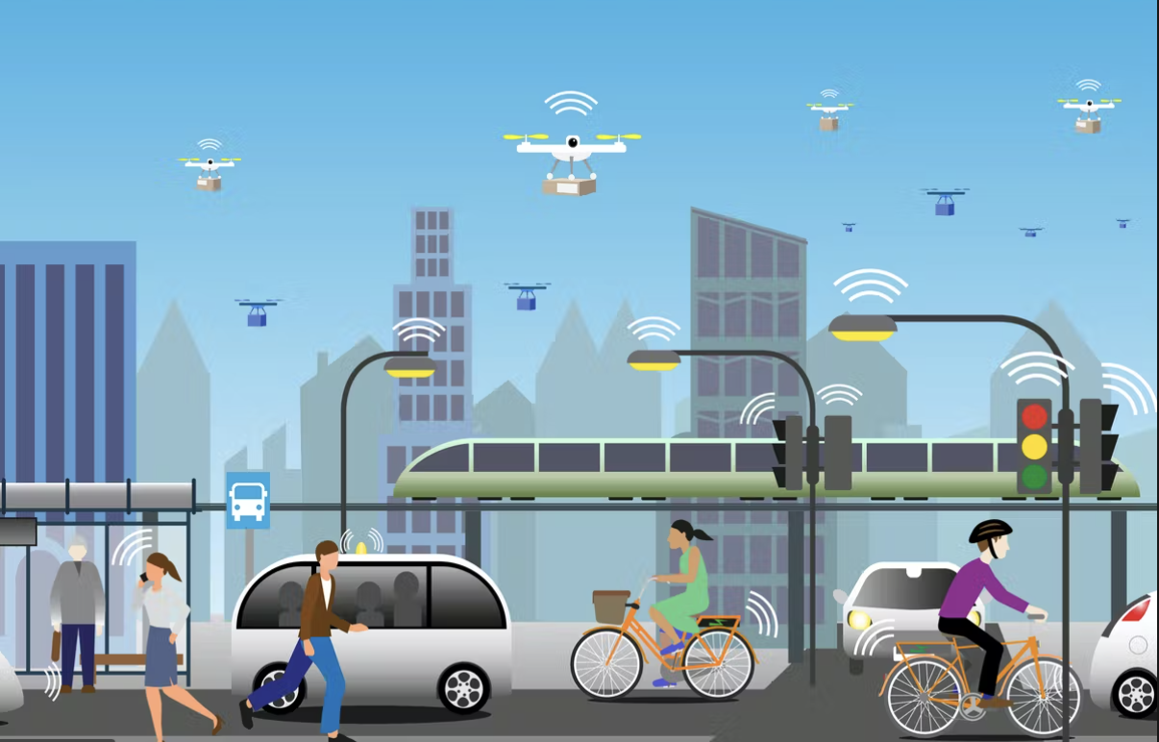
Unit
11
TRAVELLING IN THE FUTURE
LESSON 6: SKILLS 2

Slide 3

OBJECTIVES
By the end of the lesson, students will be able to:
listen for general and specific information about some future means of transport.
write about the advantages of a future means of transport.

Slide 4
LESSON 6: SKILLS 2
WARM-UP
Discussion
Vocabulary
Task 1: Listen to a talk between Mr Ha and his students. How many means of transport are they talking about?
Task 2: Listen to the talk again and complete each sentence with ONE word.
Task 3: True or False statements.
LISTENING
Task 4: Choose one future means of transport in 3 and tick the words and phrases that describe its advantages. Can you add more words and phrases?
Task 5: Write a paragraph of about 70 words about the advantages of the means of transport you’ve chosen.
WRITING
CONSOLIDATION
Wrap-up
Homework

Slide 5
WARM-UP
DISCUSSION
Which words/ phrases that you think are used to describe the future means of transport?

Slide 6
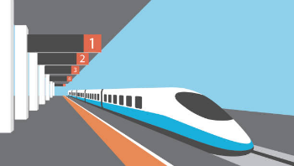
LISTENING: VOCABULARY
bullet train (n)
/ˈbʊlɪt ˌtreɪn/
tàu cao tốc

Slide 7
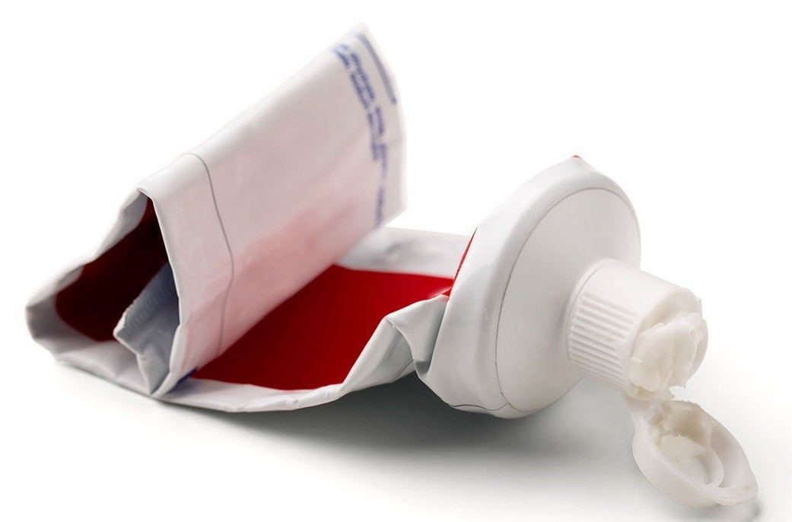
LISTENING: VOCABULARY
use up (phr.v.)
/juz up/
sử dụng hết

Slide 8

LISTENING: VOCABULARY
comfortable (a)
/ˈkʌmfətəbəl/
thoải mái

Slide 9
LISTENING: VOCABULARY
New words | Pronunciation | Meaning
1. bullet train (n) | /ˈbʊlɪt ˌtreɪn/ | tàu cao tốc
2. use up (phr.v.) | /juz up/ | sử dụng hết
3. comfortable (adj) | /ˈkʌmfətəbəl/ | thoải mái

Slide 10


LISTENING
1
Listen to a talk between Mr Ha and his students. How many means of transport are they talking about? Circle the correct answer.

Slide 11
LISTENING
2
Listen to the talk again and complete each sentence with ONE word.
1. ﻿Bullet trains will be faster, safer, and riders can avoid traffic _________.
2. SkyTrans will use less space and run on _________.
3. SkyTrans may be too __________ for students.
4. ______________ will be cheaper and easier to use.
5. Solar-powered ships will be __________ and comfortable.
accidents
autopilot
expensive
Bamboo-copters
eco-friendly

Slide 12





LISTENING
3
True or False statements.
Statements | True | False
1. Tom thinks that bullet trains will be the fastest transport in the future.
2. Lan said that skyTrans would not use up much space.
3. It may be too expensive for students to use SkyTrans
4. Students will use bamboo-copters to fly to school.
5. Lan thinks solar-power ships will be eco-friendly and uncomfortable.

Slide 13

WRITING
4
Choose one future means of transport in 3 and tick the words and phrases that describe its advantages. Can you add more words and phrases?
Suggested answers:
economical, carrying many passengers, avoiding traffic jams, having an autopilot function, driverless, etc.

Slide 14
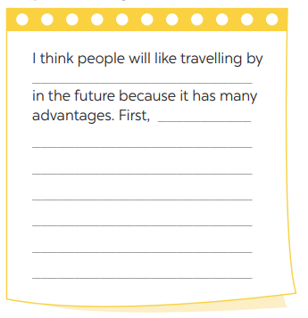
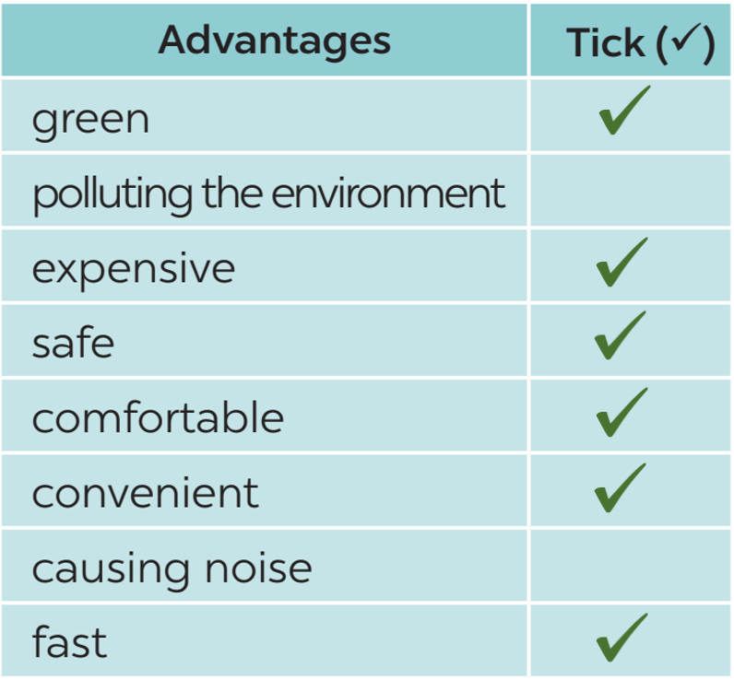
WRITING
5
Write a paragraph of about 70 words about the advantages of the means of
transport you’ve chosen. Start your writing as shown below..
More advantages:
- economical
- carry many people
- avoid traffic jams
- have an autopilot function
- driverless
etc.

Slide 15

WRITING
CLASS GALLERY
Students can:
go and see other’s work
give comments to each other

Slide 16

CONSOLIDATION
1
WRAP-UP
In this lesson, we have learnt to:
listen for general and specific information about some future means of transport.
write about the advantages of a future means of transport.

Slide 17

CONSOLIDATION
2
HOMEWORK
Rewrite the letter on the notebook.
Prepare for the next lesson: Looking back & Project

Slide 18

Website: hoclieu.vn
Fanpage: facebook.com/www.tienganhglobalsuccess.vn/

