Slide 1

Unit 5: London Was Great!
Lesson 5d: Everyday English
Page 93

Slide 2
Lesson Outline
Warm-up
Speaking
Pronunciation
Consolidation
Wrap-up

Slide 3
Objectives
By the end of this lesson, students will be able to…
- practise a dialogue about holiday.
- act out a dialogue about holiday.
- practise pronouncing the -ed ending (Past Simple).

Slide 4

WARM-UP

Slide 5
Who am I?
I am a wild animal. I am big. I have a thin mane.
→ I am a lion.

Slide 6
Who am I?
I am a pet. I have long wings, small eyes, and a sharp beak.
→ I am a parrot.

Slide 7
Who am I?
I am a wild animal. I have long neck and 4 long legs.
→ I am a giraffe.

Slide 8
Who am I?
I am a wild animal. I am very big. I have a big head, a long trunk, and big ears.
→ I am an elephant.

Slide 9
Who am I?
I am an animal with a long body and small eyes.
→ I am a snake.

Slide 10
Work with a partner. List down famous places for holiday in Vietnam.
What is your favourite place?

Slide 11

It’s time to learn …

Slide 12

Speaking

Slide 13
Pre-speaking
Activities people can do on holiday.
Match the verbs with the appropriate phrases.
go
sightseeing
What activities do you like doing when you are on holiday?
visit
in a hotel
take
football on the beach
play
a boat
photos
stay
row
swimming
go
a museum

Slide 14
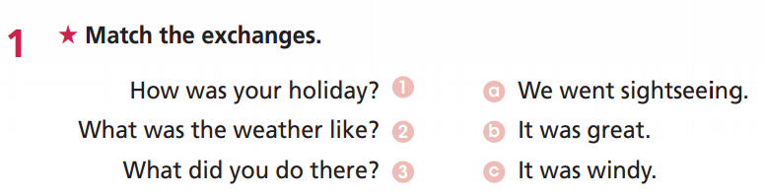
WB, P. 47
Pre-speaking

Slide 15
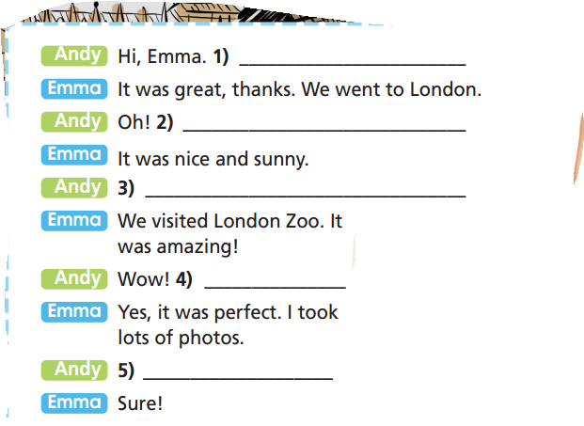
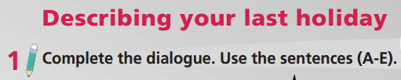
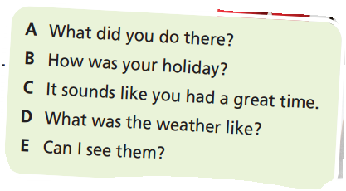

Pre-speaking
B How was your holiday?
D What was the weather like?
A What did you do there?
C It sounds like you had a great time.
E Can I see them?
Which tense do you use?

Slide 16
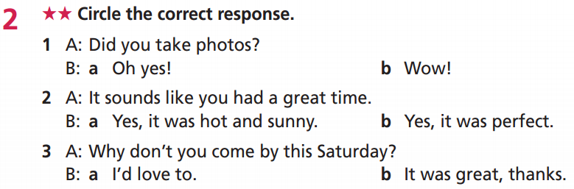
WB, P. 47
While-speaking

Slide 17
Practise the conversation with your friend.
Andy: Hi, Emma. How was your holiday?
Emma: It was great, thanks. We went to London.
Andy: Oh! What was the weather like?
Emma: It was nice and sunny.
Andy: What did you do there?
Emma: We visited London Zoo. It was amazing!
Andy: Wow! It sounds like you had a great time.
Emma: Yes, it was perfect. I took lots of photos.
Andy: Can I see them?
Emma: Sure!

Slide 18
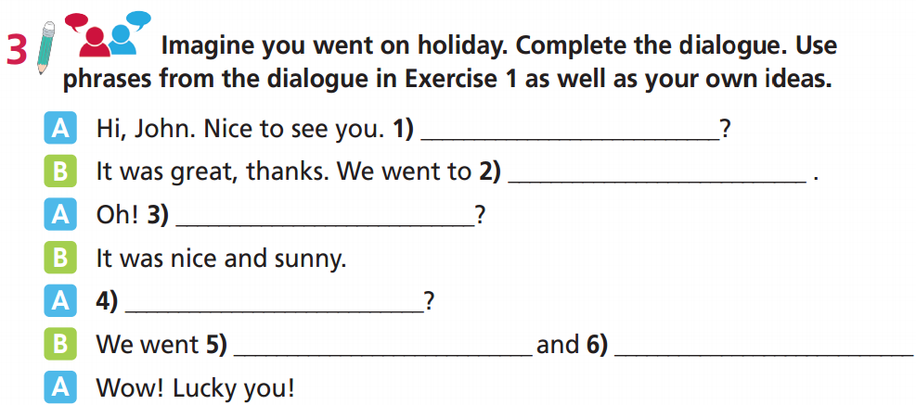
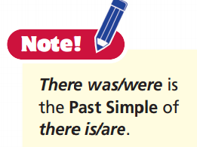
While-speaking
How was your holiday
Ho Chi Minh City
What was the weather like
What did you do there
to the Ho Chi Minh City Museum
the Reunification Palace

Slide 19
Rearrange the sentences to make a complete conversation.
Extra practice
3
What was the weather like?
Hi Bob. Nice to see you. How was your holiday?
1
It was great, thanks. We went to Rome.
We went sightseeing and visited Bioparco. We saw lots of animals at the local zoo.
2
Can I see them?
6
9
It was hot and sunny.
4
Wow! Lucky you.
7
8
Yes, it was perfect. I took lots of photos.
I’d love to.
11
Sure. Why don’t you come by this weekend?
10
What did you do there?
5

Slide 20

Practice

Slide 21
Work in pairs. Take turns to ask and answer about each other’s last holiday.
B: Answer your friend’s question about your holiday: feeling, where
A: Greeting. Ask about your friend’s holiday.
A: Ask about the weather.
B: Give information about the weather.
A: Ask about the activities.
B: Tell your friend what you did.
A: ……..
B: Answer the question.

Slide 22
Report about your friend’s holiday.
My partner is …….. He/She went to ……… last holiday. It was …….... The weather was ……….. during his/her holiday. She/ He ……

Slide 23


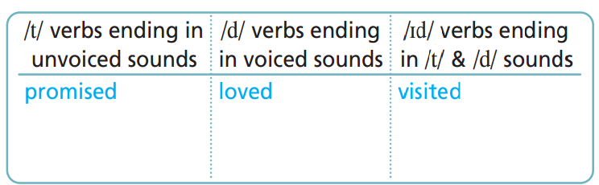
helped
called
needed
Unvoiced sound: /p/, /f/, /s/, /ʃ/, /ʧ/, /k/
Voiced sound: all other sounds

Slide 24
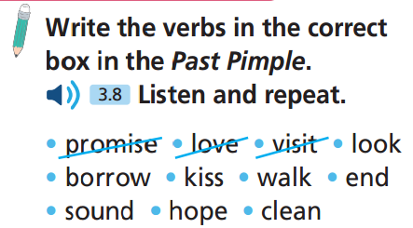
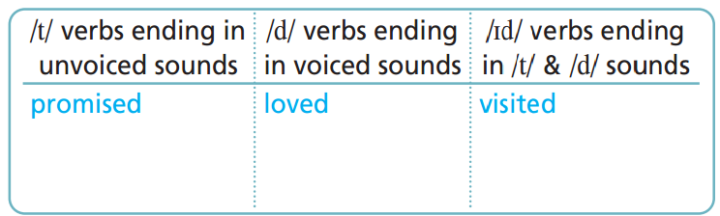
looked, kissed,
walked, hoped
borrowed
cleaned
ended
sounded

Slide 25
Odd one out
a. promised b. worked c. finished d. started
a. stayed b. walked c. turned d. loved
a. decided b. ended c. hoped d. visited
a. died b. kissed c. cleaned d. performed
a. looked b. stopped c. washed d. needed
a. borrowed b. looked c. helped d. walked

Slide 26
Odd one out
1. a. promised b. worked c. finished d. started
2. a. stayed b. walked c. turned d. loved
3. a. decided b. ended c. hoped d. visited
/t/
/t/
/t/
/id/
/d/
/t/
/d/
/d/
/id/
/id/
/id/
/t/

Slide 27
Odd one out
4. a. died b. kissed c. cleaned d. performed
5. a. looked b. stopped d. washed d. needed
6. a. borrowed b. looked c. helped d. walked
/d/
/d/
/d/
/t/
/t/
/t/
/t/
/id/
/t/
/t/
/t/
/d/

Slide 28

CONSOLIDATION

Slide 29
Write about 40 words to describe your last holiday. Remember to include information about the place, weather, activities, and feelings.
My last holiday was great/perfect … We travelled to…….

Slide 30

WRAP-UP

Slide 31
Today’s lesson
Speaking:
Practise a dialogue about holiday.
Act out a dialogue about holiday.
Pronunciation
Practise pronouncing the -ed ending (Past Simple).

Slide 32
Homework
Practise the vocabularies and grammar and make sentences using them.
Do the exercises in TA 6 Right on WB (p. 47).
Prepare the next lesson (p. 94 SB).

Slide 33
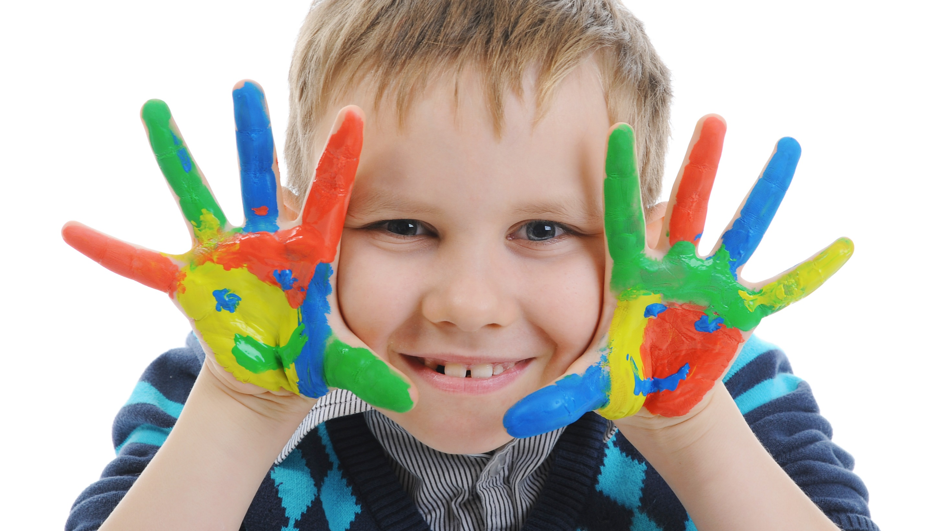
Enjoy your day!

