Slide 1

UNIT 4: INTERNATIONAL CHARITIES AND ORGANIZATIONS
Lesson 3.1 – Listening & Reading
Page 36

Slide 2



Lesson 3.1
LESSON OUTLINE
Consolidation

Slide 3

By the end of this lesson,
students will be able to …
practice listening and reading for gist and specific information.
talk about ways to raise money for charities.

Slide 4



Slide 5

Work in groups.
Can you think of three international organizations and charities, and what do they do?

Slide 6
Work in pairs:
Have you ever raised money for charity? What did you do?
What would you like to do in the future?

Slide 7



Slide 8
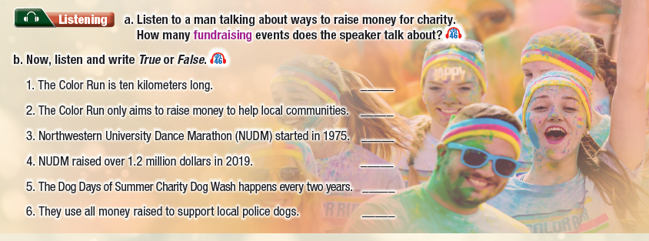

Slide 9
Pre-Listening
a. Listen to a man talking about ways to raise money for charity. How many fundraising events does the speaker talk about?
Read the instruction, underline the key words and answer these questions.
1 Are we going to listen to a man or a woman?
2 What is the speaker talking about?
3 What should we focus on?

Slide 10
Underline the key words/phrases.
Pre-Listening
1. The Color Run is ten kilometers long. _____
2. The Color Run only aims to raise money to help local communities. _____
3. Northwestern University Dance Marathon (NUDM) started in 1975. _____
4. NUDM raised over 1.2 million dollars in 2019. _____
5. The Dog Days of Summer Charity Dog Wash happens every two years. _____
6. They use all money raised to support local police dogs. _____

Slide 11

While-Listening
a. Listen to a man talking about ways to raise money for charity. How many fundraising events does the speaker talk about?
Answer: three

Slide 12
Now, listen and write True or False.
While-Listening
FALSE
1. The Color Run is ten kilometers long. _____
2. The Color Run only aims to raise money to help local communities. _____
3. Northwestern University Dance Marathon (NUDM) started in 1975. _____
4. NUDM raised over 1.2 million dollars in 2019. _____
5. The Dog Days of Summer Charity Dog Wash happens every two years. _____
6. They use all money raised to support local police dogs. _____
FALSE
TRUE
TRUE
FALSE
TRUE

Slide 13
Scripts
Next, we have the Dance Marathon. One of the first dance marathons took place in Northwestern University, Illinois, in 1975. Every spring, students try to complete a thirty-hour dance marathon. In 2019, NUDM raised more than one point two million dollars to help their local poor and sick students.
Finally, the Charity Dog Wash. The Dog Days of Summer Charity Dog Wash is an annual fundraising event in Beverly, Massachusetts. At this event, volunteers wash dogs for a five-dollar donation. The money goes to support local police dogs. People can also donate chew toys, towels, and pet food to a local animal shelter.
So, those were our top three charity events. Which one is your favorite?
Track 46
M: Welcome back to the show. Now, let's look at some exciting and creative fundraising events. First, the Color Run. It's a five-kilometer paint race which started in 2011 in Phoenix, Arizona. Runners wear white clothes and are covered in different colored paint at each part of the race. The Color Run’s main aim is to raise money for local communities, but it also encourages everyone to enjoy running and promotes the health benefits of sports.

Slide 14
Post-Listening
Work in pairs.
What does your school often do to raise money for charities?

Slide 15



Slide 16
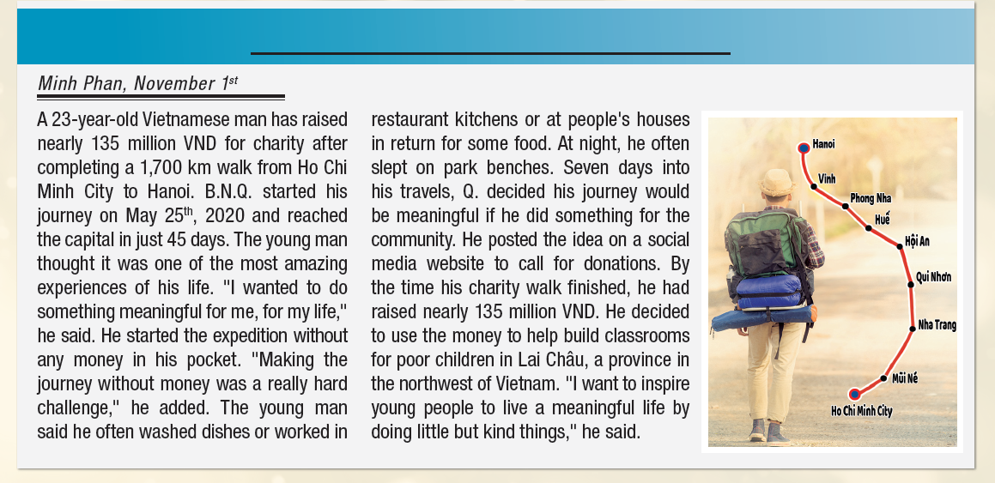

Slide 17
Pre-Reading
Read the article and choose the best title.
1. Man Walks for Charity
2. Man Walks to Ho Chi Minh City in 35 Days
1. Man Walks for Charity
2. Man Walks to Ho Chi Minh City in 35 Days
Underline the key words/phrases.
Answer: 1. Man walks for Charity

Slide 18
Pre-Reading
a. Read Tâm's essay and choose the main idea.
Underline the key words/phrases.
A 23-year-old Vietnamese man has raised nearly 135 million VND for charity after completing a 1,700 km walk from Ho Chi Minh City to Hanoi. B.N.Q. started his journey on May 25th, 2020 and reached the capital in just 45 days. The young man thought it was one of the most amazing experiences of his life. "I wanted to do something meaningful for me, for my life,“ he said. He started the expedition without any money in his pocket. "Making the journey without money was a really hard challenge," he added.

Slide 19
Pre-Reading
The young man said he often washed dishes or worked in restaurant kitchens or at people's houses in return for some food. At night, he often slept on park benches. Seven days into his travels, Q. decided his journey would be meaningful if he did something for the community. He posted the idea on a social media website to call for donations. By the time his charity walk finished, he had raised nearly 135 million VND. He decided to use the money to help build classrooms for poor children in Lai Châu, a province in the northwest of Vietnam. "I want to inspire young people to live a meaningful life by doing little but kind things," he said.

Slide 20
While-Reading
a. Read the article and choose the best title.
Skim the essay to choose the main idea
1. Man Walks for Charity
2. Man Walks to Ho Chi Minh City in 35 Days
→ 1. Man walks for Charity

Slide 21
b. Now, read the essay again and answer the questions.
Scan the essay to answer the questions
1. When did B.N.Q's walk begin? ____________________________________
2. How long did it take him to complete the journey? ____________________________________
3. What was the most difficult thing about the journey? ____________________________________
4. What did he use the money to build? ____________________________________
May 25th 2020
45 days
Making the journey without any money
Classrooms for poor children in Lai Châu
While-Reading

Slide 22


Post-Reading
Work in pairs.
What can you do to raise money for charity?
Who will you help with the money you raise?

Slide 23

Consolidation

Slide 24
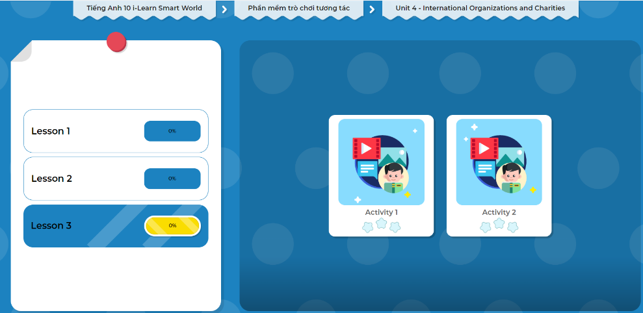
LET’S PLAY!
Click here to play the games.

Slide 25

WRAP-UP

Slide 26
Today’s lesson
Reading & Listening: for gist and specific information
Speaking: talk about ways to raise money for charities

Slide 27

Do the exercises in WB on page 24
Do the exercises in Tiếng Anh 10 i-Learn Smart World Notebook on page 24.
Prepare the next lesson - Writing on page 37 in SB.
Play the consolidation games in Tiếng Anh 10 i-Learn Smart World DHA App on www.eduhome.com.vn

