Slide 1


Slide 2
Unit
9
SOCIAL ISSUES
Unit
FAMILY LIFE
LESSON 7
@#&!*
COMMUNICATION AND CULTURE / CLIL
EW
YOU CAN'T

Slide 3
LESSON 7
COMMUNICATION AND CULTURE / CLIL
WARM-UP
Game: Positive or negative?
Task 1: Listen and complete the conversation.
Task 2: Make similar conversations.
EVERYDAY ENGLISH
Task 1: Match each percentage in the chart with ONE social problem.
Task 2: Discussion.
CLIL
CONSOLIDATION
Wrap-up
Homework

Slide 4

WARM-UP
Students work in 4 groups.
You will hear and find if 4 speakers below express positivity or negativity.
Raise your hands to answer.

Slide 5


Listen and find if 4 speakers below express positivity or negativity
1
2
3
4
Negativity
Positivity

Slide 6
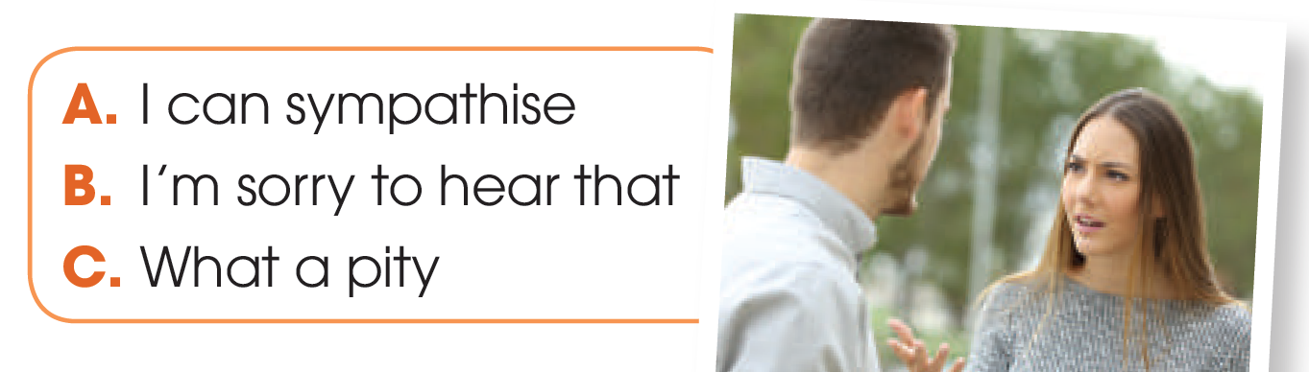

EVERYDAY ENGLISH
1
Listen and complete the conversation.
Mary: I’m afraid I can’t go to the cinema
with you, Andy.
Andy: (1) ________! I really wanted you to
watch the film.
Mary: Maybe another time. My brother is going to see a doctor tomorrow and I promised to go with him.
Andy: (2) ________. What’s wrong with him?
Mary: He’s been bullied at school. We think he’s suffering from depression and needs help.
Andy: (3) ________. I was also the victim of bullying and had a very painful experience. I hope he’ll be fine.
Mary: Thank you for your sympathy, Andy.
C
B
A

Slide 7
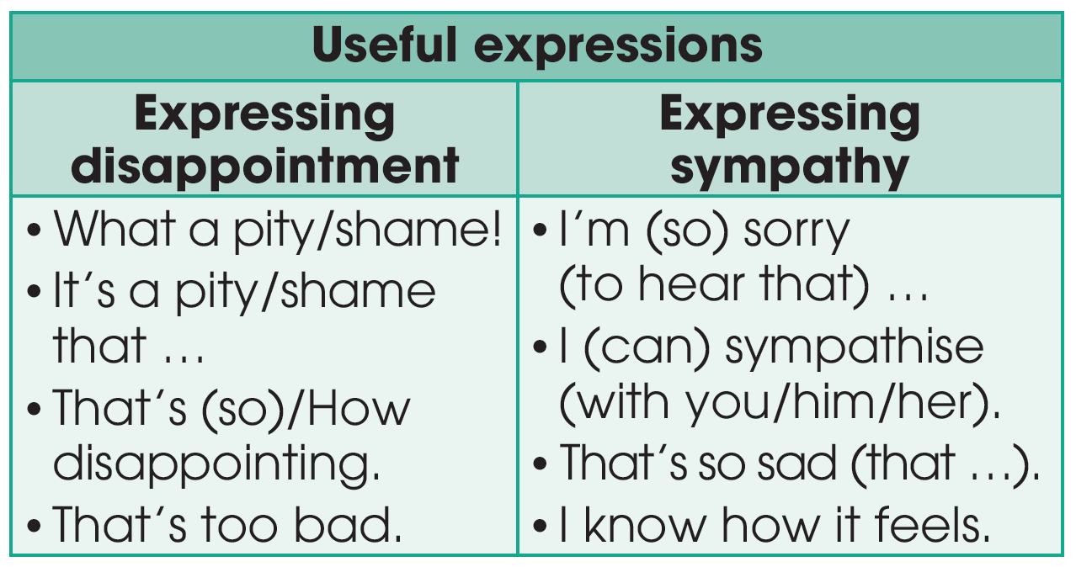
EVERYDAY ENGLISH

Slide 8
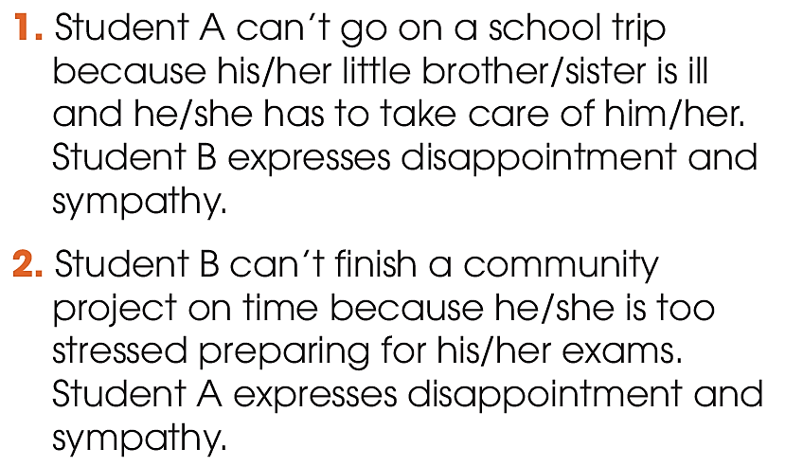

EVERYDAY ENGLISH
2
Work in pairs. Use the model in 1 to make similar conversations for these situations. One of you is Student A, the other is Student B. Use the expressions to help you.

Slide 9
EVERYDAY ENGLISH
SAMPLE CONVERSATION 1
A: I’m afraid I can’t go on the school trip tomorrow.
B: What a shame! We’ve been planning for the trip for weeks. What’s wrong?
A: My brother’s ill and I have to take care of him.
B: I’m so sorry to hear that. I wish him a quick recovery.
A: Thanks.

Slide 10
EVERYDAY ENGLISH
SAMPLE CONVERSATION 2
B: I don’t think I’ll be able to finish the community project on time.
A: That’s too bad! Is everything OK?
B: Not really. I’m so stressed about the exams next week, so I don’t have time for the project. I can’t sleep well, either.
A: I can sympathise. Exams can be stressful. Try doing yoga to feel less stressed, and good luck with the exams.
B: Good idea! Thank you.

Slide 11
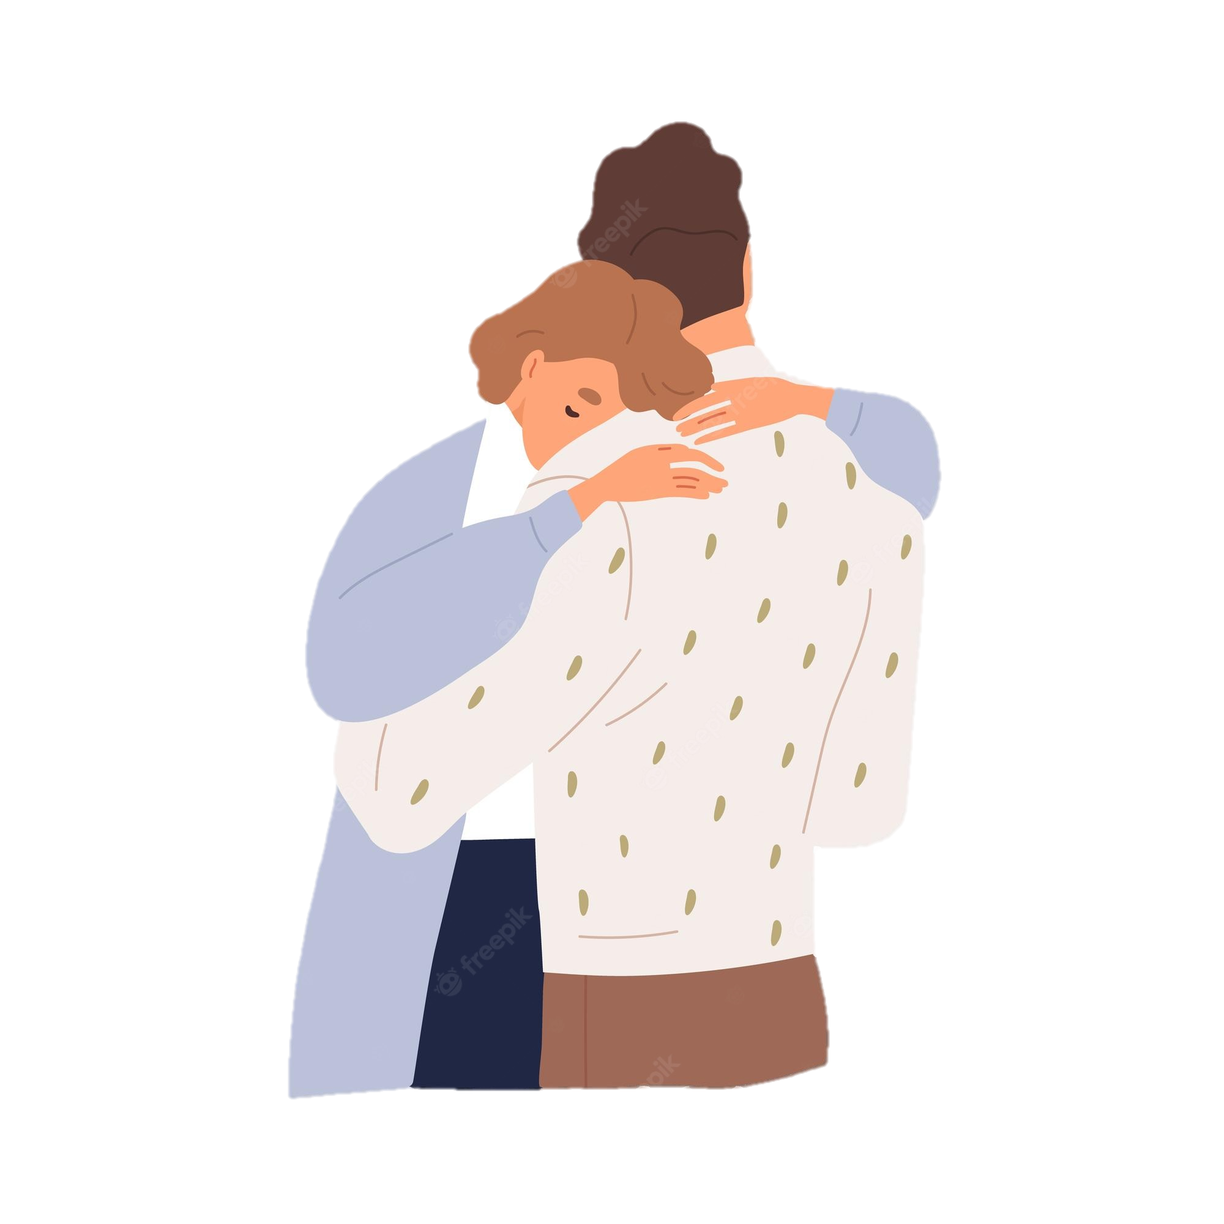
CLIL
sympathy (n)
/ˈsɪmpəθi/
(an expression of) understanding and care for someone else's suffering

Slide 12
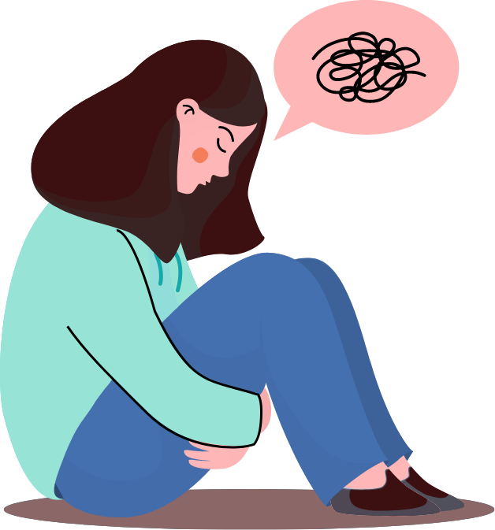
CLIL
anxiety (n)
/æŋˈzaɪəti/
an uncomfortable feeling of nervousness or worry about something that is happening or might happen in the future

Slide 13
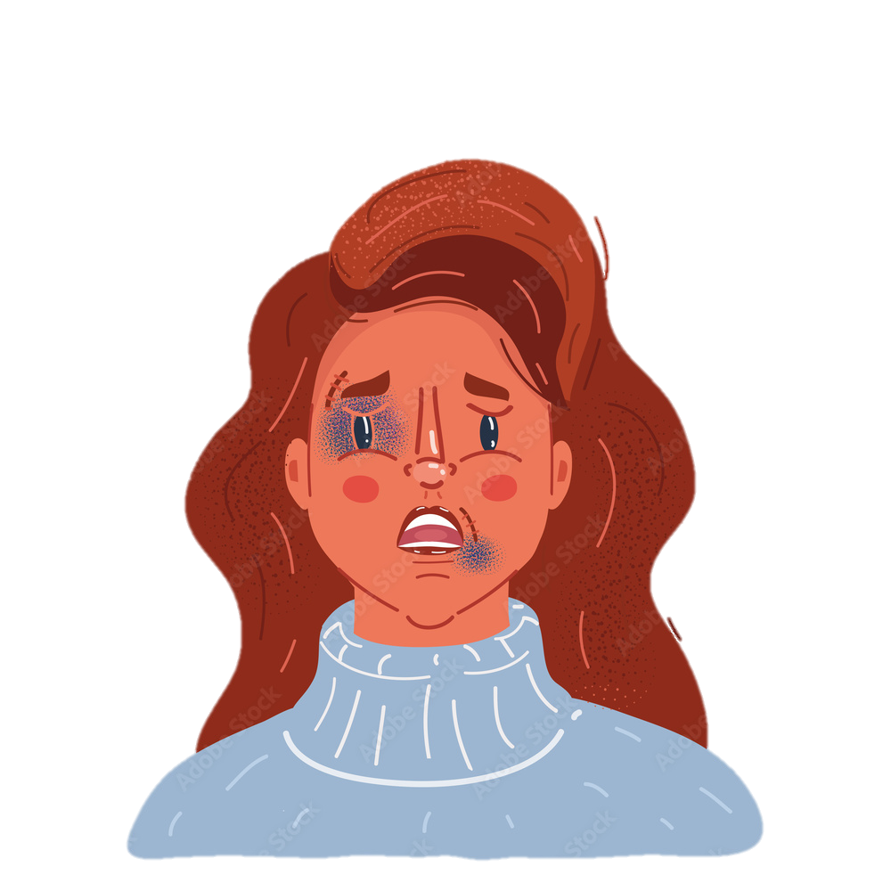
CLIL
victim (n)
/ˈvɪktɪm/
someone or something that has been hurt, damaged, or killed or has suffered, either because of the actions of someone or something else, or because of illness or chance

Slide 14
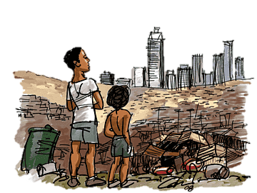
CLIL
poverty line (n)
/ˈpɒvəti ˌlaɪn/
the official level of income that is needed to achieve a basic living standard with enough money for things such as food, clothing, and a place to live

Slide 15
CLIL
Form | Pronunciation | Meaning
1. sympathy (n) | /ˈsɪmpəθi/ | (an expression of) understanding and care for someone else's suffering
2. anxiety (n) | /æŋˈzaɪəti/ | an uncomfortable feeling of nervousness or worry about something that is happening or might happen in the future
3. victim (n) | /ˈvɪktɪm/ | someone or something that has been hurt, damaged, or killed or has suffered, either because of the actions of someone or something else, or because of illness or chance
4. poverty line (n) | /ˈpɒvəti ˌlaɪn/ | the official level of income that is needed to achieve a basic living standard with enough money for things such as food, clothing, and a place to live

Slide 16
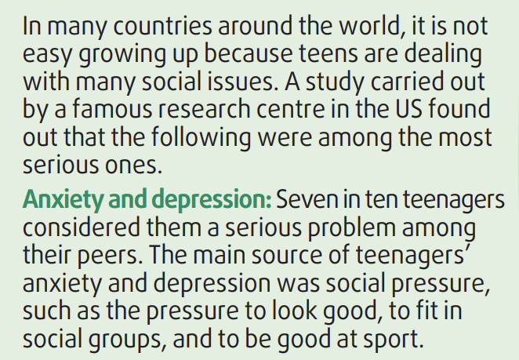
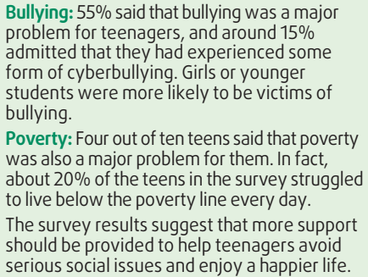
CLIL
1
Read the text and match each percentage in the chart with ONE social problem mentioned in the text.

Slide 17
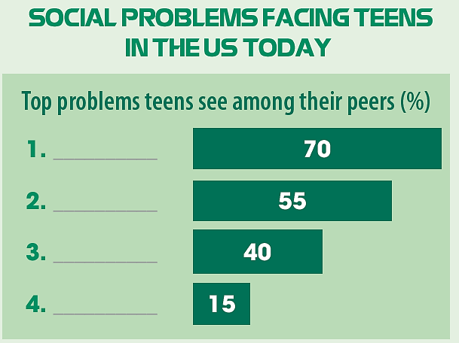
CLIL
1
Read the text and match each percentage in the chart with ONE social problem mentioned in the text.
Anxiety and
depression
Bullying
Poverty
Cyberbullying

Slide 18
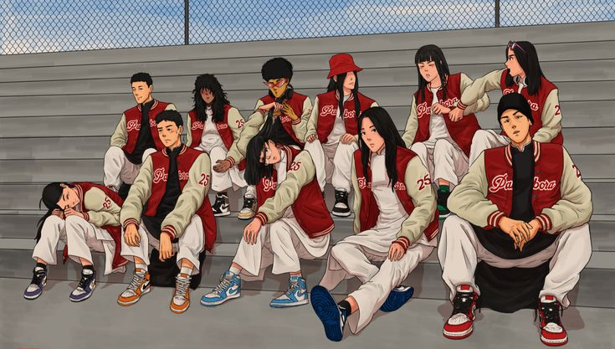
CLIL
2
Work in pairs. Discuss the following questions.
Are the problems mentioned in the text similar to those facing Vietnamese teens? Are there any other problems among teenagers in Viet Nam?

Slide 19
01
WRAP-UP
CONSOLIDATION
@#&!*
What have you learnt today?
Express disappointment and sympathy.
Understand some of the social problems facing teens in the US today.
YOU CAN'T

Slide 20
02
HOMEWORK
CONSOLIDATION
@#&!*
Do exercises in the workbook.
Prepare for Lesson 8 - Unit 9.
YOU CAN'T

Slide 21

Website: hoclieu.vn
Fanpage: facebook.com/www.tienganhglobalsuccess.vn/

