Slide 2

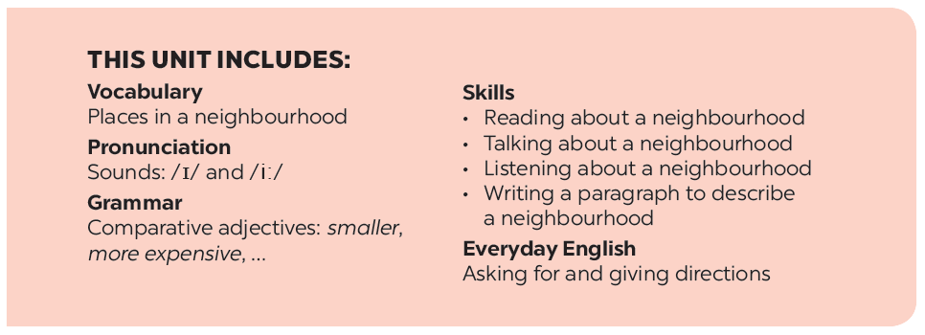

Slide 3







Vocabulary
Write the name for each picture.
Now write their comparative forms in the table below.
Grammar
Complete the sentences comparing the pictures. Use the comparative forms of the adjectives below.
Put the following adjectives in the correct column.

Slide 4
Vocabulary

Slide 5


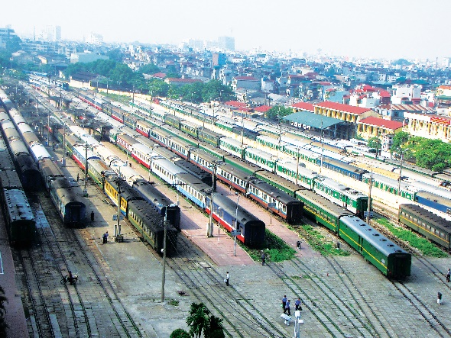
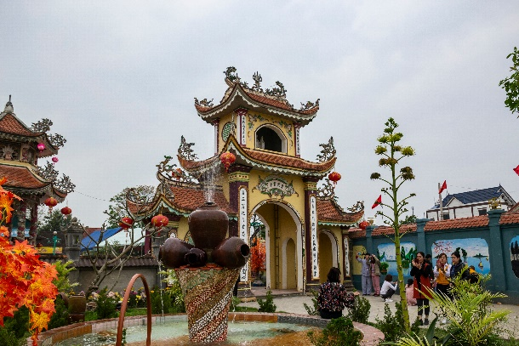
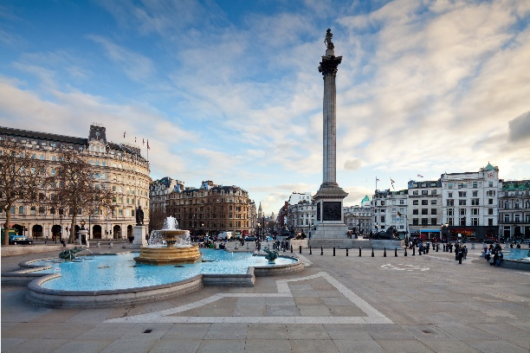
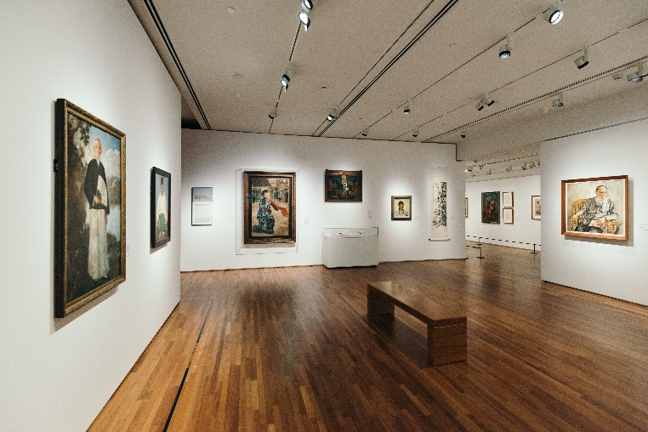
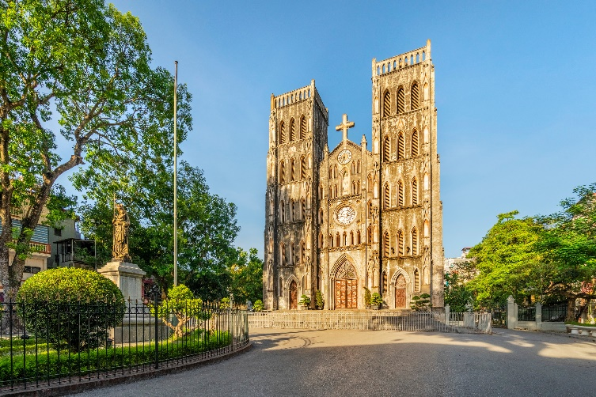
Write the name for each picture.

Slide 6

1.
1. temple

Slide 7

2.
2. railway station

Slide 8

3.
3. square

Slide 9

4.
4. art gallery

Slide 10

5.
5. cathedral

Slide 11
Write the name for each picture.
1. temple
2. railway station
3. square
4. art gallery
5. cathedral

Slide 12
Grammar

Slide 13

Put the following adjectives in the correct column.
fast
hot
large
expensive
exciting
fast
hot
large
expensive
exciting
heavy
noisy
quiet
beautiful
heavy
noisy
quiet
beautiful
One syllable | Two syllables | Three or more syllables
fast
heavy
expensive
hot
noisy
exciting
large
quiet
beautiful

Slide 14

Now write their comparative forms in the table below.
Adjectives | Comparative form
fast | faster
beautiful
noisy
expensive
hot
exciting
quiet
heavy
large
more beautiful
noisier
more expensive
hotter
more exciting
quieter
heavier
larger

Slide 15

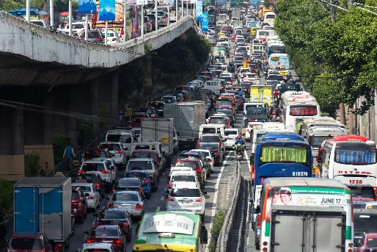
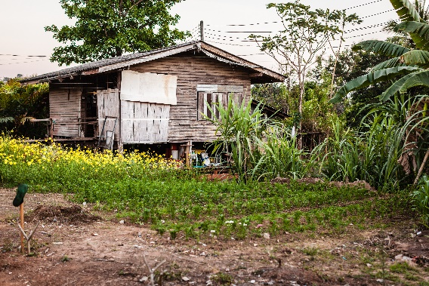
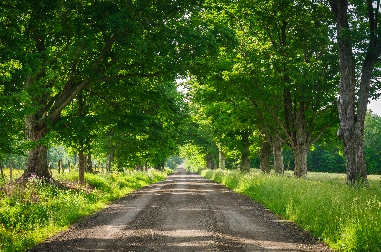
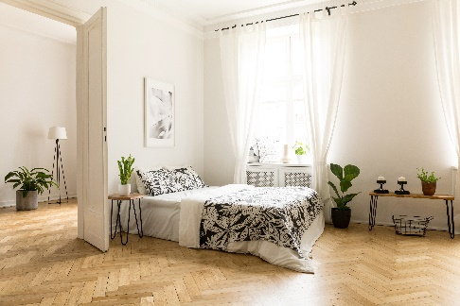
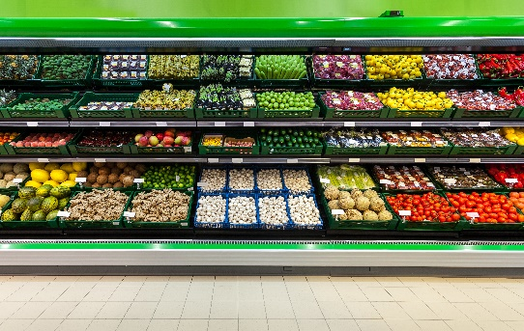
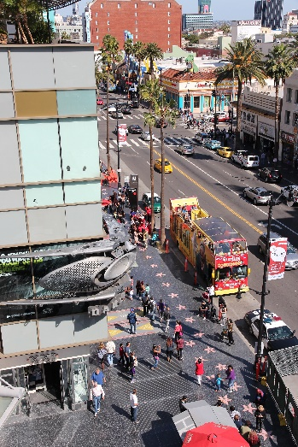
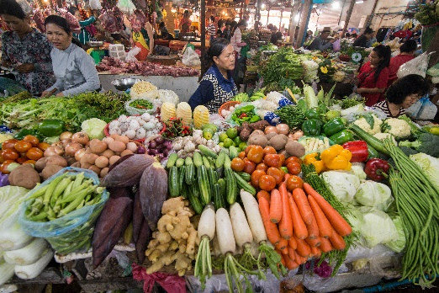
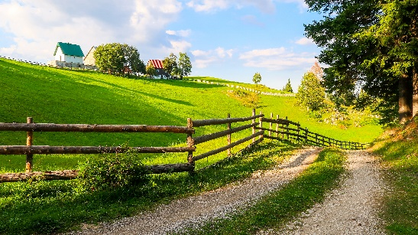
Complete the sentences comparing the pictures. Use the comparative forms of the adjectives below.
expensive
noisy
modern
peaceful

Slide 16
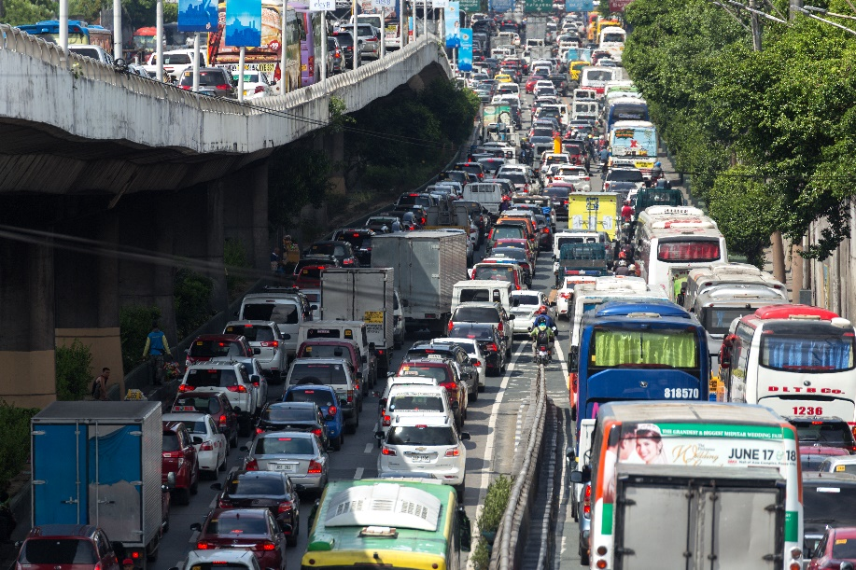

expensive
noisy
modern
peaceful
1.
1. This street is noisier than that one.
This street is than that one.

Slide 17


expensive
noisy
modern
peaceful
2. A city house is more modern than a country house.
2.
A city house is than a country house.

Slide 18
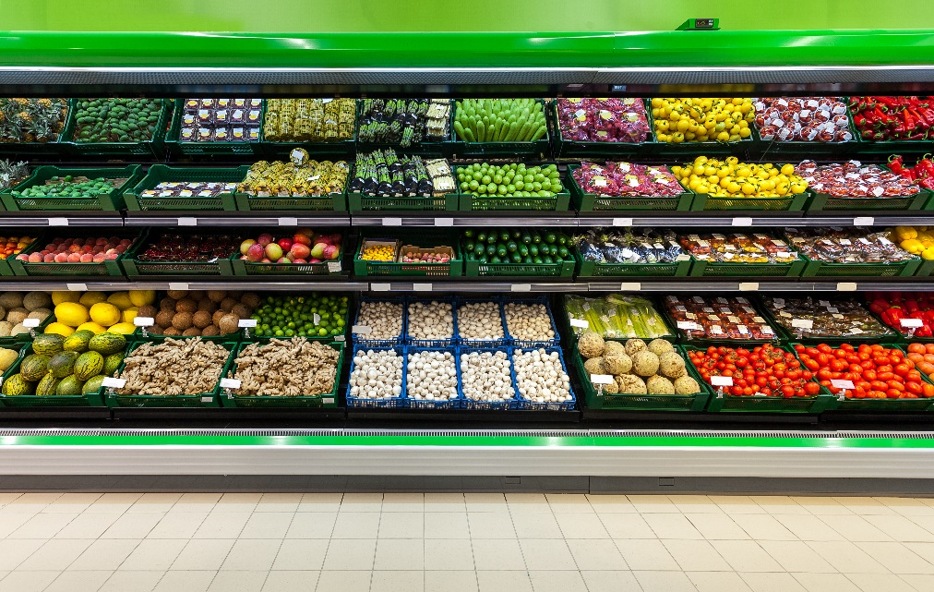

expensive
noisy
modern
peaceful
3. Things at a corner shop are more expensive than things
at a village market.
3.
Things at a corner shop are than things at a village market.

Slide 19


expensive
noisy
modern
peaceful
4. Life in the countryside is more peaceful than life
in the city.
4.
Life in the countryside is than life in the city.

Slide 20



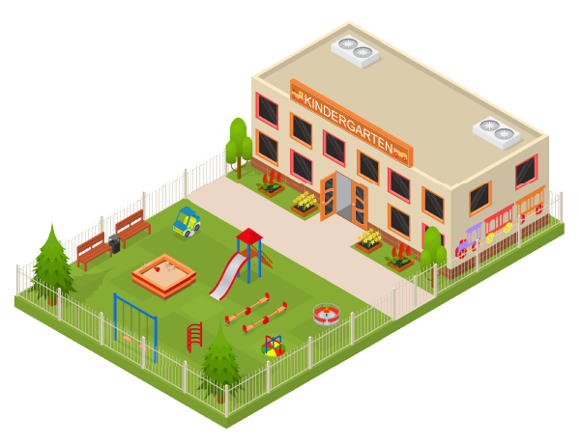

Draw a map of a neighbourhood. Write names of at least five places on your map.

Slide 21
Work in pairs. Take turns to ask for and give directions to the places on the map.

Slide 22
Now I can … |  |  | 
use the words to name places in a neighbourhood.
pronounce the sounds /ɪ/ and /i:/ correctly.
compare two people or things using comparative adjectives.
ask for and give directions.
read about a neighbourhood.
talk about a neighbourhood.
listen about a neighbourhood.
write a paragraph to describe a neighbourhood.
✓
✓
✓
✓
✓
✓
✓
✓
✓
✓
✓
✓
✓
✓
✓
✓
✓
✓
✓
✓
✓
✓
✓
✓

Slide 23






Website: hoclieu.vn
Fanpage: facebook.com/www.tienganhglobalsuccess.vn/

