Slide 2
Unit 4
urbanization
LISTENING
A radio talk about Urbanization

Slide 3
LESSON 5
LISTENING
WARM-UP
Watch a video and answer the questions.
Task 1: Choose the correct meanings.
PRE- LISTENING
Task 2: Listen to a conversation between two students.
Task 3: Listen and choose the correct answers.
WHILE- LISTENING
POST- LISTENING
Task 4: Discuss the questions.
Wrap-up
Homework
CONSOLIDATION

Slide 4

Watch the video about urbanization and answer the questions.
https://www.youtube.com/watch?v=U3hHdunQLuM&t=1s

Slide 5
In 1950, only ___ of the world’s population lived in cities
50%
30%
40%
25,5%

Slide 6
They are looking for better _____.
Infrastructure
Leisure facilities
Education and jobs
All are correct

Slide 7
In 2050, around ____ of the world’s population will live in cities.
55%
70%

Slide 8
It will raise some problems, so we can improve the quality of living by making cities more modern.
No
Yes

Slide 9


VOCABULARY
reliable (adj)
/rɪˈlaɪ.ə.bəl/
Someone or something that is reliable can be trusted or believed because he/she, or it works or behaves well in the way you expect

Slide 10

VOCABULARY
rapidly (v)
/ˈræpɪdli/
very quickly; at a great rate

Slide 11

VOCABULARY
Go up (phr.v)
/ɡəʊ/ /ʌp/
to move higher, rise, or increase

Slide 12
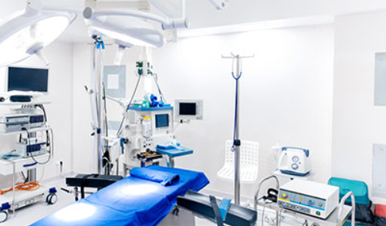
VOCABULARY
medical facilities
/ˈmɛdɪkəl/ /fəˈsɪlətiz/
to places or establishments where medical care, treatment, and health-related services are provided.

Slide 13
VOCABULARY
Form | Pronunciation | Meaning
1. reliable (adj) | /rɪˈlaɪ.ə.bəl/ | Someone or something that is reliable can be trusted or believed because he, she, or it works or behaves well in the way you expect
2. rapidly (v) | /ˈræpɪdli/ | very quickly; at a great rate
3. Go up (phr.v) | /ɡəʊ/ /ʌp/ | to move higher, rise, or increase
4. medical facilities | /ˈmɛdɪkəl/ /fəˈsɪlətiz/ | to places or establishments where medical care, treatment, and health-related services are provided.

Slide 14
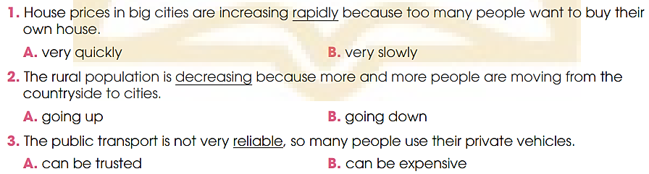
PRE- LISTENING
1
Choose the correct meanings of the underlined words.

Slide 15
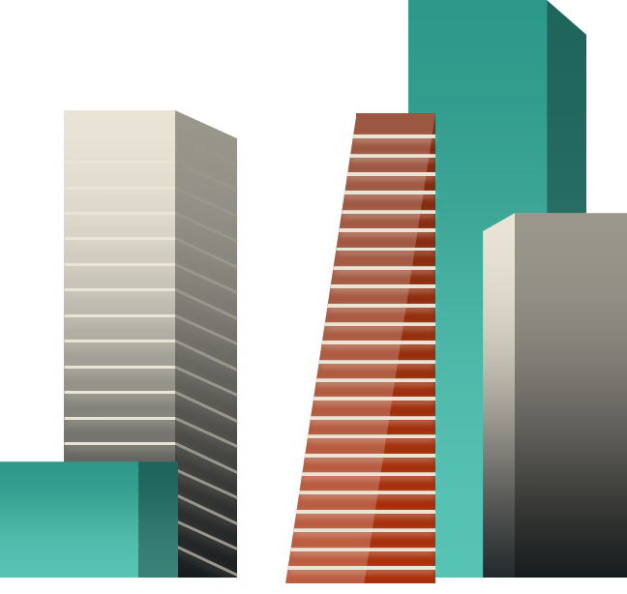


WHILE- LISTENING
2
Listen to a radio talk about urbanisation. Choose the correct answer a, B, or C.

Slide 16
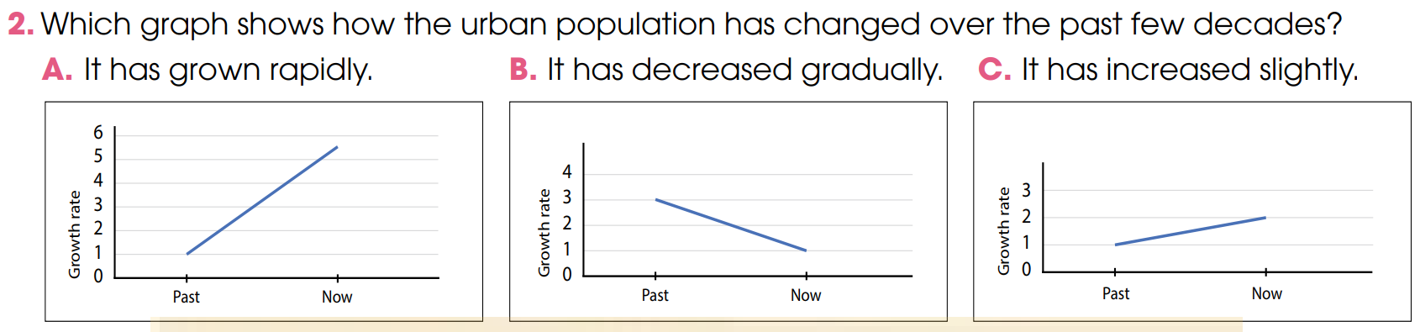

WHILE- LISTENING
2
Listen to a radio talk about urbanisation.
Choose the correct answer a, B, or C.

Slide 17
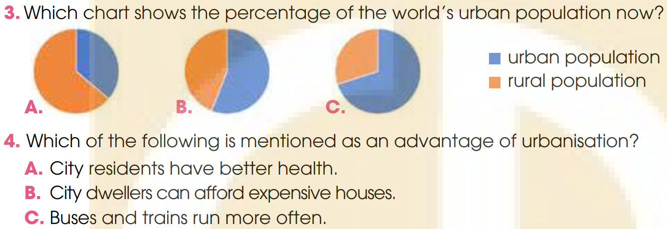
WHILE- LISTENING
2
Listen to a radio talk about urbanisation.
Choose the correct answer a, B, or C.

Slide 18
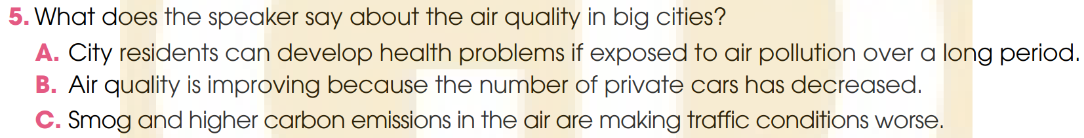

WHILE- LISTENING
2
Listen to a radio talk about urbanisation.
Choose the correct answer a, B, or C.

Slide 19
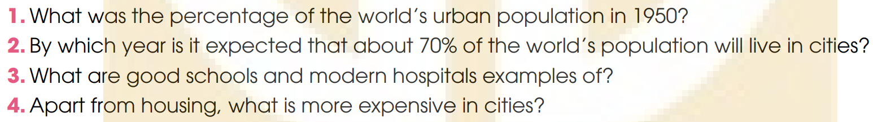


WHILE- LISTENING
3
Listen to the talk again and answer the questions.
Use no more than THREE words and/or a number.
*ANSWER
1. About 30 %/ thirty percent
2. By 2050
3. (City’s) better facilities
4. Goods and services

Slide 20
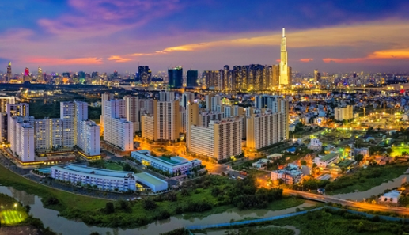
POST- LISTENING
4
Work in groups. Discuss the following question.

Slide 21


POST- LISTENING
4
*Sample answers:
I think the biggest advantage of urbanisation is the opportunity to get access to better health services. This is because most of the big hospitals with the best medical facilities are often located in big cities. When people have better health services, they will have a healthier body and enjoy their life.
I think the biggest advantage of urbanisation is having modern facilities.
When people have access to more and better facilities, their life also gets easier and more comfortable.

Slide 22
CONSOLIDATION
1
Wrap-up
What have you learnt today?
Listen for main ideas and specific information in a conversation about an ASEAN school tour programme.

Slide 23

CONSOLIDATION
2
Homework
Learn new words by heart.
Do exercises in the workbook.
Prepare for Lesson 6 - Unit 4.

Slide 24
Website: hoclieu.vn
Fanpage: facebook.com/www.tienganhglobalsuccess.vn

