Slide 1

Hello 3
Pages 10-11-12

Slide 2
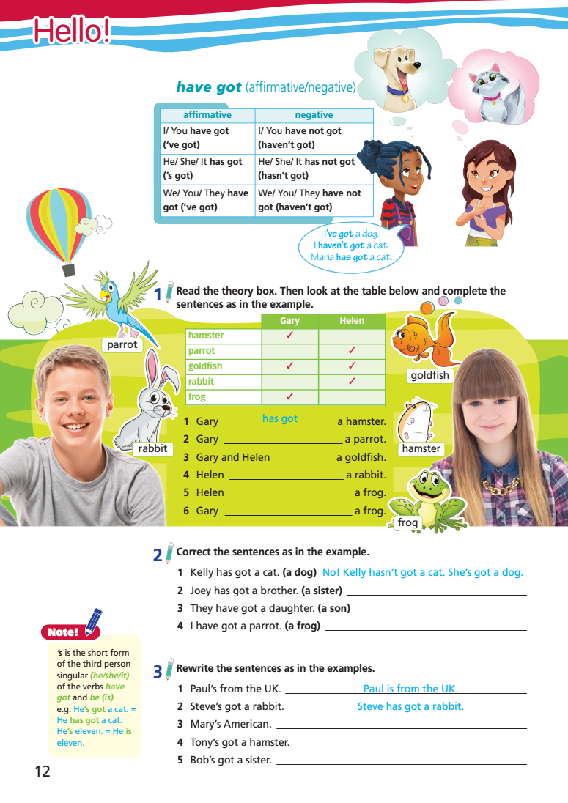
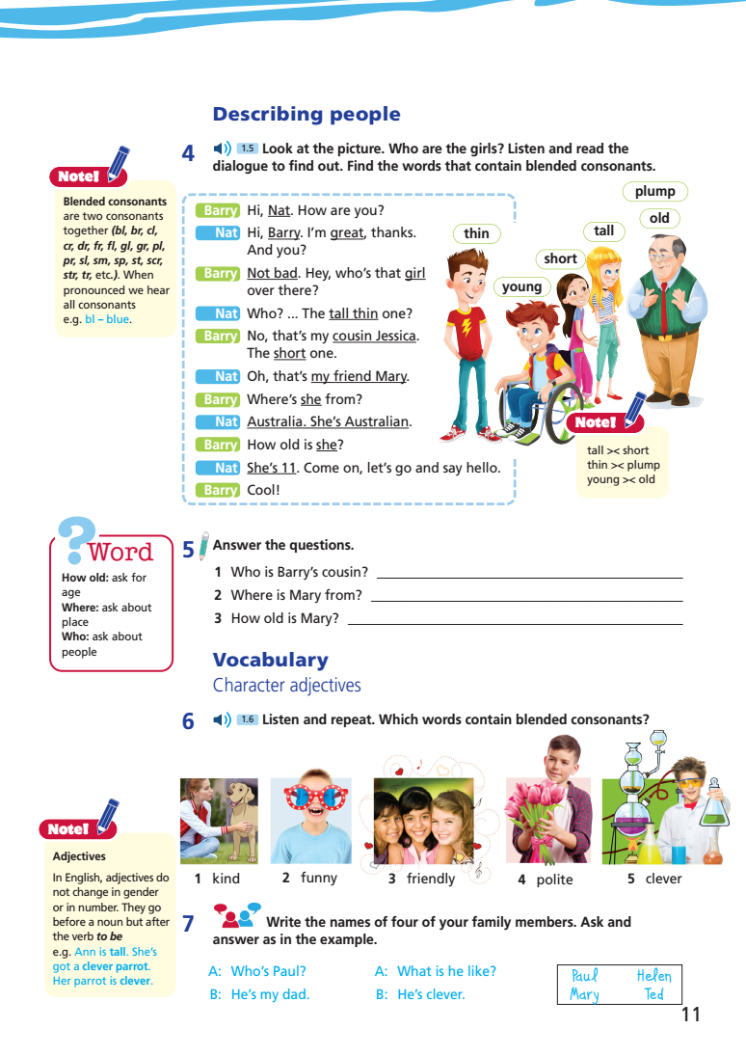
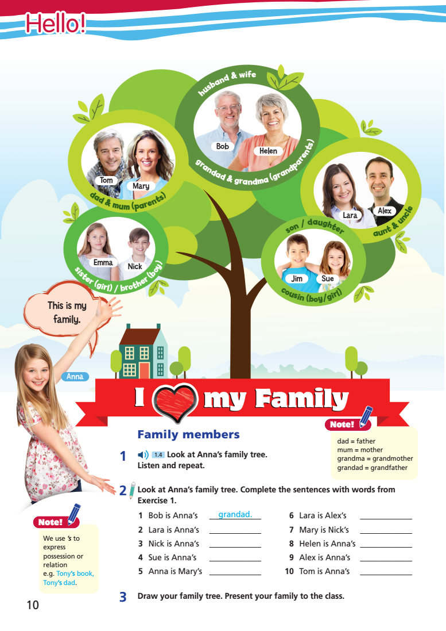
Lesson Outline
Warm-up
Vocabulary
Speaking
Grammar
Consolidation
Wrap-up

Slide 3
Objectives
By the end of this lesson, students will be able to…
- Revise the vocabulary for family members and character adjectives.
- Revise the structure “have got” (affirmative and negative).
- Practise describing people.

Slide 4

WARM-UP

Slide 5
How many members are there in your family? Who are they?

Slide 6

It’s time to learn …

Slide 7
Vocabulary

Slide 8

Presentation

Slide 9

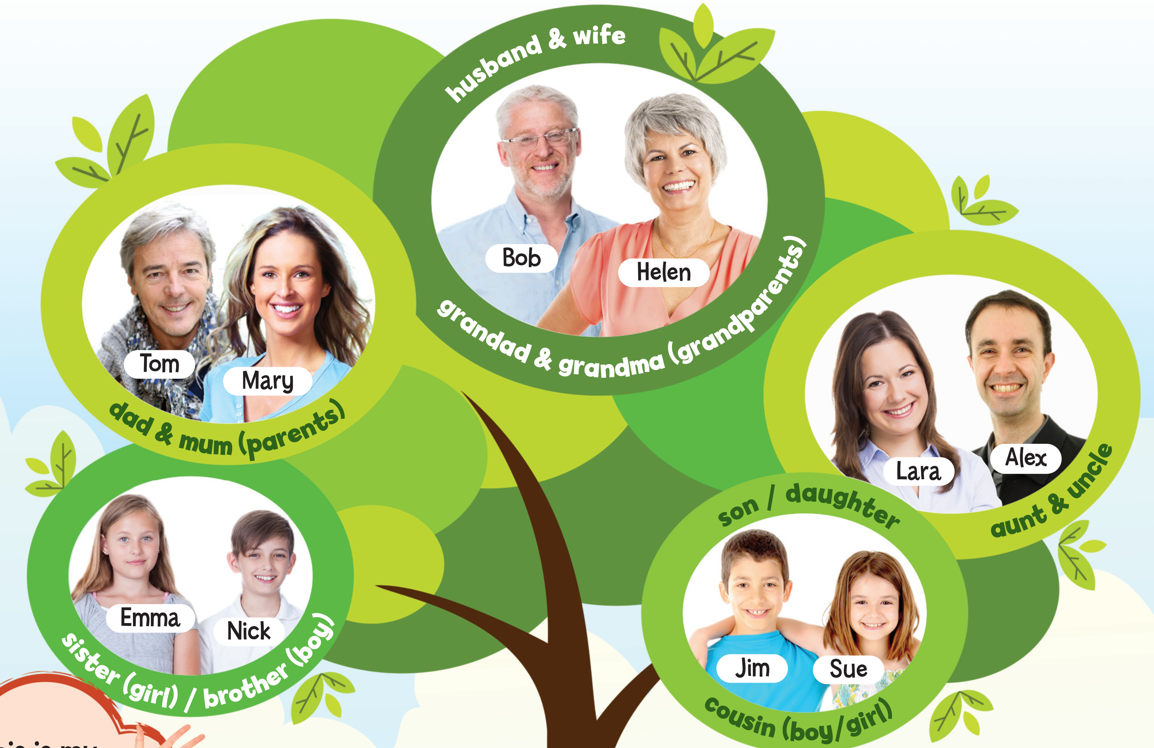

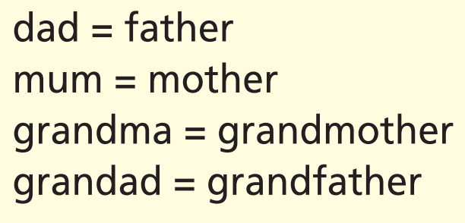
1 Look at Anna’s family tree. Listen and repeat.

Slide 10

Practice

Slide 11
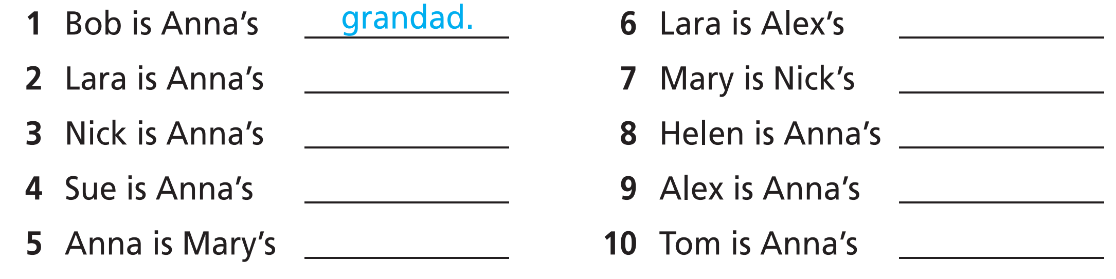
2 Look at Anna’s family tree. Complete the sentences with words from Exercise 1.
We use ’s to express possession or relation e.g. Tony’s book, Tony’s dad.

Slide 12
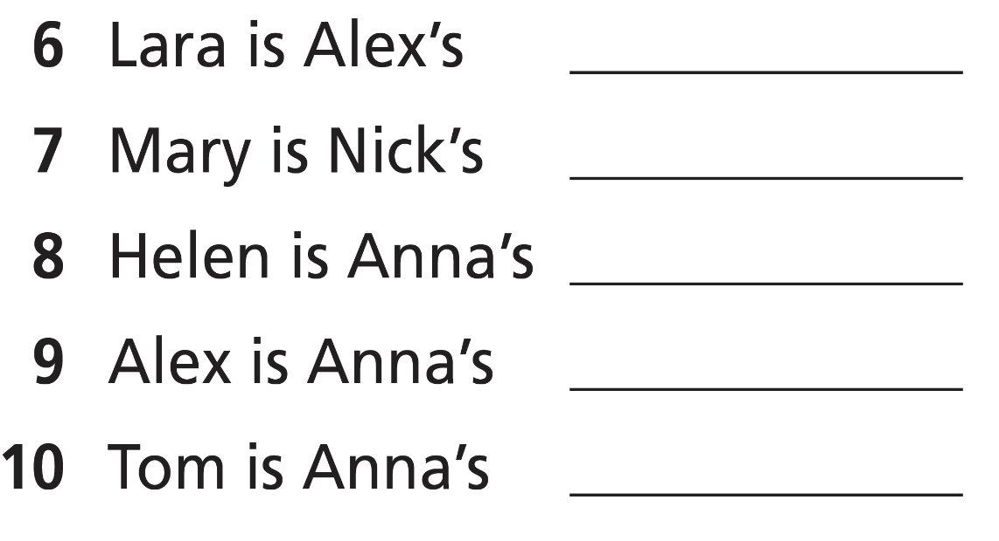
2 Look at Anna’s family tree. Complete the sentences with words from Exercise 1.
aunt.
brother.
cousin.
daughter.
wife.
mum/mother.
grandma/
grandmother.
uncle.
dad/father.

Slide 13

Production

Slide 14
3 Draw your family tree. Present your family to the class.

Slide 15

Speaking

Slide 16
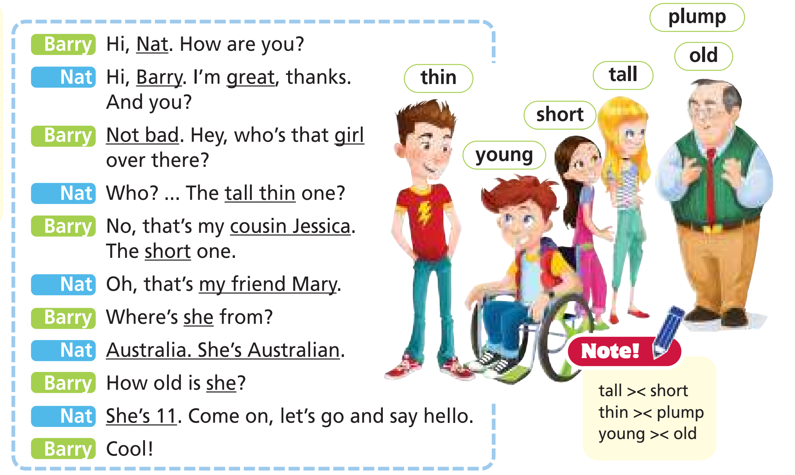

Pre-speaking
4 Look at the picture. Who are the girls? Listen and read the
dialogue to find out.
Jessica is the tall girl.
Mary is the short girl.

Slide 17
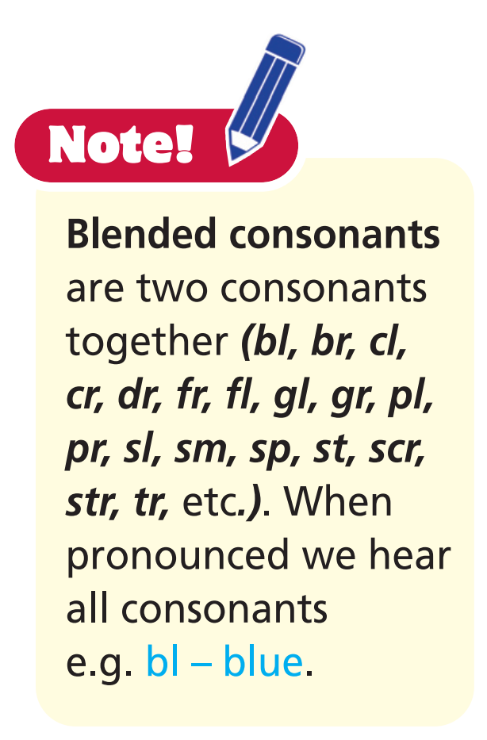
Find the words that contain blended consonants.

Slide 18
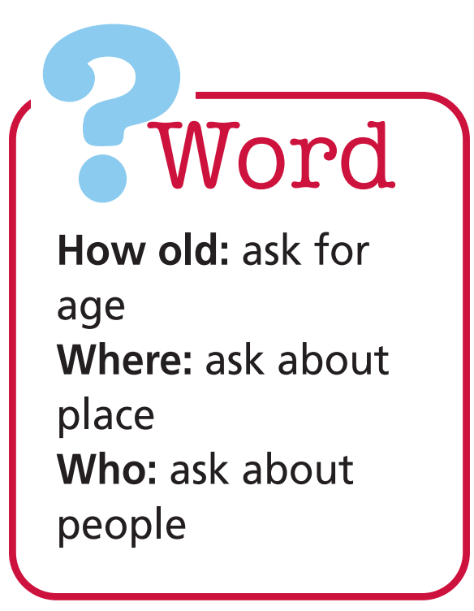
5 Answer the questions.
1 Who is Barry’s cousin?
Jessica is Barry’s cousin.
2 Where is Mary from?
She is from Australia.
3 How old is Mary?
She is 11.

Slide 19
Work in pairs. Change the underlined words and phrases to talk about other people in the picture.
While-speaking

Slide 20
Post-speaking
Work in pairs. Use the adjectives above to talk about your classmates.

Slide 21
Vocabulary

Slide 22
Presentation

Slide 23
6 Listen and repeat. Which words contain blended consonants?
1. kind
2. funny
3. friendly
4. polite
5. clever
Adjectives
In English, adjectives do not change in gender or in number. They go before a noun but after the verb to be e.g. Ann is tall. She’s got a clever parrot. Her parrot is clever.

Slide 24
6 Listen and repeat. Which words contain blended consonants?
1. kind
2. funny
3. friendly
4. polite
5. clever
The words contain blended consonants:
kind (nd)
friendly (fr)
clever (cl)

Slide 25
Vocabulary:
- kind /kaɪnd/ (adj.) tử tế

- funny /ˈfʌni/ (adj.) vui tính

- friendly /ˈfrendli/ (adj.) thân thiện

- polite /pəˈlaɪt/ (adj.) lịch sự

- clever /ˈklevə/ (adj.) thông minh

Slide 26
Practice

Slide 27

7 Write the names of four of your family members. Ask and answer
as in the example.
A: Who’s Paul?
B: He’s my dad.
A: What is he like?
B: He’s clever.

Slide 28
Production

Slide 29
Introduce your family members to the class.

Slide 30
Grammar

Slide 31
Presentation

Slide 32
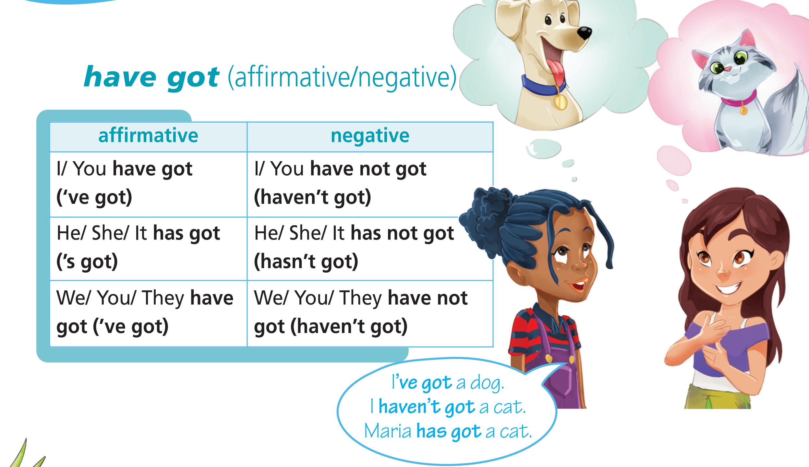

Slide 33
Practice

Slide 34
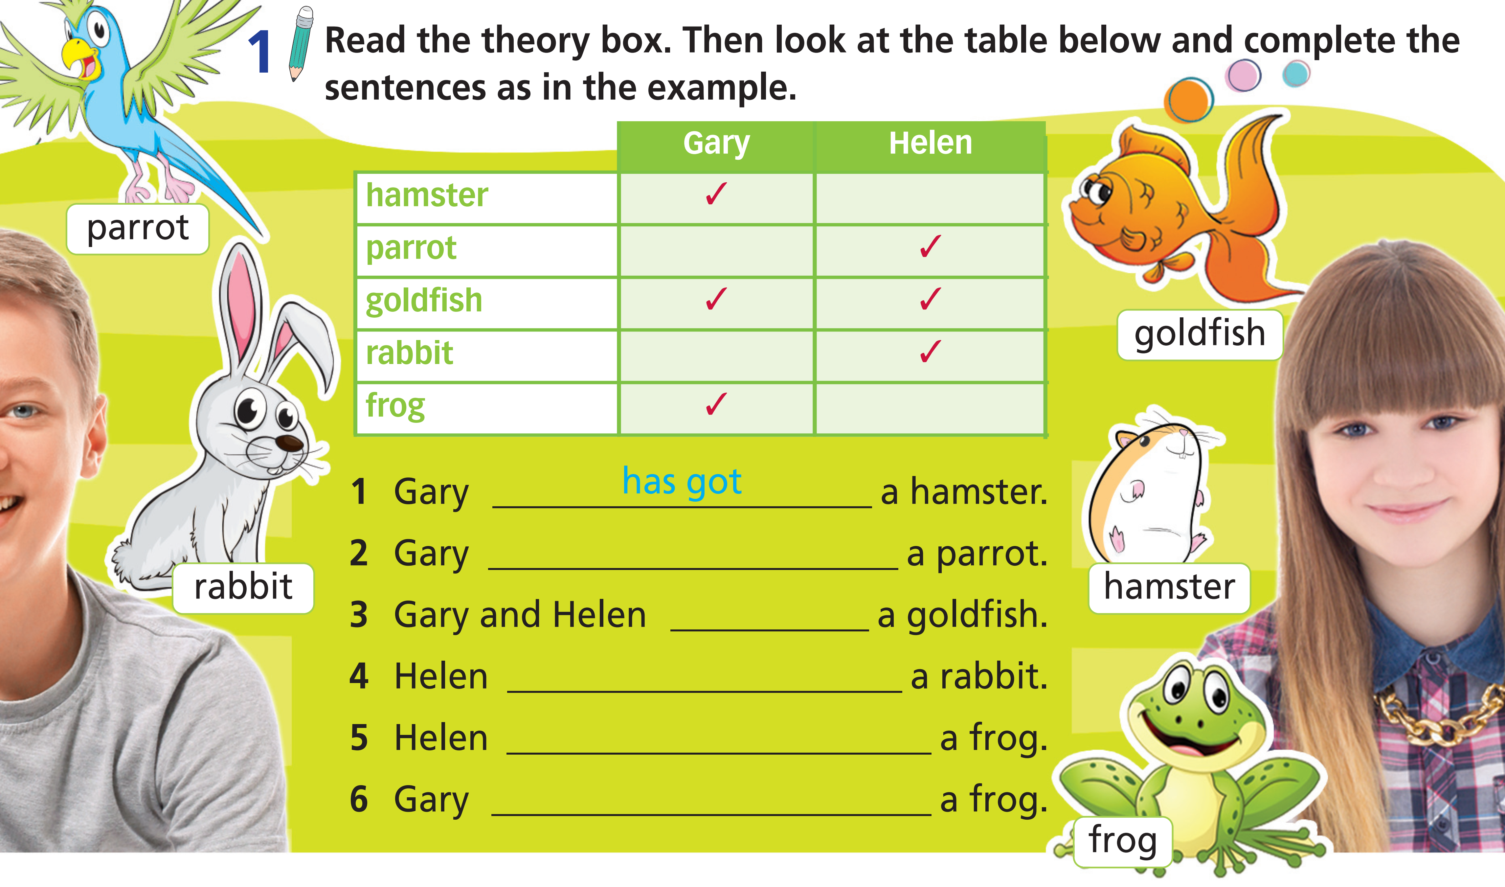
1 Look at the table below and complete the sentences as in the example.
hasn’t got
have got
has got
hasn’t got
has got

Slide 35
2 Correct the sentences as in the example.
1 Kelly has got a cat. (a dog)
=> No! Kelly hasn’t got a cat. She’s got a dog.
2 Joey has got a brother. (a sister)
=> No! Joey hasn’t got a brother. He’s got a sister.
3 They have got a daughter. (a son)
=> No! They haven’t got a daughter. They’ve got a son.
4 I have got a parrot. (a frog)
=> No! I haven’t got a parrot. I’ve got a frog.

Slide 36
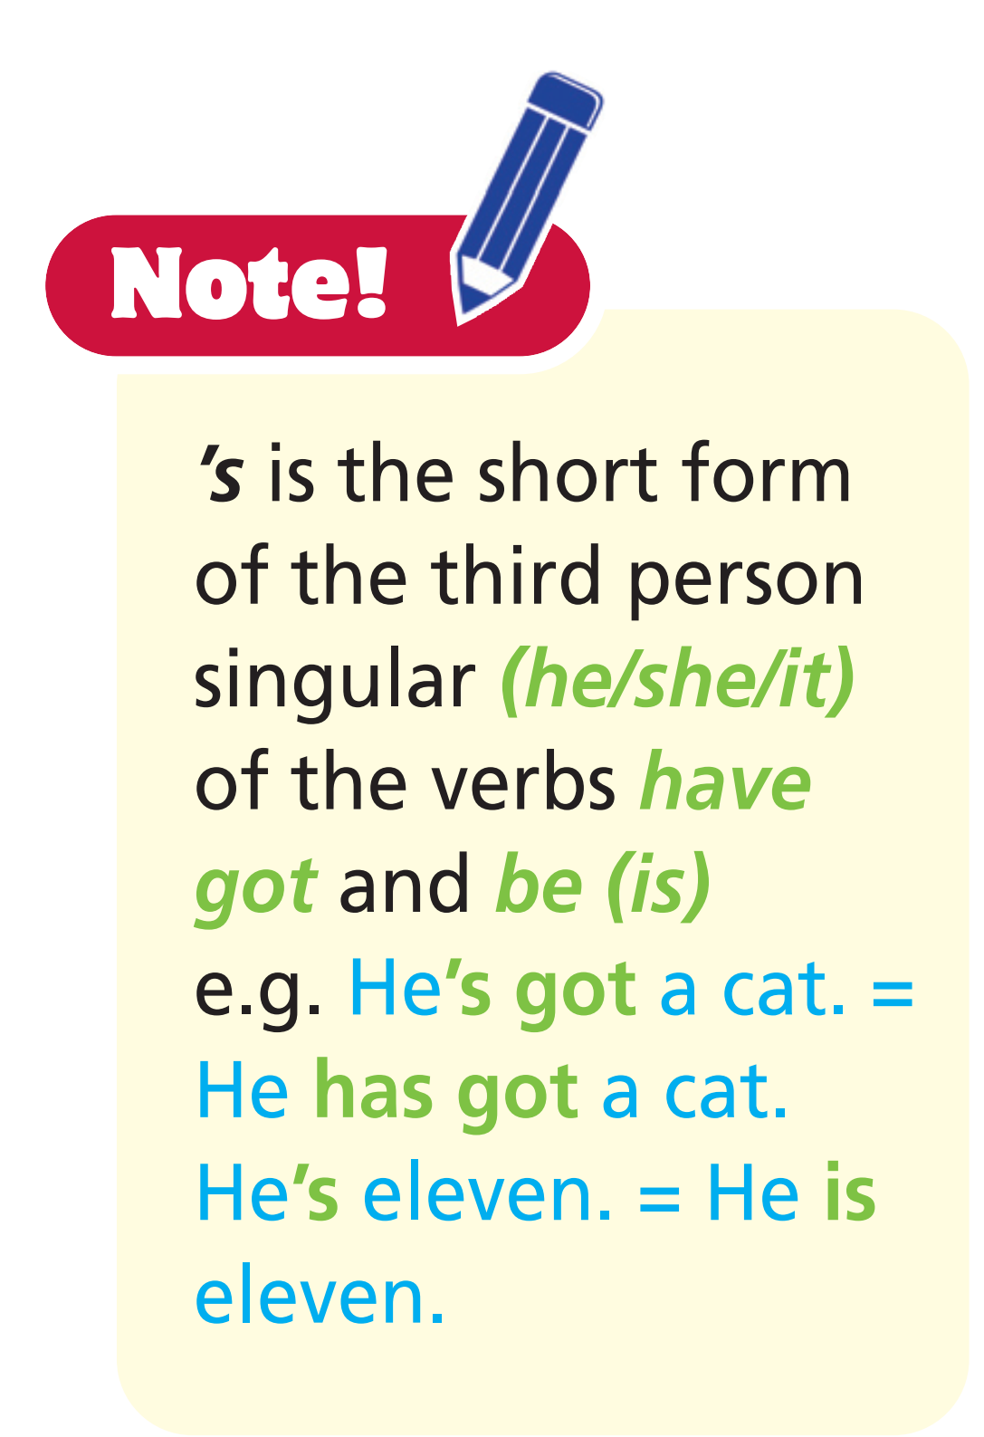
3 Rewrite the sentences as in the examples.
1 Paul’s from the UK.
2 Steve’s got a rabbit.
3 Mary’s American.
4 Tony’s got a hamster.
5 Bob’s got a sister.
=> Paul is from the UK.
=> Steve has got a rabbit.
=> Mary is American.
=> Tony has got a hamster.
=> Bob has got a sister.

Slide 37
Production

Slide 38
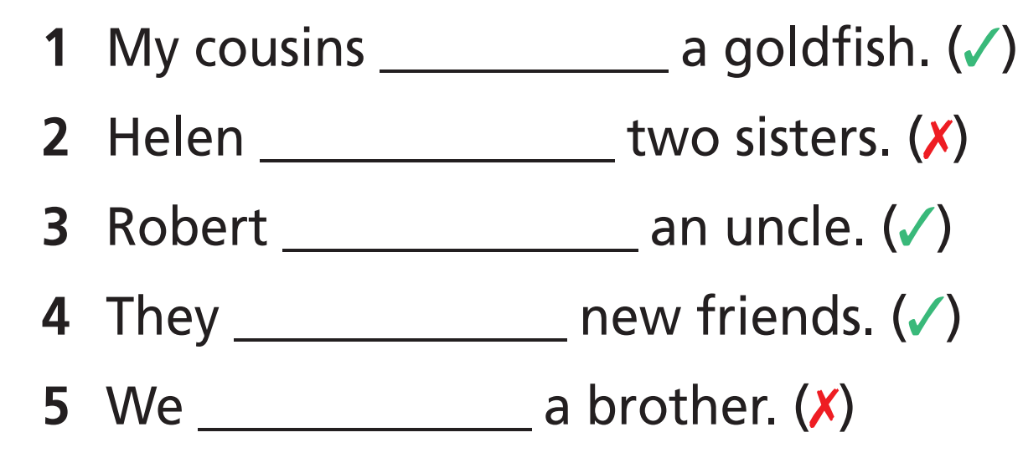
Fill in the gaps with has got, have got, hasn’t got or haven’t got.
have got
hasn’t got
has got
have got
haven’t got

Slide 39

CONSOLIDATION

Slide 40
Work in groups of four. Make at least four sentences with “have got” or “haven’t got” about yourself.

Slide 41

WRAP-UP

Slide 42
Today’s lesson
Vocabularies
Sports
Character adjectives
Grammar
Have got
Structure to describe people

Slide 43
Homework
Practise the vocabularies and grammar and make sentences using them.
Do the exercises in TA 6 Right on WB (pp. 7, 8)
Do the exercises in TA 6 Right on Notebook (pp. 6, 7, 8)
Prepare the next lesson (pp. 12, 13, 14 SB)

Slide 44
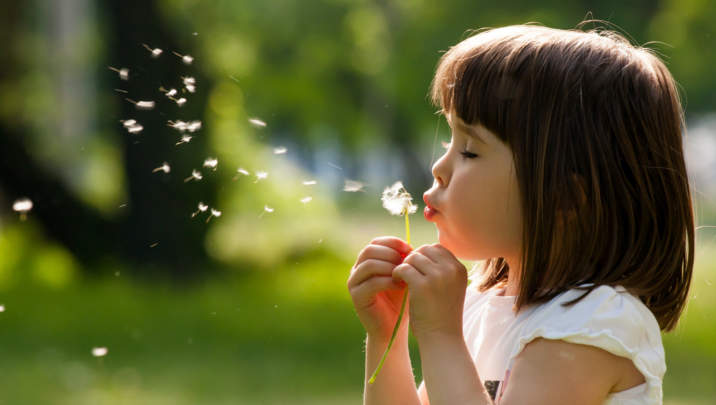
Enjoy your day!

