Slide 1

Unit 4: Holidays!
Lesson 4b: Grammar
Page 75

Slide 2
Lesson Outline
Warm-up
Grammar
Preposition
Consolidation
Wrap-up

Slide 3
Objectives
By the end of this lesson, students will be able to…
use the Present Continuous tense to ask and answer about actions happening now.
use prepositions of movement correctly.

Slide 4

WARM-UP

Slide 5
Work in groups
Sketches
Students work in 3-4 groups. The teacher distributes one card with a Present Continuous sentence about an action to each group (e.g. Two boys are playing football. / A boy is climbing a tree. / Two women are drinking coffee. / A man is teaching English. / A man is listening to music. etc.)
Each group draws a picture to describe that sentence. Groups then present the picture to the class and other groups volunteer to guess what that group has drawn by asking questions: Is he/she …..ing? / Are they…ing?
That group replies with short answers as appropriate (e.g. Yes / No). If one group successfully guesses what is happening in the picture, both the guessing group and the drawing group score one point. If not, none of them gets a point.
The team with the most points at the end of the game wins.

Slide 6

It’s time to learn …

Slide 7

The Present Continuous tense
Presentation

Slide 8
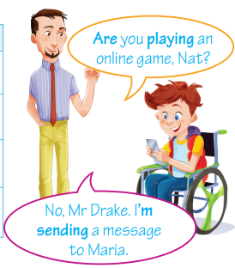
Look at the sentences and complete the rule for
The Present Continuous tense:
Am I writing the wrong answer?... No, I’m not.
Interrogative | Short answers
……. I sleeping? | Yes, I ………... No, I………….
………. you sleeping? | Yes, you …………. No, you …………….
…… he/ she/ it sleeping? | Yes, he/ she/ it ……….. No, he/ she/ it ………………
……… we/ you/ they sleeping? | Yes, we/ you/ they ………. No, we/ you/ they ………..
am
Am
‘m not
Is Tom eating pizza?
Are
are
aren’t
Yes, he is.
Is
is
isn’t
Are they using computers?
Are
are
aren’t
No, they aren’t. They are playing in the garden.

Slide 9
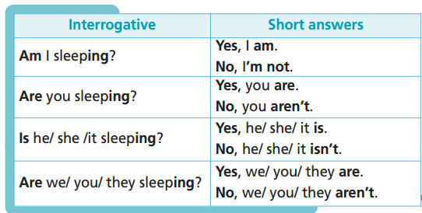
Remember:

Slide 10

Practice

Slide 11
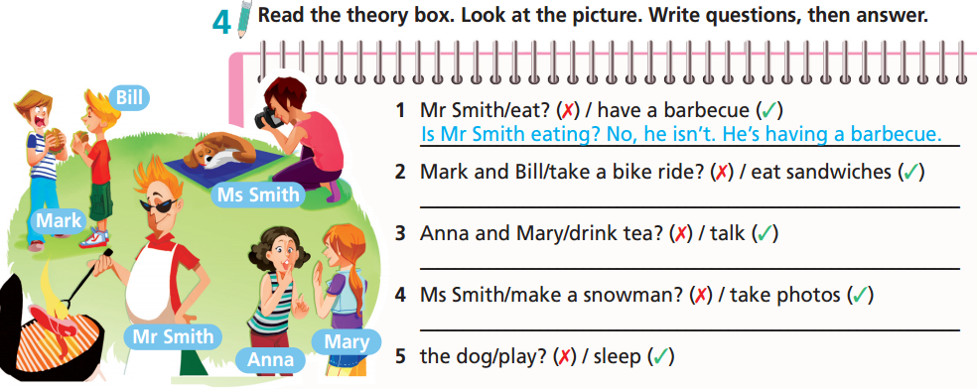
Are Mark and Bill taking a bike ride? No, they aren’t. They're eating sandwiches.
Are Anna and Mary drinking tea? No, they aren’t. They're talking.
Is Ms. Smith making a snowman? No, she isn't.
She's taking photos.
Is the dog playing? No, it isn't. It's sleeping.

Slide 12
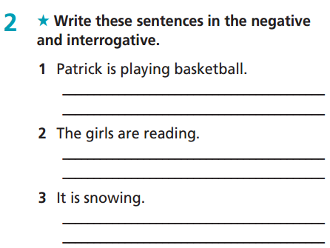
Extra Practice
WB page 39
Patrick isn’t playing basketball.
Is Patrick playing basketball?
The girls aren’t reading.
Are the girls reading?
It isn’t snowing.
Is it snowing?

Slide 13
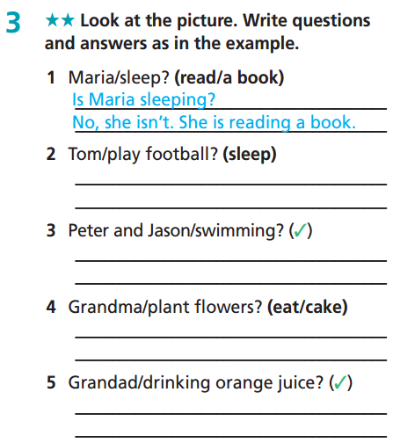
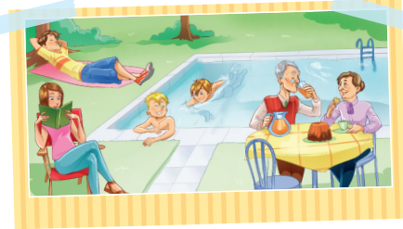
Extra Practice
WB page 39
Is Tom playing football?
No, he isn’t. He’s sleeping.
Are Peter and Jason swimming?
Yes, they are.
Is Grandma planting flowers?
No, she isn’t. She’s eating a cake.
Is Grandad drinking orange juice?
Yes, he is.

Slide 14
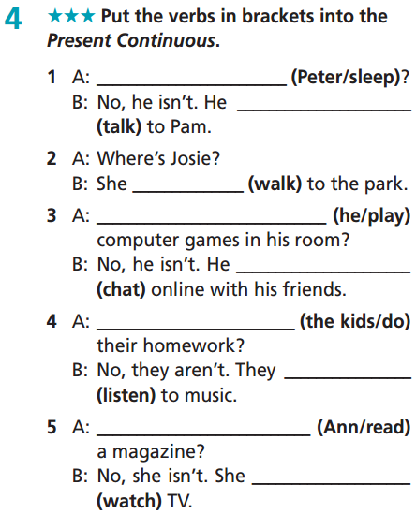
Extra Practice
WB page 39
Is Peter sleeping
is talking
is walking
Is he playing
is chatting
Are the kids doing
are listening
Is Ann reading
is watching

Slide 15
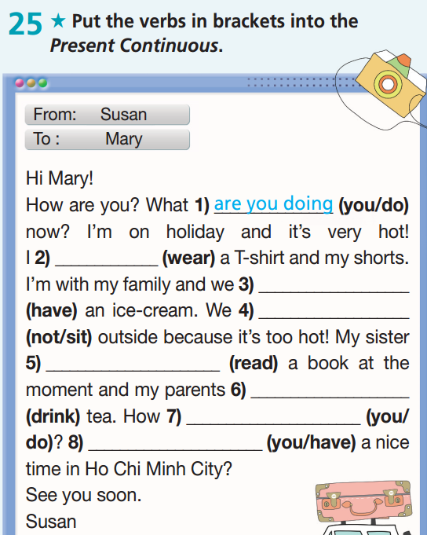
Extra Practice
Grammar bank page 69
am wearing
are having
are not sitting
is reading
are drinking
are you doing
Are you having

Slide 16
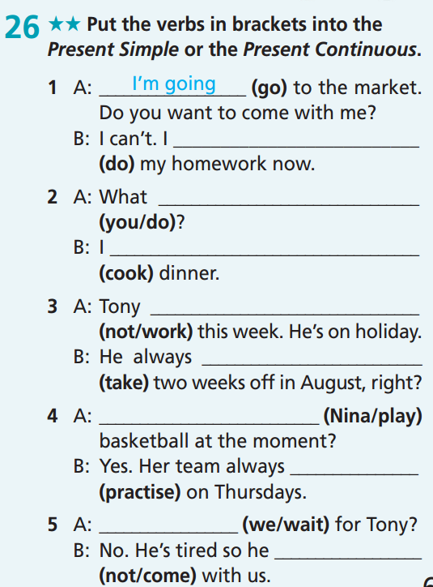

Extra Practice
Grammar bank page 69
am doing
are you doing
am cooking
isn’t working
takes
Is Nina playing
practises
Are we waiting
isn’t coming

Slide 17

Production

Slide 18
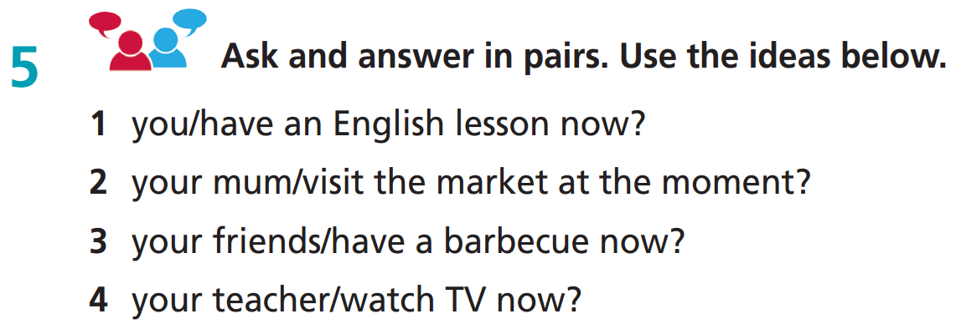
1. Are you having an English lesson now? Yes, I am.
2. Is your mum visiting the market at the moment? Yes, she is./ No, she isn’t.
3. Are your friends having a barbecue now? Yes, they are./ No, they aren’t.
4. Is your teacher watching TV now? Yes, he/she is./ No, he/she isn’t.

Slide 19

Work in pairs.
Extra Practice
Ask and answer about what the members of your friend’s family are doing now. Use the Yes/No questions and short answers.
Are your parents staying at home now?
No, they aren’t.
Is your grandmother cooking now?
Yes, she is.

Slide 20

Prepositions of Movement
Presentation

Slide 21
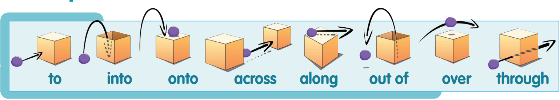
Find a suitable preposition for each picture
out of * into * across * through * over * along * to * onto

Slide 22
Remember:

Slide 23

Practice

Slide 24
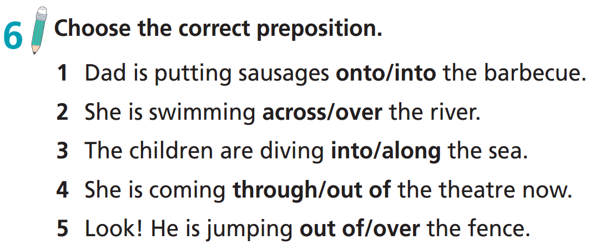

Slide 25
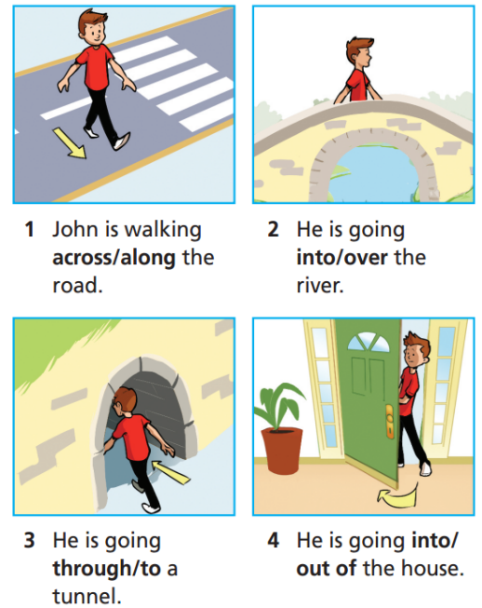

Extra Practice
WB page 39

Slide 26

Production

Slide 27
Extra Practice
Work in pairs
Take turns making sentences using the following prepositions:
e.g.
I go to school every day.
She dived into the water.
He put the books onto the shelf.
The boy is walking across the
street.
Minh is walking along the road.
The dog is trying to get out of the house.
The bird is flying over the flowers.
The girl is walking through the door.

Slide 28

CONSOLIDATION

Slide 29
Find someone who is…
Students walk around the class and ask their friends to find the person who has the information in each sentence. Students should use structures of Yes/No questions for Present Continuous tense and short answers. Who can finish first with more names is the winner.
Activities | Names
feeling hungry | Toan
feeling happy
reading a good book this month
……….. | ….
You: Are you feeling hungry?
Toan: Yes, I am.

Slide 30
Find someone who is….
Activities | Names
feeling hungry | Toan
feeling happy
reading a good book this month
learning a new sport
looking for a good film to watch
waiting for a message reply
learning to play a musical instrument (e.g. guitar, piano,…)
having problems with their family members / friend
You: Are you feeling hungry?
Toan: Yes, I am.

Slide 31

WRAP-UP

Slide 32
Today’s lesson
Grammar
use the Present Continuous to ask and answer about actions happening now.
use prepositions of movement correctly.

Slide 33
Homework
Practise vocabulary and grammar and make sentences using them.
Do the exercises in TA 6 Right on WB (p. 39).
Complete the grammar notes in TA 6 Right on Notebook (p. 40).
Prepare for the next lesson (p. 76 SB).

Slide 34

Enjoy your day!

