Slide 2



Review
3
LESSON 2: SKILLS
1

Slide 3
REVIEW 3 – LESSON 2: SKILLS
LESSON 1: GETTING STARTED
WARM-UP
Warm-up: Guess the sports
Reading:
Task 1: Read the two descriptions of strange sports and choose titles for them.
Task 2: Use the information from the passages above to tick the correct box.
Speaking: Task 3: Work in groups. Interview your classmates about their likes. Take notes of their answers and report to the class.
Listening: Task 4: Listen to a talk about Singapore and fill the missing information.
Writing: Task 5: Look at the information on Mark’s visit to India last summer. Write a paragraph of about 50 words about his visit.
READING
SPEAKING
LISTENING
WRITING
Wrap-up
Homework
CONSOLIDATION

Slide 4
WARM-UP
GUESS THE SPORTS
- Teacher divides the class into 4 big groups.
- Each group will guess the sports based on the given pictures along with the points they bet for each correct answer.
- The group which has the correct answer will get the point they bet and the group with the highest score will be the winner.
GUESS THE SPORTS

Slide 5
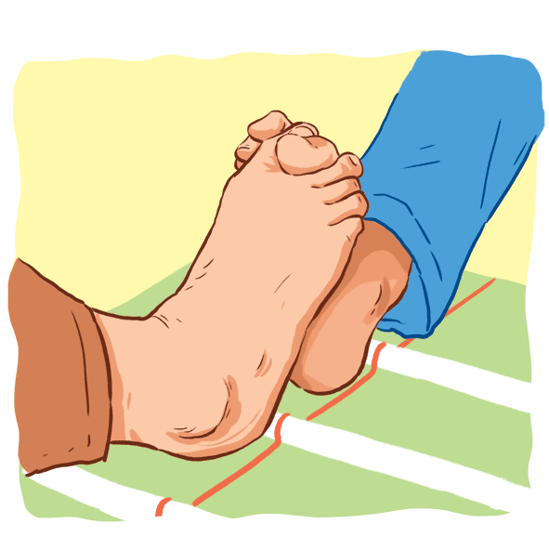
WARM-UP
GUESS THE SPORTS

Slide 6
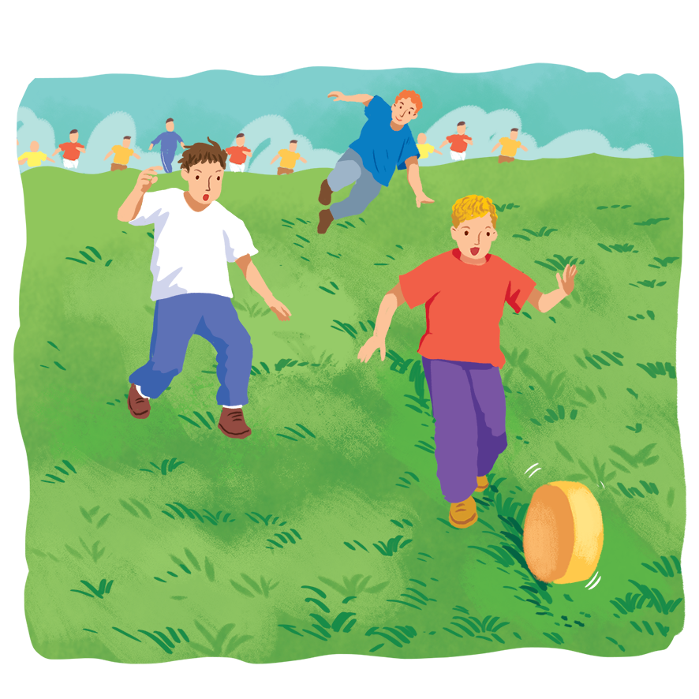
WARM-UP
GUESS THE SPORTS

Slide 7
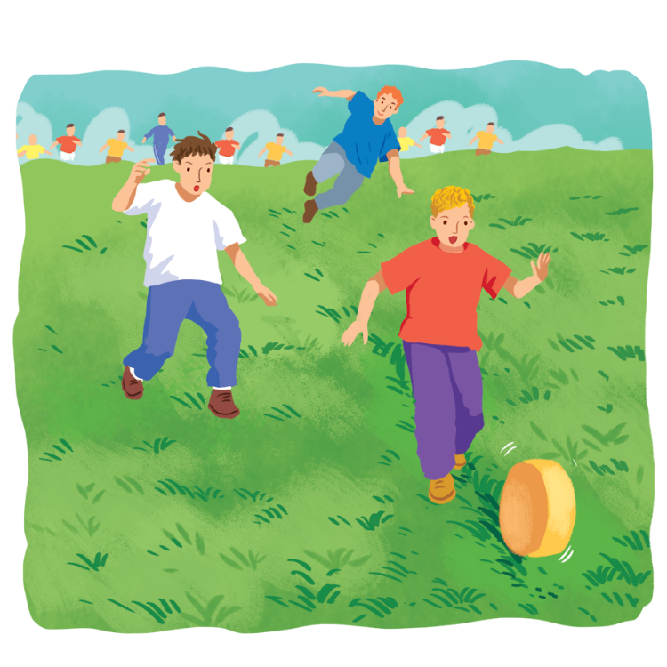
WARM-UP
GUESS THE SPORTS
Let’s check the answer in p.36!

Slide 8
REVIEW 3: LESSON 2
Reading
Strange sports

Slide 9

REVIEW 3
1
Read the two descriptions of strange sports and choose titles for them.
1.
Cheese Rolling
2.
Toe Wrestling
It’s a simple sport. Competitors roll a big round piece of cheese from the top of a hill. Competitors run after it and try to catch it. Very few people can catch it because it goes very fast, about 112 km an hour.
It’s a popular sport for children. This game started in Derbyshire in the North of England. Two children lock their toes together and try to push the other’s foot to the ground. It’s similar to arm wrestling.
A.
Toe Wrestling
B.
Cheese Rolling

Slide 10
REVIEW 3
2
Use the information from the passages above to tick () the correct box.
 | Toe Wrestling | Cheese Rolling
1. You need a hill to play this sport.
2. You use the lower part of the body for this sport.
3. It travels at about 112km/h.
4. Not many people can catch it.
5. It first started in England.






Slide 11
REVIEW 3: LESSON 2
Speaking

Slide 12
REVIEW 3
3
Work in groups. Interview your classmates about their likes. Take notes of their answers and report to the class.
Questions | Person 1 | Person 2
1. What city would you like to visit?
2. What sports do you like playing?
3. What TV programme do you like watching?

Slide 13
REVIEW 3: LESSON 2
Listening

Slide 14

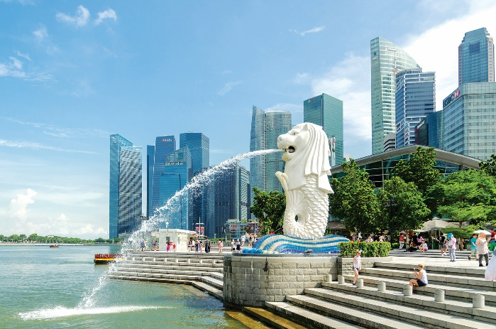
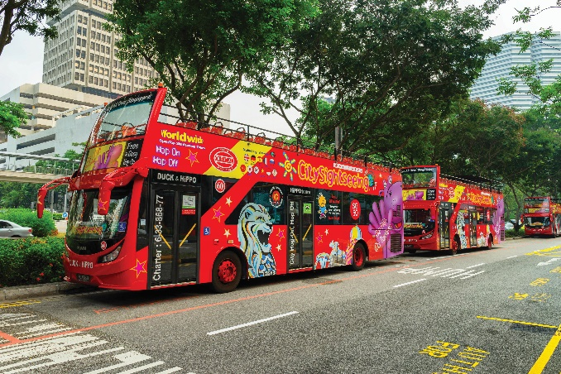
REVIEW 3
4
Listen to a talk about Singapore and fill the missing information.
Singapore attracts millions of (1)_______ every year.
A hop-on hop-off bus goes (2)_____ around the city.
The cost of the tour is (3) ___ dollars.
The bus comes every (4) ____ minutes.
This tour is good for people with (5)____ time.
visitors
slowly
35
Merlion Park
30
little
Hop-on hop-off bus

Slide 15
REVIEW 3
4
AUDIO SCRIPT
Singapore is a small island city-state. It attracts millions of visitors every year. A good way to see the city is by taking a hop-on hop-off bus. The bus goes slowly around the city. It stops at different attractions like Chinatown and Merlion Park. You can get off the bus at any place, and then get on the next bus. The tour costs 35 dollars, and there is a bus every 30 minutes. This kind of sightseeing is good for people with little time in the city.

Slide 16
REVIEW 3: LESSON 2
Writing

Slide 17
REVIEW 3
5
Look at the information on Mark’s visit to India last summer. Write a paragraph of about 50 words about his visit.
Last summer, Mark visited Delhi in India.
He _____________________________.
You can start with:
Country/City | India/Delhi
Time | 7 days
Activities | Watch a snake performance Visit temples Eat street food
People | friendly
Weather | hot

Slide 18






Website: hoclieu.vn
Fanpage: facebook.com/www.tienganhglobalsuccess.vn/

