Slide 1







UNIT 2.
MY HOUSE

Slide 2

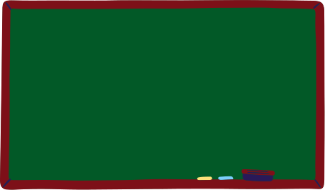




PART 1. THEORY

Slide 3
I. VOCABULARY

Slide 4
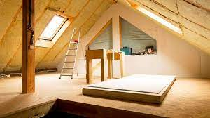
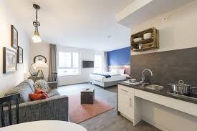

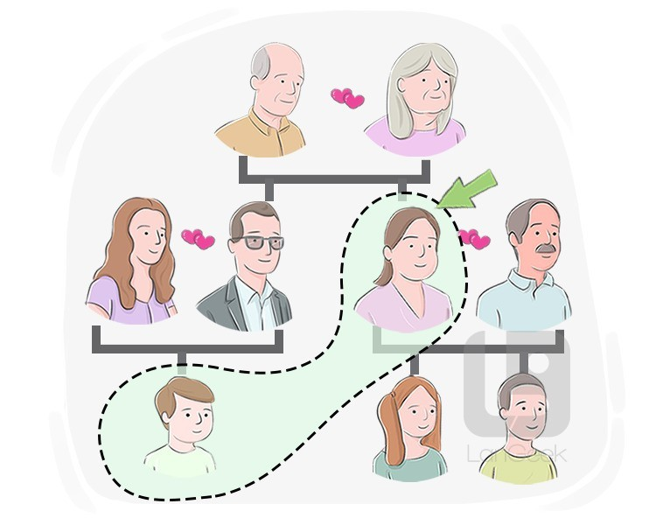
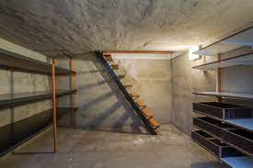

1. apartment (n):
2. attic (n):
/'ætɪk/
tầng gác mái
/ə'pɑːtmənt/
căn hộ chung cư
3. aunt (n):
4. basement (n):
/'beismənt/
tầng hầm
/ɑːnt/
cô, dì, thím, mợ

Slide 5
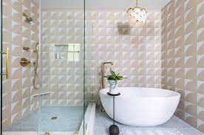
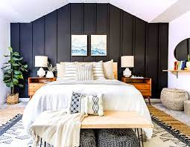
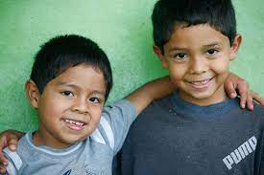
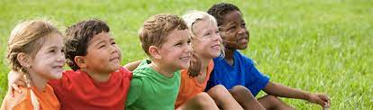
5. bathroom (n):
6. bedroom (n):
/'bedru:m/
phòng ngủ
/'bɑːθ ru:m/
phòng tắm
7. brother (n):
8. children (n):
/'brʌðə(r)/
anh/em trai
/'tʃɪldrən/
trẻ con

Slide 6
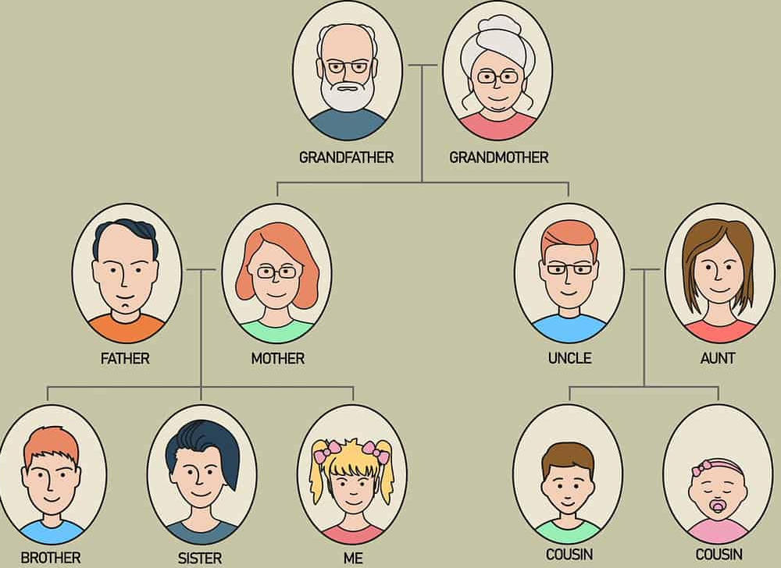
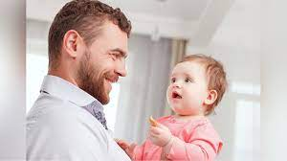
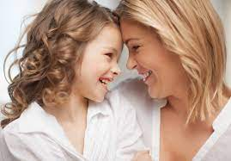
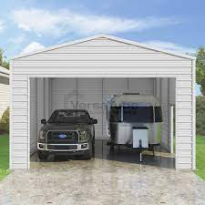
9. cousin (n):
/'kʌzn/
anh, em họ
10. dad (n):
/dæd/
bố
11. daughter (n):
/'dɔːtə (r)/
con gái
12. garage (n):
/'gærɑːʒ/
nhà xe

Slide 7
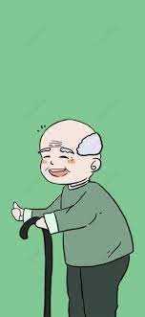
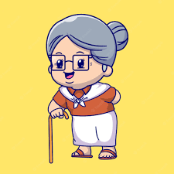
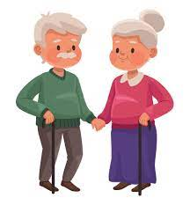
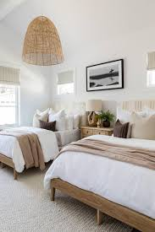
13. grandma/ grandmother (n):
14. grandpa/
grandfather (n):
/'grænmɑː/
/'grænmʌðə(r)/
bà
/'grænpɑː/
/'grænfɑːðə(r)/
ông
15. grandparents (n):
16. guest room (n):
/gest ru:m/
phòng ngủ
dành cho
khách
/'grænpeərənts/
ông bà

Slide 8
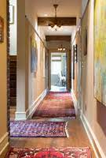
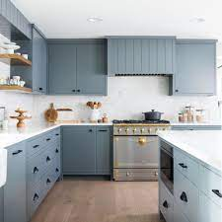
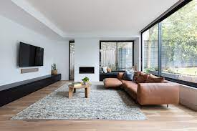
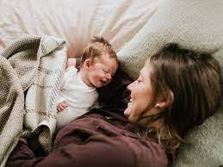
17. hall (n):
/hɔːl/
đại sảnh
18. kitchen (n):
/’kɪtʃɪn/
nhà bếp
19. living room (n):
20. mum (n):
/'lɪvɪη ru:m/
phòng khách
/mʌm/
mẹ

Slide 9

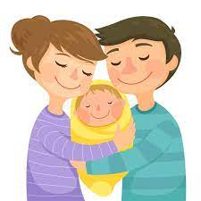

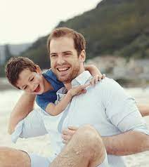
21. palace (n):
/'pæləs/
cung điện
22. parents (n):
/'peərənts/
bố mẹ
23. sister (n):
24. son (n):
/'sɪstə(r)/
chị, em gái
/sʌn/
con trai

Slide 10
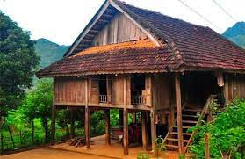
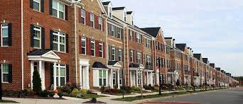
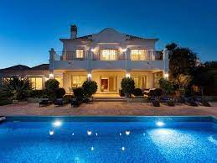
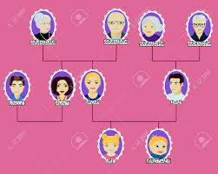
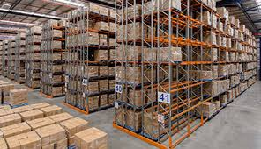
25. stilt house (n):
26. townhouse (n):
/taʊn haʊs/
nhà ở
thành phố
/stɪlt haʊs/
nhà sàn
28. villa (n):
/'vɪlə/
biệt thự
27. uncle (n):
/'ʌηkl/
chú, bác, cậu
29. warehouse (n):
/'weəhaʊs/
nhà kho, kho chứa đồ

Slide 11
apartment
attic
aunt
basement
bathroom
bedroom
brother
children
cousin
dad
daughter
garage
grandma/ grandmother
grandpa/ grandfather
grandparents
guest room
hall
kitchen
living room
mum
palace
parents
sister
son
stilt house
townhouse
uncle
villa
warehouse

Slide 12
VOCABULARY CHECK
https://wordwall.net/resource/36125965
https://wordwall.net/resource/36453346
https://wordwall.net/resource/15048447

Slide 13
II. GRAMMAR

Slide 14





1. Possessive case (Sở hữu cách)
a. Định nghĩa sở hữu cách
Sở hữu cách được dùng để diễn tả sự sở hữu của một người hay một nhóm người đối với một vật hay nhiều đồ vật nào đó.
b. Công thức chung của sở hữu cách
Thông thường, ta thành lập dạng sở hữu cách bằng cách thêm 's vào sau một danh từ.
Ex. My father’s table = The table of my father: cái bàn của bố tôi
Tom's mother = The mother of Tom: mẹ của Tom

Slide 15
c. Một số trường hợp khác:
- Với danh từ số nhiều không tận cùng là s, ta thêm 's.
Ex. The children's toys = The toys of the children: Đo chơi của trẻ em
- Với danh từ là số nhiều có tận cùng là s, ta chỉ thêm dấu phẩy (’).
Ex. Students’ library = The library of students (Thư viện của sinh viên)
- Nếu có hai người cùng sở hữu một vật gì đó, ta chỉ thêm 's cho danh từ thứ hai.
Ex. Mai and Long’s car. (Xe hơi của Mai và Long)

Slide 16
GRAMMAR CHECK
https://wordwall.net/resource/57693916
https://wordwall.net/resource/37349406
https://wordwall.net/resource/10062270

Slide 17
2. Preposition of place (Giới từ chỉ vị trí)
- Giới từ chỉ vị trí là một trong những loại giới từ thường gặp nhất trong tiếng Anh. Nó dùng để chỉ vị trí của một người hoặc một vật so với vị trí của một người khác hoặc vật khác.
Ex. The cat is on the bed. (Con mèo ở trên giường.)
The birds are in the cage. (Những con chim ở trong cái lồng.)

Slide 18
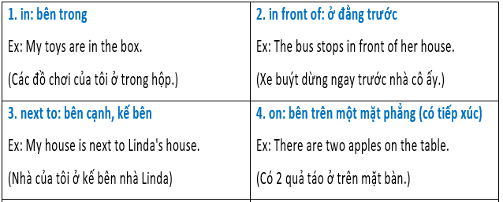
- Một số giới từ chỉ vị trí thường gặp:

Slide 19
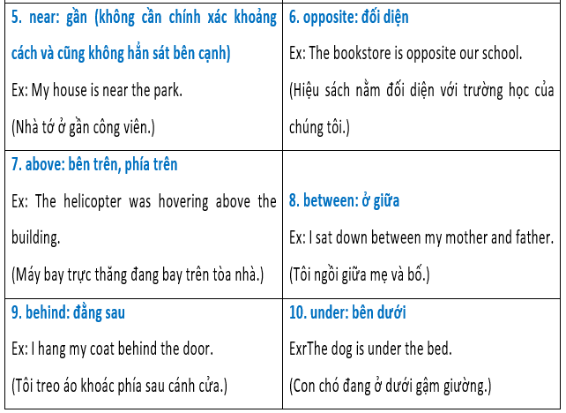

Slide 20
GRAMMAR CHECK
https://wordwall.net/resource/37378587
https://wordwall.net/resource/23092577
https://wordwall.net/resource/34938578

Slide 21
III. PHONETICS

Slide 22
 Cách phát âm âm đuôi s, es trong tiếng Anh.
Có 3 cách phát âm âm đuôi s và es như sau:
Cách 1. Phát âm là /s/ khi tận cùng từ là âm -p, -f, -k, -t.
Cách 2. Phát âm là /iz/ khi tận cùng từ là âm -s, -ss, -z, -o, -ge, -ce, -ch, -sh.
Cách 3. Phát âm là /z/ với các âm còn lại.

Slide 23
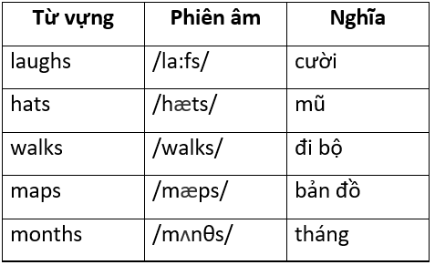
Cụ thể như sau:
✓ Cách 1. Phát âm là /s/ khi từ có tận cùng là các âm /f/, /t/, /k/, /p/, /θ/. Và thường là các chữ cái: -f, -t, -k, -p và -th.

Slide 24
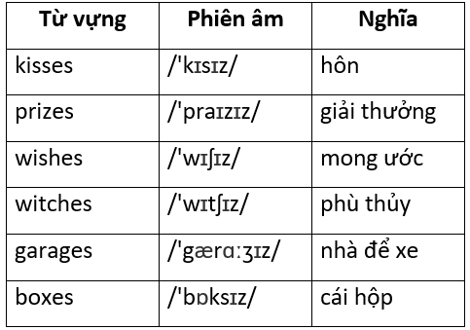
✓ Cách 2. Phát âm là /iz/ khi từ có tận cùng là các âm: /s/, /z/, /ʃ/, /tʃ/, /dʒ/, /ʒ/. Và thường là các chữ cái -sh, -ce, -s, -ss, -z, -ge, -ch, -c.

Slide 25
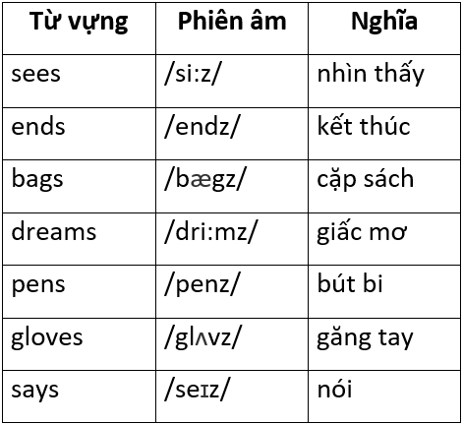
✓ Cách 3. Phát âm là /z/ khi từ có tận cùng là một âm hữu thanh. Hay để dễ nhớ hơn thì ngoài 2 trường hợp bên trên, s đều phát âm là /z/.

Slide 26
PART 2. LANGUAGE

Slide 27
I. VOCABULARY

Slide 28



Exercise 1. Find the word which does not belong to the group.
1. A. sofa B. chair C. toilet D. table
2. A. flat B. school C. town house D. villa
3. A. bed B. lamp C. fan D. Villa
4. A. aunt B. uncle C. grandmother D. teacher
5. A. cousin B. mother C. father D. Brother

Slide 29
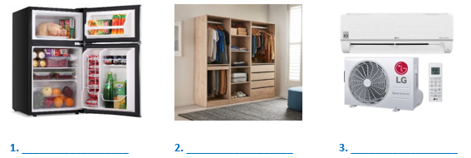
Exercise 2. Look at the picture and write the correct word under each picture.
fridge
wardrobe
air conditioner

Slide 30
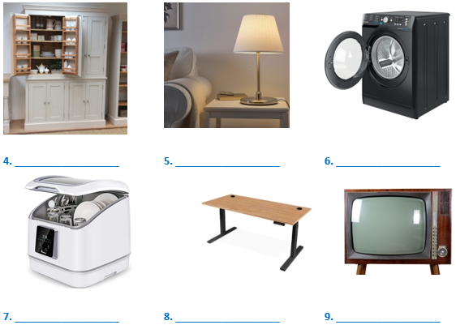
cupboard
lamp
washing machine
dishwasher
desk
television

Slide 31
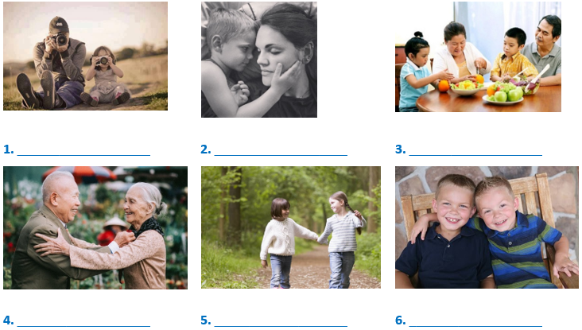
Exercise 3. Look at the picture and write the family members.
father and daughter
mother and son
grandparents and children
grandpa and grandma
SSisters
brothers

Slide 32
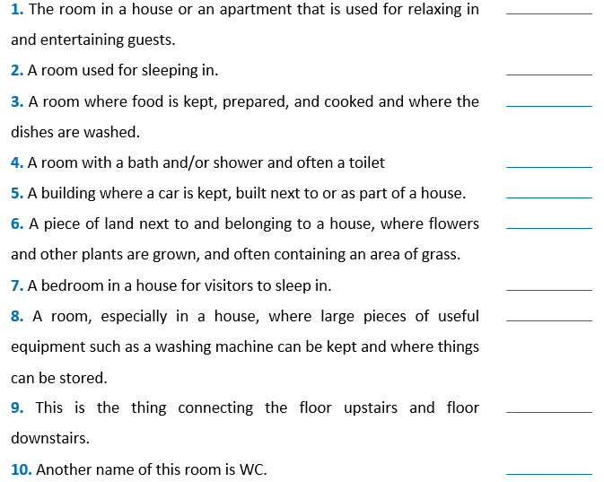
Exercise 4. Put the words/ phrases into their correct explanation.
kitchen
utility room
guest room
toilet
garden
bathroom
garage
bedroom
staircase
living room

Slide 33
Exercise 5. Choose the best answer to complete each of the following sentences.
1. There ____________ a restaurant around the corner.
A. be B. are C. to be D. is
2. Your keys are ____________ the table.
A. from B. over C. on D. in
3. There ____________ two people waiting outside.
A. are B. is C. be D. isn’t
4. The men were standing ____________ the roof.
A. with B. on C. under D. in
5. There ____________ three Japanese students in my class.
A. be B. is C. are D. isn’t
6. I left keys ____________ the car.
A. my – in B. my – over C. mine – in D. mine – over

Slide 34
Exercise 5. Choose the best answer to complete each of the following sentences.
7. The cat________ the table.
A. are between B. is between C. are under D. is under
8. There ____________ a new café ____________ the centre of town.
A. is – in B. is – on C. are – in D. are – on
9. There ____________ two new buildings ____________ the school.
A. are - under B. is – under C. are - next to D. is - next to
10. I hung ____________ coat ____________ the door.
A. me-in B. my-in C. me-behind D. my-behind
11. Turn on the ____________, please. It’s so hot in here.
A. cupboard B. dishwasher C. air conditioner D. lamp
12. I ____________ an ____________ with three friends in Ha Noi.
A. share - apartment B. move – attic
C. share - furniture D. move - country house

Slide 35
Exercise 5. Choose the best answer to complete each of the following sentences.
13. I put my clothes in the ____________ at the corner of my bedroom.
A. chest of drawers B. hall C. kitchen D. wall
14. You must be ____________ to lend him your motorbike. He’s very careless.
A. crazy B. attic C. interesting D. care
15. - Where should we go to buy some clothes, fruits and food?
- In ____________.
A. a hall B. a living room
C. a department store D. a stilt house
16. Don't run the ____________ half empty. It wastes energy.
A. dishwasher B. kitchen C. wardrobe D. sink
17. Would you mind helping me hang this dress in the ____________?
A. sofa B. sink C. wardrobe D. vase
18. A ____________ is a piece of electrical equipment to store food and keep food cold or fresh.
A. fridge B. dishwasher C. microwave D. cooker

Slide 36
II. GRAMMAR

Slide 37
Exercise 1. Complete the sentences with the correct possessive form
of the word in brackets.
1. ____________ mother is my teacher of English. (Mai)
2. Is it ____________ study room? (Nam)
3. My _______________ bedroom is my favourite room in our house. (grandmother)
4. My ____________ father is my uncle. (cousin)
5. Look! ____________ dog is running in the park. (Tom)
6. There is a cat behind my ____________ computer. (sister)
Mai's
Nam's
grandmother's
cousin's
Tom's
sister's

Slide 38
Exercise 2. Fill the gaps with the possessive case of nouns.
Peter's
1. This is ____________ book. (Peter)
2. Let’s go to the ____________ (Smiths)
3. The ____________ room is upstairs. (children)
4. ____________ sister is twelve years old. (John)
5. ____________ and ____________ school is old. (Susan - Steve)
6. ____________ shoes are on the second floor. (men)
7. My ____________ car was not expensive. (parents)
8. ____________ CD player is new. (Henry)
9. This is the ____________ bike. (boy)
10. These are the ____________ pencils. (boys)
Smiths'
children's
John's
Susan
Steve's
Men's
parents'
Henry's
boy's
boys'

Slide 39
Exercise 3. Complete the sentence with the correct preposition in, on or at.
in
1. I’ve got a computer ______ my bedroom.
2. Do you live _______ a house or an apartment?
3. He is sitting _______ a sofa ______ the corner of the sitting room.
4. There is such a mess _____ the kitchen!
5. The dog is sleeping _______ the carpet.
6. We live ______ the 3rd floor _____ 53 Pine Street ______ London.
7. Jane is waiting for a bus ______ the bus stop.
8. Are there any pictures ______ the walls ______ the living room?
9. We are staying ______ the Royal Hotel ______ New York City.
10. My camera is ______ a box ______ a shelf _____ the bedroom closet.
in
on
in
in
on
on
at
in
at
on
in
at
in
in
on
in

Slide 40
Exercise 4. Circle the correct preposition.
1. Don't sit in/ on/ under this stool. It’s broken.
2. My grandma is sitting in/ on/ at the armchair on/ next/ beside the fireplace.
3. Simon likes to stay in/ on/ at bed all Sunday morning.
4. We live on/ in/ at an apartment on/ at/ into a very busy road.
5. I put my book in/ on/ over the table in/ at/ on the dining room.
6. There is a clock under/ next to/ above the teacher’s desk.
7. He always hides the key on /at/ under the box.
8. Mary is sitting under/ between/ behind her parents. They are watching TV.
9. On a bus, passengers sit in front of/ behind/ between the driver.
10. You can see the children's books in/ on/ at the bookshelf to/ at/ in the corner.

Slide 41
Exercise 5. Choose the best preposition to complete the sentence.
1. I eat ____________ home with my family.
A. at B. in C. on D. beside
2. May ____________ comes April.
A. before B. after C. from D. against
3. There is a clock ____________ the wall in class.
A. near B. across C. on D. at
4. "Where is Susan?” - "She is sitting ____________ Jim."
A. on B. under C. Between D. next to
5. We’re studying ____________ Sai Gon University.
A. at B. in C. of D. from

Slide 42
Exercise 5. Choose the best preposition to complete the sentence.
6. There are 40 students ____________ the class.
A. inside B. in C. at D. over
7. My pen is ____________ the books and the computer.
A. among B. down C. up D. between
8. I saw a mouse ____________ the chair.
A. among B. between C. in D. behind
9. My house is ____________ to the hospital.
A. close B. near C. opposite D. across
10. We come ____________ Viet Nam.
A. in B. above C. from D. below

Slide 43
Exercise 5. Choose the best preposition to complete the sentence.
11. There are two students ____________ the class.
A. next B.in C. on D. Front
12. The oranges are not in the basket. They are ____________ the table.
A. in B. between C. next D. on
13. My pencil is ____________ the books and the notebooks.
A. between B. in C. on D. next
14. The red car is ____________ of the house.
A. behind B. in front C. next to D. under
15. There isn’t anything ____________ my pocket.
A. between B. next to C. in D.near

Slide 44
Exercise 5. Choose the best preposition to complete the sentence.
16. Some students are waiting in ________ the classroom.
A. next to B. front of C. between D. under
17. Our house is ____________ to the supermarket.
A. in B. on C. behind D. next
18. Oh my God! I saw a mouse ____________ the sofa.
A. behind B. in C. next D. between
19. There is a big supermarket ____________ the park.
A. on B. near C. in front D. next
20. The children are playing ____________ the garden.
A. on B. between C. in D. to

Slide 45
III. PHONETICS

Slide 46
Exercise 1. Find the word which has a different sound in the part underlined.
Then say the words aloud.
1. A. boys B. lessons C. cats D. pictures
2. A. places B. messages C. houses D. clothes
3. A. sinks B. bags C. laptops D. students
4. A. fridges B. kisses C. watches D. wardrobes
5. A. plates B. posters C. trees D. songs

Slide 47
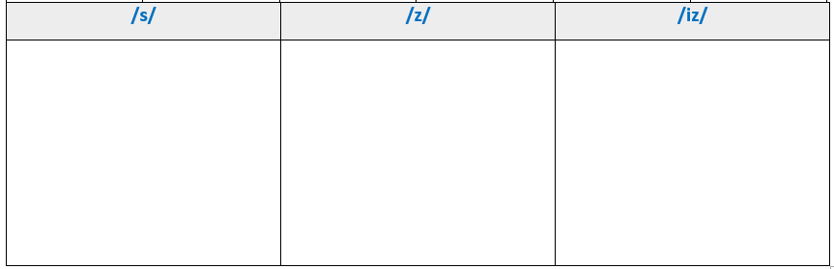
Exercise 2. Add "s/es" after each verb then divide them into three columns.
work
push
reply
kick
teach
hope
fix
miss
sing
drink
crash
type
go
keep
give
roof
speak
meet
cry
drop
buzz
finish
ship
pass
sit
hold
catch
draw
brush
change
works
kicks
hopes
replies
sings
goes
pushes
teaches
fixes
drinks
types
keeps
gives
cries
holds
misses
crashes
roofs
speaks
meets
draws
buzzes
finishes
drops
ships
sits
passes
catches
brushes
changes

Slide 48
PART 3.
COMMUNICATION SKILLS

Slide 49
I. LISTENING

Slide 50
Exercise 1. Listen and complete the sentences.  Track 03
1. Many ____________ are very noisy.
2. The speaker ____________ hears her neighbors.
3. A lot of houses have a ___________ to enjoy the free time.
4. Most apartments are ____________ than houses.
5. You feel more relaxed when you live in a big ____________.
apartments
never
yard
smaller
house

Slide 51
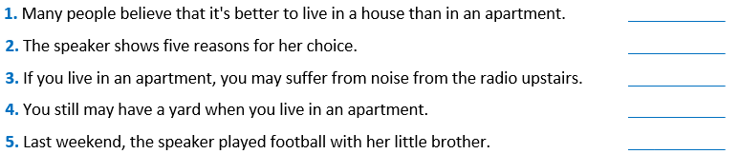
Exercise 2. Listen again and decide if each statement is True (T) or False (F).
 Track 04
T
F
F
F
T

Slide 52
II. SPEAKING

Slide 53
Exercise 1. Complete the conversation with the verbs below
and then practice it with your classmates.
watching
helping
going
doing
writing
Conversation 1
David: What are you doing on Saturday, Susan?
Mary: Nothing much. I’m (1) ____________ some old DVDs.
David: Aren’t you going to the cinema?
Mary: No, there's nothing new. What are you doing?
David: I'm (2) ____________ to the city centre with some friends.
Mary: Sounds good. Can I come?
David: Sure! Good idea!
Conversation 2
Peter: What are you (3) ____________ this evening?
Anna: I'm (4) ____________ my essay for English.
Peter: Really?
Anna: Why don't you do your essay too? We could help each other.
Peter: I'm sorry, I can’t. I'm (5) ____________ my dad with his new computer.

Slide 54
Exercise 2. Complete the conversation with available sentences.
Bill: OK, Julia, we are going to talk about your house.
Julia: What would you like to know?
Bill: (1) ____________?
Julia: I live in a big detached house.
Bill: A big house. Really? (2) ____________?
Julia: About 12.
Bill: It's big indeed! Is it a new house or an old house?
Julia: (3) ____________
Bill: (4) ____________? In the country or in the city?
Julia: In a country village.
Bill: (5) ____________?
Julia: It has got two floors: the ground floor and the first floor. There's also an attic and a basement.
Bill: Do you like your house?
Julia: Yes. I do. My house is small but beautiful.
A. It's about 80 years old
B. How many floors has it got
C. How many rooms has it got
D. Do you live in a big or a small house
E. Where is your house located
D
C
A
E
B

Slide 55
III. READING

Slide 56
☞ Read and do the tasks followed.
HOUSES
There are houses all over the world. Some houses are large. Some are small. Some are made of wood. Some are made of rock. People usually build their houses with something that is easy to find. For example, there are many trees in a forest. So people who live there might build a house made of logs.
Some houses have one room. Some houses have many rooms. There is usually a bedroom for sleeping, a kitchen for cooking, a living room for sitting and talking. There is usually a bathroom. Some houses have attics. The attic is above the main part of the house. Most houses have a door so people can enter and exit the house. Most houses have windows so the people can look outside.
Houses look very different in different parts of the world. But, people who live in a house probably all agree that there is no place like home!

Slide 57
Exercise 1a. Choose the correct answer.
1. Why are many forest houses made of logs?
A. There are many logs in the forest.
B. Trees are easy to find in the forest.
C. There is a lot of wood in the forest.
D. All of the above
2. According to your opinion, where do you think there are rock houses?
A. Near the sea B. Near the forest. C. Near the mountain D. Near the city
3. Why do houses have bedrooms?
A. For sleeping B. For cooking C. For relaxing D. For building things
4. Where is the attic of a house?
A. Beside the house B. Above the house C. Under the house D. None of the above
5. What do people do in the living room?
A. They sleep. B. They take a bath C. They talk. D. They do gardening.

Slide 58
Exercise 1b. Complete the sentence.
1. Houses have ____________ so people can enter and exit.
2. Houses have ____________ to let people look outside.
3. A ____________ is a room for cooking.
4. An attic is a room or space just ____________ the roof of a house.
5. If people ____________, they feel the same way about something.
doors
windows
kitchen
below
agree

Slide 59
Exercise 2. Read the text below and write one word in each blank to complete it.
with
I live in a semi detached house (1) ____________ a large front garden and extra large front garden with about fourteen trees. I have a front room (2) ____________ a large kitchen with a utility room which used to be (3) ____________ outhouse and coal house, a hall, separate toilet and bathroom and three bedrooms upstairs. I have lived here (4) ____________ twenty six years, and (5) ____________ we moved here, my neighbours had been here since the houses were built a few years before. They (6) ____________ in their eighties now and we have got on with them. They (7) ____________ buy my children presents at Christmas and now buy for my grandchildren. I have been so lucky to (8) ____________ such good neighbours like them.
and
an
for
when
are
often
have

Slide 60
Exercise 3. Read the article about unusual houses, and do the task followed.
A house? A boat? A houseboat!
Pete and Karen Clay are from Kentucky. They have an unusual house. It’s a houseboat named Fargo. Their houseboat has a living room, a dining room, a kitchen, and a bathroom, and three bedrooms. The Clay’s children, Andy and Kris, love it. "It’s a cool house and a fun boat,” says Kris.
Up in a tree!
Grant Stone is 12, and his sister, Jenna, 8. They're only kids, but they have a house. It's a tree house! It's in the country. It’s at their grandparents’ house in Kansas. Their tree house has one room. It's a living room with a table and a few chairs. It's small, but Grant and Jenna think it's great. Grant says, "It’s my favourite place! That's the name - My Place.”

Slide 61
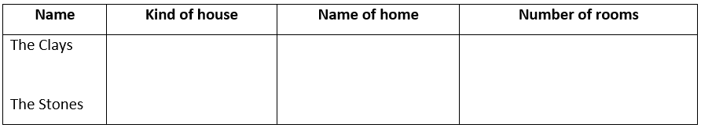
Read the article again. Then complete the chart.
A houseboat
Fargo
7
A tree house
My place
1

Slide 62
IV. WRITING

Slide 63
Exercise 1. Make sentences from the given words or phrases.
1. There/a bed/corner/the room.
→ There is a bed in the corner of the room.
2. Shelves/above/the closet.
→ The shelves are above the closet.
3. Wardrobe/the center/the room.
→ The wardrobe is in the centre of the room.
4. Table/ between/ two chairs.
→ The table is between the two chairs.
5. Lamp/ next/ the bed.
→ The lamp is next to the bed.

Slide 64
Exercise 1. Make sentences from the given words or phrases.
6. Table/ the right/ the wardrobe.
→ The table is on the right of the wardrobe.
7. There/ some pictures/ the wall.
→ There are some pictures on the wall
8. There/ a window/ the left-side/ the room.
→ There is a window on the left-side of the room.
9. Bed/ opposite/ the door.
→ The bed is opposite the door.
10. There/ some bottles/ the shelf.
→ There are some bottles on the shelf.

Slide 65
Exercise 2. Answer the question about your house.
1. What kind of house is it?
→ It is a two-floor house.
2. How many rooms are there?
→ There are five rooms.
3. Where is your bedroom?
→ It's on the first floor.
4. What is there in your bedroom?
→ There is a bed, a desk, a bookshelf and a wardrobe.
5. What is there in the living room?
→ There is a wireless TV, two armchairs, a coffee table and a houseplant.

Slide 66
Exercise 2. Answer the question about your house.
6. Which room do you like?
→ I like my bedroom.
7. Why do you like that room?
→ Because I can do many things there such as sleeping, studying, playing
8. Why do you like your house?
→ Because it is convenient.
9. What do you want to add in your room?
→ I want to add a mirror
10. Why do you want to add that thing?
→ Because I don't want to go to the bathroom every time I comb my hair.

Slide 67
Exercise 3. Write a paragraph (about 100 words) to describe your house.
The questions and answers in Exercise 2 are cues for you.
I live in a two-floor house with my parents in New York, USA. There are five rooms in the house: one living room, two bedrooms, a kitchen and a bathroom. My bedroom is on the first floor, next to my parents' bedroom. In my bedroom, there is a single bed, a desk, a bookshelf and a wardrobe for me to keep my clothes. This is the room I love the most because I can do many things there such as sleeping, studying, playing and even having meals sometimes. However, I would like to have a mirror in my room. I really do not want to go to the bathroom every time I comb my hair.

Slide 68






Thank you for Listening!

Slide 69





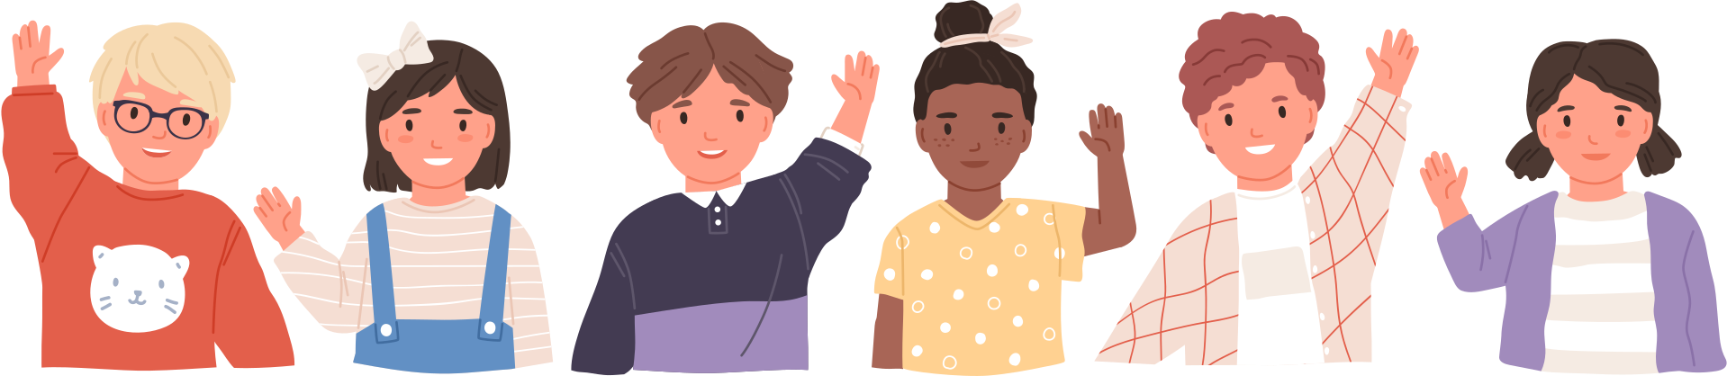
See you next time!

