Slide 1

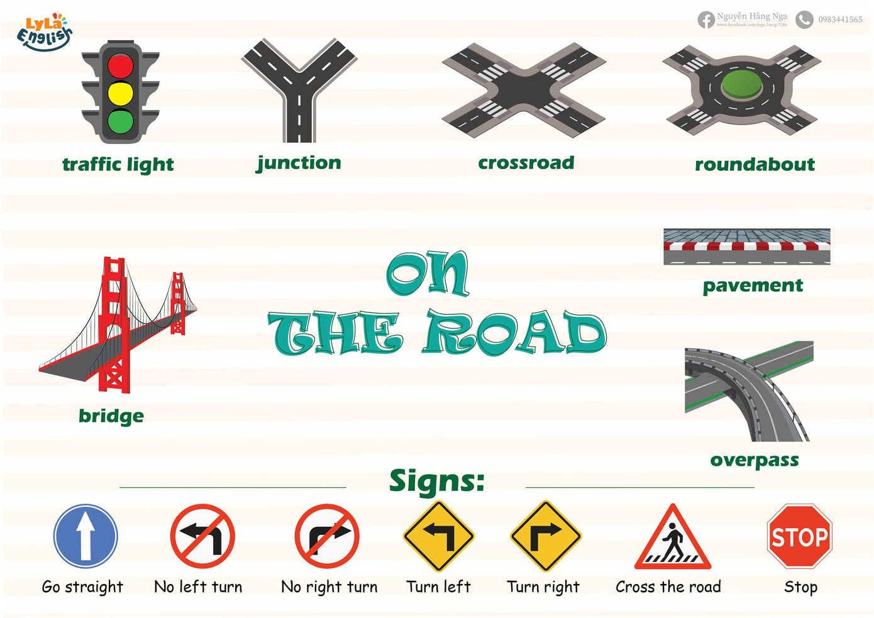


Slide 2
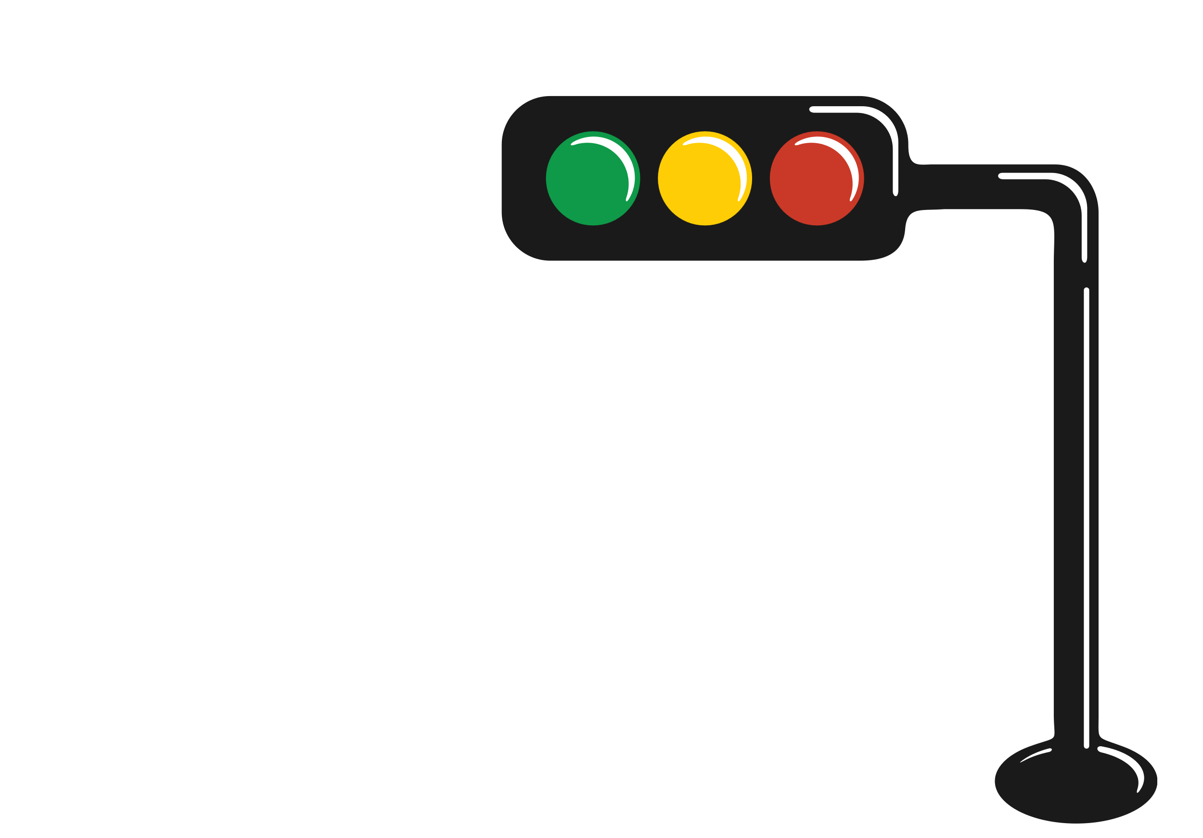
I. QUESTION
1.What is it? - It’s a ...
2. How may lights are there? What are they?
- There ... lights:
3. What shape are they?
-They are ...
4. What do you do when you see the traffic light?
- ... is stop.
- ... is slow
- ... is go.

Slide 3
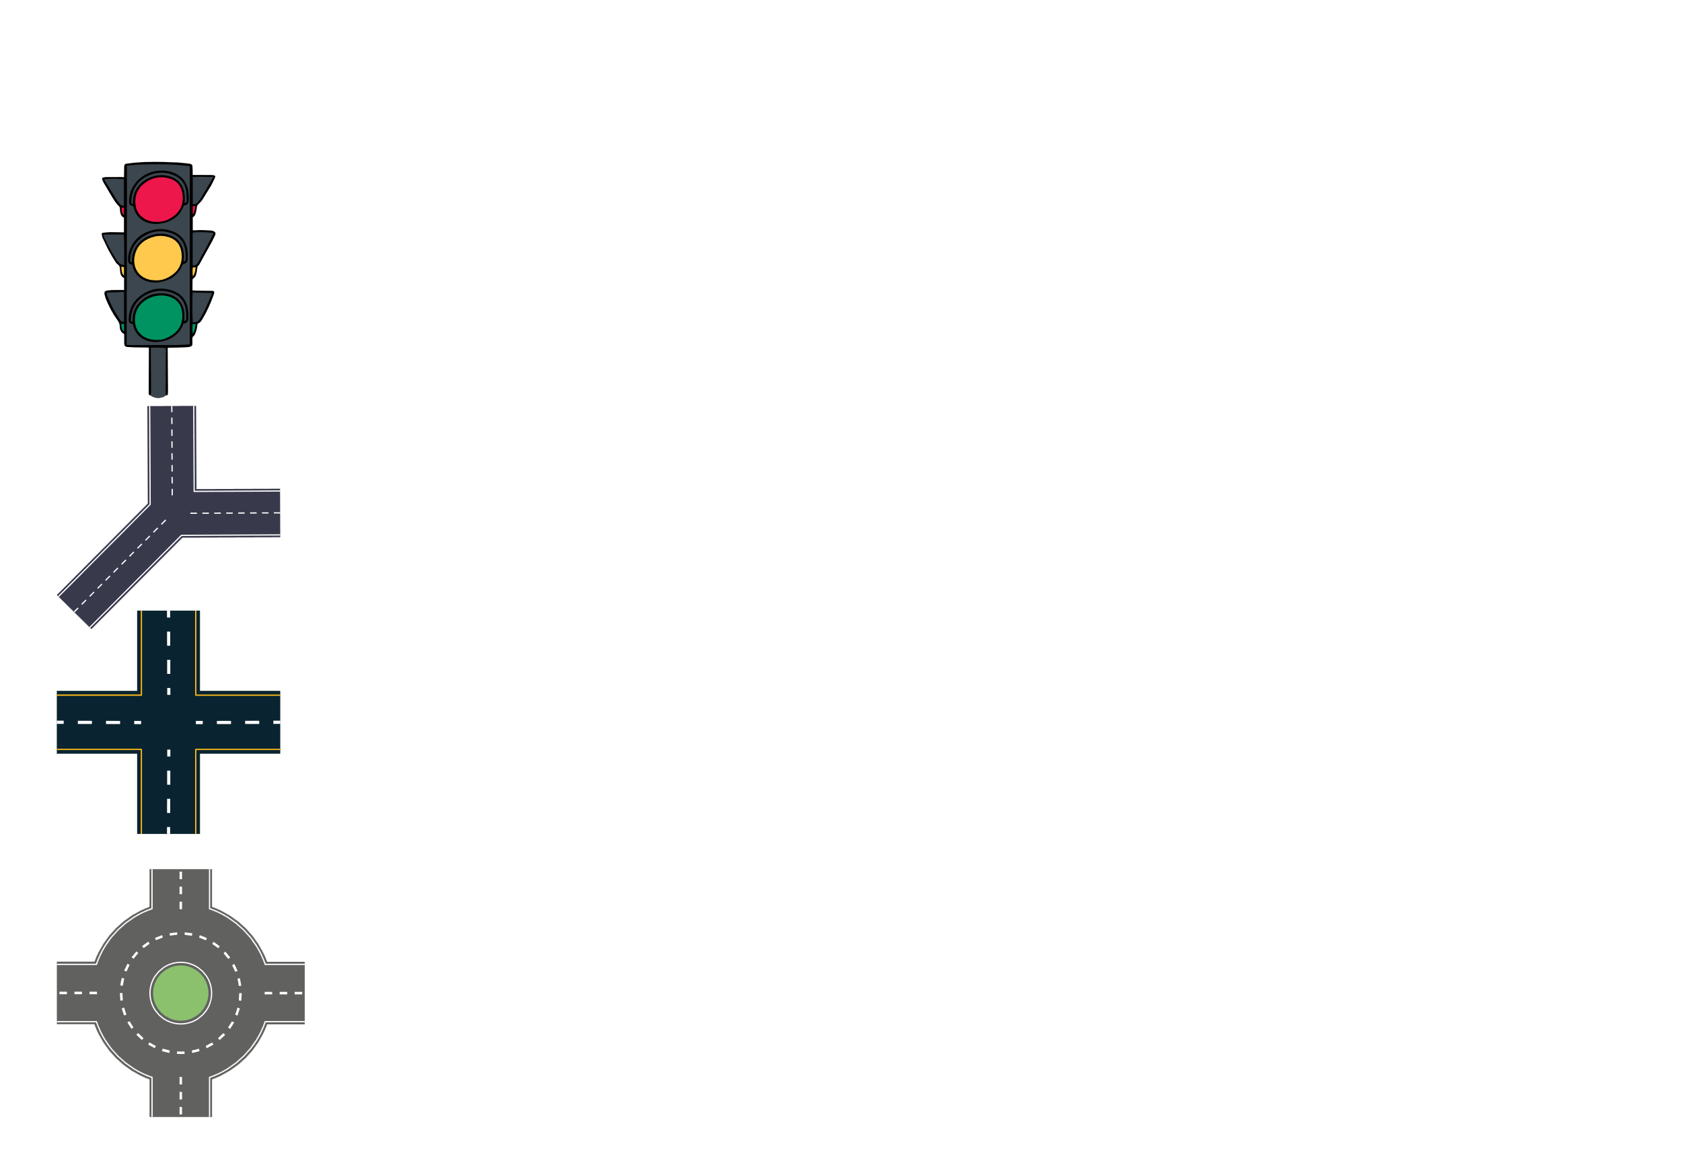
II. VOCABULARY
Traffic light:.....................................................
Junction:........................................................
Crossroad:.......................................................
Roundabout:....................................................

Slide 4

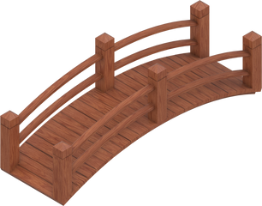
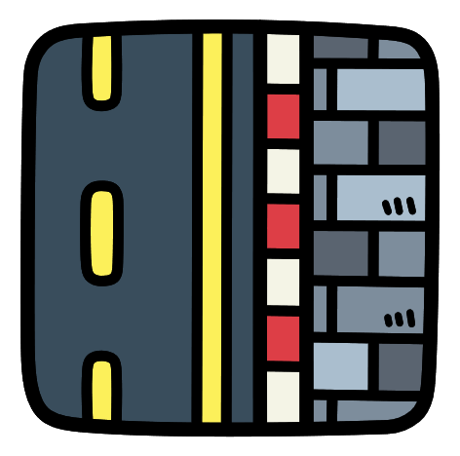
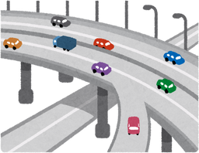
II. VOCABULARY
Bridge:..........................................................
Pavement:.....................................................
Overpass:.......................................................

Slide 5
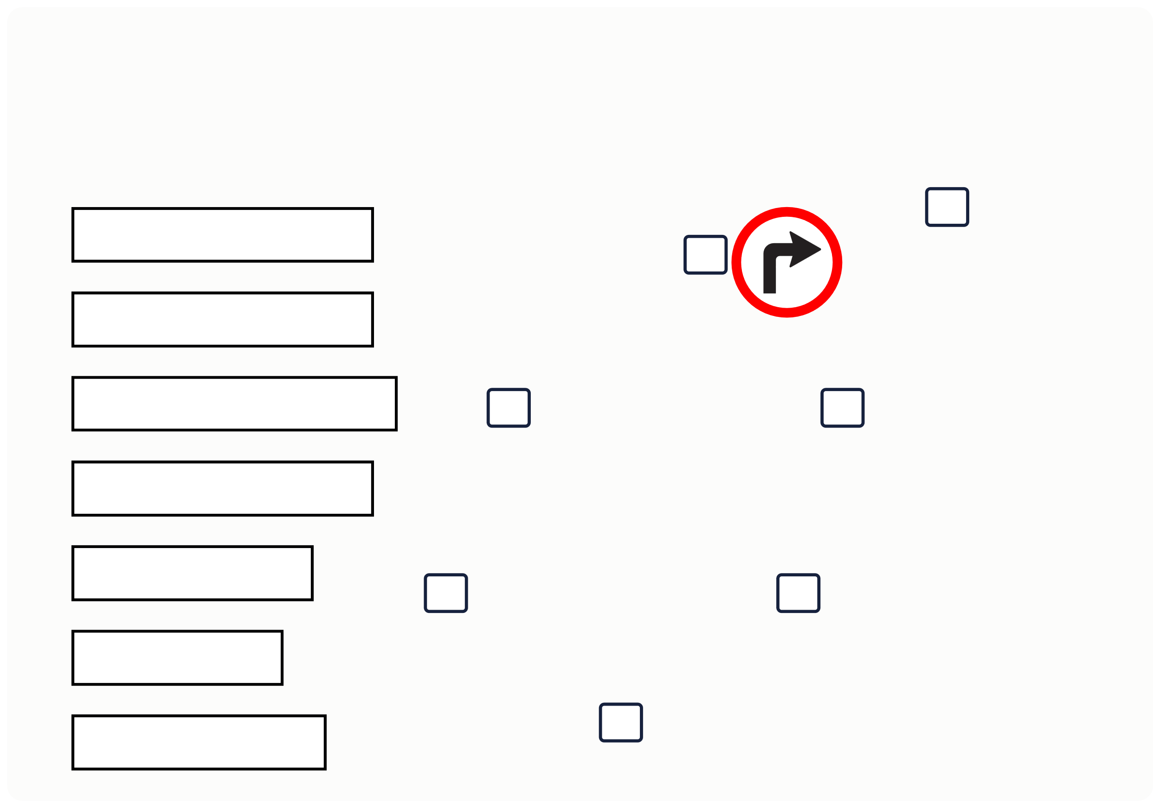
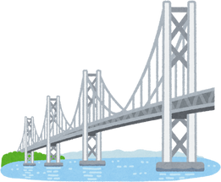
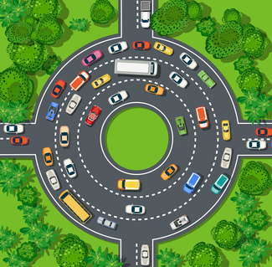
III. EXERCISES:
1.Write the number in the box:
1. Overpass 2. roundabout
3. Go straight
4. Traffic light 5. Junction
6. Bridge
7. Turn right

Slide 6
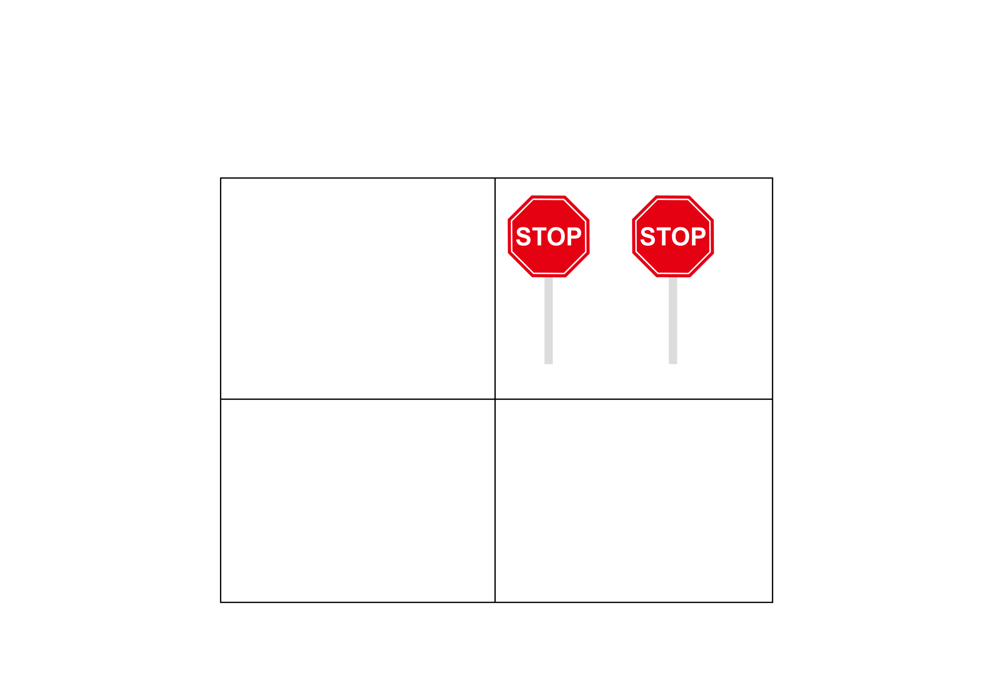
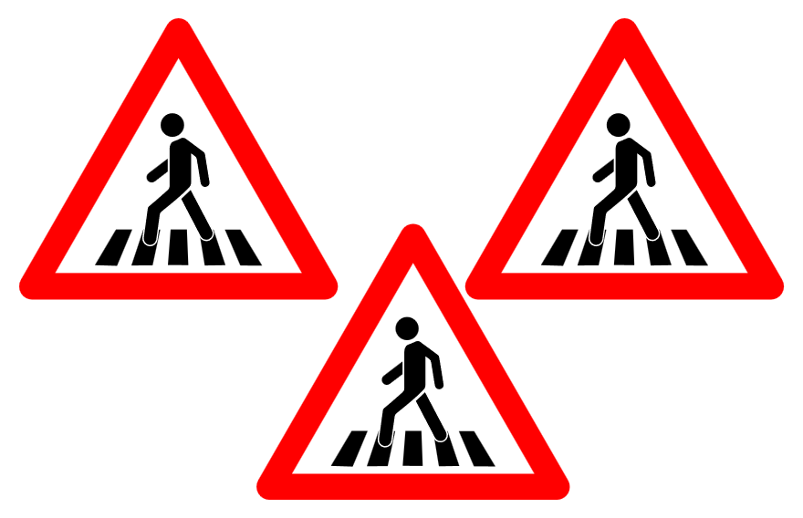
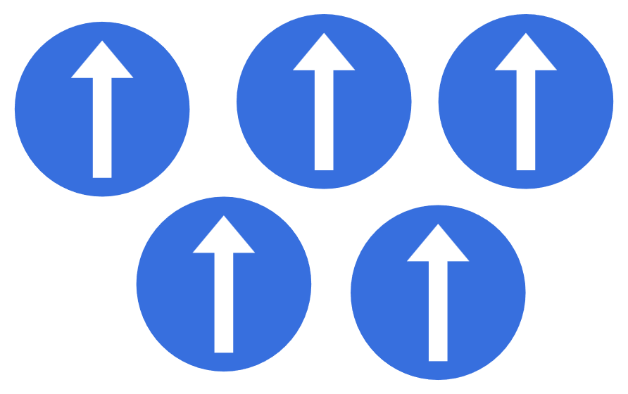
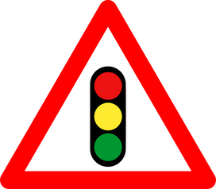
III. EXERCISES:
2. Count and circle the number of things in each box:
3
5
4
7
1
2
3
4
5
7
8
9
1
2
3
4

Slide 7
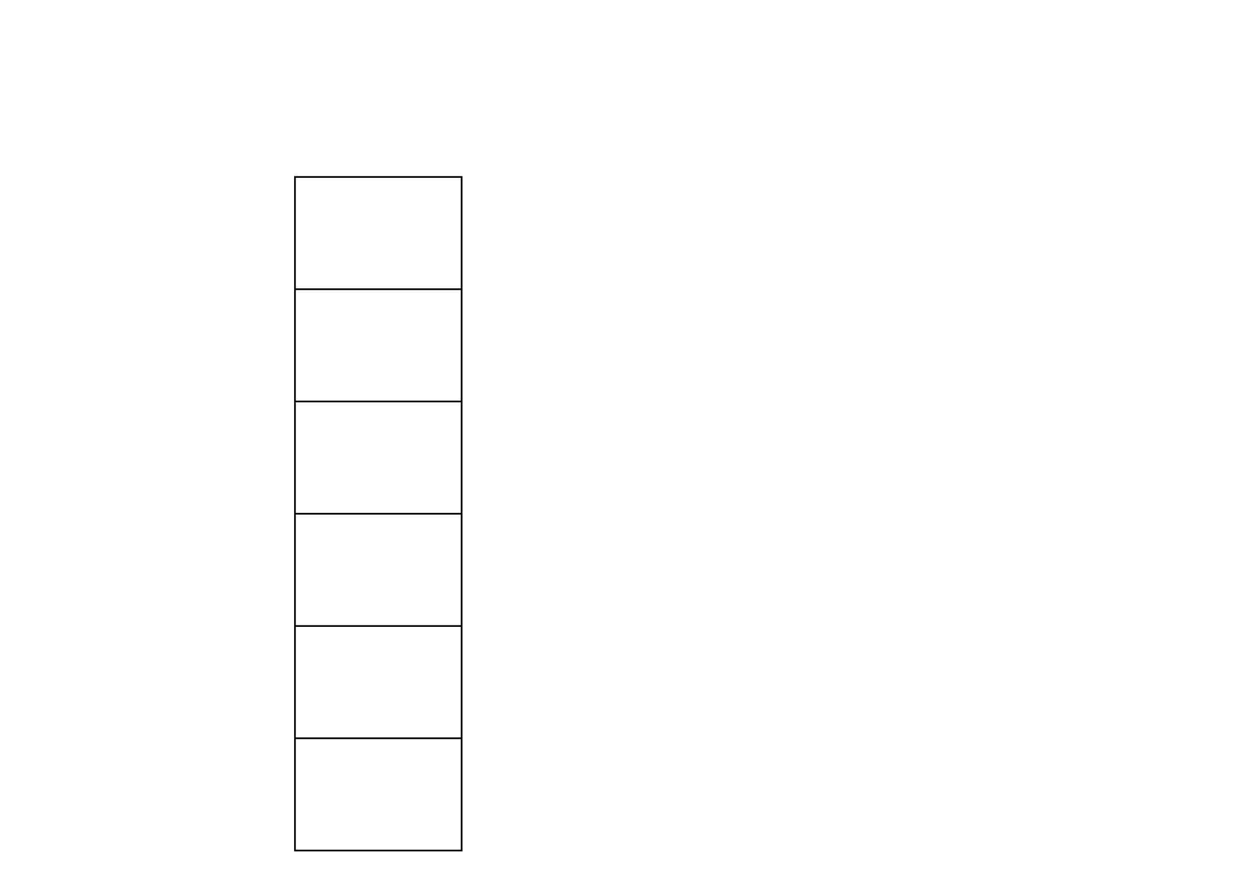

III. EXERCISES:
3. Please match the sign to the correct label:
no left turn
Cross the road
turn right
no right turn
turn left
stop

Slide 8
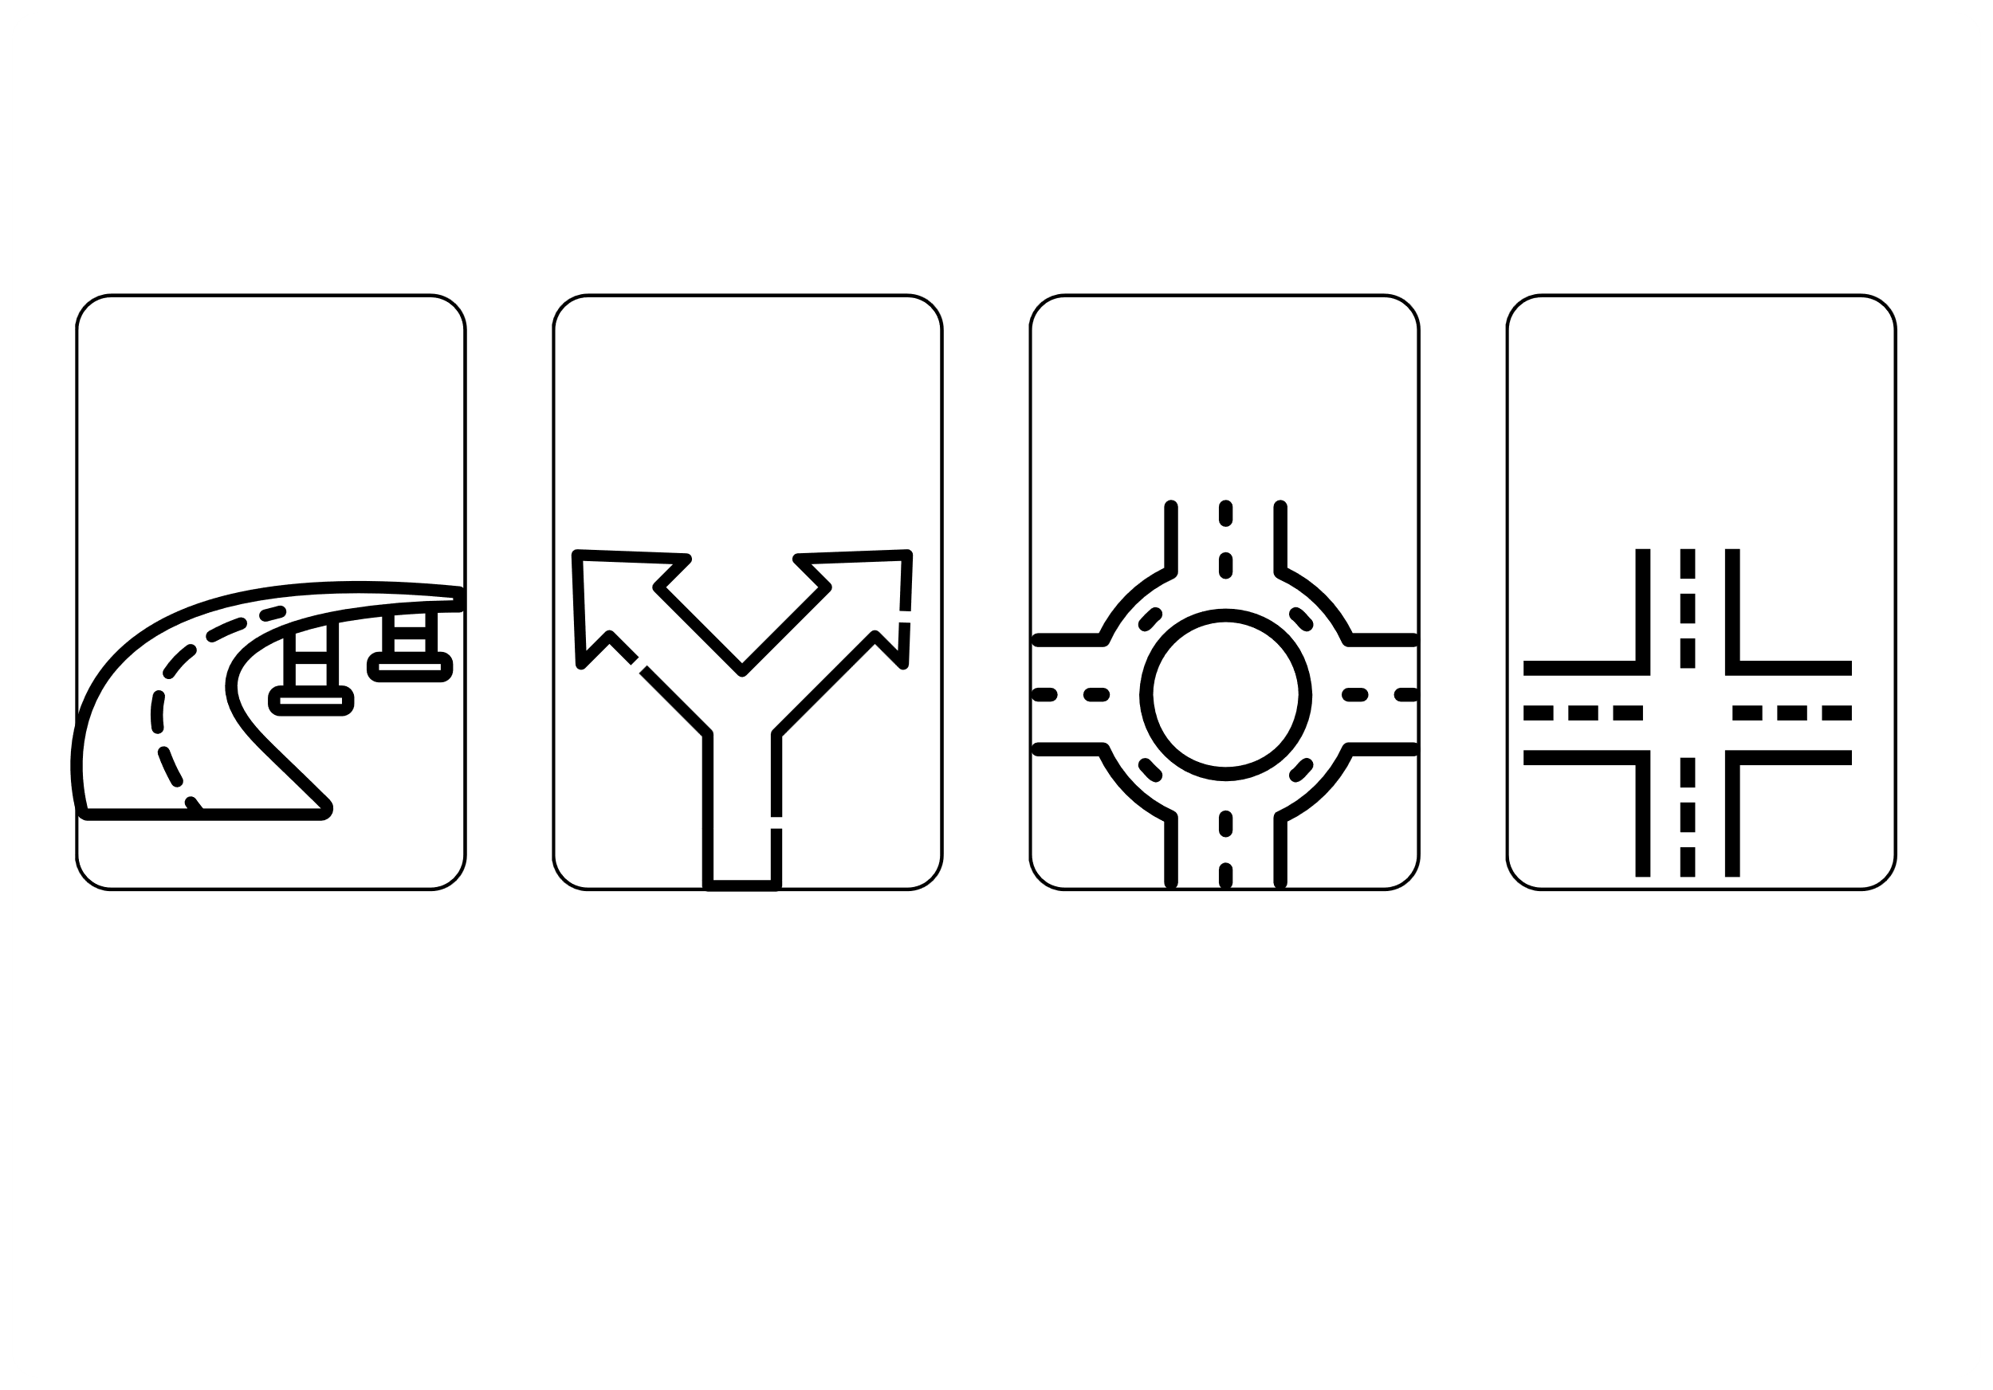
III. EXERCISES:
4. Trace and color:
overpass
junction
roundabout
crossroad

Slide 9
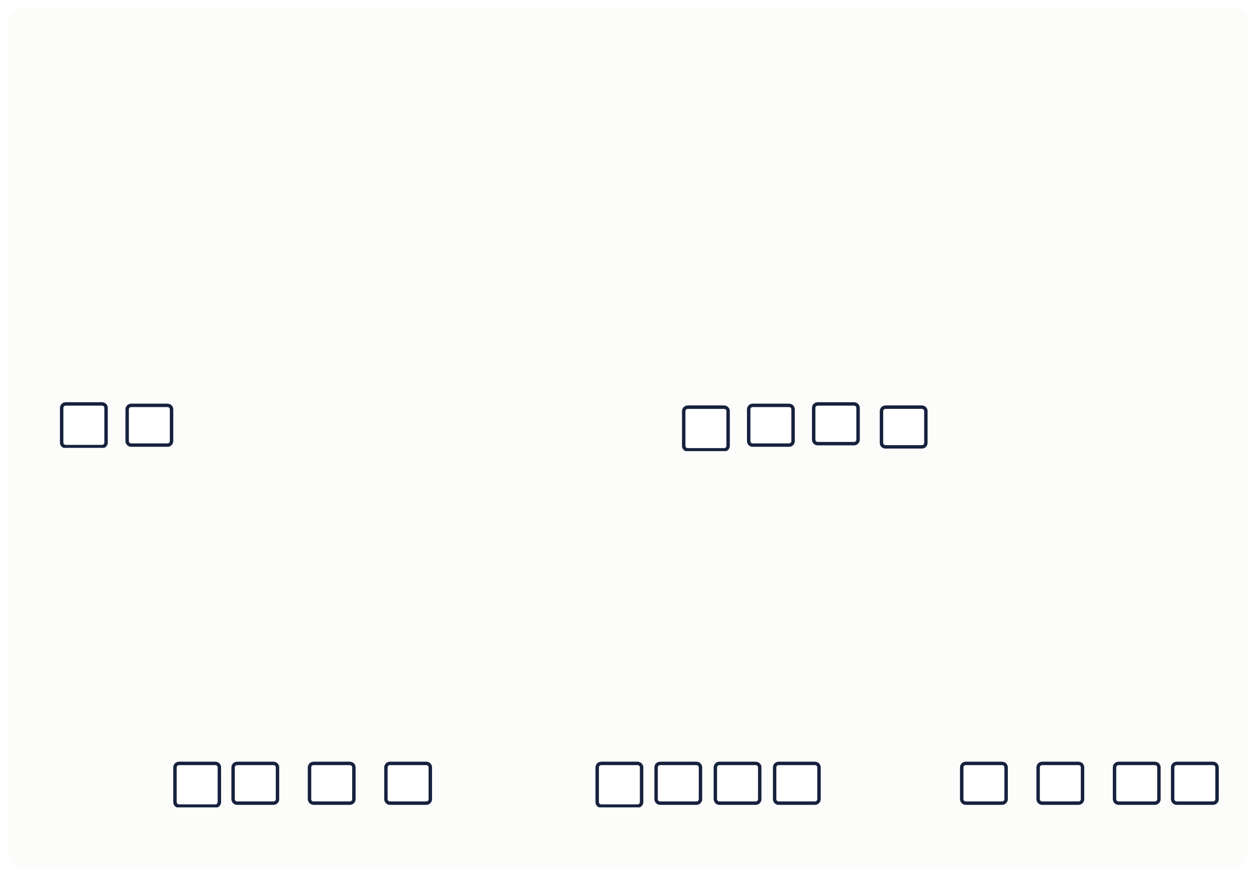
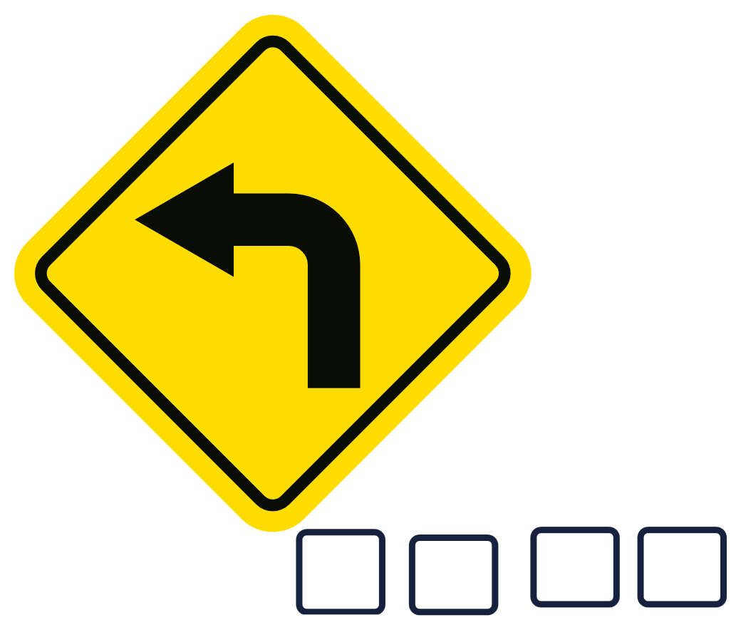

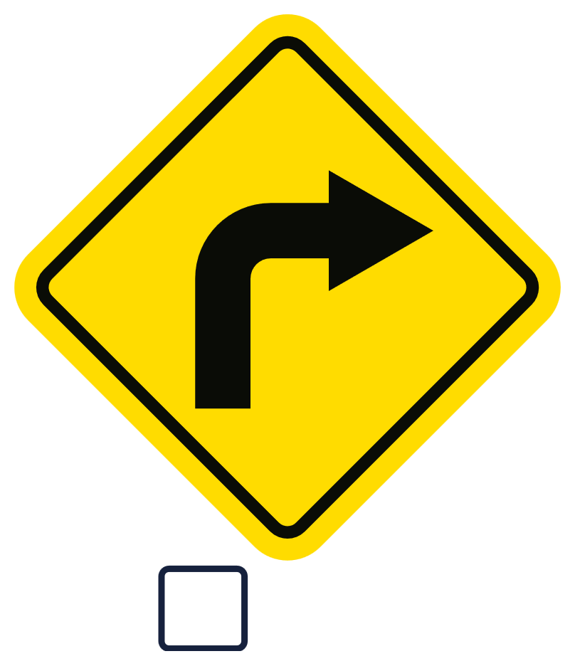

III. EXERCISES:
5. Complete the signs below:
C
the road
T
L
S
T
R

Slide 10
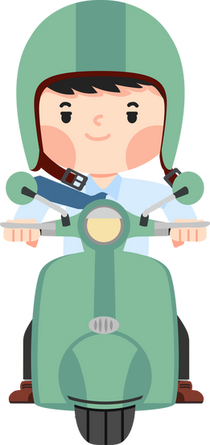
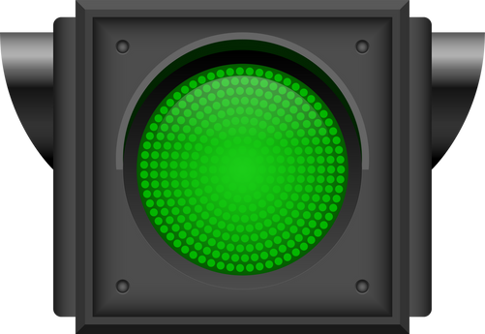
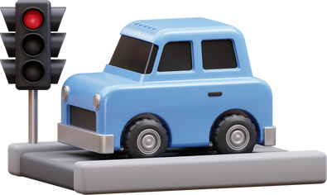
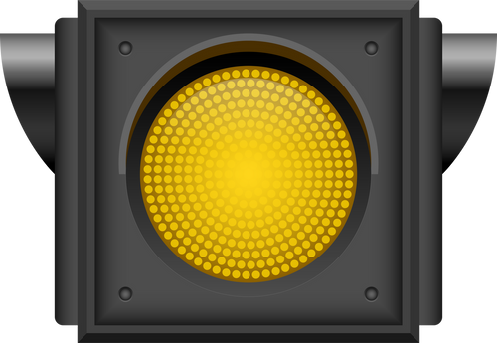
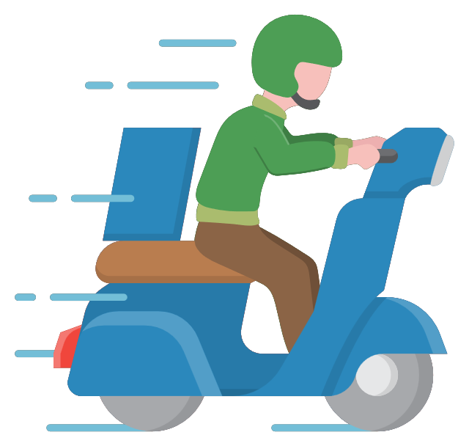
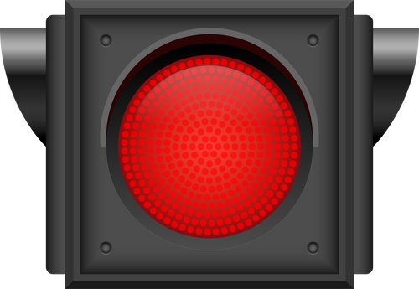
III. EXERCISES:
6. Match the traffic lights and what we need to do?

Slide 11
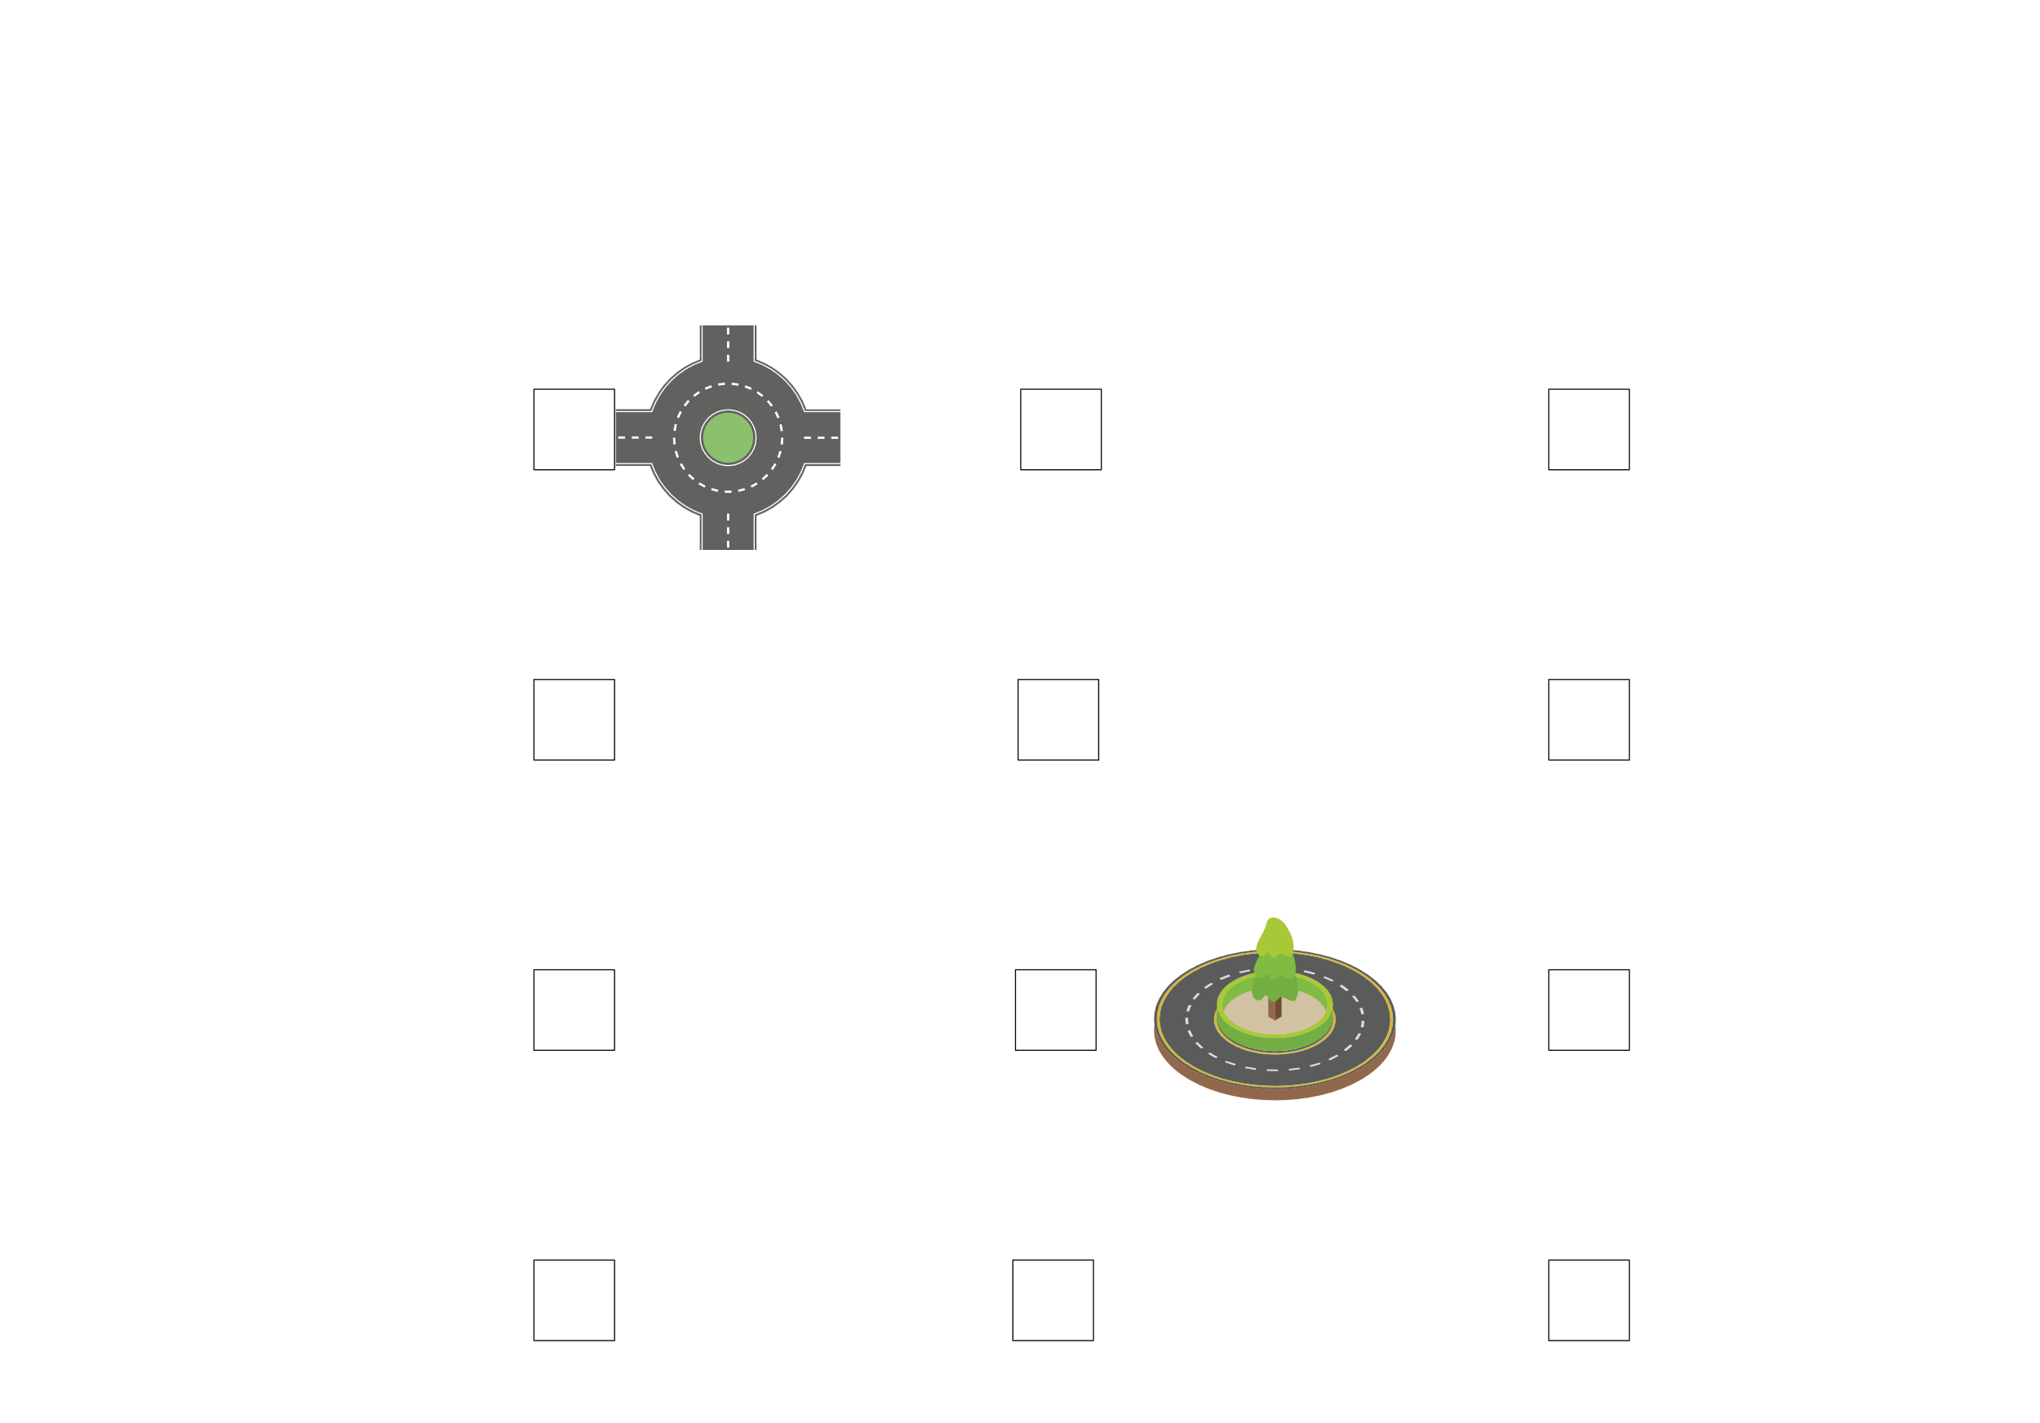
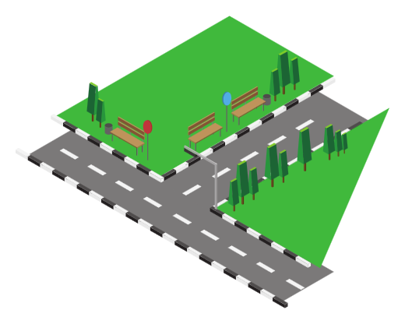
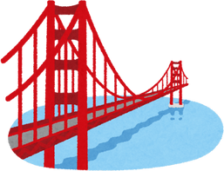
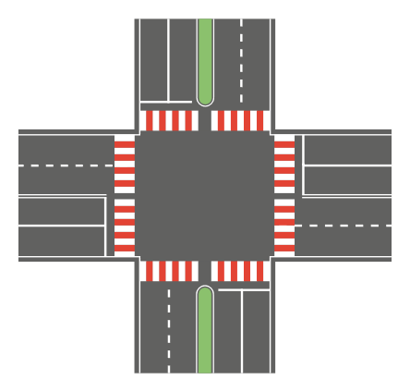
III. EXERCISES:
7. Choose the correct answer:
Roundabout
Overpass
Junction
Crossroad

Slide 12
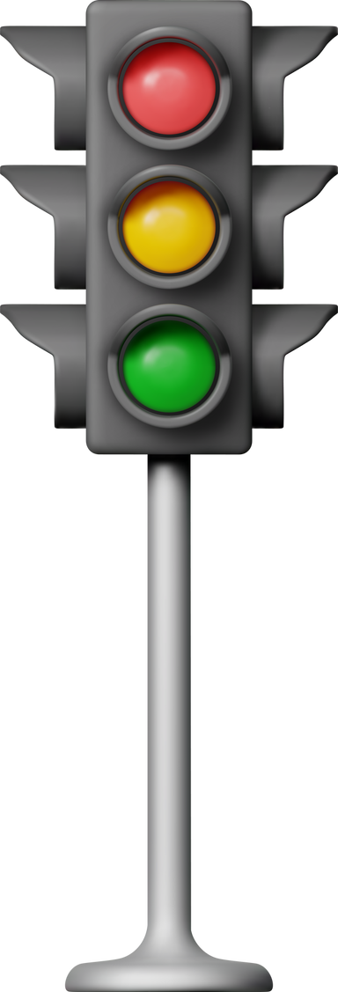
III. EXERCISES:
8. Rearrangre the traffic light:
e/r/d
e/y/l/o/w/l
e/g/r/e/n

