Slide 2
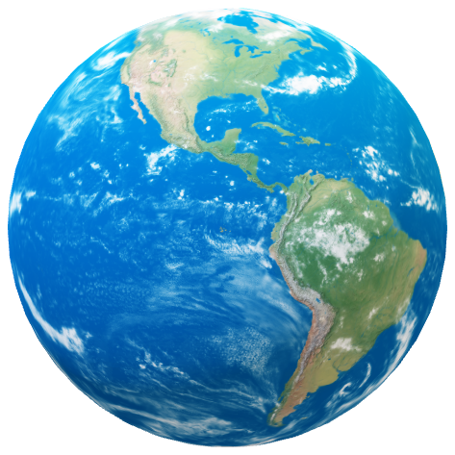



Unit
10
PLANET EARTH
PLANET EARTH
PLANET EARTH
LESSON 1: GETTING STARTED
In a science club

Slide 3
Unit
10
PLANET EARTH
PLANET EARTH
PLANET EARTH
LESSON 1: GETTING STARTED
In a science club

Slide 4

OBJECTIVES
By the end of the lesson, students will be able to:
Use the words and phrases related to planet Earth, habitats, and flora and fauna;
Gain vocabulary to talk about the planet Earth.

Slide 5
LESSON 1: GETTING STARTED
LESSON 1: GETTING STARTED
WARM-UP
Option 1: Think!
Option 2: Making a Solar System picture.
Vocabulary
PRESENTATION
Task 1: Listen and read.
Task 2: Read the conversation again and tick (√) T (True) or F (False) for each sentence.
Task 3: Write a word or phrase from the box under the correct picture.
Task 4: Complete each sentence with a word or phrase from 3.
PRACTICE
PRODUCTION
Task 5: Quiz: Work in groups. Answer the following questions.
Wrap-up
Homework
CONSOLIDATION

Slide 6

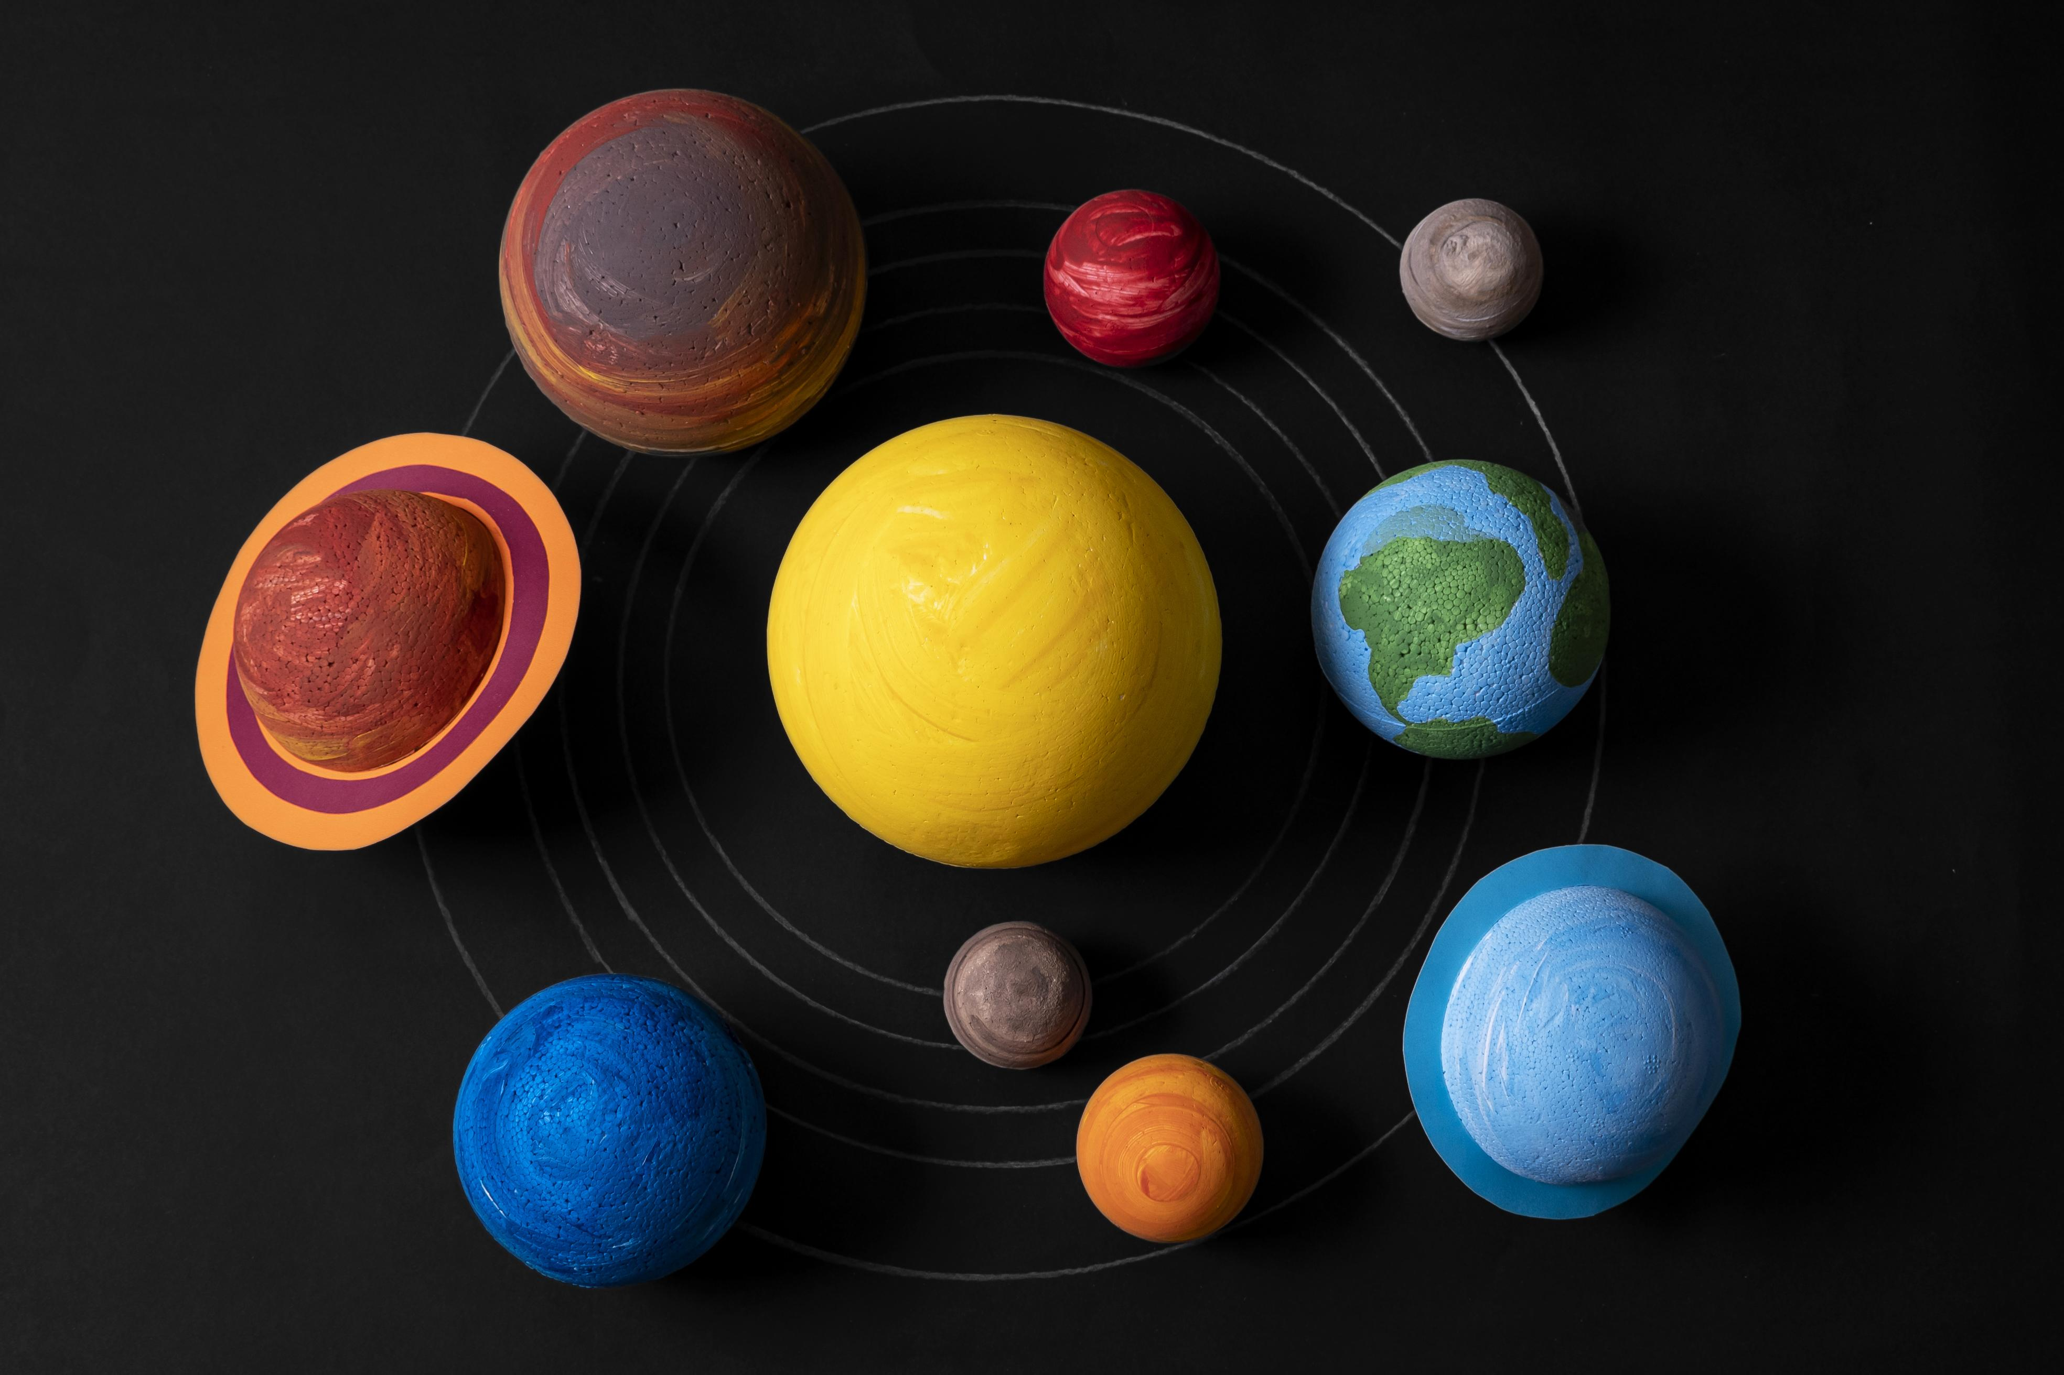
WARM-UP
OPTION 1
- Work in 2 groups to play games.
- There are 2 sets of names of planets.
- The two groups to stick the names of planets on the position from the Sun outward.
THINK

Slide 7
Jupiter
Mars
WARM-UP
OPTION 1
Saturn
Earth
Neptune
Uranus
Mercury
Venus

Slide 8
WARM-UP
OPTION 1
Jupiter
Mars
HA LONG BAY
Saturn
Earth
Mercury
Neptune
Uranus
Venus

Slide 9
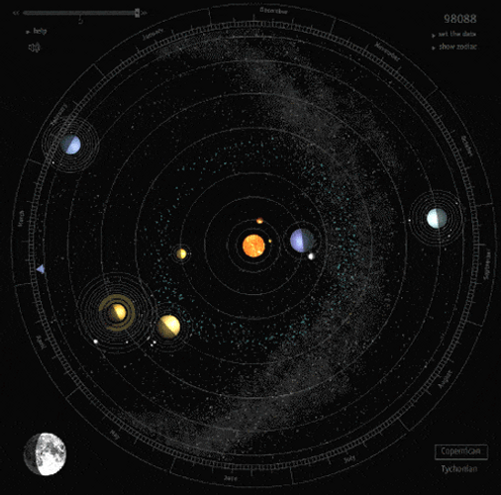
WARM-UP
OPTION 2
Making a Solar System picture

Slide 10
WARM-UP
OPTION 2
- There are large sheets of paper and art supplies.
- Work together to create a picture about the solar system by showing your creativity and understanding of planetary features.
Making a Solar System picture

Slide 11
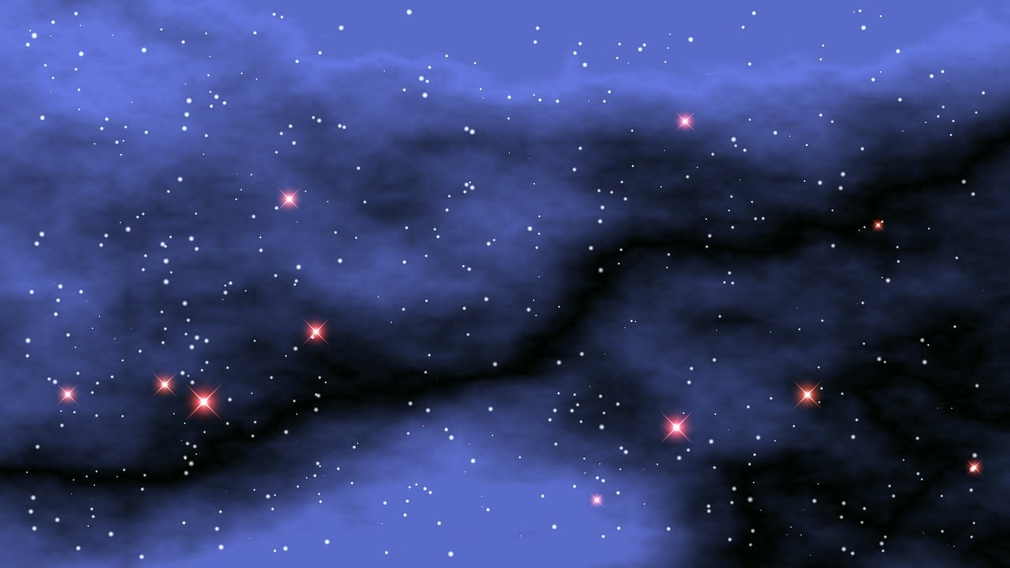
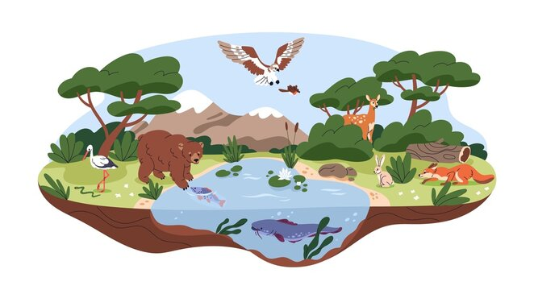

PRESENTATION
the part of space that is very far away from Earth
outer space (n)
/ˌaʊtə ˈspeɪs/
ngoài vũ trụ

Slide 12
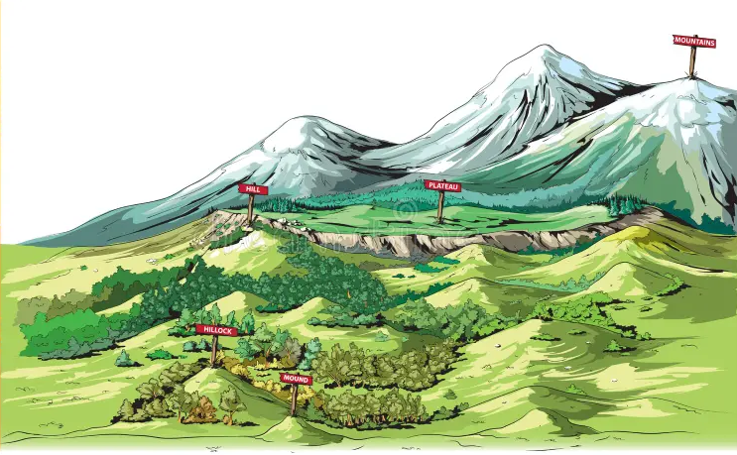
PRESENTATION
the natural environment in which an animal or plant usually lives
habitat (n)
/ˈhæbɪtæt/
môi trường sống của động thực vật

Slide 13

PRESENTATION
a natural shape on the earth’s surface, such as mountain or a valley
landform (n)
/ˈlændfɔːm/
dạng địa hình, địa mạo

Slide 14
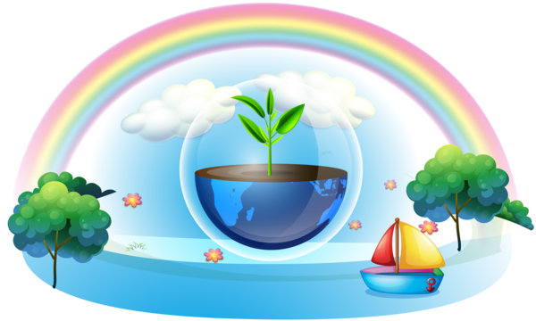
PRESENTATION
necessary or needed
essential (adj)
/ɪˈsenʃl/
vô cùng quan trọng

Slide 15
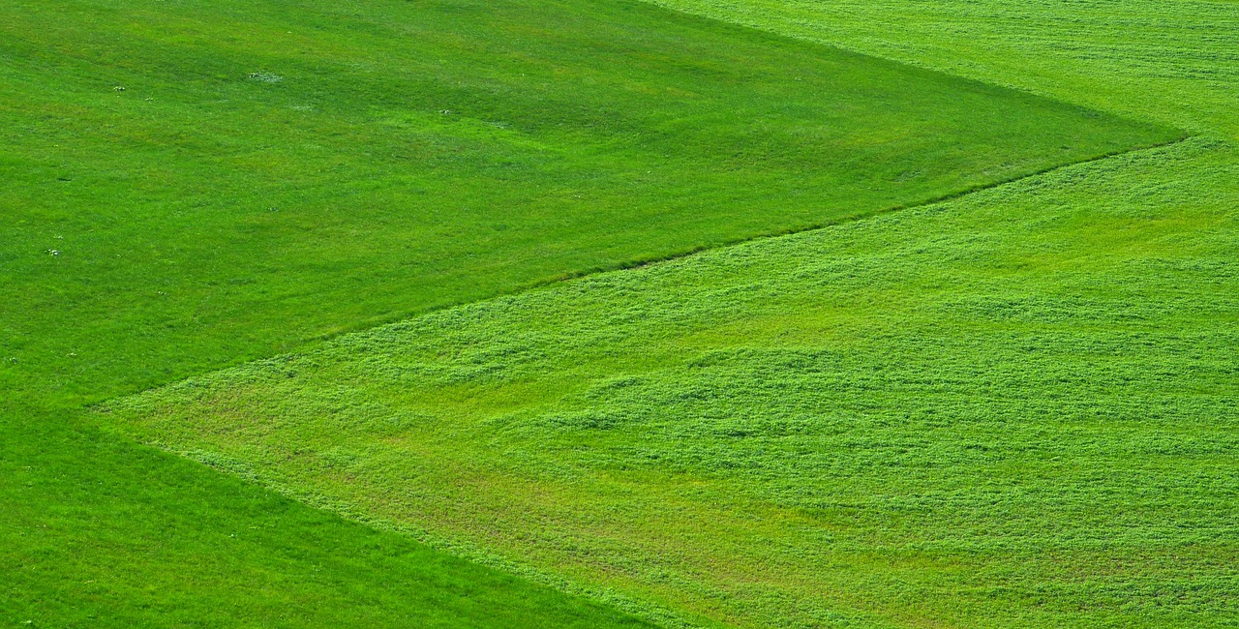
PRESENTATION
to keep something as
it is, especially in order
to prevent it from being damaged
preserve (v)
/prɪˈzɜːv/
bảo tồn

Slide 16
PRESENTATION
a large area of land covered with grass
grassland (n)
/ˈɡrɑːslænd/
khu vực đồng cỏ

Slide 17
PRESENTATION
New words | Pronunciation | Meaning
1. outer space (n) | /ˌaʊtə ˈspeɪs/ | ngoài vũ trụ
2. habitat (n) | /ˈhæbɪtæt/ | môi trường sống của động thực vật
3. landform (n) | /ˈlændfɔːm/ | dạng địa hình, địa mạo

Slide 18
PRESENTATION
New words | Pronunciation | Meaning
4. essential (adj) | /ɪˈsenʃl/ | vô cùng quan trọng
5. preserve (v) | /prɪˈzɜːv/ | bảo tồn
6. grassland (n) | /ˈɡrɑːslænd/ | khu vực đồng cỏ

Slide 19
LESSON 1: GETTING STARTED
LESSON 1: GETTING STARTED
WARM-UP
Option 1: Think!
Option 2: Making a Solar System picture.
Vocabulary
PRESENTATION
Task 1: Listen and read.
Task 2: Read the conversation again and tick (√) T (True) or
F (False) for each sentence.
Task 3: Write a word or phrase from the box under the
correct picture.
Task 4: Complete each sentence with a word or phrase
from 3.
PRACTICE

Slide 20
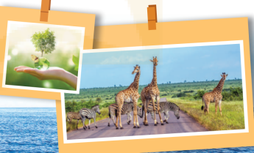
PRACTICE
- Look at the heading In a science club, the conversation and the pictures. Then, answer these questions:
Questions:
1. What can you see in the
pictures?
2. What do you think Mr An,
Nick and Lan are talking about?

Slide 21
PRACTICE
1
Listen and read.
President: Hi, welcome to our science club. Our topic today is planet Earth. Our guest is Mr An, an earth scientist.
Mr An: Hi everybody. Pleased to meet you. I’m looking forward to answering your questions about our planet.
Lan: Mr An, where’s Earth in the Solar System?
Mr An: There are eight planets in the Solar System, and Earth is the third from the Sun, after Mercury and Venus. It’s also the fifth largest in our system.
Nick: Is it also called the Blue Planet?
Mr An: Right. From the outer space it looks blue because water covers more than 70 per cent of it.
Lan: Is it the only planet that has liquid water?

Slide 22
PRACTICE
1
Listen and read.
Mr An: Exactly. Without it, there wouldn’t be living things, like humans, or the flora and fauna of your habitat.
Nick: How about the role of air, light and heat? How do they affect Earth?
Mr An: Well, water bodies and landforms, which are main areas on Earth, together with air, light, and heat, provide essential habitats for plants and animals.
Nick: It’s fascinating to observe and study these habitats.
Mr An: Yes. However, they are being destroyed by pollution. We should all help out to preserve them. …

Slide 23
PRACTICE
- Look at these questions again:
Questions:
1. What can you see in the pictures?
2. What do you think Mr An, Nick and Lan are talking about?
Suggested answers:
1. We can see the giraffes, a globe, plants and sea / ocean.
2. They are talking about Earth, it’s another name, its living things and non-living things.

Slide 24
PRACTICE
2
Read the conversation again and tick (√) T (True) or F (False) for each sentence.
 | T | F
1. The students are asking about the Solar System.
2. Another name for Earth is the Blue Planet.
3. Water covers four fifths of Earth.
4.Water bodies and landforms are essential habitats for plants and animals.
5. Mr. An thinks pollution is threatening the habitats of plants and animals.
- Work in pairs to read the conversation.
- Then, underline the key words and phrases
in the statements.
- Work in pairs in one or two minutes to check
if the statements are true or false.

Slide 25
PRACTICE
2
Read the conversation again and tick (√) T (True) or F (False) for each sentence.
 | T | F
1. The students are asking about the Solar System.
2. Another name for Earth is the Blue Planet.
3. Water covers four fifths of Earth.
4.Water bodies and landforms are essential habitats for plants and animals.
5. Mr An thinks pollution is threatening the habitats of plants and animals.
√
√
√
√
√

Slide 26
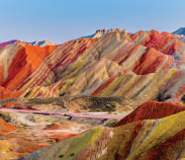
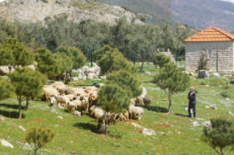
PRACTICE
3
Write a word or phrase from the box under the correct picture.
liquid water
flora and fauna
Solar System
landforms
water bodies
outer space

Slide 27

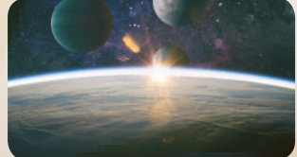
PRACTICE
3
Write a word or phrase from the box under the correct picture.
liquid water
flora and fauna
Solar System
landforms
water bodies
outer space

Slide 28
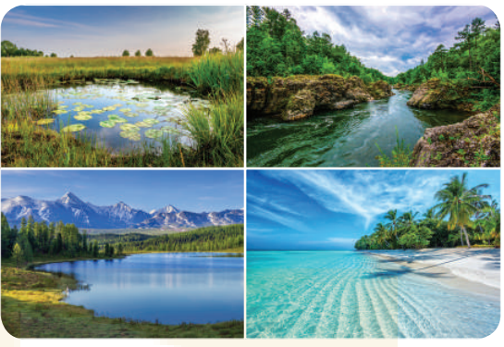
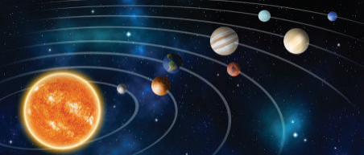
PRACTICE
3
Write a word or phrase from the box under the correct picture.
liquid water
flora and fauna
Solar System
landforms
water bodies
outer space

Slide 29
PRACTICE
4
Complete each sentence with a word or phrase from 3.
Flora and fauna
1. _______________ refer to the plants and animals of a particular place.
2. Oceans, seas, rivers, and lakes are different types of _____________ on Earth.
water bodies
solar system
3. There are eight planets in the ____________.
outer space
4. The Soviet Union launched Sputnik 1 into ____________ in 1957.
landforms
5. Some examples of __________ include mountains, grassland, and deserts.

Slide 30
LESSON 1: GETTING STARTED
LESSON 1: GETTING STARTED
WARM-UP
Option 1: Think!
Option 2: Making a Solar System picture.
Vocabulary
PRESENTATION
Task 1: Listen and read.
Task 2: Read the conversation again and tick (√) T (True)
or F (False) for each sentence.
Task 3: Write a word or phrase from the box under the
correct picture.
Task 4: Complete each sentence with a word or phrase
from 3.
PRACTICE
PRODUCTION
Task 5: Quiz: Work in groups. Answer the following
questions.

Slide 31
PRODUCTION
5
QUIZ: Work in groups. Answer the following questions.
1. 7 (Asia, Africa, North America, South America, Europe, Australia and Antarctica)
2. 5 (Arctic, Atlantic, Indian, Pacific, and Southern)
3. 1
4. 1. Oxygen (O2), medical use, 2. Nitrogen (N2): fire suppression, provides an inert atmosphere 3. Helium (He): balloons, medical equipment 4. Argon (Ar): welding, provides an inert atmosphere for materials 5. Carbon dioxide (CO2): carbonated soft drinks …
5. Mars
1. How many continents are there on Earth?
2. How many oceans are there on Earth?
3. How many moons orbit Earth?
4. Which gas is essential for life on Earth?
5. Which planet has conditions similar to those on Earth?

Slide 32
1. How many continents are there on Earth?
2. How many oceans are there on Earth?
3. How many moons orbit Earth?
4. Which gas is essential for life on Earth?
5. Which planet has conditions similar to those on Earth?
PRODUCTION
Suggested answers:
1. 7 (Asia, Africa, North America, South America, Europe, Australia, and Antarctica)
2. 5 (Arctic, Atlantic, Indian, Pacific, and Southern Oceans)
3. 1
4. 1. Oxygen (O2), medical use 2. Nitrogen (N2): fire suppression, provides an inert atmosphere 3. Helium (He): balloons, medical equipment 4. Argon (Ar): welding, provides an inert atmosphere for materials 5. Carbon dioxide (CO2): carbonated soft drinks …
5. Mars

Slide 33
LESSON 1: GETTING STARTED
LESSON 1: GETTING STARTED
WARM-UP
Option 1: Think!
Option 2: Making a Solar System picture.
Vocabulary
PRESENTATION
Task 1: Listen and read.
Task 2: Read the conversation again and tick (√) T (True) or F (False) for each sentence.
Task 3: Write a word or phrase from the box under the correct picture.
Task 4: Complete each sentence with a word or phrase from 3.
PRACTICE
PRODUCTION
Task 5: Quiz: Work in groups. Answer the following questions.
Wrap-up
Homework
CONSOLIDATION

Slide 34

CONSOLIDATION
2
Homework
- Do exercises in the workbook.

Slide 35
CONSOLIDATION
2
Homework
- Prepare for the Project of the unit.
- Open book p.113, look at the picture and say what the
topic of the project is.
- Work in groups to design a poster.
- You will show and present in Lesson 7 – Looking back and Project.

Slide 36
CONSOLIDATION
2
Homework
- The project requirements: work in groups to think about your area and the flora and fauna of the area. Otherwise, you can choose an area they know. Use
the guiding questions to prepare.

Slide 37
CONSOLIDATION
2
Homework
+ What area with special plants and animals do they like to talk about?
+ What animals and plants does the area have?
+ Are the plants special in any way? (for wood, for medicine, for the fresh air or for the beauty of the area ….?)
+ Are the animals special in any way?(Are they rare? Do they need protection? Are they hunted for food/ fur/ ivory … or killed to produce medicine?)
+ What do you think local people should do to protect them? (stop cutting trees, stop hunting these animals, building nature reserve …)

Slide 38
CONSOLIDATION
2
Homework
- You can use a poster or ppt slides to present the flora and fauna you choose to talk about. In this case, your slides or posters should include a mixture of texts and pictures or photos of plants and animals of the area you choose to illustrate.
- Choose your group leader. Ask the leader to make a timeline for the group and help report the progress of the group to the teacher as well as assigning tasks to the group member if needed during their preparation period. Ask group members to work together to brainstorm the topic and support each other during the time they prepare for the project.

Slide 39
Website: hoclieu.vn
Fanpage: facebook.com/www.tienganhglobalsuccess.vn/

