Slide 1

Unit 2: Every Day
Lesson 2e: Grammar (Cont.)
Page 45

Slide 2
Lesson Outline
Warm-up
Presentation
Practice
Production
Consolidation
Wrap-up

Slide 3
Objectives
By the end of this lesson, students will be able to…
- make questions in Present Simple tense.

Slide 4

WARM-UP

Slide 5
Choose the word whose underlined part is pronounced differently from that of the others.
A. chair B. child C. lunch D. school
/tʃeə/ /tʃaɪld/ /lʌntʃ/ /skuːl/
2. A. this B. that C. three D. the
/ðɪs/ /ðæt/ /θriː/ /ðə/
3. A. music B. science C. student D. Sunday
/ˈmjuːzɪk/ /ˈsaɪəns/ /ˈstjuːdənt/ /ˈsʌndeɪ/

Slide 6
PAIRWORK
Tell your friend about your hobbies and interests.
What’s your favourite subject?
What are your favourite free-time activities?

Slide 7
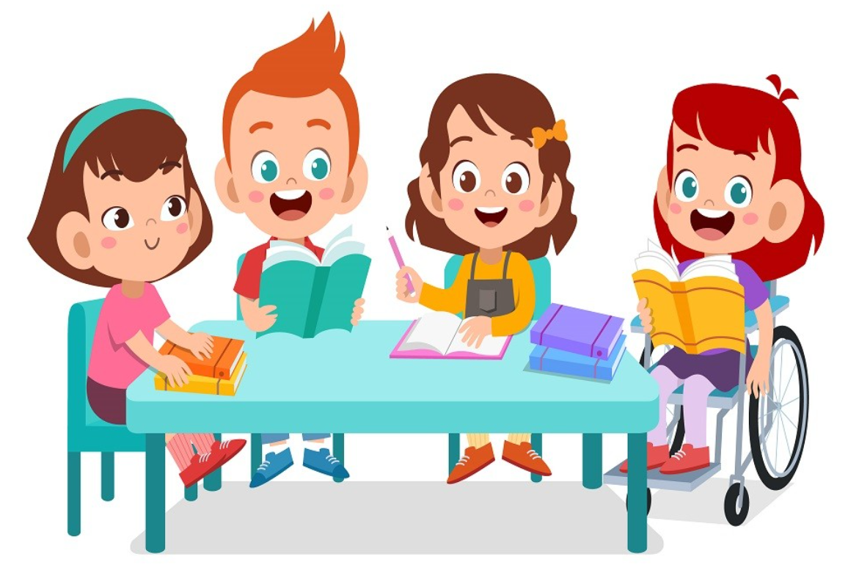
It’s time to learn …

Slide 8
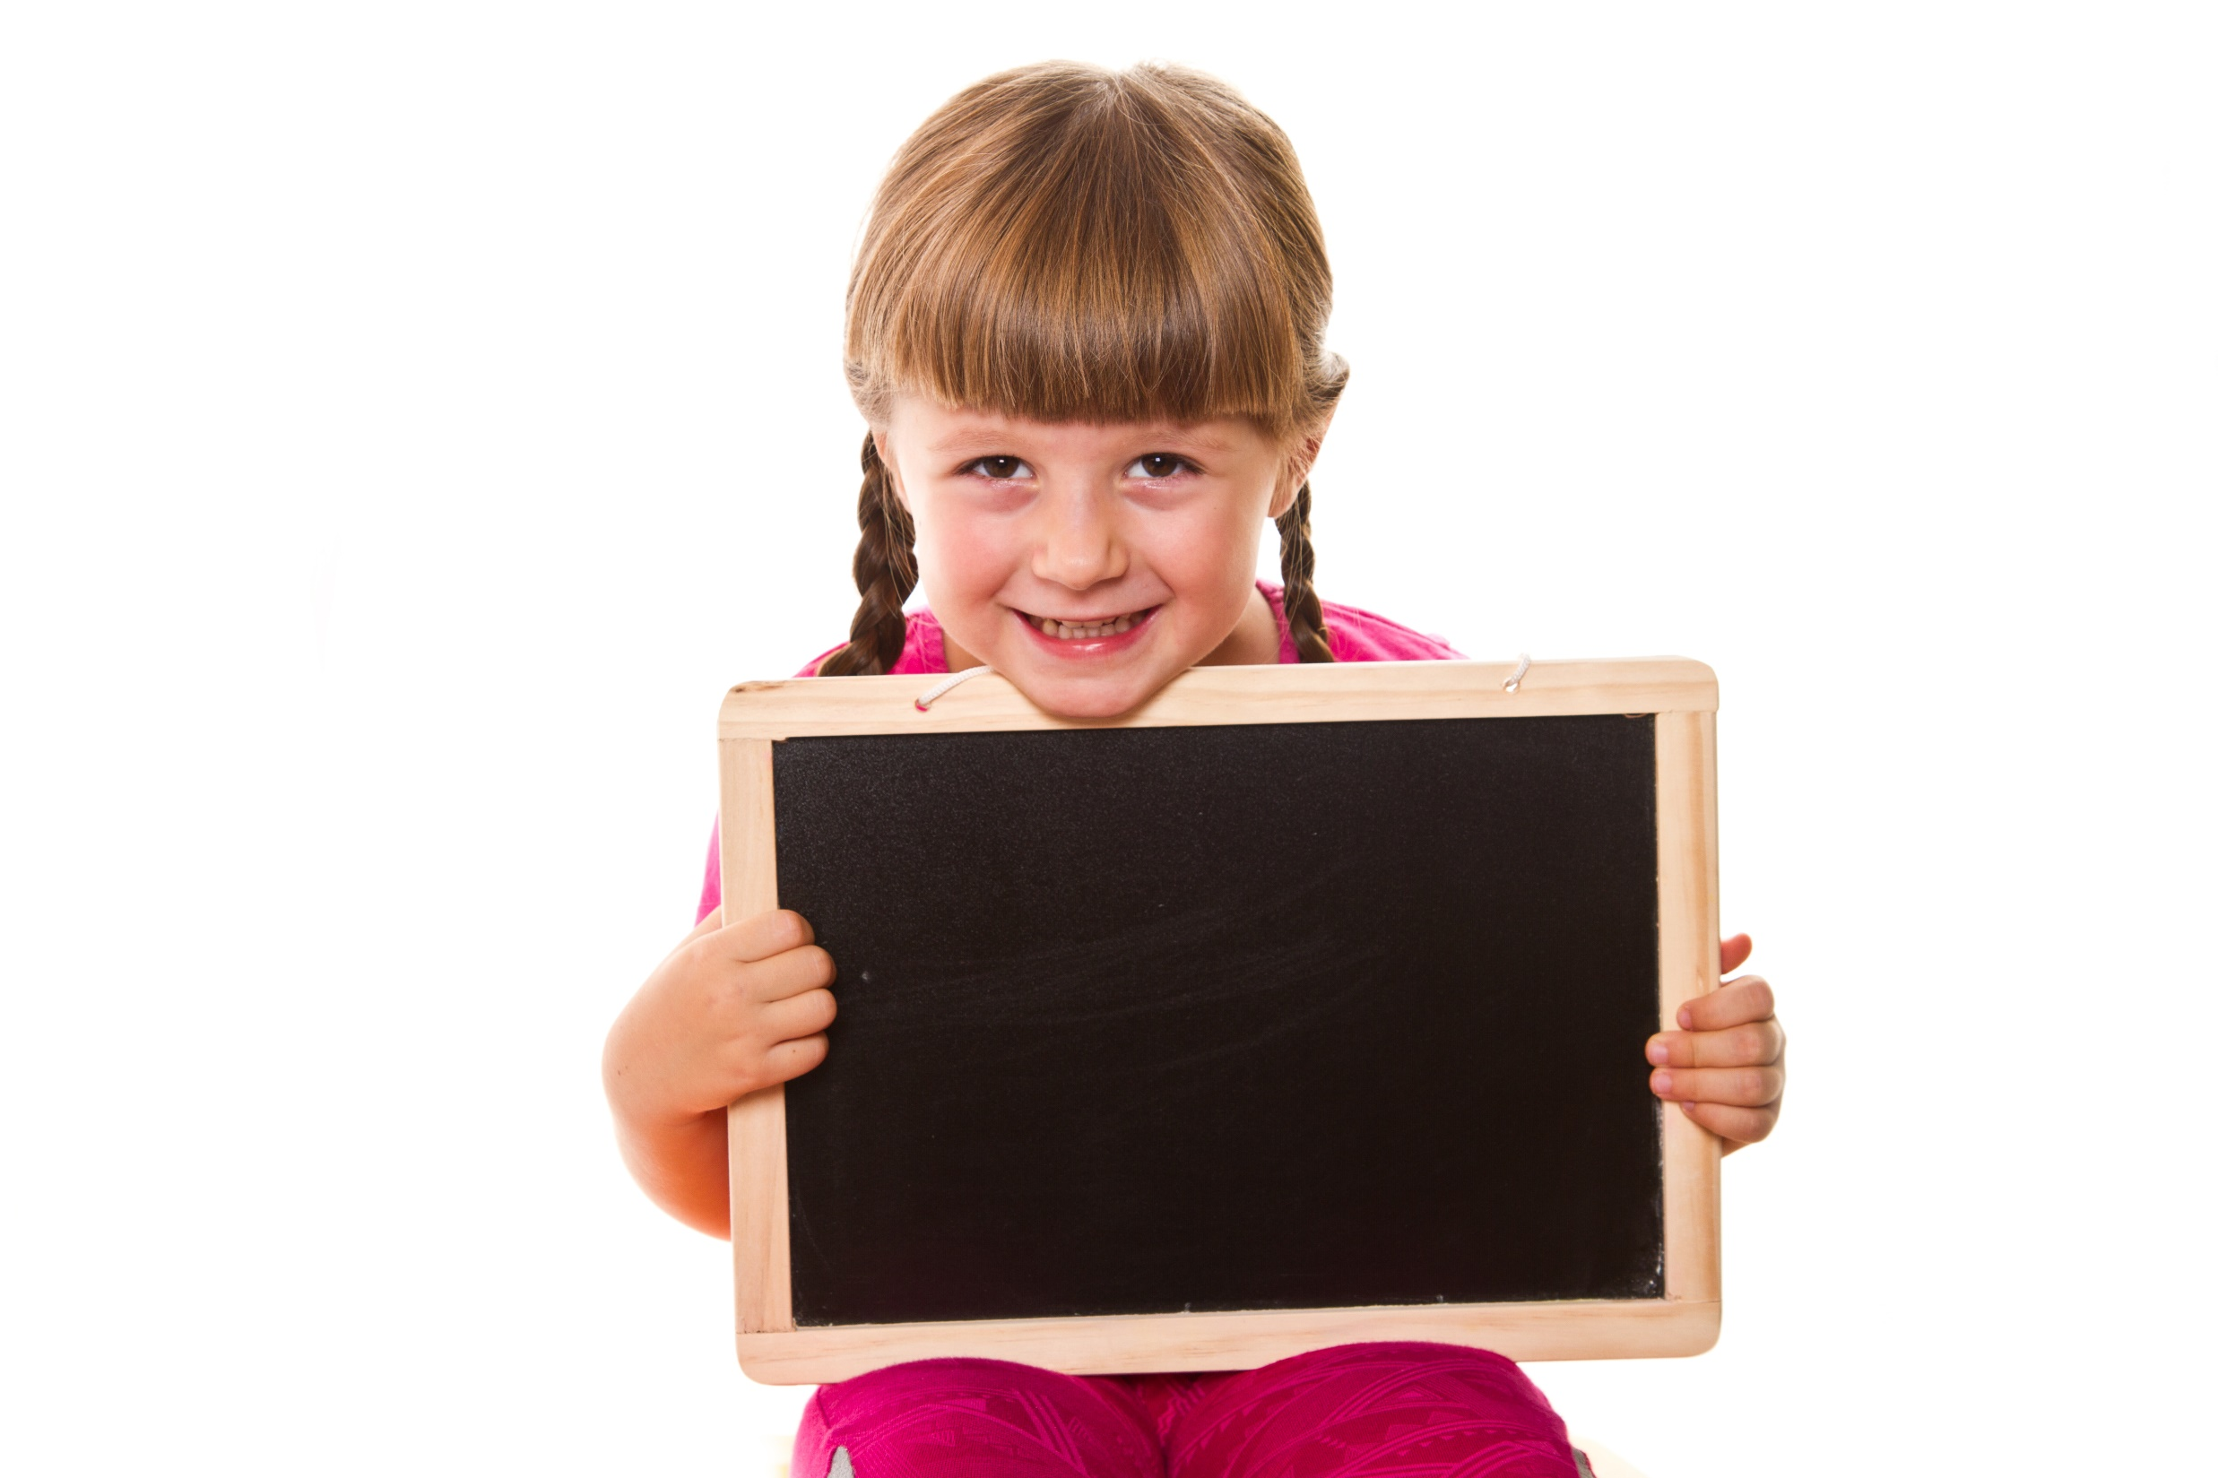
Presentation

Slide 9
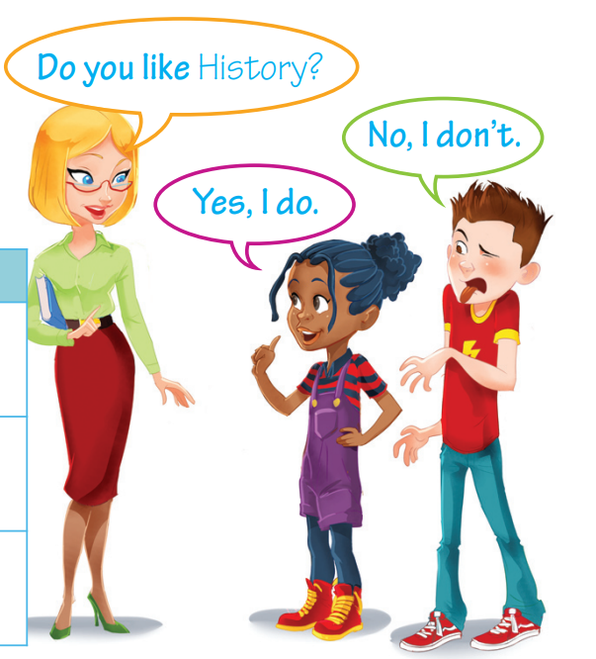
Present Simple tense (interrogative)
Does she like history?
Yes, she does.
Does he like history?
No, he doesn’t.

Slide 10
Present Simple (interrogative & short answers)
 | interrogative | short answers
Singular
Plural
Yes, I/you do.
No, I/you don’t.
Do I/you work?
Yes, he/she/it does.
No, he/she/it doesn’t.
Does he/she/it work?
Yes, we/you/they do.
No, we/you/they don’t.
Do we/you/they work?

Slide 11

In English, when we give a short answer to
a Yes/No question, we use the auxiliary verb
do/does.
e.g. Do you like Maths?
Yes, I do./ No, I don’t.
(NOT: Yes, I like. / No, I don’t like.)
We use rising intonation in Yes/No questions
e.g. Do you walk to school?

Slide 12
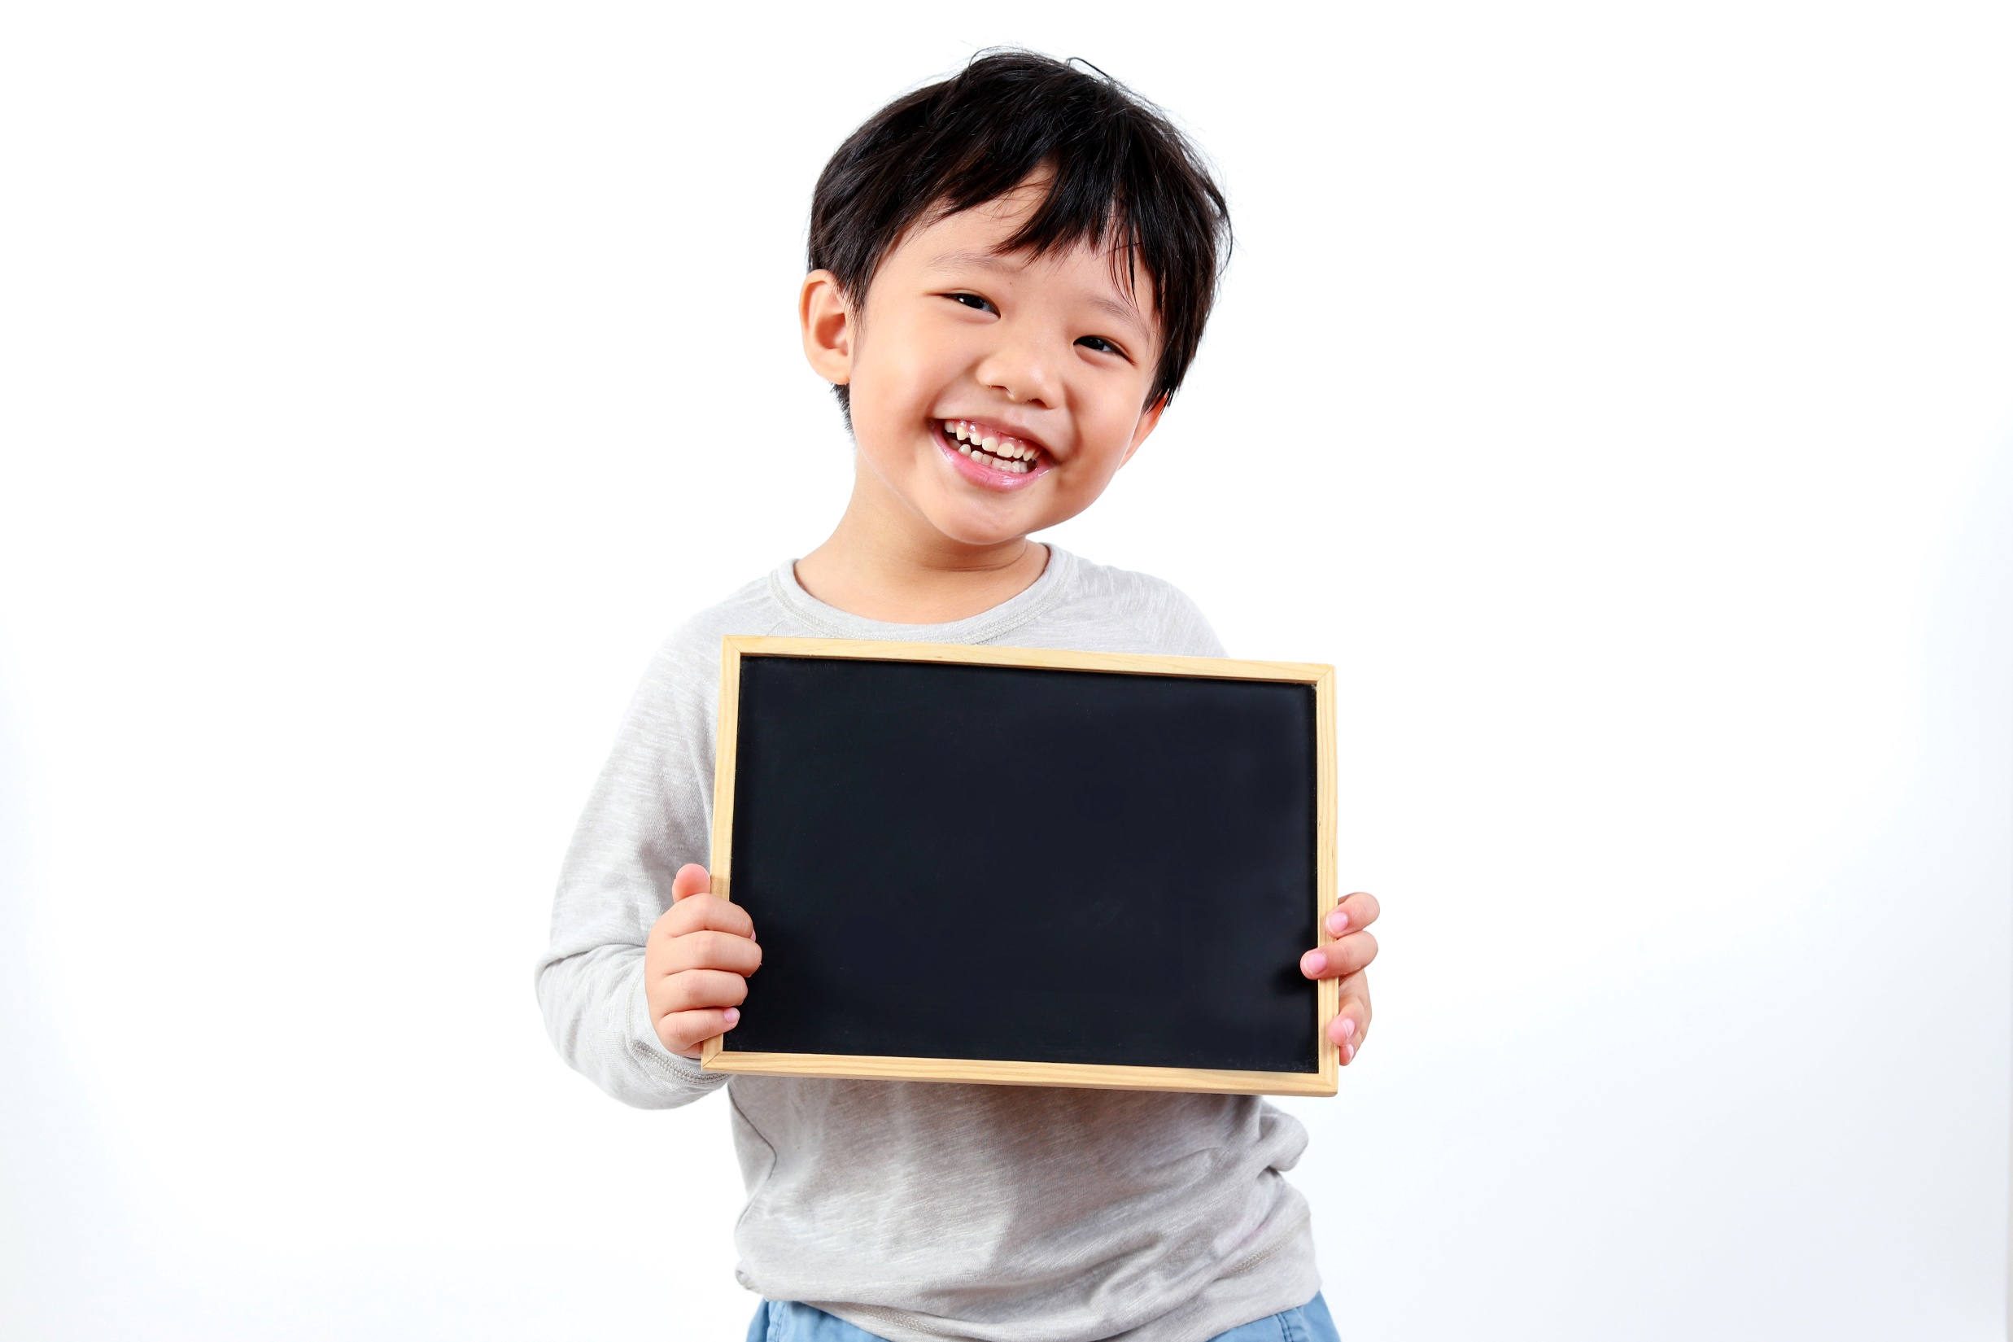
Practise

Slide 13
5. Read the theory box. Choose the correct item. Then complete the answers.
1 Do/Does you eat lunch at school? Yes,__________________________________ .
2 Do/Does your friends have dinner at 7:00 p.m.?
No, __________________________________ .
3 Do/Does Mary drive to work?
Yes, __________________________________ .
4 Do/Does he have a shower in the morning?
No, __________________________________ .
5 Do/Does you and your friends play tennis?
No, __________________________________ .
I do
they don’t
she does
he doesn’t
we don’t

Slide 14
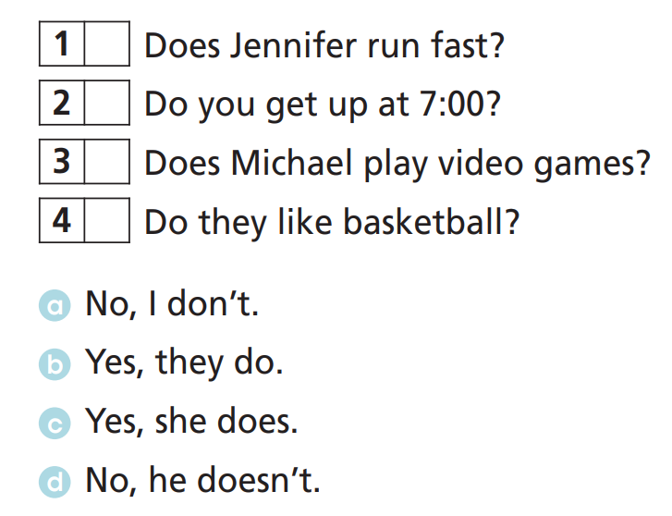
4 Match the questions to the correct answers.
c
a
d
b
Extra Practise
WB, P. 26

Slide 15
5. Fill in the gaps with do, does, don’t or doesn’t.
1 _______________ Frank have breakfast at 7 o’clock?
No, he _____________________ .
2 _______________ you go to school at 8:00?
No, we _____________________ .
3 _______________ she speak English?
Yes, she _____________________ .
4 _______________ they play football?
Yes, they ____________________ .
Does
doesn’t
Do
don’t
Does
does
Do
Extra Practise
WB, P. 26
do

Slide 16
6. Form questions, then answer them.
1 Mario / like Art? (No)
A: “Does Mario like Art?” B: “No, he doesn’t.”
2 Sandra / have Maths on Mondays? (Yes)
A: Does Sandra have Maths on Mondays? B: Yes, she does.
3 you / watch TV after dinner? (No)
A: Do you watch TV after dinner? B: No, I don’t.
4 they / have lunch at home? (Yes)
A: Do they have lunch at home? B: Yes, they do.

Slide 17
19 ★ Fill in the gaps with the correct question word.
1 ___________ is Ann? She’s at school.
2 ___________ is her favourite colour, red or blue? Blue.
3 ___________ ’s she? She’s my cousin, Jane.
4 ___________ old is your dad? 39.
5 ___________ is his birthday? 20th July.
6 ___________ do you go to school? By bus.
7 ___________ is he from? New York, USA.
8 ___________ car is this? John’s.
9 ___________ ‘s your name? Mary.
10 ___________ ‘s my bag? On the desk.
Where
What
Who
How
When
How
Where
Whose
What
Extra Practise
WB, P. 67
Where

Slide 18
7. Fill in the gaps with the Present Simple of these verbs: finish, work, have, not/go, you/get up, watch, you/do, make, play and listen.
Hi Joshua!
How are you? What time 1) _____________ in the morning? I get up at 7:30 and my mum 2) _______ breakfast for me and my sister, Karen. Karen is 21 and she 3) __________ to school. She 4) ______ in a bank. I go to school and my lessons 5) _______ at 3:00. After that, I 6) _______ football in the park with my friends. Then, I do my homework. In the evening, I 7) _____to music and my sister 8) ________ TV. We usually 9) _____ dinner with our parents at 8:00. What 10) ________ every day?
Write back.
Paul
do you get up
makes
doesn’t go
works
finish
play
listen
watches
have
do you do

Slide 19
Answer the questions.
Hi Joshua!
How are you? What time do you get up in the morning? I get up at 7:30 and my mum makes breakfast for me and my sister, Karen. Karen is 21 and she doesn’t go to school. She works in a bank. I go to school and my lessons finish at 3:00. After that, I play football in the park with my friends. Then, I do my homework. In the evening, I listen to music and my sister watches TV. We usually have dinner with our parents at 8:00. What do you do every day?
Write back.
Paul
1 Does Paul get up at 8:00?
No, he doesn’t. He gets up at 7:30.
2 Does Karen work in a bank?
Yes, she does.
3 Do Paul’s lessons finish at 3:00?
Yes, they do.
4 Do Paul and Karen have dinner at 9:00?
No, they don't. They have dinner at 8:00.

Slide 20
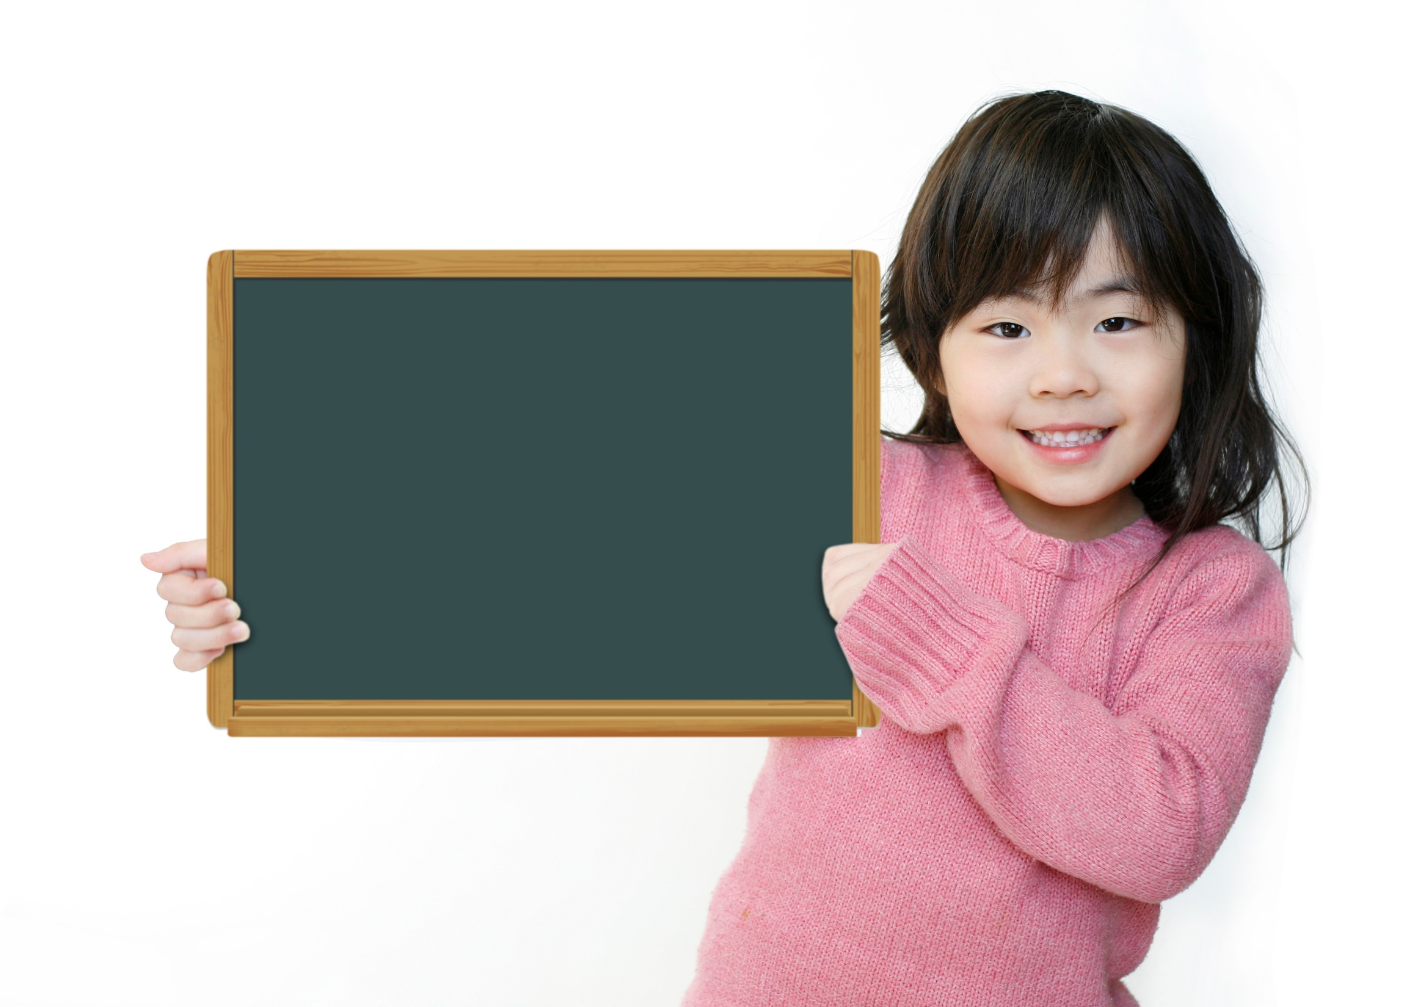
Production

Slide 21
Pair work
Ask and answer about your daily routines, using the words given.
get up early?
Mom take you to school?
have lunch at home?
play sports after school?
Dad cook dinner?
do homework in the evening?
Do you get up early?
Yes, I do. I get up at 6:00 a.m.

Slide 22

CONSOLIDATION

Slide 23
Write five questions about your friend’s routines, using Present Simple tense (interrogative form).

Slide 24

WRAP-UP

Slide 25
Today’s lesson
Grammar
Present Simple tense
(Interrogative form and short answers)

Slide 26
Homework
Practise asking about daily routines or free time activities, using Present Simple tense.
Do exercise 6 in TA 6 Right on WB (p. 26)
Complete the grammar notes in TA 6 Right on Notebook
(p. 24)
Prepare the next lesson (p. 46 SB)

Slide 27
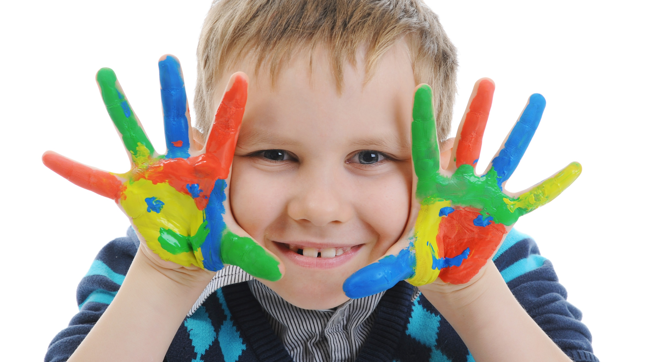
Enjoy your day!

