Slide 1


Slide 2
Unit 9
CAREER PATHS
LESSON 7
COMMUNICATION AND CULTURE / CLIL
ASKING FOR AND GIVING CLARIFICATION
Let's go

Slide 3
LESSON 7
COMMUNICATION AND CULTURE / CLIL
WARM-UP
Quiz: Watch the video and answer the questions.
Task 1: Listen and read.
Task 2: True or False.
EVERYDAY ENGLISH
Task 3: Match each word with its definition.
Task 4: Complete the sentences
CULTURE
CONSOLIDATION
Wrap-up
Homework

Slide 4
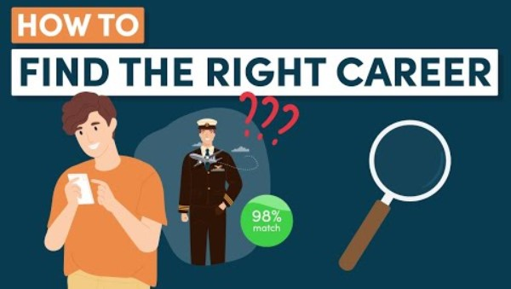
WARM-UP
https://www.youtube.com/watch?v=zhpcgpqWc1Q&t=1s

Slide 5

1. What is the primary purpose of making a list of your hobbies when exploring career options?
To impress potential employers
To identify your passions
and interests
To follow societal expectations
To showcase your
creative side

Slide 6
2. When determining your ideal career, why is it important to consider both your interests and skills?
Interests and skills are unrelated in career choices
Interests alone are sufficient
for career success
Skills alone are sufficient for career success
Both play a role in finding a fulfilling career

Slide 7
3. Why is it crucial to identify your personality traits when choosing a career?
Personality traits have no impact on career success
Personality traits change frequently
It helps align your career with your strengths and preferences
Employers are not
interested
in personality traits

Slide 8
4. What is an essential factor to consider when determining what you want out of a career?
The length of the daily commute
The availability of coffee in the workplace
The color scheme of the office
Salary, job title, or working for a cause

Slide 9
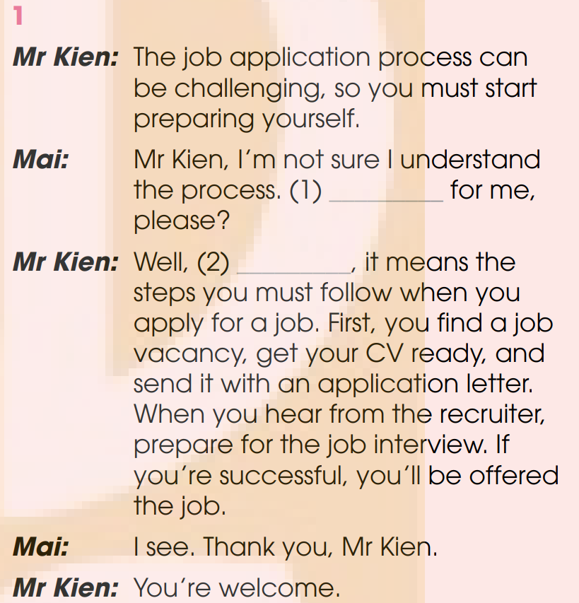
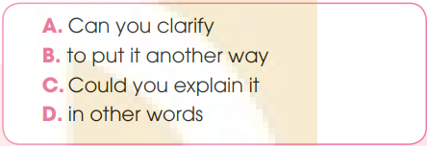
EVERYDAY ENGLISH
1
Listen and complete the conversations with the expressions in the box. Then practise them in pairs.
C
B

Slide 10
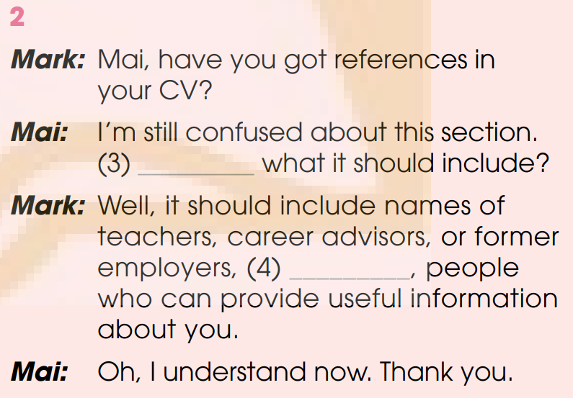
EVERYDAY ENGLISH
1
Listen and complete the conversations with the expressions in the box. Then practise them in pairs.
A
D

Slide 11
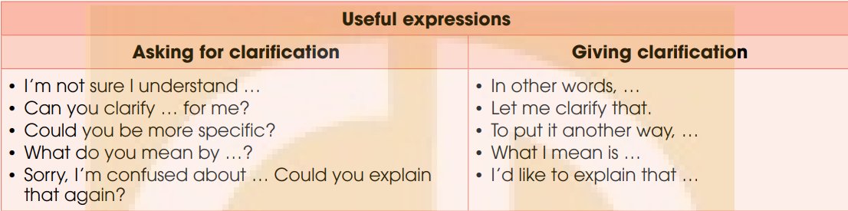
EVERYDAY ENGLISH
2
Work in pairs. Use the models in 1 to make similar conversations for these situations. One of you is A, the other is B. Use the expressions below to help you.

Slide 12
EVERYDAY ENGLISH
2
Work in pairs. Use the models in 1 to make similar conversations for these situations. One of you is A, the other is B. Use the expressions below to help you.
A is a Grade 12 student. B is a career adviser. B is explaining career path options. A is asking for clarification. B is giving clarification.
2. B is a new teaching assistant at a language centre. A has worked as a teaching assistant at the centre for several years. A is describing their job responsibilities. B is asking for clarification. A is giving clarification.

Slide 13
EVERYDAY ENGLISH
**Students’ answers:
<1>
B. So, if you don’t want to continue a formal education, you may start looking for a job. Of course, you will need on-the-job training, then.
A. Excuse me, I’m not sure I understand what ‘on-the-job training’ means. Can you clarify it for me?
B. Well, to put it another way, it is the training that you will get while doing the job.
A. Oh, I see. Thank you very much.
B. You’re welcome.

Slide 14
EVERYDAY ENGLISH
**Students’ answers:
<2>
As a new teaching assistant, your duty is to help teachers with classroom management.
B. Sorry, I’m confused about ‘classroom management’. Could you be more specific?
Well, put it in another way, classroom management is keeping students organised, focused orderly, attentive and on task during a class.
B. Yeah, I understand it now. Thank you.

Slide 15
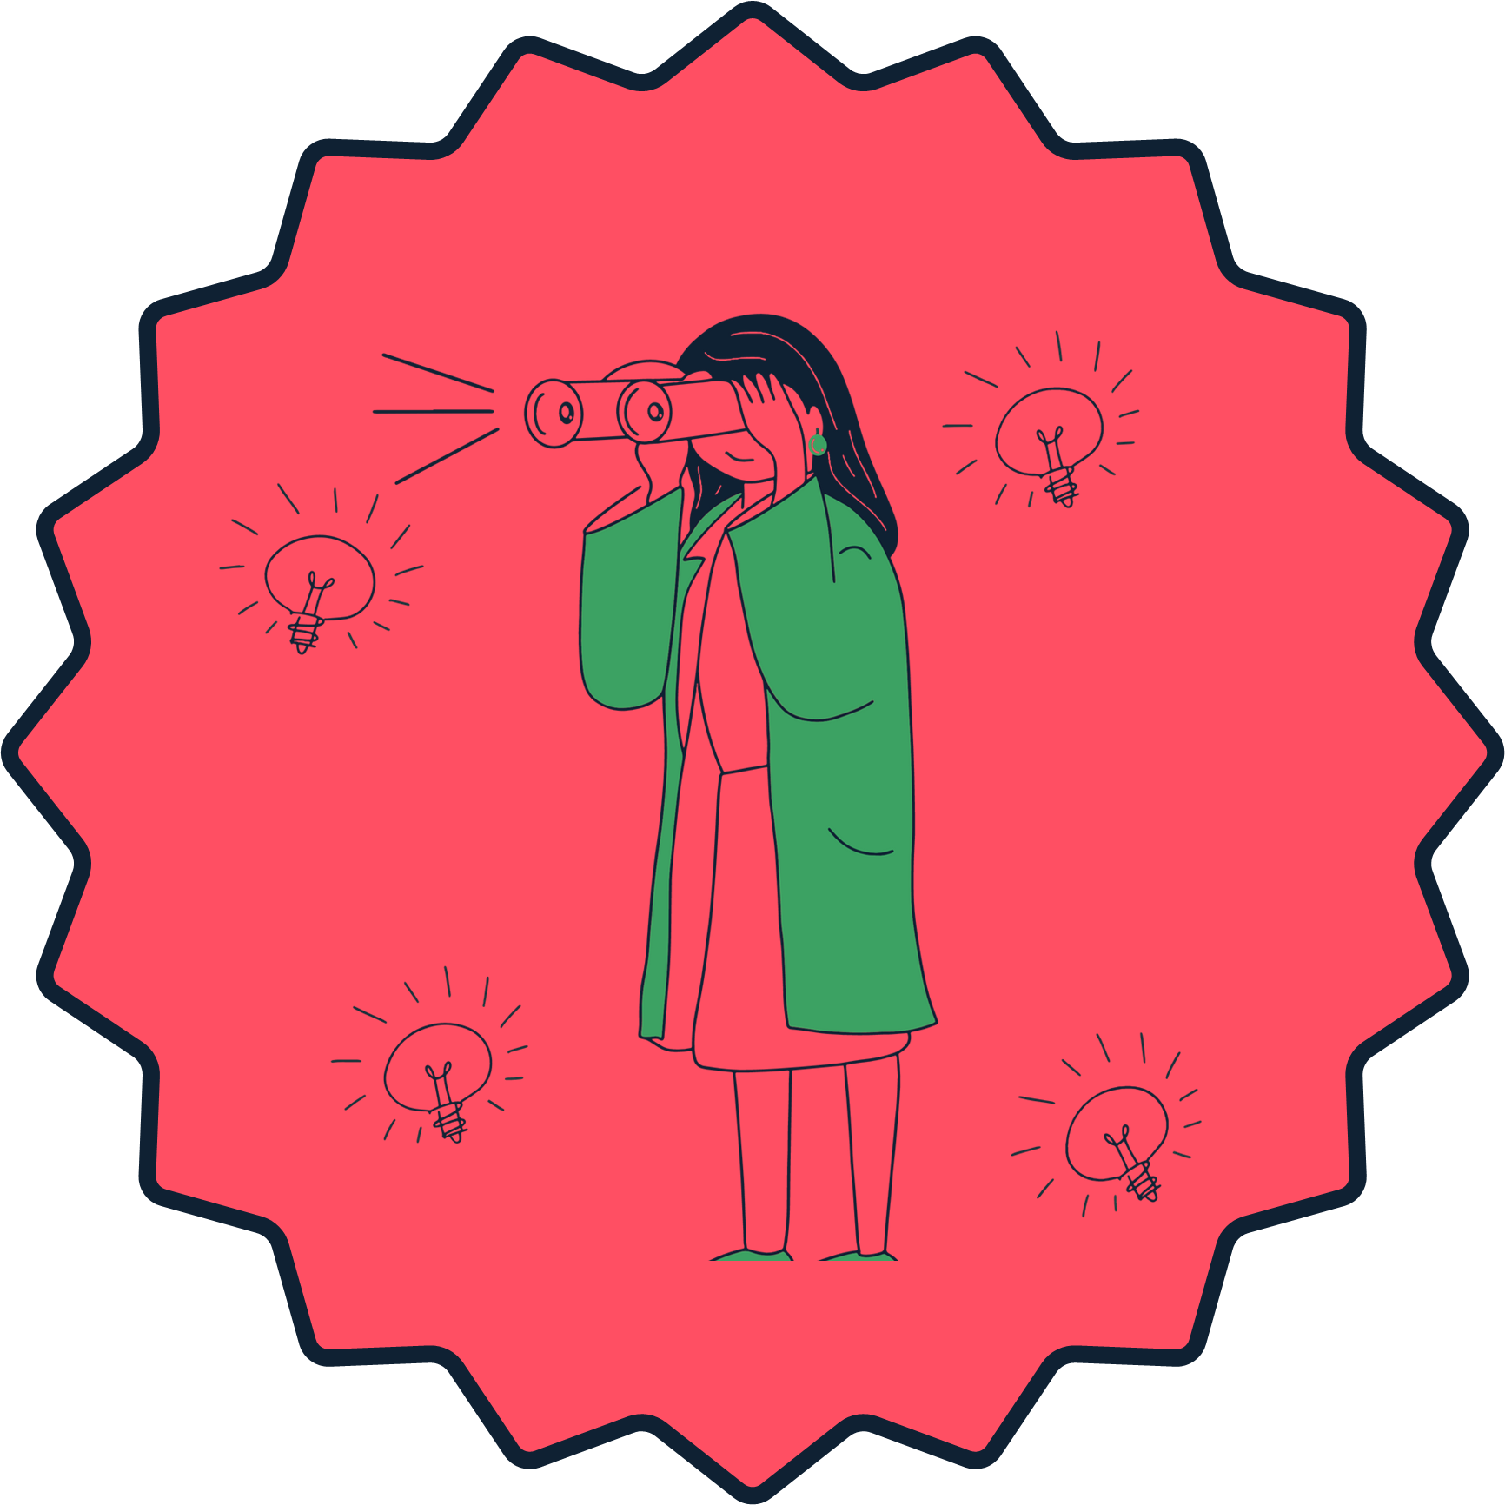
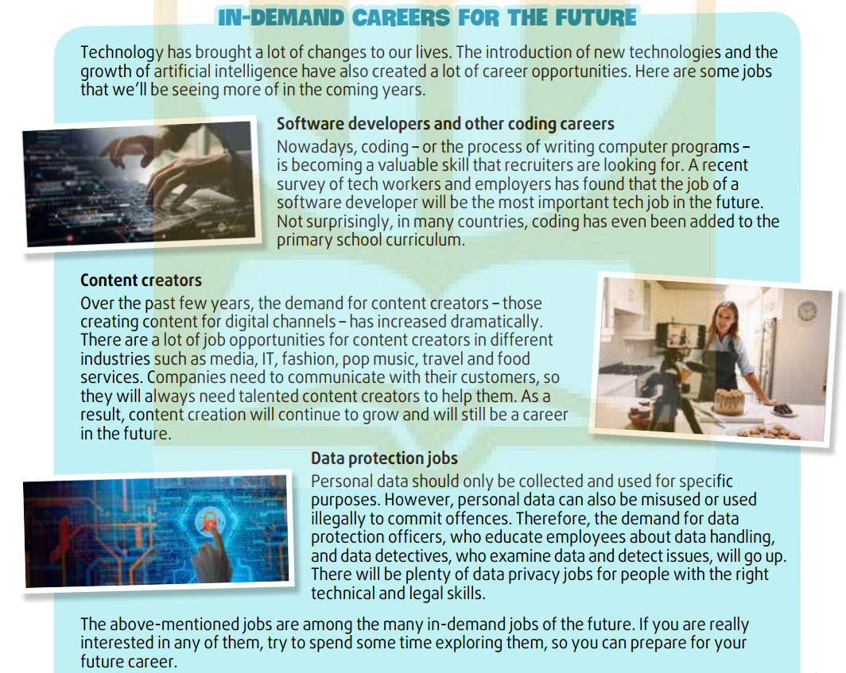
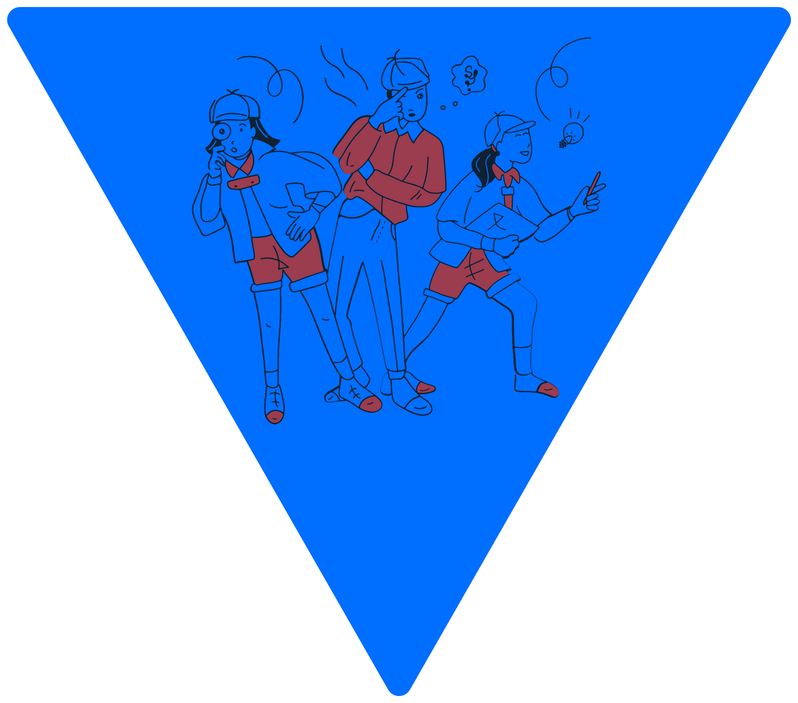
CULTURE
1
Read the text and answer the questions.

Slide 16
CULTURE
1
Read the text and answer the questions.
Which job(s) involve(s) …
1. stopping or detecting illegal actions?
2. helping businesses to understand their customers better?
3. a skill that some students can start learning from a young age?
data protection jobs
content creators
software developers and other coding careers

Slide 17
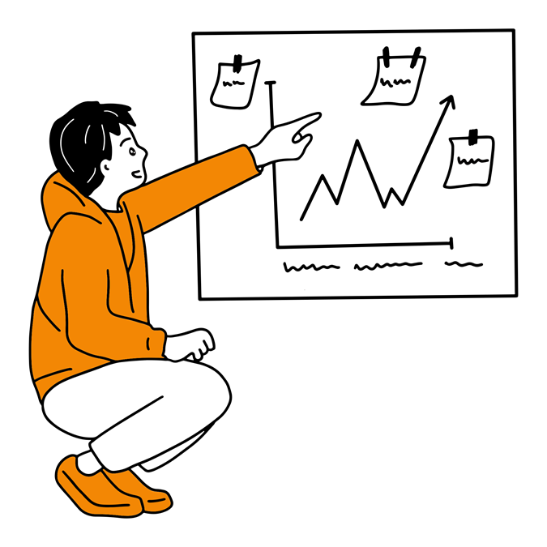
CULTURE
2
Work in pairs. Discuss the following questions.
Which job do you find the most interesting and why?
What other jobs do you think will become popular in the future?

Slide 18
CULTURE
Sample Answer:
We think the job of ‘content creator’ is the most interesting because content creators can work in different types of businesses and connect with different people.
Besides these jobs, I think other traditional jobs such as doctors and teachers will still be prevalent in the future.

Slide 19
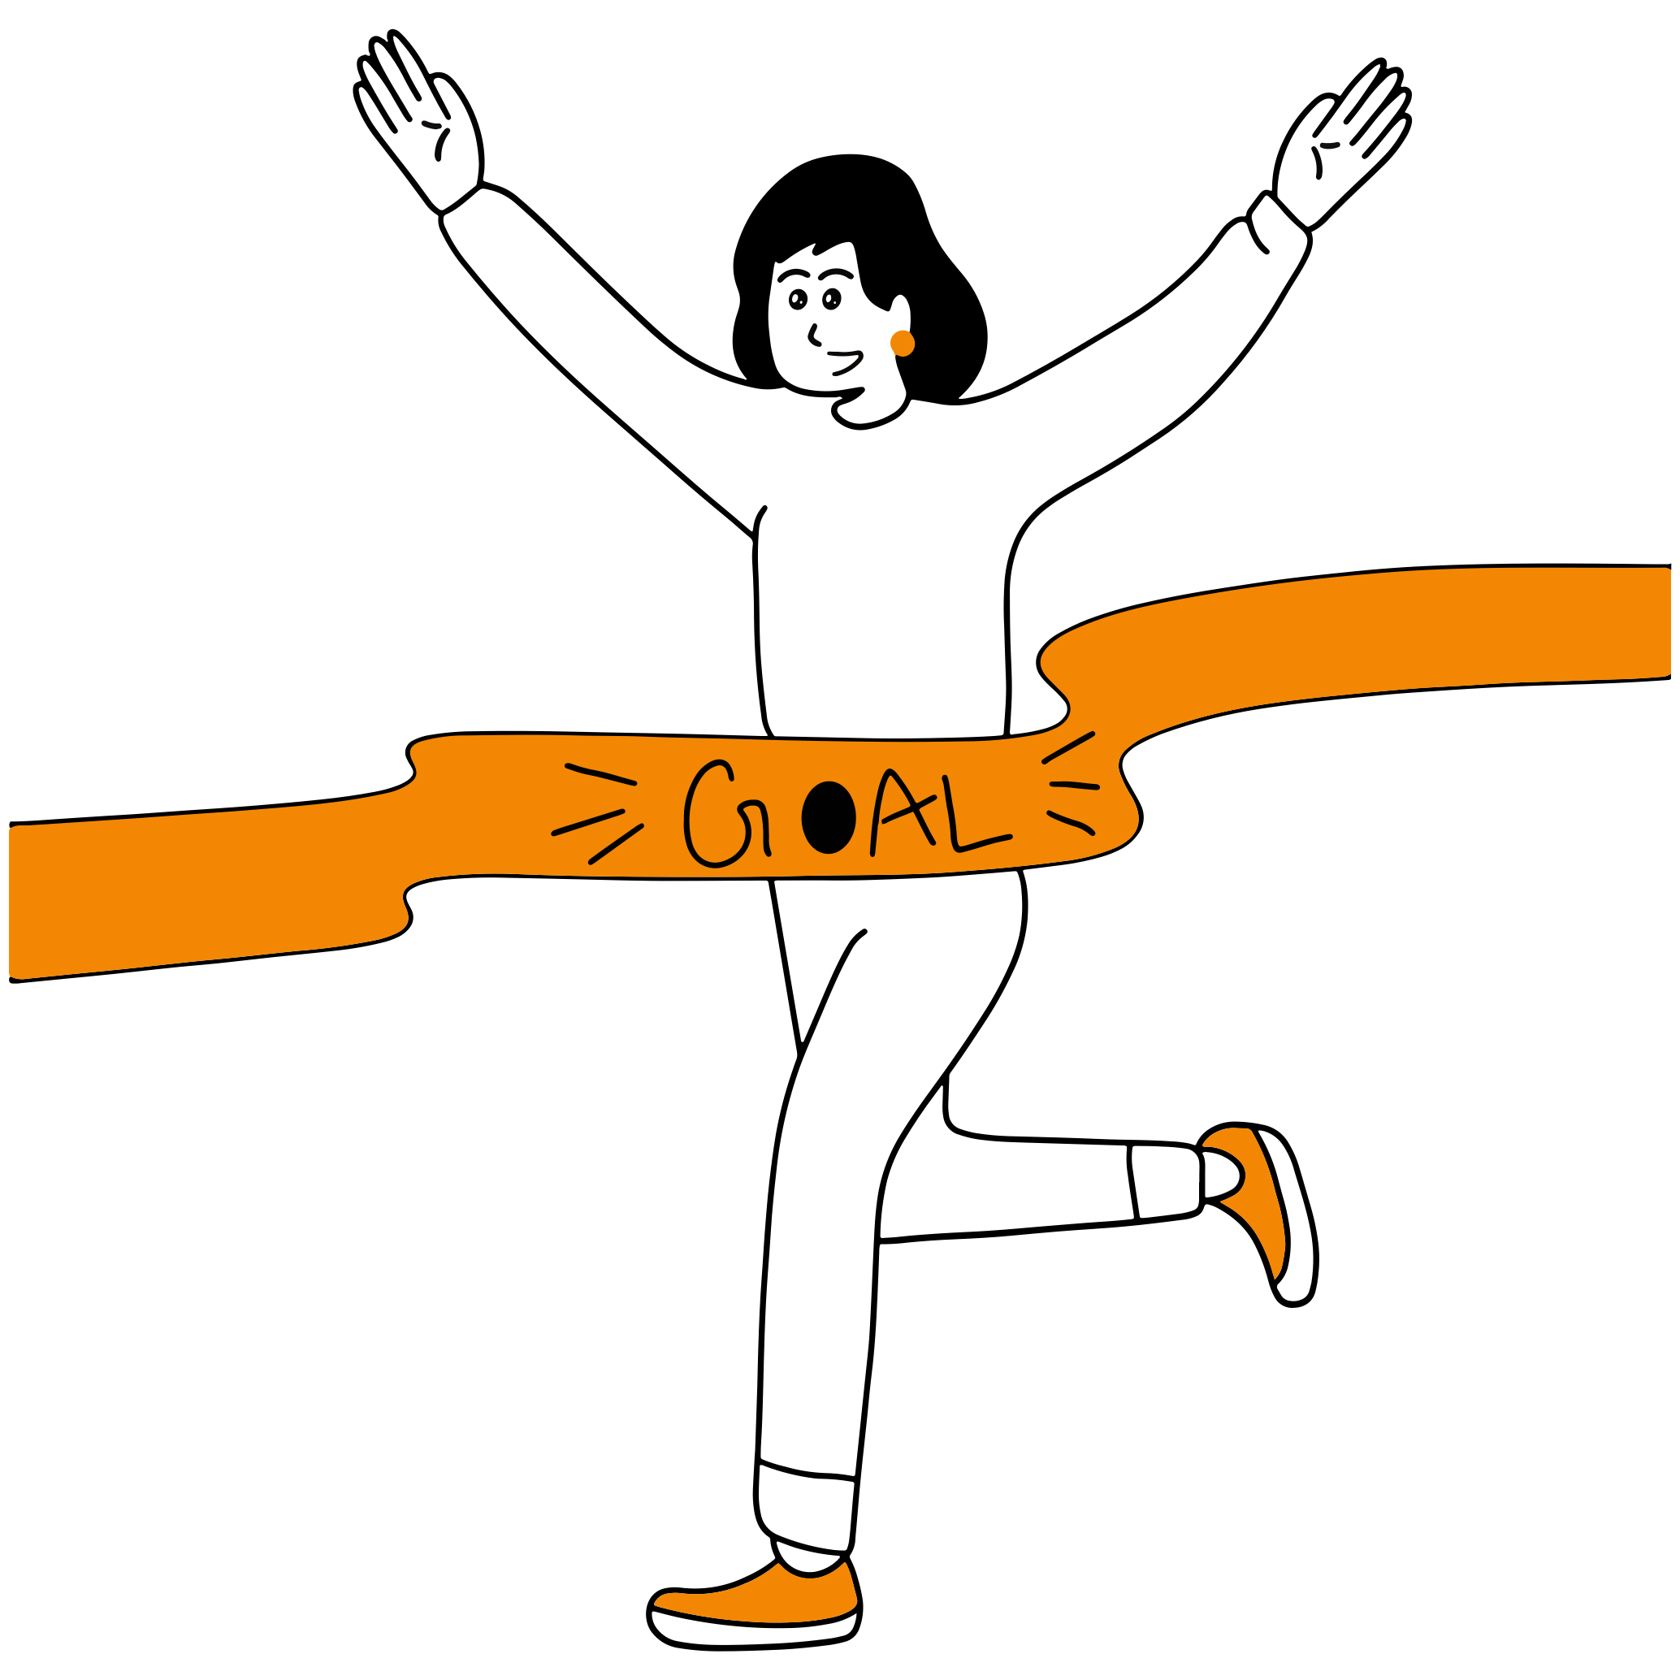
CONSOLIDATION
1
Wrap-up
What have you learnt today?
Listen for main ideas specific information and make a conversation.

Slide 20

CONSOLIDATION
2
Homework
Do exercises in the workbook.
Prepare Lesson 8 – Unit 9.

Slide 21

Website: hoclieu.vn
Fanpage: facebook.com/www.tienganhglobalsuccess.vn

