Slide 1


Slide 2
REVIEW
2
(UNITS 4-5)
FAMILY LIFE
LESSON I
LANGUAGE

Slide 3
LESSON I
GETTING STARTED
WARM-UP
GAME: Name ASEAN countries
Task 1: Underline the stressed words.
Task 2: Underline words with elision.
PRONUNCIATION
VOCABULARY
Task 1: Find the missing letters.
Task 2: Complete the sentences
Task 1: Put the verbs in brackets in the correct forms.
Task 2: Rewrite the sentences.
Task 3: Find the mistakes.
GRAMMAR
CONSOLIDATION
Wrap-up
Homework

Slide 4
WARM-UP
Name ASEAN countries
Work in 4 groups.
Each group is given a set of pictures about ASEAN countries’ flags.
Write the name of the countries below the flags.
The fastest team with correct answers is the winner.

Slide 5
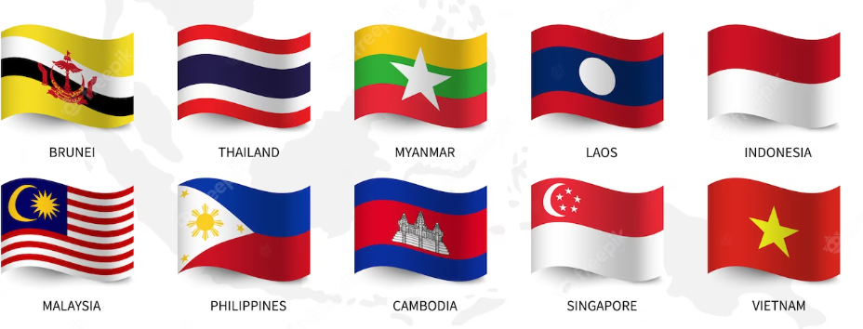

Slide 6

PRONUNCIATION
1
Underline the stressed words in each one. Then mark the stressed syllables in these words.
1. The earth is getting warmer and warmer.
2. There will be more floods and storms in the coming years.
3. ASEAN has helped its members to achieve economic growth.
4. The burning of coal and oil releases a lot of carbon dioxide into the air.

Slide 7
PRONUNCIATION
1
Underline the stressed words in each one. Then mark the stressed syllables in these words.
1. The earth is ‘getting ‘warmer and ‘warmer.
2. There will be more floods and storms in the ‘coming years.
3. ‘ASEAN has helped its ‘members to achieve eco’nomic growth.
4. The ‘burning of coal and oil releases a lot of ‘carbon di’oxide into the air.

Slide 8
PRONUNCIATION
2
Underline words with elisions in the following sentences.
diff(e)rent
5. The young ASEAN leaders had many different ideas.
6. It’s very easy to use digital cameras.
7. She’s giving a talk about the history of chocolate.
8. We’ll have our discussion on ASEAN in the library tonight.
cam(e)ras
hist(o)ry choc(o)late
libr(a)ry t(o)night

Slide 9


VOCABULARY
1
Find the missing letters.
1. Black carbon contributes to global warming.
2. World leaders agreed on reducing CO2 em_____ and ending def_________ at the COP.
3. The burning of fos__ _____ has increased the amount of gre_______ _____ in the earth’s atmosphere.
issions
orestation
il
fuels
enhouse
gases

Slide 10

VOCABULARY
2
Complete the sentences using these words and phrases.
current issues
1. Country leaders are meeting to discuss ______________, such as climate change and land use, in the region.
2. Using renewable energy is the best way to reduce _____________ emissions.
3. The company provides training sessions to improve the managers' _______________.
4. Young people need the right skills and knowledge to be able to make a ____________ to the economy.
5. ___________, such as carbon dioxide and methane, are known as greenhouse gases.
greenhouse gas
leadership skills
contribution
Pollutants

Slide 11
GRAMMAR
1
Put the verbs in brackets in the correct forms.
1. Tourists enjoy (buy) __________ handmade souvenirs on their trips to ASEAN countries.
2. (feel) __________ confident about her English, Mia decided to enter the English-speaking competition at her school.
3. I decided (reduce) __________ my carbon footprint by cycling to school.
buying
Feeling
to reduce

Slide 12
GRAMMAR
1
Put the verbs in brackets in the correct forms.
4. Because air pollution levels rise in the city, doctors recommend (wear) __________ masks outdoors.
5. World leaders need (work) __________ together to solve big health and environmental problems.
wearing
to work

Slide 13
GRAMMAR
2
Rewrite the sentences using gerunds or participle clauses.
1. If you use an online dictionary in this way, you can learn many new words.
→ __________________, an online dictionary can help you learn many new words.
2. It was wonderful to go on the ASEAN tour.
→ ______________________ was a wonderful experience.
3. The farmers cut down the trees, and started using the land for growing crops.
→ ______________________, the farmers started using the land for growing crops.
Used in this way
Going on the ASEAN tour
Cutting down the trees

Slide 14
GRAMMAR
2
Rewrite the sentences using gerunds or participle clauses.
4. The sun warms the earth’s surface, which releases heat into the air.
→ ____________________, the earth’s surface releases heat into the air.
5. She usually prepares the guest list for all conferences.
→ She is responsible for ______________________ for all conferences.
Warmed by the Sun
preparing the guest list

Slide 15
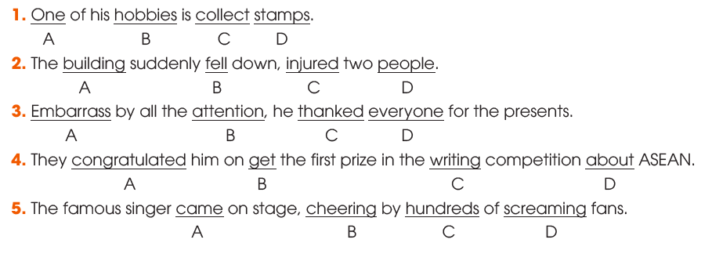
GRAMMAR
3
Circle the underlined part that is incorrect in each of the following sentences. Then correct it.
→ collecting
→ injuring
→ Embarrassed
→ getting
→ cheered

Slide 16
CONSOLIDATION
1
Wrap-up
What have you learnt today?
Pronunciation: word stress, sentence stress and elision
Vocabulary of Unit 4 and 5
Grammar of Unit 4 and 5

Slide 17
CONSOLIDATION
2
Homework
Do exercises in the workbook.
Prepare for Review 2 - Skills (1).

Slide 18

Website: hoclieu.vn
Fanpage: facebook.com/www.tienganhglobalsuccess.vn

