Slide 1

Unit 6: Education
Lesson 2.2: Grammar
Page 48

Slide 2


LESSON OUTLINE
Consolidation

Slide 3

By the end of this lesson, students will be able to…
use intensifiers (so and really) and because.

Slide 4

Because

Slide 5

WARM UP

Slide 6

Work in pairs.
Match the questions to the answers
1. Why were you surprised?
2. Why are you so upset?
3. Why does James think he failed some tests?
A. Because they were so difficult.
B. Because I got an F.
C. Because I got a good grade on my English test.

Slide 7



Slide 8
PRESENTATION
Because

Slide 9
Lead in
Read the sentences and choose the correct words to complete the rules.
I failed my math test because I didn't study.
2. Why are you upset?
I’m so disappointed because I got an F.
3. I'm delighted because I got 100% on my science test.
Because
is used to
two
connect …………clauses in a sentence
why
answer question “…………”
reason
give a …………. for the other clause.

Slide 10
Read the sentences and choose the correct words to complete the rules.
He's so happy because he passed his test.
Why are you so angry? I was trying to be nice!
My teacher is really annoyed because I lost my math book.
I really want to buy that computer game.
3.
We use the intensifiers so and really to make adjectives…………….
We can use so to show……………… about something being more than you expect it to be.
We can use really before……………….. or some verbs to make them stronger. It is a little stronger than "very."
stronger
surprise
adjectives

Slide 11
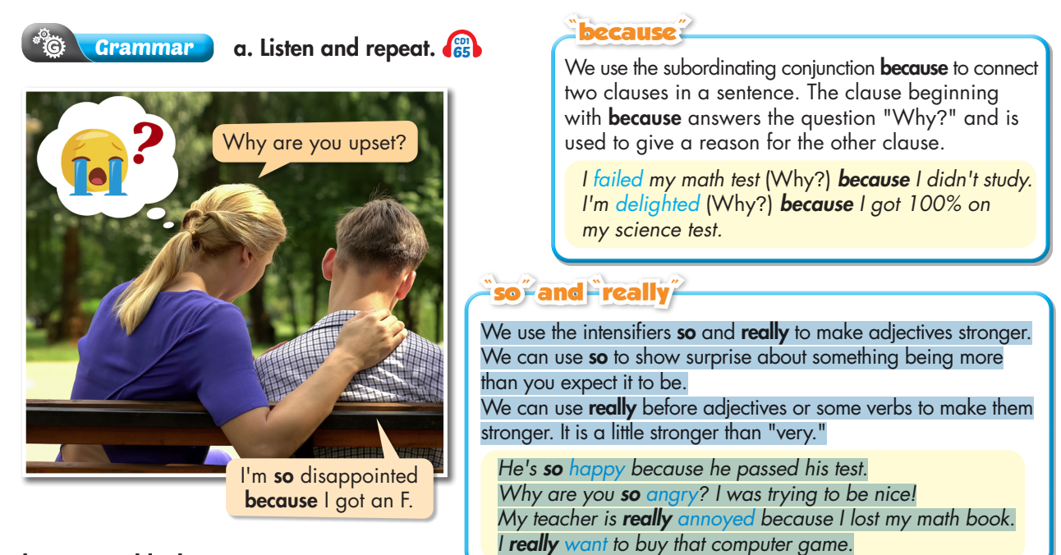


Slide 12

PRACTICE

Slide 13
b. Unscramble the sentences.
1. because/passed/really/English/I/happy/I'm/my/test.
______________________________________________________________
2. lost/because/She's/her/upset/math textbook./she/so
______________________________________________________________
3. mom/My/my/failed/geography/disappointed/really/because/test./I/is
______________________________________________________________
4. annoyed/got a D/history/homework./so/my/on/I'm/I/because
______________________________________________________________
5. were/surprised/The students/really/they/passed/exams./their/because
______________________________________________________________
6. she/on/pleased/was/She/because/so/her/got an A/math test.
______________________________________________________________
I'm really happy because I passed my English test.
She's so upset because she lost her math textbook.
My mom is really disappointed because I failed my geography test.
I'm so annoyed because I got a D on my history homework.
The students were really surprised because they passed their exams.
She was so pleased because she got an A on her math test.

Slide 14
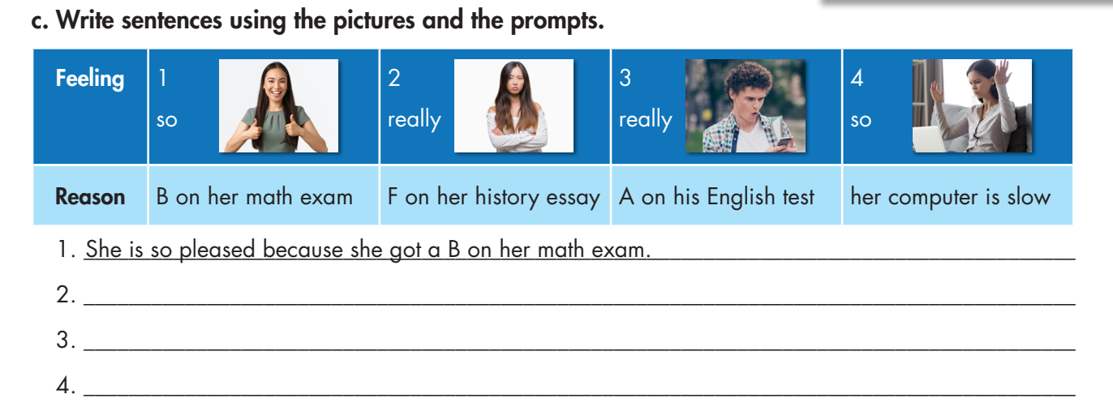
She is really disappointed because she got an F on her history essay.
He is really surprised because he got an A on his English test.
She is so annoyed because her computer is slow.

Slide 15

Extra Practice
WB, page 35
1. are/my/because/so/I/passed/parents/exams./all/My/delighted
_________________________________________________________________
2. I/class./of/didn't/come/because/top/disappointed/I'm/the
_________________________________________________________________
3. physics/really/I/I'm/because/test./passed/my/surprised
_________________________________________________________________
4. his/test./math/annoyed/failed/very/because/He's/he
___________________________________________________________
5. presentation./my/was/very/pleased/class/The/teacher/with
_________________________________________________________________
My parents are so delighted because I passed all my exams.
I'm disappointed because I didn't come top of the class.
I'm really surprised because I passed my physics test.
He's very annoyed because he failed his math test.
The teacher was very pleased with my class presentation.

Slide 16
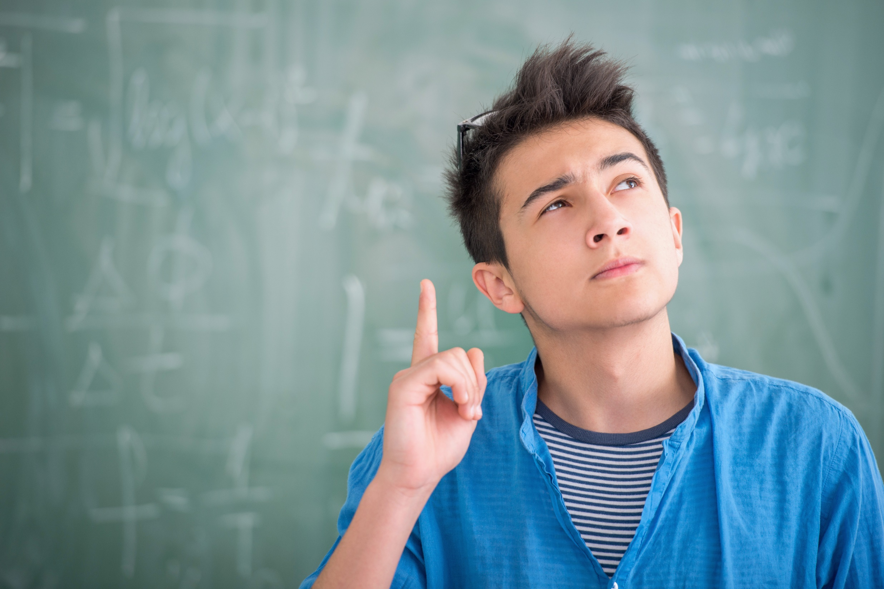
PRODUCTION

Slide 17
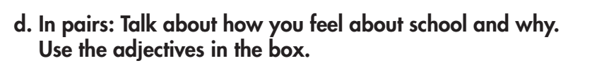
I'm really pleased because I got an A on my math test.

Slide 18

CONSOLIDATION

Slide 19

How do you feel about the following things at school? Write a sentence for each.
1. School sports competitions: ________________________________________________
2. School lunches: ________________________________________________
3. School lessons: ________________________________________________

Slide 20
How do you feel about the following things at school? Write a sentence for each.
Sample answer:
1. School sports competitions make me feel delighted because they are fun and exciting.
2. I'm very annoyed with school lunches because the food is always the same.
3. I'm really pleased with school lessons because our teachers are funny and helpful.

Slide 21
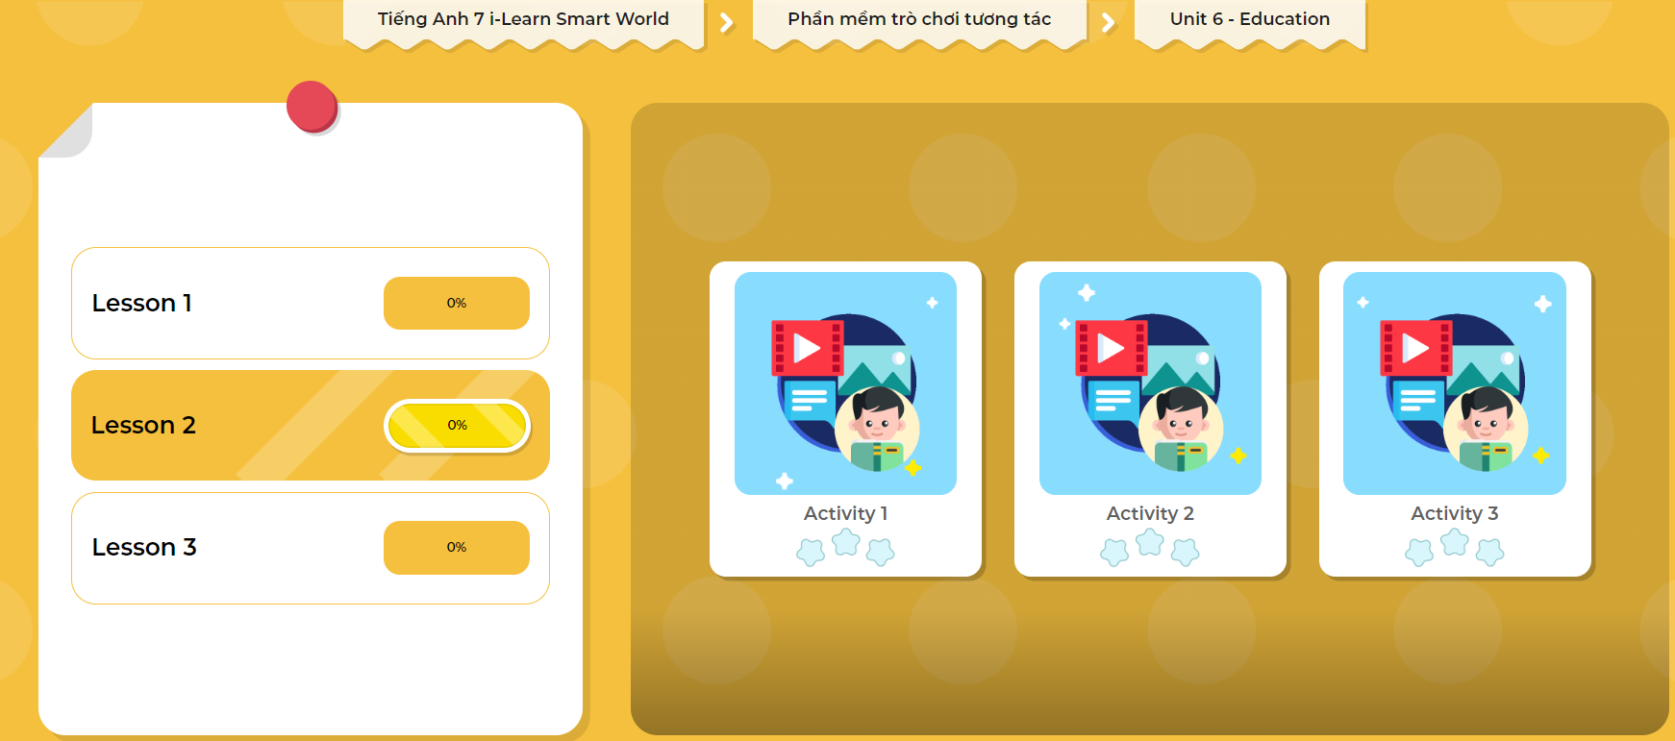
LET’S PLAY!
Click here to play the games

Slide 22

WRAP-UP

Slide 23
Today’s lesson
Grammar:
Use Because to give reason and answer the question Why
Use intensifiers (so and really) to make adjectives stronger.
Speaking & Writing:
- Talk and write about how did you feel about school and school things and why.

Slide 24
Homework
Practice making sentences, using Because, So, and Really.
Do the writing exercise in workbook p.35.
Complete the grammar notes in Tiếng Anh 7 i-Learn Smart World Notebook (Page 39)
Prepare the next lesson (page 49 SB).
Play the consolidation games in Tiếng Anh 7 i-Learn Smart World DHA App on www.eduhome.com.vn

Slide 25

Lesson 3
Stay positive and have a nice day!

