Slide 1
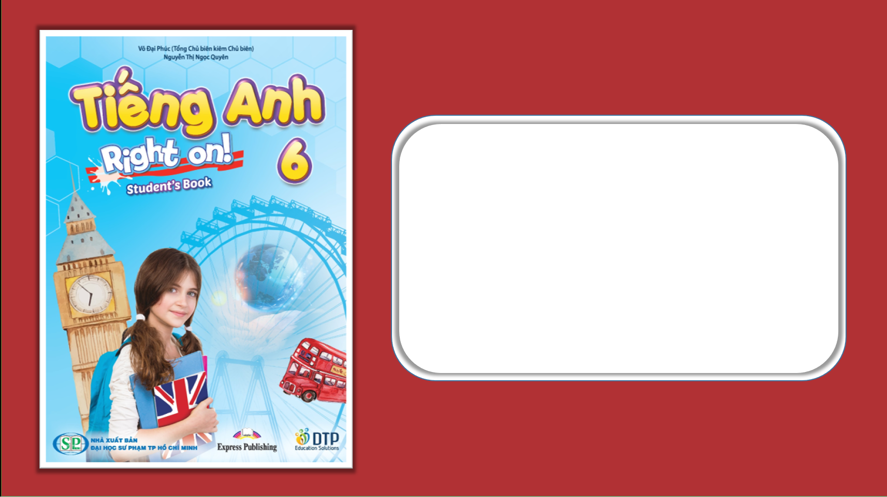
Unit 6: Entertainment
Lesson 6e: Grammar
Page 110

Slide 2
Lesson Outline
Warm-up
Presentation
Practice
Speaking
Consolidation
Wrap-up

Slide 3
Objectives
By the end of this lesson, students will be able to…
- learn might – should (shouldn’t).
- learn the structure to show interest and give advice.
- talk about the etiquette in their country.

Slide 4

WARM-UP

Slide 5
1 ★ Underline the correct item.
1 I nearly fell asleep during the film. It was the most boring/bored film I’ve ever seen.
2 I find documentaries very interested/interesting and educational. I like learning about nature!
3 John was disappointed/disappointing with the new thriller. It wasn’t scary at all!
4 The new action film is out! I’m so exciting/ excited!

Slide 6
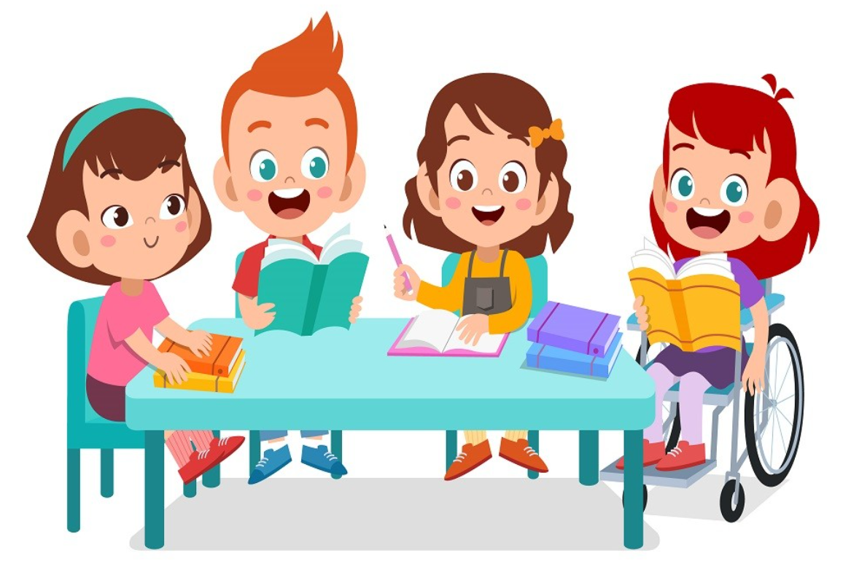
It’s time to learn …

Slide 7
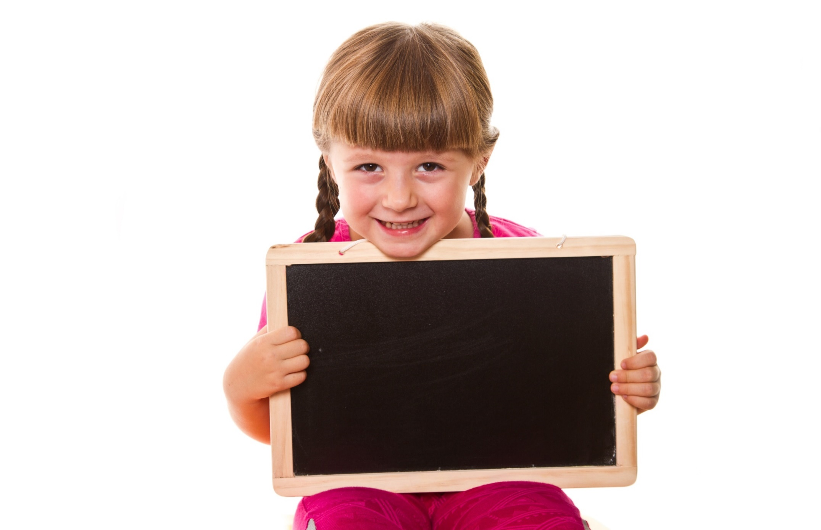
Presentation

Slide 8
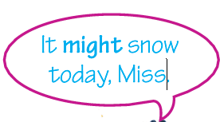
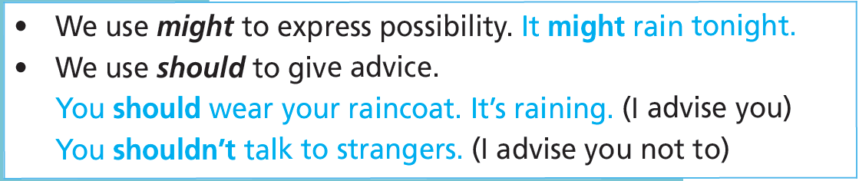
might – should(n’t)
You should stay in,
then. You shouldn’t
go out.

Slide 9
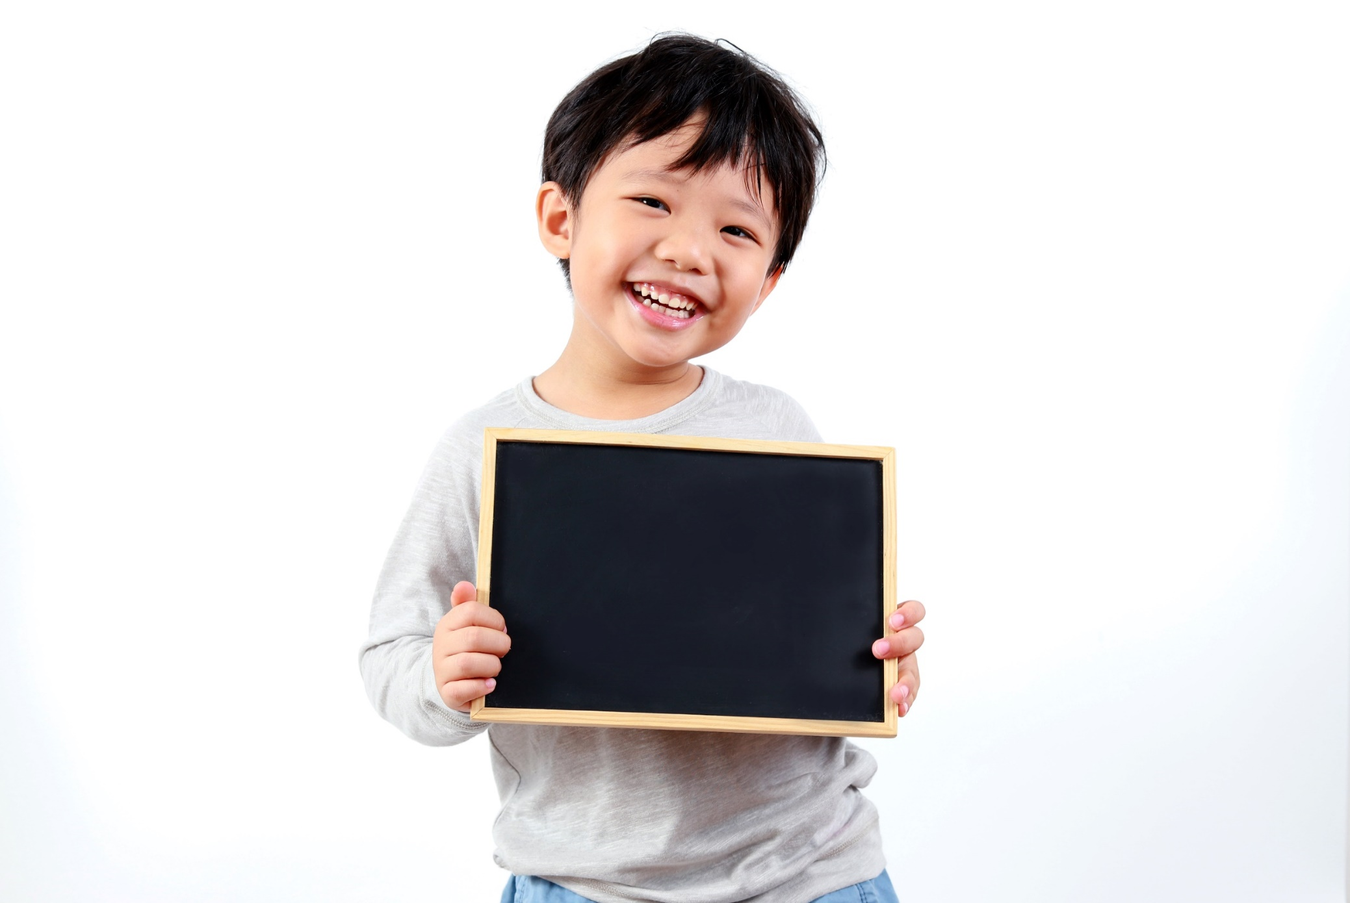
Practice

Slide 10
1 Look at the pictures. Use the prompts to make sentences as in the example.
• become a pianist • fall • fall behind with homework • have a car crash
Ann
Steve
Mark
Laura
Ann might fall.
Mark might have a car crash.
Steve might fall behind with his homework.
Laura might become a pianist.

Slide 11

Mime an activity. The class in teams guess what might happen to you.

Slide 12
2 Look at the notes. What should/shouldn't one do while visiting someone in Canada? Write sentences in your notebook.
Etiquette
1 take off sunglasses when you talk to someone (✓)
2 arrive late at a meeting (✗)
3 put elbows on the table when eating (✗)
4 eat with your hands (✗)
5 talk with your hands in your pockets (✗)
6 bring flowers or chocolates when you visit someone (✓)

Slide 13
2 Look at the notes. What should/shouldn't one do while visiting someone in Canada? Write sentences in your notebook.
Etiquette
1 take off sunglasses when you talk to someone (✓)
2 arrive late at a meeting (✗)
3 put elbows on the table when eating (✗)
1. You should take off sunglasses when you talk to someone.
2. You shouldn’t arrive late at a meeting.
3. You shouldn’t put elbows on the table when eating.

Slide 14
2 Look at the notes. What should/shouldn't one do while visiting someone in Canada? Write sentences in your notebook.
4 eat with your hands (✗)
5 talk with your hands in your pockets (✗)
6 bring flowers or chocolates when you visit someone (✓)
You shouldn’t eat with your hands.
You shouldn’t talk with your hands in your pockets.
You should bring flowers or chocolates when you visit someone.

Slide 15
1 ★ Underline the correct item.
More Practice
WB p. 58
1 John might/should come later but he isn’t sure.
2 You should/might see a doctor; you don’t look well.
3 If it snows tomorrow, you might/should stay at home.
4 He doesn’t drive carefully; he might/ should have an accident.
5 You should/shouldn’t tell lies to your parents.

Slide 16
More Practice
GB p. 72
37 ★ Rewrite the sentences. Use might, should or shouldn’t.
might
1 You __________________ meet Tony at the party if you come.
2 You __________________ be rude.
3 You __________________ show respect to people.
4 You __________________ buy food from local shops while on holiday.
5 Ann __________________ call us if she finishes early.
6 He __________________ be late today; he needs to work overtime.
shouldn’t
should
should
might
might

Slide 17
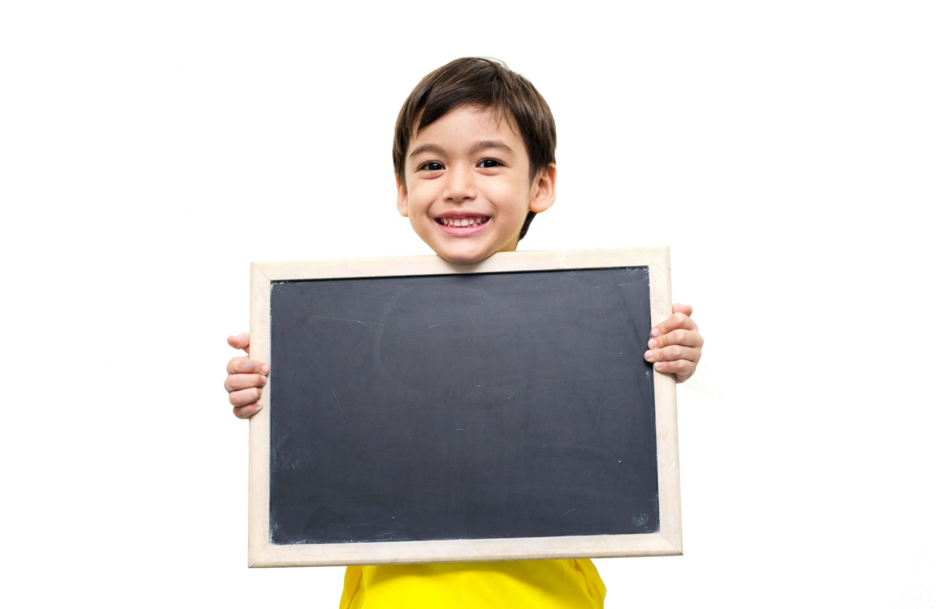
Speaking

Slide 18
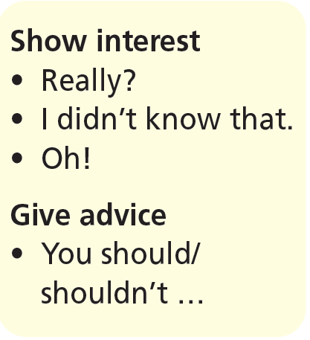
3. What is the etiquette in your country? Prepare a list.
Act out a dialogue. Use the phrases in the box.
A: I’m going to Vietnam next week.
B: Really? It’s a beautiful country.
A: You were there last year. Is there something I should know?
B: Well, you should ...
A: Really? Anything else ...

Slide 19

CONSOLIDATION

Slide 20
Write a paragraph (about 40-60 words) to about etiquette in your country.

Slide 21

WRAP-UP

Slide 22
Today’s lesson
Grammar
- might
- should, shouldn’t

Slide 23
Homework
Practise the grammar points and make sentences using them.
Do the exercises in TA 6 Right on WB (p. 58).
Complete the grammar notes in TA 6 Right on Notebook (p. 58).
Prepare the next lesson (p. 111 SB).

Slide 24
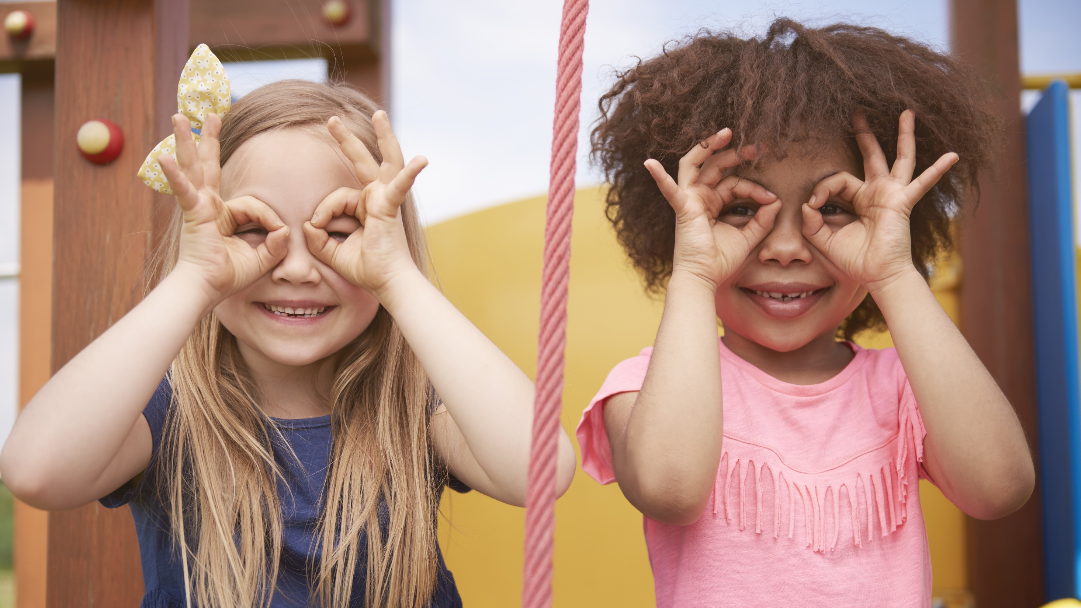
Enjoy your day!

