Slide 1


Slide 2
Unit
3
CITIES OF THE FUTURE
Unit
FAMILY LIFE
LESSON 4
SPEAKING
Discussing cities of the future

Slide 3
LESSON 4
SPEAKING
WARM-UP
Watch a video
PRE-SPEAKING
Task 1. Work in pairs. Complete the diagram.
Task 2. Match the questions with the answers to make a conversation.
Task 3. Practise asking and answering about future cities
Task 4. Practise discussing cities of the future
WHILE-SPEAKING
POST-SPEAKING
Further practice
Wrap-up
Homework
CONSOLIDATION

Slide 4

WARM-UP
WATCH A VIDEO
Notes:
https://youtube.com/watch?v=m1z1rAC7nBs&feature=share

Slide 5
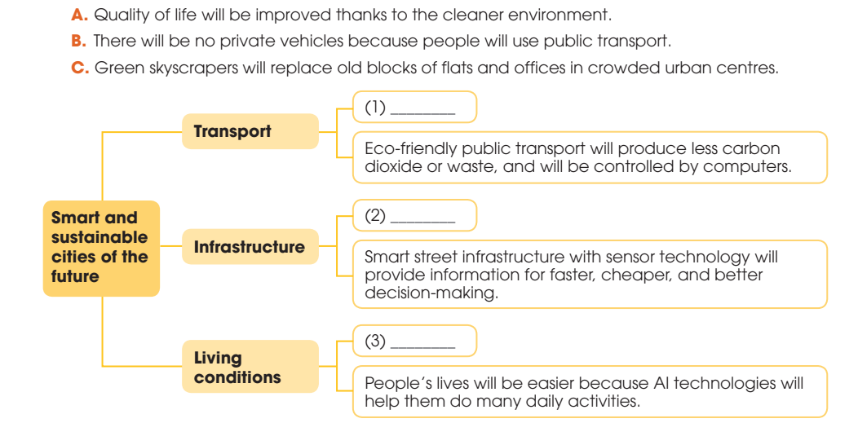
PRE-SPEAKING
1
Work in pairs. Complete the diagram with the ideas below .
B
B
C
C
A
A

Slide 6
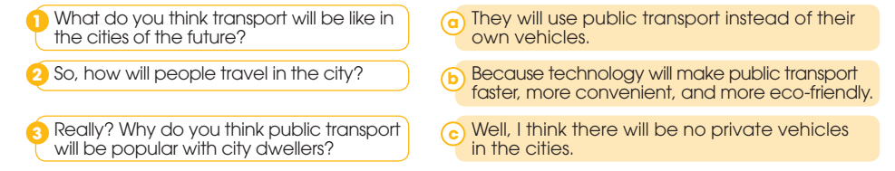
WHILE-SPEAKING
2
Match the questions with the answers to make a conversation. Then practice it in pairs.
1. C
2. A
3. B

Slide 7
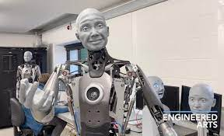
WHILE-SPEAKING
3
Work in pairs. Ask and answer questions about one of the features of future cities in 1. Use the model and the tips in 2 to help you.
Example: A: How will city dwellers’ life be like in the future? B: Well, I think people’s lives will be easier because AI technologies will help them do many daily activities. A: So, what kinds of activities can be done by AI technologies? B: Robots can help people do household chores and smart sensors can inform people of possible congestion in the street. It really saves people time and money. A: That’s great.

Slide 8

WHILE-SPEAKING
4
Work in groups.
Discuss what the cities of the future will be like and present your groups’ ideas to the whole class.

Slide 9

POST-SPEAKING
FURTHER PRACTICE
Work in pairs and talk about the feature that they like most about the future cities.

Slide 10
CONSOLIDATION
1
Wrap-up
What have you learnt today?
How to discuss cities of the future

Slide 11
CONSOLIDATION
2
Homework
Do exercises in the workbook.
Prepare for Lesson 5 - Unit 3.

Slide 12

Website: hoclieu.vn
Fanpage: facebook.com/www.tienganhglobalsuccess.vn

