Slide 2
Review 2
LESSON 1
LANGUAGE

Slide 3
LESSON 1
LANGUAGE
WARM-UP
Menti Game
Task 1: Mark the letter A, B, C or D.
Task 2: Mark the letter A, B, C or D.
Task 3: Mark the letter A or B.
Task 4: Underline the stressed words.
PRONUNCIATION
Task 1: Choose the synonym.
Task 2: Choose the antonym.
Task 3: Choose the best answer.
VOCABULARY
Task 1: Choose the correct answer.
Task 2: Choose the sentence that has the same meaning.
GRAMMAR
CONSOLIDATION
Wrap-up
Homework

Slide 4
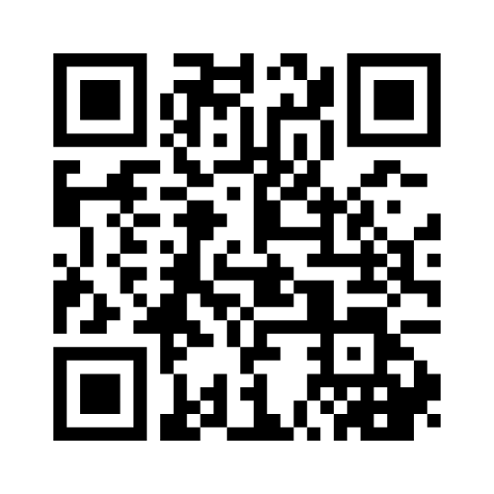
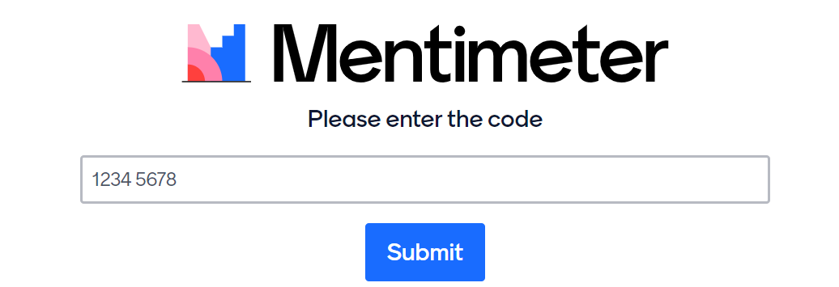
WARM-UP
MENTI GAME
Enter: menti.com
Scan the QR code or enter the code
SCAN ME
Notes:
Link menti: https://www.menti.com/alcme5pr1ppf

Slide 5
WARM-UP
Write down three types of sentences you have learnt in Unit 5

Slide 6
PRONUNCIATION
1
Choose the word whose underlined part differs from the other three in pronunciation.
1. A. afford | B. urban
C. area | D. expand
2. A. bonus | B. employ
C. overtime | D. local

Slide 7
PRONUNCIATION
2
Choose the word which differs from the other three in the position of the main stress.
1. A. concern | B. bonus
C. housing | D. leisure
2. A. flexible | B. glamorous
C. rewarding | D. challenging

Slide 8

PRONUNCIATION
3
Choose the stressed auxiliary or modal verb.
1. Peter (A) will attend the job fair next week if he (B) can.
2. A: His grandmother (A) doesn’t enjoy living in the city.
B: Well, actually, she (B) does.

Slide 9
PRONUNCIATION
4
Underline the unstressed words in each one.
1. Life in the city is very convenient and comfortable, but also expensive.
2. It usually takes thirty to eighty job applications to get a job offer.

Slide 10
VOCABULARY
1
Choose the word or phrase closest in meaning to the underlined word.
1. Today, young people from rural areas often move to big cities to seek better job opportunities.
A. look for B. look at
C. carry out D. look after
2. Many employers find it difficult to recruit workers for night shifts.
A. working conditions B. performances
C. working hours D. lifestyles

Slide 11
VOCABULARY
3. A lot of companies provide their employees with affordable housing.
A. places B. warehouses
C. containers D. homes
4. The company has employed more people to work on the new project this year.
A. hired B. supported
C. stopped D. used

Slide 12
VOCABULARY
2
Choose the word or phrase opposite in meaning to the underlined word.
1. The authorities are planning to expand the local airport and make it more modern.
A. widen B. reduce C. build up D. shorten
2. Very few people can afford a home in city centres nowadays.
A. have enough money to buy
B. be able to buy
C. don't have enough money to buy
D. don't have any money to buy

Slide 13
VOCABULARY
3. Working as a researcher can be mentally challenging, but it is very interesting.
A. boring B. simple C. reliable D. difficult
4. A lot of companies have cut down on staff, so the number of jobless people is getting higher and higher.
A. employed B. unemployed
C. recruited D. trained

Slide 14
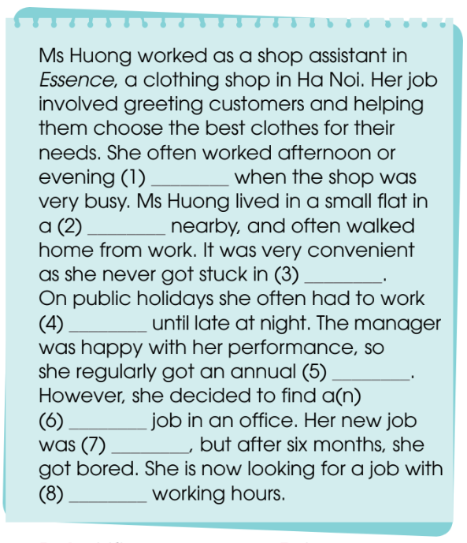
VOCABULARY
3
Choose the correct word or phrase to complete the passage.
Key:
1. A 2. B 3. D
4. C 5. A 6. C
7. A 8. B

Slide 15
GRAMMAR
1
Mark the letter A, B, C, or D to indicate the correct answer.
1. This is the first time I ____ on the Ha Noi Metro.
A. have travelled B. will travel
C. travel D. travelled
2. The ____ serious the air pollution in the city is becoming, the ____ its negative impact is on people’s life there.
A. less … more B. more … bigger
C. fewer … fewer D. more … less

Slide 16
GRAMMAR
3. ______ people now tend to move to big cities to look for better job opportunities.
A. More and less B. Less and less
C. More and more D. Fewer and fewer
4. My grandparents don’t want to live in the city ______ they don't like the crowded streets and the traffic jams.
A. although B. because C. moreover D. if

Slide 17
GRAMMAR
5. The increasing number of private cars causes traffic jams; _____, it is also the main reason for air pollution in big cities.
A. as a result B. on the other hand C. so that D. moreover
6. Local authorities have improved the frequency of public transport _____ more people will find it convenient to use.
A. so that B. not only C. such that D. neither

Slide 18
GRAMMAR
2
Choose the sentence that is closest in meaning to each of the given sentences.
1. Shopping centres are places where people go shopping as well as places where friends and family go to meet, eat, and be entertained.
A. Shopping centres are neither places where people go shopping nor places where friends and family go to meet, eat, and be entertained.
B. Although shopping centres are places where people go shopping, they are not places where friends and family go to meet, eat, and be entertained.
C. Shopping centres are places where people go shopping because these are places where friends and family go to meet, eat, and be entertained.
D. Shopping centres are not only places where people go shopping, but also places where friends and family go to meet, eat, and be entertained.

Slide 19
GRAMMAR
2. I have been to a job fair once before. A. This is the first time I have been to a job fair. B. This is the second time I have been to a job fair. C. This is the last time I have been to a job fair. D. I have been to a job fair three times this year.

Slide 20
GRAMMAR
3. My friend performed his duties at work very efficiently. He was promoted after only one month.
A. Although my friend performed his duties at work very efficiently, he was promoted after only one month.
B. My friend performed his duties at work very efficiently because he was promoted after only one month.
C. My friend performed his duties at work very efficiently; as a result, he was promoted after only one month.
D. My friend didn’t perform his duties at work so efficiently that he was promoted after only one month.

Slide 21
GRAMMAR
4. The air in big cities was polluted, and now it is even more polluted.
A. The air in bigger and bigger cities was polluted.
B. The air in big cities is becoming more and more polluted.
C. The air in big cities used to be polluted, but now it is cleaner.
D. The more polluted the air was, the less polluted big cities were.

Slide 22
GRAMMAR
5. If you get more work experience, you will have a greater chance of employment.
A. The more work experience you get, the greater chance of employment you will have.
B. The more work experience you get, the less chance of employment you will have.
C. Although you get more work experience, you will have greater chance of employment.
D. The less work experience you get, the greater chance of employment you will have.

Slide 23
GRAMMAR
6. She has a well-paid job, but she always works overtime to earn more money.
A. If she has a well-paid job, she always works overtime to earn more money.
B. She has a well-paid job; moreover, she always works overtime to earn more money.
C. When she has a well-paid job, she always works overtime to earn more money.
D. Although she has a well-paid job, she always works overtime to earn more money.

Slide 24
CONSOLIDATION
1
Wrap-up
What have you learnt today?
Revise the knowledge learnt in Unit 4-5

Slide 25
CONSOLIDATION
2
Homework
Do exercises in the workbook.
Prepare for Review 2 - Skills (1)

Slide 26
Website: hoclieu.vn
Fanpage: facebook.com/www.tienganhglobalsuccess.vn

