Slide 1

UNIT 8: ECOLOGY AND THE ENVIRONMENT
Lesson 2.3 – Pronunciation & Speaking
Page 69

Slide 2



Lesson 2.3
LESSSON OUTLINE
Consolidation

Slide 3
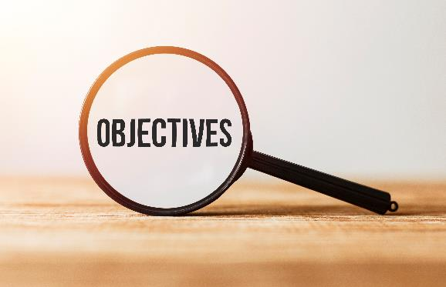
By the end of this lesson,
students will be able to:
- practice sound change of Would.
- talk about improving the environment.
- improve speaking skill.

Slide 4



Slide 5

Choose the word whose main stress is placed
differently from the others.
Work in pairs.
A. compost B. livestock C. package D. motel
2. A. impact B. landfill C. canoe D. forest
3. A. stuntwoman B. solution C. accountant D. decision
/ˈkɑ:mpoʊst/
/ˈlaɪvstɑ:k/
/ˈpækɪdʒ/
/moʊˈtel/
/ˈɪmpækt/
/ˈlændfɪl/
/kəˈnu:/
/ˈfɔ:rɪst/
/ˈstʌntˌwʊmən/
/səˈlu:ʃən/
/əˈkaʊntənt/
/dɪˈsɪʒən/

Slide 6
Work in pairs.
Choose the word whose underlined part is
pronounced differently from that of the other words.
A. mixture B. micro C. increase D. linkage
2. A. delayed B. happened C. snorkled D. started
3. A. bamboo B. partner C. father D. marker
/ˈmɪkstʃə/
/ˈmaɪkroʊ/
/ɪnˈkri:s/
/ˈlɪŋkɪdʒ/
/dɪˈleɪd/
/ˈhæpənd/
/ˈsnɔ:rkəld/
/ˈstɑ:rtɪd/
/bæmˈbu:/
/ˈpɑ:rtnə/
/ˈfɑ:ðə/
/ˈmɑ:rkə/

Slide 7
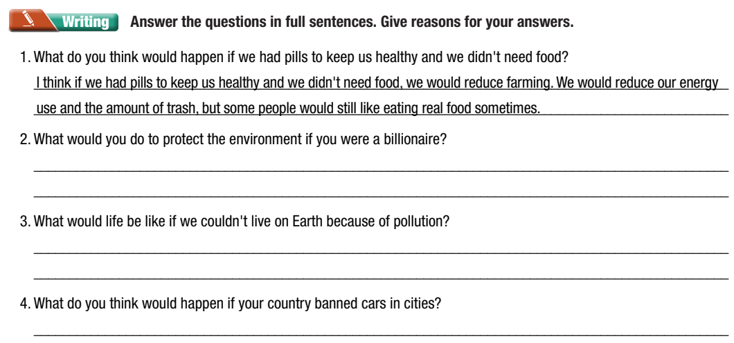
Checking homework
Notes:
Choose some student’s products to stick on the board, ask the others to move around to read and give comments (check the grammar mistakes related to the second conditional sentence)

Slide 8
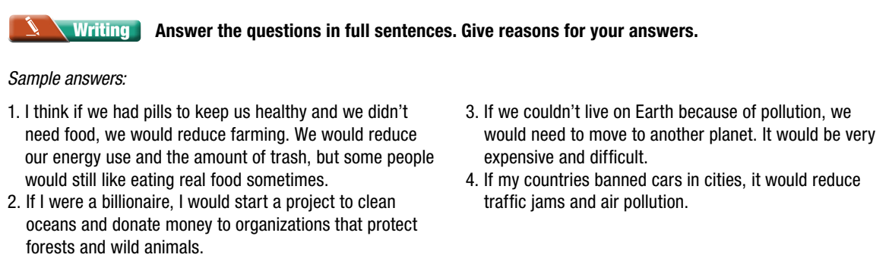
Checking homework
Suggested answers/ product

Slide 9


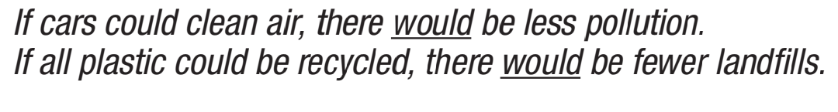

Listen. Notice the sound changes of the underline words

Slide 10
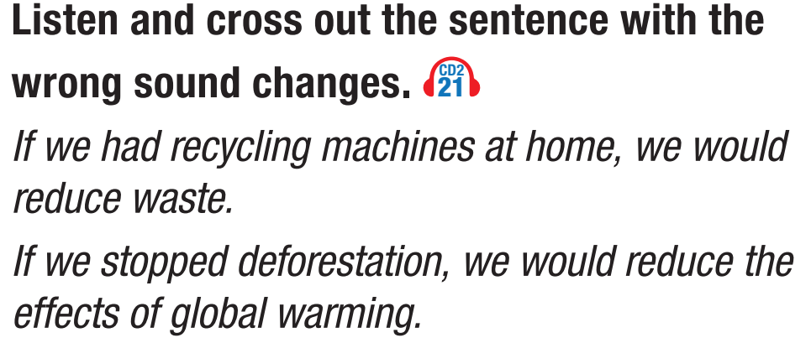
Read that sentences with the correct intonation to a partner

Slide 11

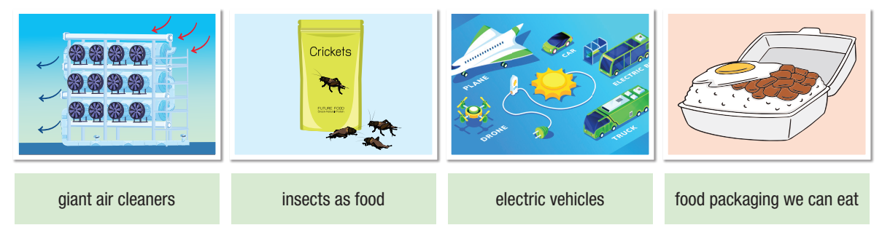

Slide 12

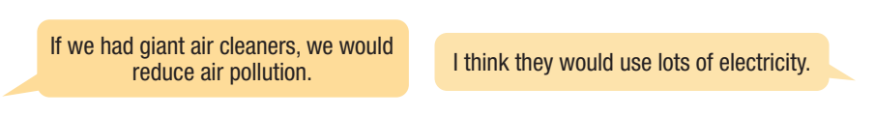
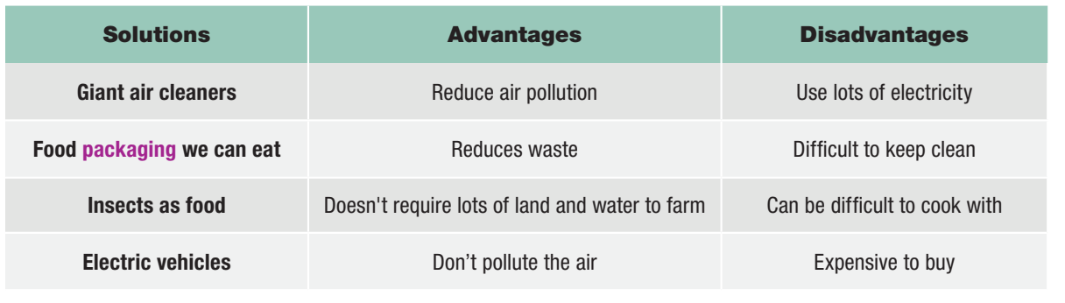

Slide 13

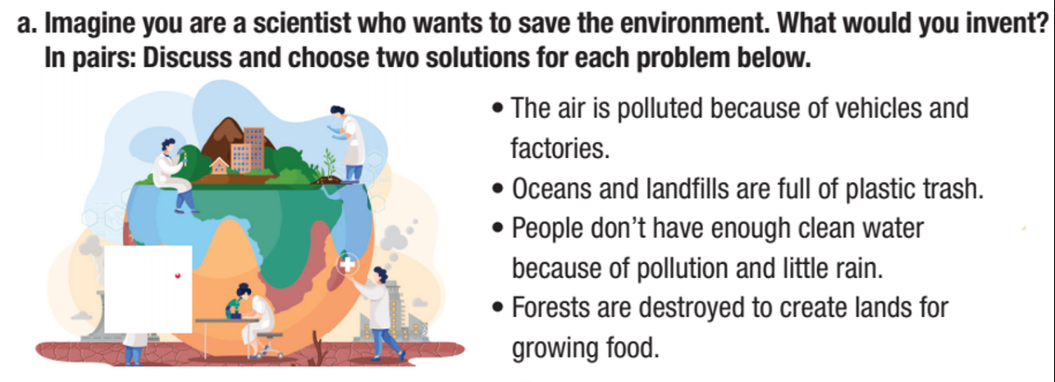
HOW WOULD YOU SAVE THE WORLD?

Slide 14
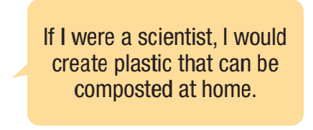
Example
If I were a scientist, I would create electric vehicles to reduce air pollution

Slide 15

Post Speaking
Join another pair and discuss to choose one best solution for each problem. Share with the class

Slide 16

Consolidation

Slide 17
Wrap-up
Today’s lesson
Pronunciation: practice sound change of Would.
Speaking: talk about improving the environment.

Slide 18

- Make a list of five environmental problems in your village.
Prepare the next lesson: Lesson 3.1 – Listening & Reading, (page 70).
Play the consolidation games in Tiếng Anh 10 i-Learn Smart World DHA App on www.eduhome.com.vn

