Slide 1

Unit 1: My friends
Lesson 1.2
Page 11

Slide 2
Lesson Outline
Warm-up
Listening
Speaking
Consolidation
Wrap-up

Slide 3
Objectives
By the end of this lesson, students will be able to practice listening skills and …
Vocabulary: Alphabet
Structure: What’s your name? – My names Alfie.
How do you spell “Alfie”? – A-L-F-I-E.
Phonics: spell, space

Slide 4

WARM UP

Slide 5

REARRANGE
the order
Notes:
Divide students into small groups
Students rearrange the letters in the shape in order of the Alphabet (the first one is opened already)
The team having the quickest and the most correct answer is the winner

Slide 6

1
2
A
E
H
L
F
D
G
O
C
B
S
A =>
B => C => E => F
D =>
G => H => L => O => S
3
4
M
N
I
Y
R
J
U
W
Z
S
F
T
X
P
M =>
N => R => T => U => W
F =>
I => J => P => S => X => Y => Z
Notes:
- There are 4 rounds

Slide 7

It’s time to learn …

Slide 8
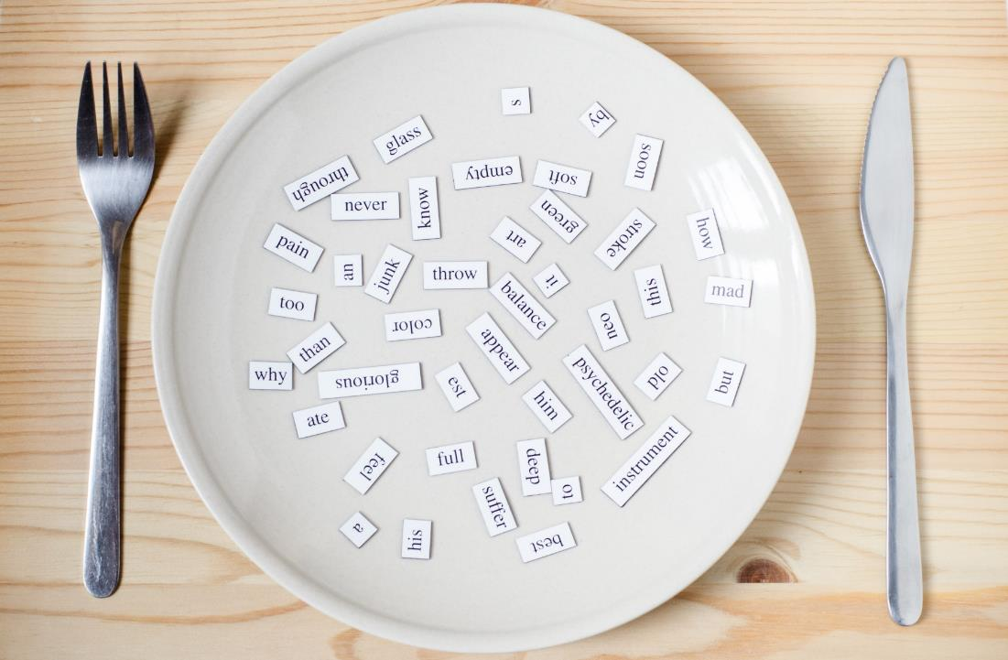
Phonics
/sp/

Slide 9


spell
space
Act1. Read and say YES
or NO Listen and check.
spider
spring
strong
speak
spider
spring
surprise
spicy
sport
speak
sport
star
spoil
spicy
spoil
spa
spa
Notes:
(spider, strong, surprise, sport, spoil, spring, speak, spicy, star, spa) audios from Cambridge Dictionary
Click the picture to hear the sound the Aud 14
Click each word to hear the sound of each word
Act 1; click the words to hear the sounds

Slide 10

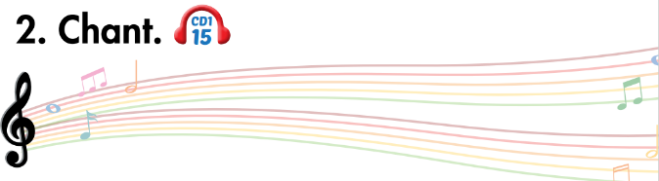
sp
spell
space

Slide 11

Listening

Slide 12


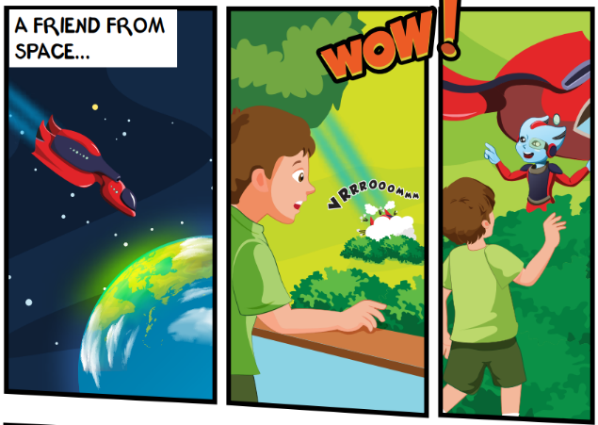
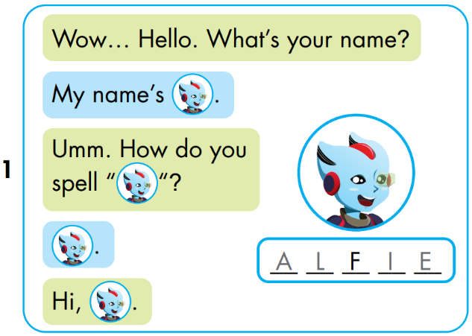


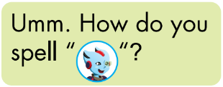


A
L
I
E
Notes:
Click the picture to hear the entire story
Click on the BIG PORTRAIT OF ALFIE to hear the CONVERSATION
Click on each sentence to hear the sound.
Click on THE SPACE (BACKGROUND) to reveal the answer.

Slide 13
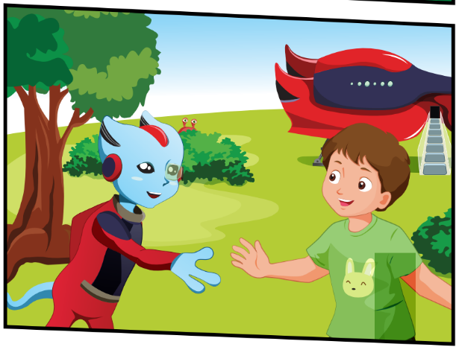
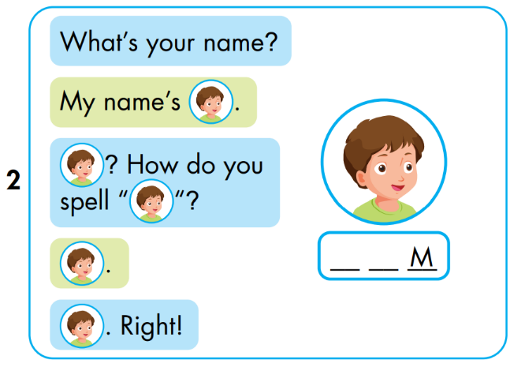


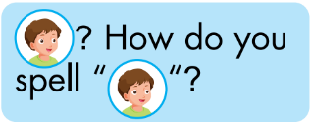


T
O
Notes:
Click the picture to hear the entire story
Click on the BIG PORTRAIT OF ALFIE to hear the CONVERSATION
Click on each sentence to hear the sound.
Click on THE SPACE (BACKGROUND) to reveal the answer.

Slide 14
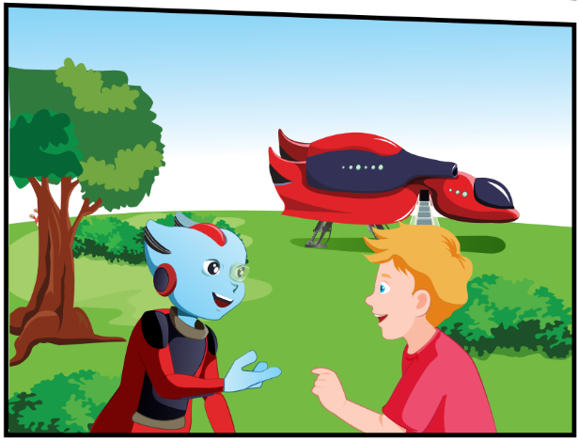
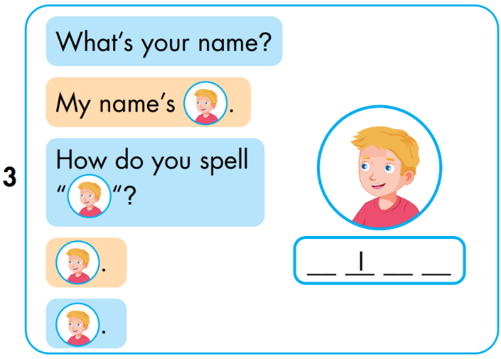


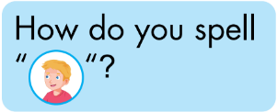


N
C
K
Notes:
Click the picture to hear the entire story
Click on the BIG PORTRAIT OF ALFIE to hear the CONVERSATION
Click on each sentence to hear the sound.
Click on THE SPACE (BACKGROUND) to reveal the answer.

Slide 15

Speaking

Slide 16
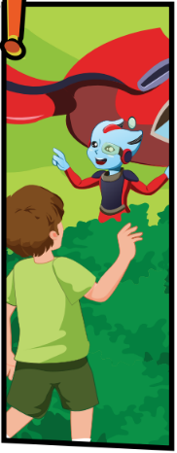
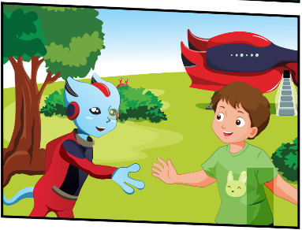




Notes:
- Lastly, students play roles and cover the story.

Slide 17

Practice

Slide 18

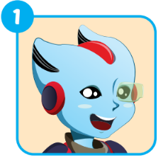
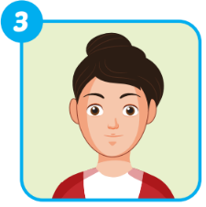
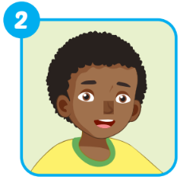
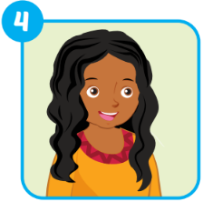
Extra 1 – WB p9
A _ _ _ _
ALFIE
_ _ _ _
MARY
_ _ _ _
HUGO
ELLA
_ _ _ _

Slide 19
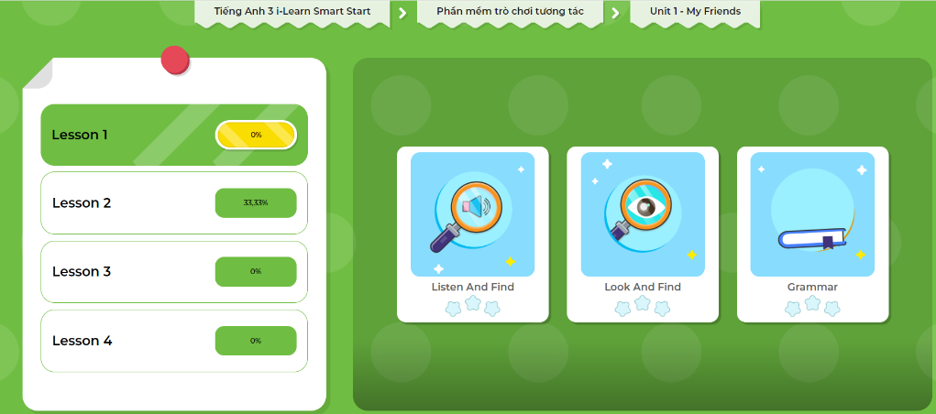
Extra-Act2. DHA app.
Click here to play the games

Slide 20
FREER PRACTICE

Slide 21

Carry out a survey
No. | What’s your name? | How can your spell ...?
1. | My name’s Alfie. | A-L-F-I-E.
2. | ...
3. | ...
4. | ...
5. | ...

Slide 22

CONSOLIDATION

Slide 23

Pop
-up

Slide 24
1
2
4
3
7
5
6
8
Notes:
Divide students into small group (2-3)
In turn, each team choose 1 option => a lot of letters automatically pop up => students have to say aloud at the same time. (speed can be adjusted)
Students in the team play one by one.
For example: Team A has 3 students. The 1st one tries and names all the letters correctly. The 2nd one cannot. They 3rd one cannot. => The whole team got 1 POINT.
Team B has 3 students. Two of whom name the letters correctly. The other one does not. => They got 2 POINTS.

Slide 26
q
c
y
z
r
READY
GO
n
e
a
g
i
o
p
f
Notes:
Click the Arrow to Replay
Click the House to come back the main theme.

Slide 28
q
z
m
d
r
READY
GO
p
b
k
g
i
o
L
f
Notes:
Click the Arrow to Replay
Click the House to come back the main theme.

Slide 30
L
z
e
s
r
READY
GO
p
c
h
g
i
o
t
f
Notes:
Click the Arrow to Replay
Click the House to come back the main theme.

Slide 32
k
q
a
s
b
READY
GO
n
z
h
o
m
s
t
f
Notes:
Click the Arrow to Replay
Click the House to come back the main theme.

Slide 34
k
L
c
f
b
READY
GO
w
s
r
o
n
v
t
g
Notes:
Click the Arrow to Replay
Click the House to come back the main theme.

Slide 36
d
f
a
i
p
READY
GO
q
t
r
m
n
w
v
h
Notes:
Click the Arrow to Replay
Click the House to come back the main theme.

Slide 38
o
u
a
e
y
READY
GO
a
g
r
s
t
p
v
h
Notes:
Click the Arrow to Replay
Click the House to come back the main theme.

Slide 40
o
i
a
f
y
READY
GO
n
b
x
g
d
r
w
t
Notes:
Click the Arrow to Replay
Click the House to come back the main theme.

Slide 41

WRAP-UP

Slide 42
Lesson 3
Today’s lesson
Vocabularies
The Alphabet
Structures/ Sentence patterns
Tom: What’s your name?
Alfie: My name’s Alfie.
Tom: How can you spell “Alife”?
Alfie: A-L-F-I-E.
Phonics
“sp”, spell, space

Slide 43
Lesson 3
Homework
Practice the vocabularies and structure; and make sentences using them.
Do the exercises in Tiếng Anh 3 i-Learn Smart Start WB (page 9)
Do the exercises in Tiếng Anh 3 i-Learn Smart Start Notebook (page 10)
Prepare the next lesson (page 12 SB)
Play games in Tiếng Anh 3 i-Learn Smart Start DHA App on www.eduhome.com.vn

Slide 44

Enjoy your day!

