Slide 1
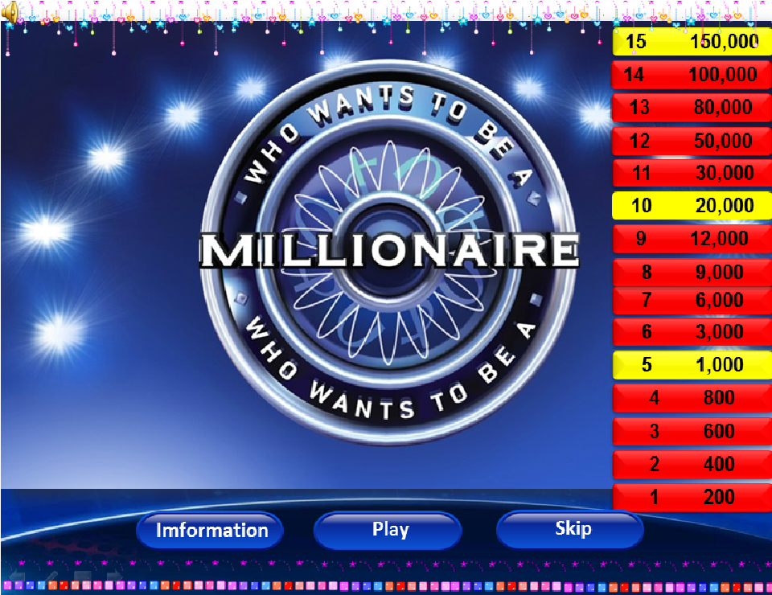

Slide 2
50/50
1
Doctor
Teacher
A
C
Teacher
B
Police
D
Engineer
Who teaches you at school is?

Slide 3
2
50/50
A
Hospital
C
Hotel
Post office
School
B
D
School
Where do you go to study?

Slide 4
3
50/50
Larger
A
Larger
C
Large
B
Largest
D
The most largest
Choose the correct answer:
My house is…..than hers.

Slide 5
4
50/50
A
An apple
C
Iphone
The other half
B
The other half
D
The apple tree
What looks like half an apple?

Slide 6
50/50
5
Trays
Says
A
C
Says
B
Days
D
Bays
Choose the word that has underlined part is pronunciation differently from the others?

Slide 7
6
50/50
A
Dozen
C
Some
Mother
Often
B
D
Often
Choose the word whose underlined part is pronunciation differently

Slide 8
7
50/50
Were
A
Were
C
Was
B
Would have been
D
Was being
Choose the correct answer:
If wish I…rich(But I am poor now)

Slide 9
8
50/50
A
Nene
C
Nunu
Mary
B
Mary
D
No information
Mary’s father has 4 daughter: Nana, Nini, Nono. What is the 4th daughter name?

Slide 10
50/50
9
9
6
A
C
6
B
7
D
8
What is the last logical number?
21,20,18,15,11,?.

Slide 11
10
50/50
A
Did you like
C
Are you liking
You like
Would you like
B
D
Would you like
……to go out to an Italian restaurant tonight?

Slide 12
11
50/50
17
A
17
C
15
B
70
D
25
What is the last logical number?
A+A+A=30
A+B+B=20
B+C+C=9
A+B+C=?

Slide 13
12
50/50
A
does this word means
C
mean this word
does this word mean
B
does this word mean
D
means this word
Choose the correct answer:
I don’t understand this word. What………..?

Slide 14
13
50/50
17
A
17
C
15
B
70
D
25
What is the last logical number?
A+A+A=30
A+B+B=20
B+C+C=9
A+B+C=?

Slide 15
14
50/50
A
Is playing
C
played
Plays usually
Usually plays
B
D
Usually plays
John…..tennis once or twice a week

Slide 16
15
50/50
I didn’t do
A
I didn’t do
C
I don’t do
B
I do
D
I did
It was a boring weekend…..anything.

Slide 17
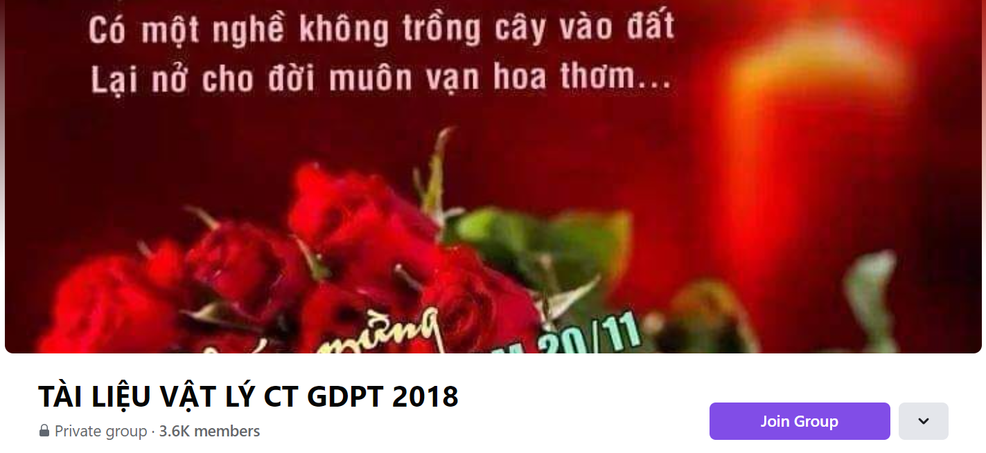
SƯU TẦM: ĐOÀN VĂN DOANH, NAM TRỰC, NAM ĐỊNH
LINK NHÓM DÀNH CHO GV BỘ MÔN VẬT LÝ TRAO ĐỔI TÀI LIỆU VÀ CHUYÊN MÔN CT 2018
https://www.facebook.com/groups/299257004355186

