Slide 1
UNIT 1: LOCAL ENVIRONMENT LESSON 6: SKILLS 2

Slide 2
Revision
Can you tell me and classmates your plan for this day out. Make notes in the table.
A DAY OUT
 | Details | Who to prepare
Place
Means of transport
Time to set off
Food
Drinks
Activities
Time to come back

Slide 3
the benefits of traditional crafts (B) or challenges that artisans may face (C). Write B or C.
1. providing employment 2.losing authenticity
3. providing additional income 5.treating waste and pollution
4.relying too much on tourism
6. preserving cultural heritage
Can you add some more benefits and challenges?
B
C

Slide 4
Can you add some more benefits and challenges that artisans may face?
Other benefits:
Creating national/regional pride
helping develop tourism,
helping improve local infrastructure and services,
Creating cohesion between craft families and communities
Other challenges:
limited designs, - natural resources running out,
competition from other countries

Slide 5
Đi nhanh qua cái gì
Tiên liệu ,tính toán trước việc gì
Hi vọng
Quay đầu nhìn cái gì, đi thăm xung quanh
to
up
ahead
Suy ngẫm chuyện gì trong quá khứ
Through
back
Coi trừng
Look
round
Tìm kiếm cái gì
for
out
Cẩn thận
in
forward to
on
Mong gì điều gì
Ghé thăm chỗ nào
Đứng nhìn mà không tham gia vào

Slide 6
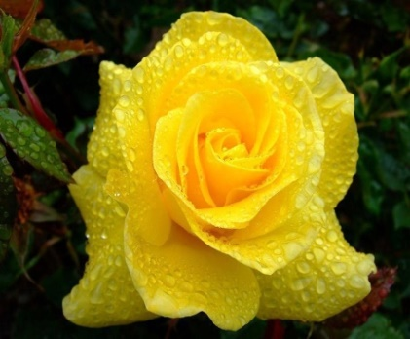
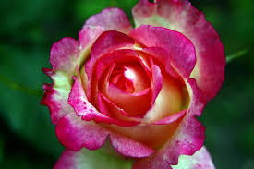

Slide 7
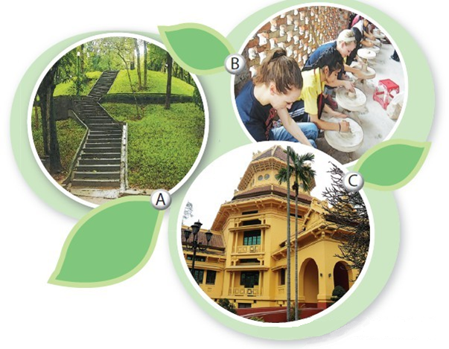
I. Listening
4Teen radio is asking different students about their places of interest.
Activity 1 Describe what you see in each picture. Do you know what places they are?
Listen and check your answers.
A. Ha Noi Botanical Garden
B. Bat Trang pottery village
C. Viet Nam National Museum of History

Slide 8
Activity 2 Listen to what these students say and decide if the statements are true (T) or false (F).
1. Tra is interested in history.
2. Nam likes making things with his hands.
3. Nam’s family owns a workshop in Bat Trang.
4. The trees in the garden only come from provinces of Viet Nam.
5. Hoa loves nature and quietness.
T
T
F
F
T

Slide 9
Activity 3 Listen again and complete the table. Use no more than three words for each blank.
Student | Place of interest | Activities
Tra | Viet Nam National Museum of History | Seeing various (1) _________ Looking round and (2) _________
Nam | Bat Trang pottery village | - Learning to (3) _________ and (4) _________
Hoa | Ha Noi Botanical Garden | Climbing up (5) _________ Reading (6) _________ Feeding (7) _________ (8) _________ people
artefacts
exploring Vietnamese culture
make things
paint on ceramics
the hill
books
pigeons
watching

Slide 10
II. Writing
Activity 4 If a visitor has a day to spend in your hometown/city, where will you advise him/her to go? What can they do there? Work in pairs, discuss and take notes of your ideas.
Places | Activities
Place 1: _______________ | _______________________
Place 2: _______________ | _______________________
Place 3: _______________ | _______________________

Slide 11
Activity 5: Imagine that your Australian pen friend is coming to Viet Nam and will spend a day in your hometown/city. He/She has asked for your advice on the places of interest they should go to and the things they can do there. Write an email to give him/her some information.
From:
To:
Subject: Places of interest in my hometown/city
Dear
Look forward to seeing you soon!
Best wishes,

Slide 12
Dear Mira,
It’s great to know that you’re coming to Viet Nam. What a pity you can only spend one day in Ha Noi. There are so many interesting places in the city, but I think within one day you should be able to visit three places. The rest place I suggest is Viet Nam National Museum of History. You like history, so it’s a must-see place. There’s an extensive collection of artefacts tracing Viet Nam’s history. They’re arranged chronologically from primitive life to modern times. The second place is Hoan Kiem Lake. It’s one of the symbols of Ha Noi. There you can enjoy the beautiful scenery and visit Ngoc Son Temple. You can also have a look at the Old Quarter. Wander around the old streets and some ancient houses to explore Vietnamese culture. Conveniently, these places are close to one another, so we can walk around easily. Tell me when you’re coming, so I can show you around these places.
Look forward to seeing you soon!
Best wishes,
Thuc Anh

Slide 13
III. Homework
Learn vocabulary by heart.
Redo exercises.
Prepare the next lesson: Looking back - Project

