Slide 1


Slide 2

Unit
7
1
VIET NAM AND INTERNATIONAL ORGANISATIONS
Unit
FAMILY LIFE
LESSON 5
LISTENING
LESSON 7
COMMUNICATION AND CULTURE / CLIL

Slide 3

Unit
1
1
FAMILY LIFE
Family Life
Unit
OBJECTIVES
Make and respond to invitations
Learn about FAO and its activities to support Viet Nam

Slide 4
LESSON 7
COMMUNICATION AND CULTURE / CLIL
WARM-UP
Game: You’re invited!
EVERYDAY ENGLISH
Task 1: Complete the conversations.
Task 2: Make similar conversations.
CULTURE
Task 3: Complete the diagram.
Task 4: Talk about FAO.
CONSOLIDATION
Wrap-up
Homework

Slide 5
LESSON 7
COMMUNICATION AND CULTURE / CLIL
WARM-UP
Game: You’re invited!

Slide 6

WARM-UP
Which event are these cards referring to?
A wedding

Slide 7

WARM-UP
Which event is this card referring to?
A graduation ceremony

Slide 8
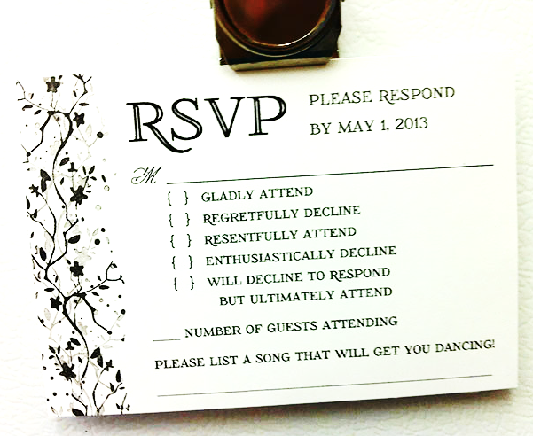
WARM-UP
What else can you do to make invitation cards interesting, creative
but appropriate?

Slide 9
LESSON 7
COMMUNICATION AND CULTURE / CLIL
WARM-UP
Game: You’re invited!
EVERYDAY ENGLISH
Task 1: Complete the conversations.
Task 2: Make similar conversations.

Slide 10

EVERYDAY ENGLISH
1
1
Listen and complete a conversation with the expressions from the box. Then practise them in pairs.
A. Yes, I’d love to | B. I’m sorry, but I can’t
C. Do you want to join me | D. Let’s go to see it
Nam: Lan, there'll be a talk about international organisations in my school on Sunday morning. (1) _____________________?
Lan: (2) ______________. Can you meet me outside the school gate?
Nam: OK, see you at 8 a.m. on Sunday then.
Lan: Yeah, I’ll be there on time. Bye.
Lan: Nam, there's an art exhibition near my school. (3) ________________ this afternoon.
Nam: Oh, (4) ____________________. I have to visit my grandparents today.
Lan: Never mind. Another time, perhaps.
Do you want to join me
Yes, I’d love to
Let’s go to see it
I’m sorry, but I can’t

Slide 11
COMMUNICATION
1
2
You want to invite a friend to join you in an activity. Work in pairs. Make similar conversations like the ones in 1. Use the useful expressions below to help you.
Game: Social butterfly
Step 1: Take out a piece of paper and create an event that you like (write down the place and time of that event, and a list of people you want to invite)
Eg. Blackpink concert – at My Dinh Stadium, next Saturday (April 16).
Step 2: Go around the class and invite people from your “guest list” to join you. Invite as many as you can and write their names in your list!
Step 3: If you accept others’ invitation, write their events in your own schedule to share later.
Note: Only accept an invitation if you really want to go and are free at that time. If not, decline the invitation and give an excuse.

Slide 12
EVERYDAY ENGLISH
Useful expressions
Making invitations | Responding to invitations
 | Accepting an invitation | Declining an invitation
Informal • Do you want to …? • Do you feel like …? • Let’s go to … | Informal • Sure. I'll be there. • Yes, I’d love to. | Informal • I'm sorry, but I can't. • Sorry, maybe next time.
Formal • Would you like to …? • Would you care to …? | Formal • I would be delighted. • Thank you very much for inviting me | Formal • Oh, I'd love to, but … • That's very kind of you, but …

Slide 13
LESSON 7
COMMUNICATION AND CULTURE / CLIL
WARM-UP
Game: You’re invited!
EVERYDAY ENGLISH
Task 1: Complete the conversations.
Task 2: Make similar conversations.
CULTURE
Task 3: Complete the diagram.
Task 4: Talk about FAO.

Slide 14
CULTURE
1
1
Read the text below and complete the diagram.
FAO and its activities in Viet Nam
The Food and Agriculture Organisation (FAO) of the United Nations was formed in 1945. Its main aim is to end hunger and poverty by making sure all people have access to healthy food. It hopes to raise the levels of nutrition and the standard of living in its member countries. It also tries to improve the production of food and agricultural products, and make sure they reach all groups of society.
FAO started working in Viet Nam in 1978. Since then, it has provided Viet Nam with technical support and advice to the government in the field of agriculture. It has also helped Viet Nam carry out hundreds of projects in different areas.
In response to FAO’s support, Viet Nam has actively participated in FAO activities, including food security and nutrition. Food security means that all people have access to enough and safe food while good nutrition or getting the right type of food is essential for normal growth and development.

Slide 15
CULTURE
1
1
FAO and its activities in Viet Nam
FAO
FAO in Viet Nam
Viet Nam’s participation
has participated in (5)__________ and nutrition activities
formed in (1)__________
main aim is to (2)_________
started in (3)_________
has provided (4)__________ and advice to the government
Read the text below and complete the diagram.

Slide 16
CULTURE
1
1
FAO and its activities in Viet Nam
FAO
FAO in Viet Nam
Viet Nam’s participation
has participated in (5) food security and nutrition activities
formed in (1) 1945
main aim is to (2) end hunger and poverty
started in (3) 1978
has provided (4) technical support and advice to the government
Read the text below and complete the diagram.

Slide 17
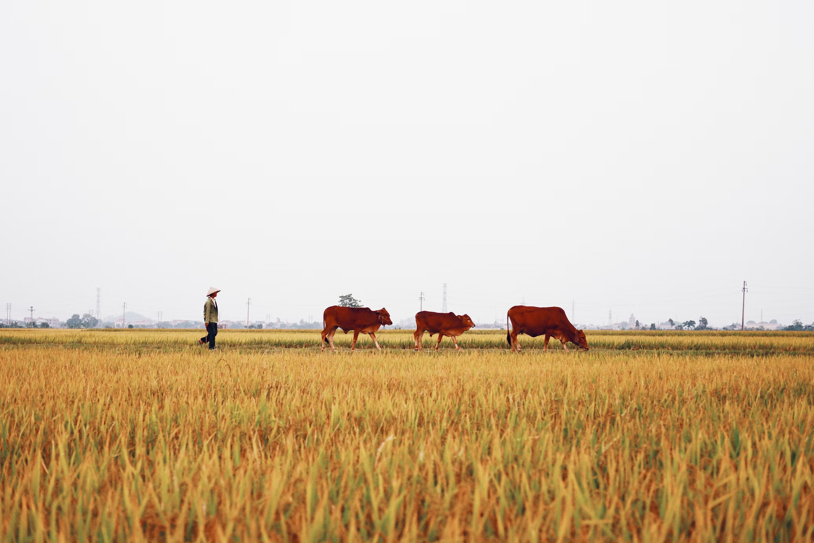
CULTURE
1
2
Work in pairs. Use the diagram in Task 1 to talk about FAO and its activities in Viet Nam.

Slide 18
LESSON 7
COMMUNICATION AND CULTURE / CLIL
WARM-UP
Game: You’re invited!
EVERYDAY ENGLISH
Task 1: Complete the conversations.
Task 2: Make similar conversations.
CULTURE
Task 3: Complete the diagram.
Task 4: Talk about FAO.
CONSOLIDATION
Wrap-up
Homework

Slide 19
CONSOLIDATION
1
Wrap-up
Communication: Making and responding to invitations
Culture: FAO and its activities in Viet Nam

Slide 20
CONSOLIDATION
2
Homework
Project preparation

Slide 21

Website: hoclieu.vn
Fanpage: facebook.com/tienganhglobalsuccess.vn/

