Slide 2
Unit
6
OUR TET HOLIDAY
LESSON 7: LOOKING BACK AND PROJECT

Slide 3



LESSON 7: LOOKING BACK AND PROJECT
LESSON 1: GETTING STARTED
WARM-UP
Mind Map
Vocabulary
Task 1: Match the verbs on the left with the nouns on the right.
Task 2: Complete the sentences.
Grammar
Task 3: Write full sentences.
Task 4: Fill in the blanks.
LOOKING BACK
PROJECT
I WISH
CONSOLIDATION
Wrap-up
Homework

Slide 4
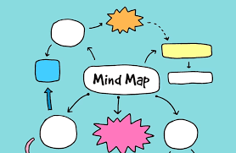
WARM-UP
Mind Map
NEW YEAR’S DAY

Slide 5
WARM-UP
Food
Traditions
TET
Games /
activities
Decorations

Slide 6

LOOKING BACK
Match the verbs on the left with the nouns on the right.
1. give | a. a wish
2. cook | b. fireworks
3. plant | c. special food
4. make | d. lucky money
5. watch | e. trees
6. break | f. things
1.
2.
3.
4.
5.
6.
d
c
e
a
b
f

Slide 7

LOOKING BACK
Complete the sentences with the words / phrases in the box.
gathering
cleaning
lucky money
banh chung
peach
1. At Tet, my mother puts ___________ into red envelopes.
2. – What are you doing?
– I’m _______ my bedroom.
3. ___________ is special for Tet.
4. We have _______ flowers only at Tet.
5. When everybody is at home together, we call it a family _______.

Slide 8

LOOKING BACK
Write full sentences using the cues given, and should or shouldn’t.
1. ask for permission before entering a room
→ He / She __________________________________.
2. run about the house
→ He / She __________________________________.
3. take things from a shelf
→ He / She __________________________________.
should ask for permission before entering a room.
shouldn’t run about the house.
shouldn’t take things from a shelf.

Slide 9
LOOKING BACK
Write full sentences using the cues given, and should or shouldn’t.
4. make a lot of noise
→ He / She ______________________.
5. ask for some water if he / she feels thirsty
→ He / She ______________________.
shouldn’t make a lot of noise.
should ask for some water if he / she feels thirsty.

Slide 10

LOOKING BACK
Read the passage and fill the blanks with some or any.
My room is ready for Tet. By the window are (1) _______ balloons. There is a picture I made from (2) _______ old magazines. It’s colourful, but I didn’t use (3) _______ paint or colour pencils. I love flowers, but I don’t have (4) _______ yet. Oh, look at this new plant. It needs (5) _______ water, but it doesn’t need (6) _______ sunlight. It can live in a room.
some
some
any
any
some
any

Slide 11


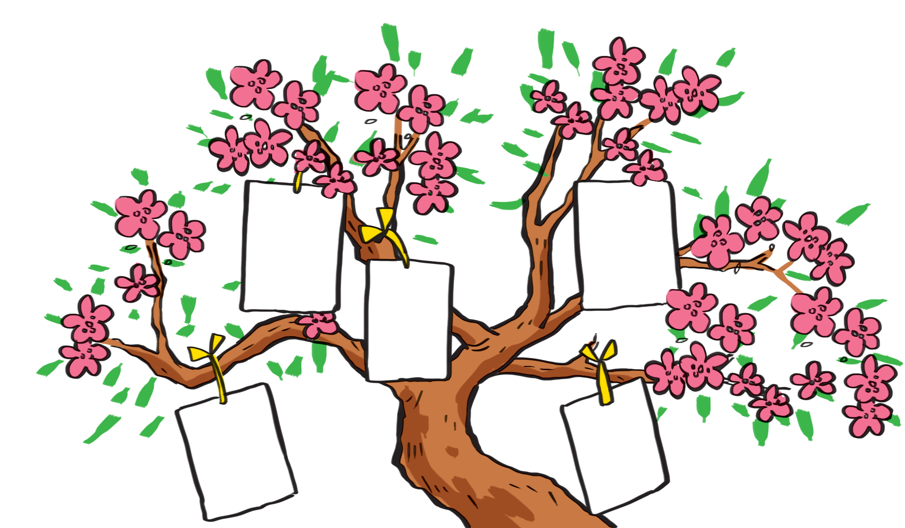

I wish
I want to have a brother.
I want to visit Singapore
I want to live in a tree house.

Slide 12

I wish
1.
Each student gets a small piece of paper and writes his / her wish on it.
2.
He / She hangs it on a tree.
3.
Other students take turns to come up, get a piece of paper and read aloud the wish.
4.
The class guess whose wish it is.

Slide 13

CONSOLIDATION
1
Wrap-up
What have we learnt in this lesson?
Review the vocabulary and grammar of Unit 6
Apply what they have learnt (vocabulary and grammar) into practice through a project.

Slide 14

CONSOLIDATION
2
Homework
- Learn the new words by heart.
- Prepare for the next lesson.

Slide 15






Website: hoclieu.vn
Fanpage: facebook.com/www.tienganhglobalsuccess.vn/

