Slide 2
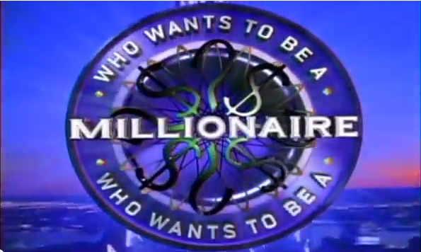
1 The capital of England is?
A
Tokyo
B
Paris
C
LonDond
D
Wales
Trả lời

Slide 3
2.How many States in the United States?
A
40
B
60
C
55
D
50
Trả lời

Slide 4
3. Which country is known as the land of the rising sun?
A
Vietnam
B
China
C
Thailand
D
Japan
Trả lời

Slide 5
4. How many countries in South East AsiA?
A
10
B
9
C
11
D
15
Trả lời

Slide 6
$2000
5. When Vietnam joined Asia?
A
1997
B
1995
C
1998
D
1996
Trả lời

Slide 7
$3000
6. Sea game 29 was held in which country?
A
Malaysia
B
China
C
Singapo
D
Thailand
Trả lời

Slide 8
$4000
7. Who is the author of the “ Tinh than the duc” of Vietnamese literature ?
A
Thach Lam
C
Nguyen Cong Hoan
B
To Hoai
D
Xuan Quynh
Trả lời

Slide 9
8. Which country has the city Bac King?
A
Vietnam
B
China
C
Thailand
D
Laos
Trả lời

Slide 10
9. How many ethnic groups in Vietnam?
A
50
B
51
C
53
D
54
Trả lời

Slide 11
10. Which country does not border the sea?
A
Laos
B
China
C
Vietnam
D
Thailand
Trả lời

Slide 12
11 . Who is the President of the United States in 2017?.
A
George Washington
B
Black Obama
C
William Mckinley
D
Donald Trump
Trả lời

Slide 13
12. China does border with which country ?
A
Vietnam
B
Campuchia
C
Laos
D
India
Trả lời

Slide 14
13. The lotus flower is a symbol of which country ?
England
India
A
B
C
Thailand
D
Vietnam
Trả lời

Slide 15
14. Which province in Vietnam does not border with the sea ?
A
Dien Bien
B
Hai Phong
C
Quang Ninh
D
Thanh Hoa
Trả lời

Slide 16
15. “ Who was the 26 President of the United States?
A
Black Obama
B
William Mckiley
C
Theodore Roosevelt
D
Lao
Trả lời

Slide 17
SƯU TẦM: ĐOÀN VĂN DOANH, NAM TRỰC, NAM ĐỊNH
LINK NHÓM DÀNH CHO GV BỘ MÔN VẬT LÝ TRAO ĐỔI TÀI LIỆU VÀ CHUYÊN MÔN CT 2018
https://www.facebook.com/groups/299257004355186

