Slide 1


Slide 2



Unit
10
ENERGY SOURCES
LESSON 7: LOOKING BACK & PROJECT
SOURCES OF ENERGY
GRAMMAR REVIEW
THE PRESENT CONTINUOUS
PROJECT
SAVING ENERGY AT SCHOOL
VOCABULARY REVIEW
Unit

Slide 3

OBJECTIVES
By the end of the lesson, students will be able to:
review the vocabulary and grammar of Unit 10
apply what they have learnt (vocabulary and grammar) into practice through a project

Slide 4
LESSON 7: LOOKING BACK & PROJECT
WARM-UP
Quick revision check
Task 1: Match the adjectives in A with the nouns in B to make phrases.
Task 2: Complete the sentences, using the phrases in 1.
VOCABULARY REVIEW
Task 3: Complete the sentences by using the correct form of the verbs in brackets.
Task 4: Find ONE mistake in each sentence and correct it.
GRAMMAR REVIEW
PROJECT
Task 5: Poster presentation: Saving energy at school
CONSOLIDATION
Wrap-up
Homework

Slide 5
LESSON 7: LOOKING BACK & PROJECT
WARM-UP
Quick revision check

Slide 6
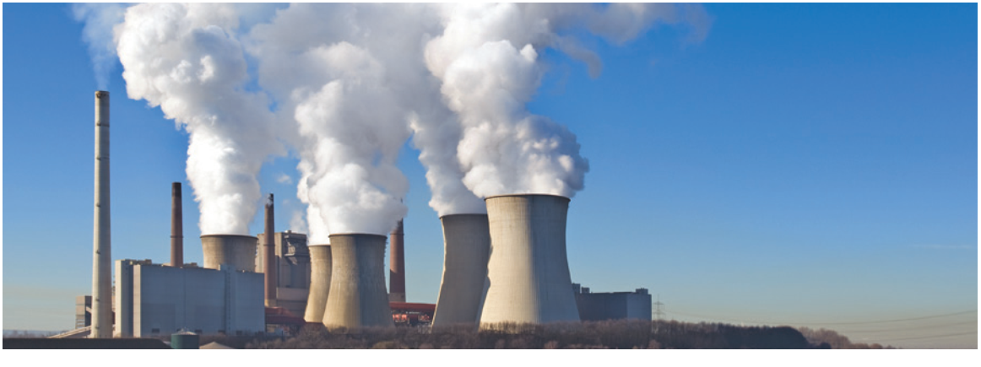
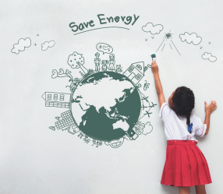

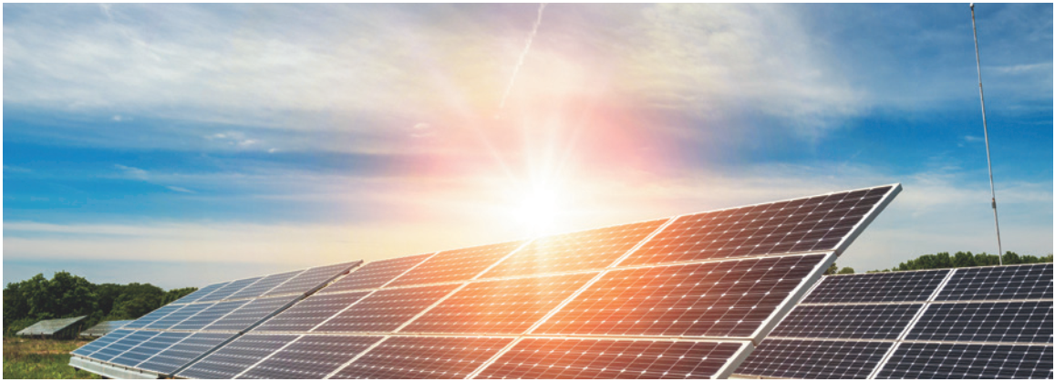
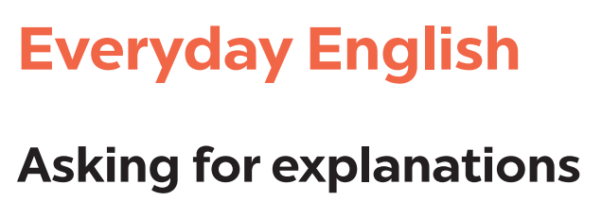
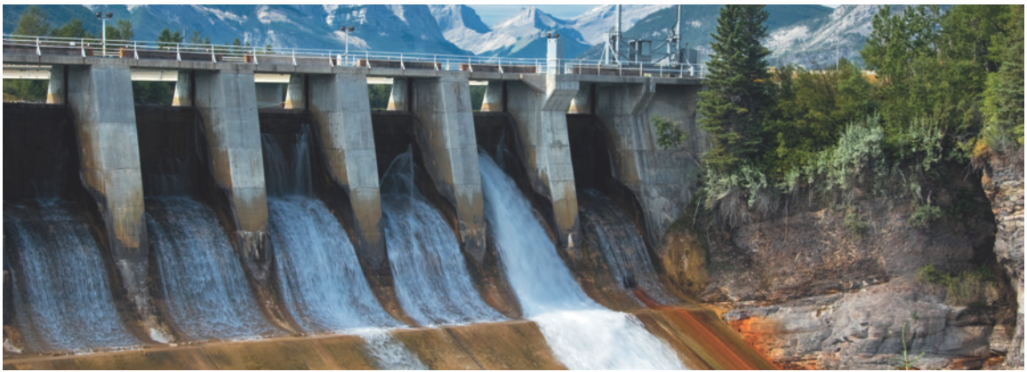
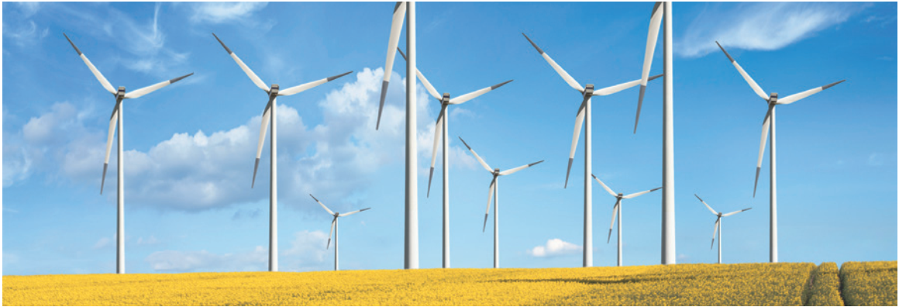
WARM-UP
QUICK REVISION CHECK

Slide 7
LESSON 7: LOOKING BACK & PROJECT
WARM-UP
Quick revision check
Task 1: Match the adjectives in A with the nouns in B to make phrases.
Task 2: Complete the sentences, using the phrases in 1.
VOCABULARY REVIEW

Slide 8
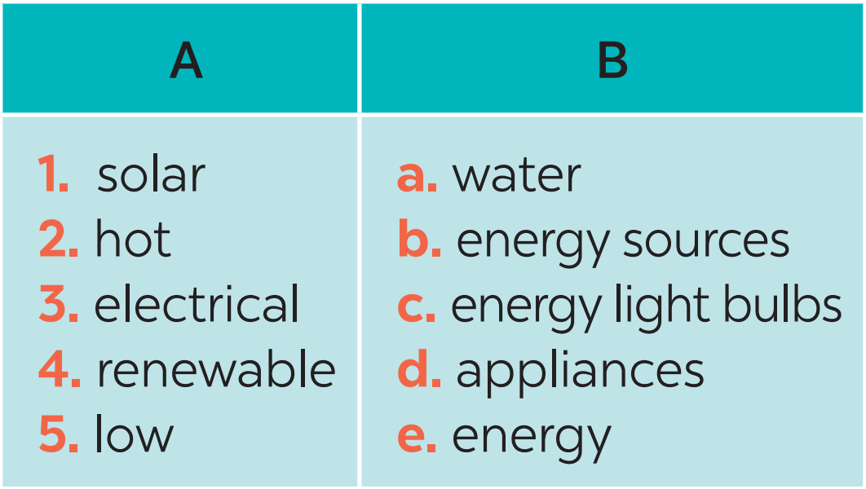
VOCABULARY REVIEW
1
Match the adjectives in A with the nouns in B to make phrases.
1. e
2. a
3. d
4. b
5. c

Slide 9
VOCABULARY REVIEW
2
Complete the sentences, using the phrases in 1.
1. We should use _________________ in our homes to save energy.
2. Do they always turn oﬀ the ________________ before leaving the room?
3. We can protect the environment by using _______________________.
4. When energy comes from the sun, we call it __________.
5. She has _________ day and night because she has solar panels on the roof of her house.
low energy light bulbs
electrical appliances
renewable sources of energy
solar energy
hot water

Slide 10
LESSON 7: LOOKING BACK & PROJECT
WARM-UP
Quick revision check
Task 1: Match the adjectives in A with the nouns in B to make phrases.
Task 2: Complete the sentences, using the phrases in 1.
VOCABULARY REVIEW
Task 3: Complete the sentences by using the correct form of the verbs in brackets.
Task 4: Find ONE mistake in each sentence and correct it.
GRAMMAR REVIEW

Slide 11
GRAMMAR REVIEW
3
Complete the sentences by using the correct form of the present continuous or present simple of the verbs in brackets.
1. Look! It (rain) __________ heavily.
2. Normally they (start) ______ school at eight o’clock in the morning.
3. He hasn’t got a bike at the moment, so he (walk) _________ to school this week.
4. He always (do) ______ his homework in the evening.
5. I’m afraid I have no time to help just now. I (write) __________ an essay.
is raining
start
is walking
does
am writing

Slide 12
GRAMMAR REVIEW
4
Find ONE mistake in each sentence and correct it.
1. The students do the project in Unit 10 now.
2. At the moment, the teacher is explain how solar energy works.
3. Nowadays, people in Africa is not using energy from natural gas.
4. They are use wind energy instead of coal.
5. We look for a cheap, clean and eﬀective source of energy now.
are doing
explaining
are
using
are looking

Slide 13
LESSON 7: LOOKING BACK & PROJECT
WARM-UP
Quick revision check
Task 1: Match the adjectives in A with the nouns in B to make phrases.
Task 2: Complete the sentences, using the phrases in 1.
VOCABULARY REVIEW
Task 3: Complete the sentences by using the correct form of the verbs in brackets.
Task 4: Find ONE mistake in each sentence and correct it.
GRAMMAR REVIEW
PROJECT
Task 5: Poster presentation: Saving energy at school

Slide 14

PROJECT
5
5
Poster presentation
How to save energy in your school?

Slide 15
LESSON 7: LOOKING BACK & PROJECT
WARM-UP
Quick revision check
Task 1: Match the adjectives in A with the nouns in B to make phrases.
Task 2: Complete the sentences, using the phrases in 1.
VOCABULARY REVIEW
Task 3: Complete the sentences by using the correct form of the verbs in brackets.
Task 4: Find ONE mistake in each sentence and correct it.
GRAMMAR REVIEW
PROJECT
Task 5: Poster presentation: Saving energy at school
CONSOLIDATION
Wrap-up
Homework

Slide 16
CONSOLIDATION
1
WRAP-UP
Vocabulary
Types of energy sources
Grammar
The present continuous
Project
Saving energy at school

Slide 17

CONSOLIDATION
2
HOMEWORK
Prepare for the next lesson:
Unit 11 – Lesson 1: Getting started

Slide 18

Website: hoclieu.vn
Fanpage: facebook.com/www.tienganhglobalsuccess.vn/

