Slide 1

Unit 5: Food and Drinks
Lesson 1.3: Pronunciation & Speaking
Page 38

Slide 2



LESSON OUTLINE
Consolidation

Slide 3

By the end of this lesson, students will be able to…
ask and answer using the recipe to make some kinds of food.
practice pronouncing /sp/ sounds.

Slide 4

WARM UP

Slide 5

Work in pairs.
Choose the word whose main stress is placed
differently from the others.
1. A. dramatic B. effective C. classical D. unhealthy
2. A. event B. contact C. workshop D. talent
3. A. milliliter B. superhero C. convenience D. frequency
/drəˈmætɪk/
/ɪˈfektɪv/
/ˈklæsɪkl/
/ʌnˈhelθi/
/ɪˈvent/
/ˈkɑːntækt/
/ˈwɜːrkʃɑːp/
/ˈtælənt/
/ˈmɪlɪliːtər/
/ˈsuːpərhɪroʊ/
/kənˈvi:niəns/
/ˈfri:kwənsi/

Slide 6
Work in pairs.
Choose the word whose underlined part is
pronounced differently from that of the other words.
A. painted B. stayed C. minded D. wanted
2. A. watched B. stopped C. washed D. played
3. A. hoped B. missed C. fixed D. lived
/peɪntɪd/
/steɪd/
/ˈmaɪndɪd/
/ˈwɑːntɪd/
/wɑ:tʃt/
/stɑ:pt/
/wɑ:ʃt/
/pleɪd/
/hoʊpt/
/mɪst/
/fɪkst/
/lɪvd/

Slide 7
Groupwork: Put the sentences into a logical order to make a dialog.
A. What do we need to make an apple pie?
C. What else do we need?
H. How much flour do we need?
E. We need some flour.
F. First, we need some apples.
D. We need six.
B. How many apples do we need?
G. We need 225 grams of flour.
ANSWER: 1. A; 2. F; 3. B; 4. D; 5. C; 6. E; 7. H; 8. G

Slide 8
This is the dialogue.
A: What do we need to make an apple pie?
B: First, we need some apples.
A: How many apples do we need?
B: We need six.
A: What else do we need?
B: We need some flour.
A: How much flour do we need?
B: We need 225 grams of flour.

Slide 9
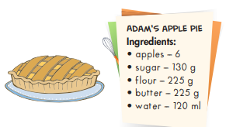
Pairwork. Let’s move on with the list of recipe to make an apple pie. Student A will be Adam, student B will be Billy.
Billy: What do we need to make an apple pie?
Adam: First, we need some apples.
Billy: How many apples do we need?
Adam: We need six.
Billy: What else do we need?
Adam: We need some sugar.
Billy: How much sugar do we need?
Adam: We need 130 grams of sugar.
Billy: …………….?

Slide 10
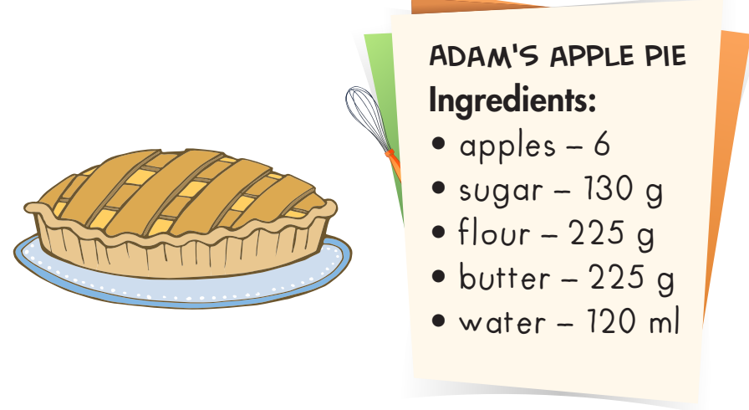
Billy: Next, what do we need ?
Adam: We need some flour.
Billy: How much flour do we need?
Adam: We need 225 grams of flour.
Billy: What else do we need?
Adam: We need some butter.
Billy: How much butter do we need?
Adam: We need 225 grams of butter.
Finally, we need 120 ml of water.

Slide 11
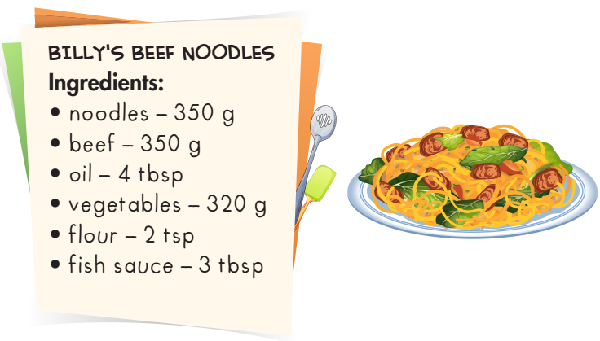
Now, it’s Billy’s turn with beef noodles. Take turns to ask the same questions and answers as mentioned above.
Billy, what do we need to make beef noodles?
We need some noodles.

Slide 12



Slide 13
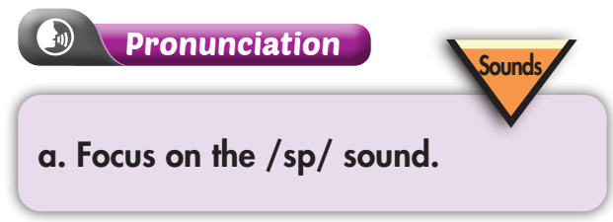

/sp/: This cluster is a combination of the /s/ and /p/ sounds. Let’s listen and copy.

Slide 14

Listen and repeat.

Slide 15
/sp/ can appear at the beginning of words.
spicy
special
spaghetti
speaker
/sp/ can also appear at the middle of words.
teaspoon
tablespoon

Slide 16
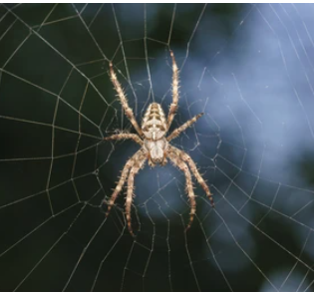

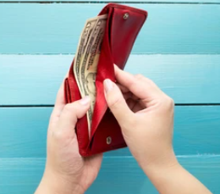

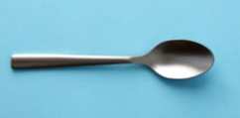

What are these with /sp/?
Spider
Space
Spend
Speed
Spoon
Misspell

Slide 17
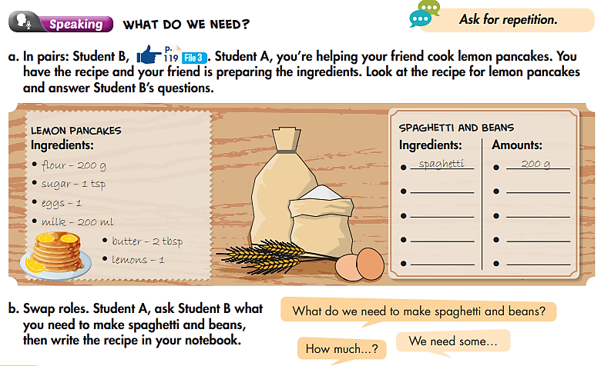

Slide 18
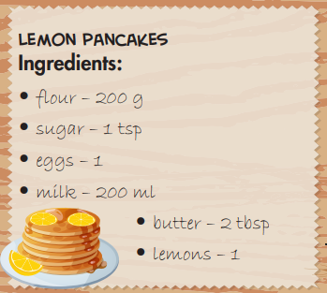
Making lemon pancakes
A: We are making some lemon pancakes.
B: What do we need to make lemon pancakes?
A: Well, we need some flour.
B: How much flour do we need?
A: We need 200 grams of flour.

Slide 19
Do the same with other ingredients.
B: What else do we need?
A: We need some sugar.
B: How much sugar do we need?
A: We need 1 teaspoon of sugar.
We also need 1 egg.
A: And we need some milk.
B: How much milk do we need?
A: We need 200 milliliters of milk.
B: How much butter do we need?
A: We need 2 tablespoons of butter.
Finally, we need 1 lemon.

Slide 20
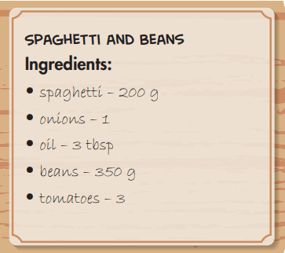
MAKING SPAGHETTI AND BEANS
B: We are making spaghetti and beans.
A: What do we need to make spaghetti and beans?
B: Well, we need some spaghetti.
A: How much spaghetti do we need?
B: We need 200 grams of spaghetti.
A: What else do we need?
B: We need some onions.
A: How many onions do we need?
B: We need 1 onion.

Slide 21
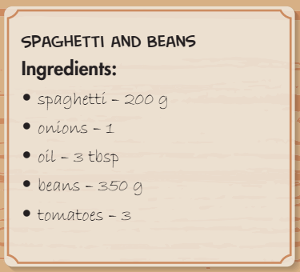
B: And we need some oil.
A: How much oil do we need?
B: We need 3 tablespoons of oil.
A: Ok. What else do we need?
B: We need 350 grams of beans.
Finally, we need some tomatoes.
A: How many tomatoes do we need?
B: We need 3 tomatoes.

Slide 22

CONSOLIDATION

Slide 23
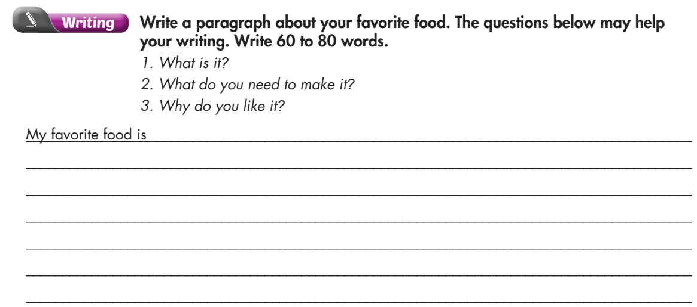
Extra Practice
WB p. 27

Slide 24
Sample answer:
My favorite food is mashed potato. To make it, you need potatoes, some boiling water, some butter, a little milk, some salt, and pepper. I like it because it's easy to make. You don't need many potatoes or much butter, and you can eat it with many different kinds of food. I usually eat it with fried chicken. It’s delicious.

Slide 25

WRAP-UP

Slide 26
Today’s lesson
Speaking:
Talk about ingredients needed to make some kinds of food.
Practice pronouncing /sp/ words.

Slide 27
Homework
Practice pronouncing /sp/ words.
Redo the writing exercise on page 27 WB.
Review the vocabulary and grammar notes in Tiếng Anh 7 i-Learn Smart World Notebook (pages 28 & 29).
Prepare the next lesson (page 39 SB).
Play the consolidation games in Tiếng Anh 7 i-Learn Smart World DHA App on www.eduhome.com.vn.

Slide 28

Lesson 3
Stay positive and have a nice day!

