Slide 1

Unit 1: Home and Places
Lesson 1e: Grammar (cont.)
Page 29

Slide 2
Lesson Outline
Warm-up
Vocabulary
Listening
Consolidation
Wrap-up

Slide 3
Objectives
By the end of this lesson, students will be able to…
- Learn prepositions of place.
- Learn the question word where.
- Describe a picture and their room.
- Write a description of an ideal bedroom.

Slide 4

WARM-UP

Slide 5
Choose the word whose main stress is placed differently from that of the others.
1 A. island B. carpet C. football D. alarm
/ˈaɪlənd/
/ˈkɑːpɪt/
/ˈfʊtbɔːl/
/əˈlɑːm/
2 A. bedroom B. bathroom C. thirteen D. kitchen
/ˈbedruːm/
/ˈbɑːθruːm/
/θɜːˈtiːn/
/ˈkɪtʃən/
3 A. quiet B. noisy C. ugly D. correct
/ˈkwaɪt/
/ˈnɔɪzi/
/ˈʌɡli/
/kəˈrekt/

Slide 6
* Fill in the blanks with these words: is, are, some, any:
1. There ____ a book on the table.
2. There _____ many pens in the box.
3. There are ______ shoes under the desk.
4. There aren’t _______ students in the school yard.
is
are
some
any

Slide 7

It’s time to learn …

Slide 8
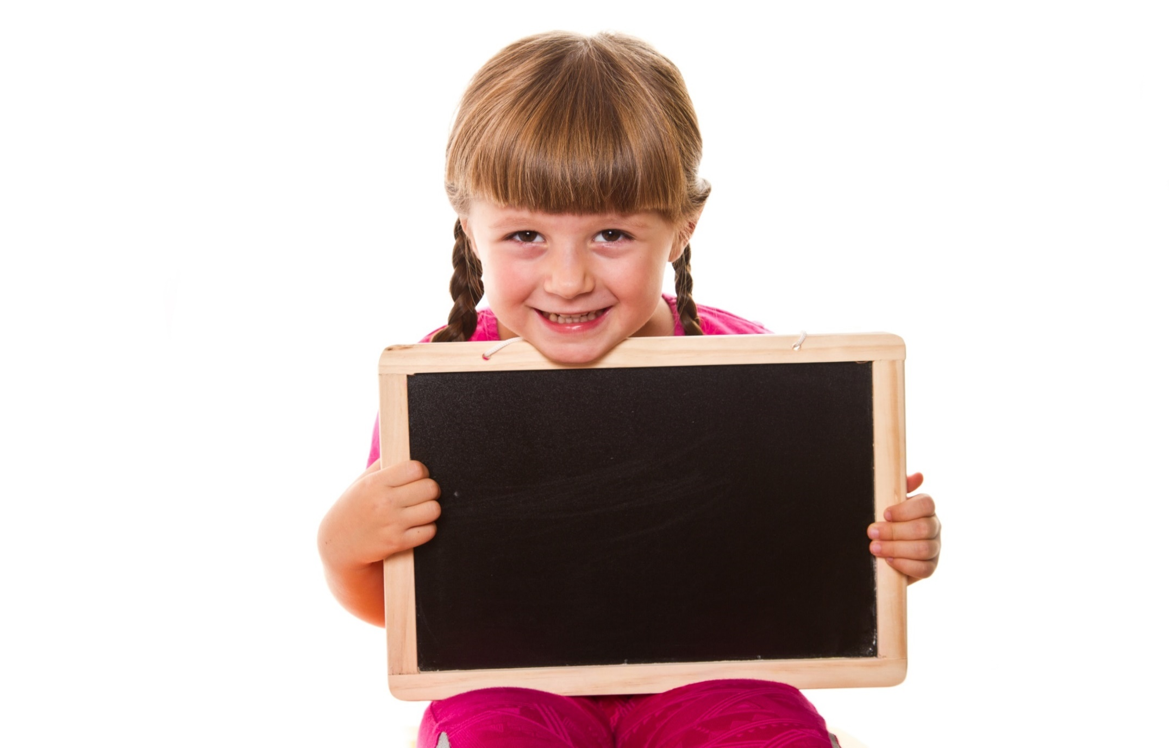
Presentation 1

Slide 9

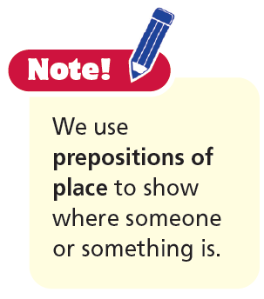
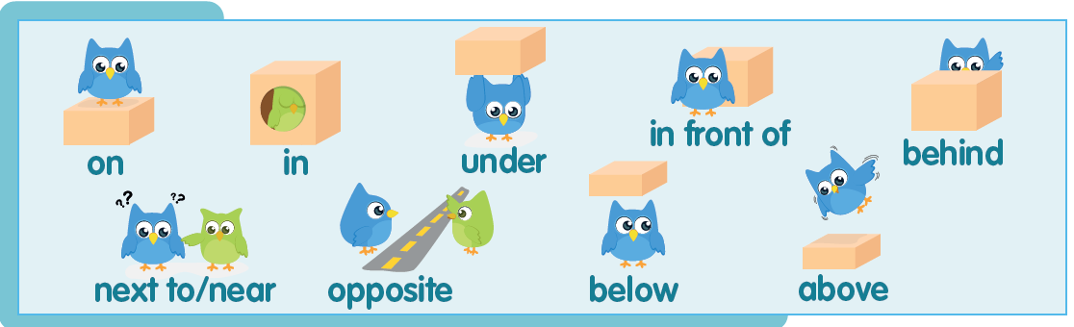

Slide 10
Look at the drawings and say.
The blue owl is on the box.

Slide 11








Look at the drawings and say.
The blue owl is near/next to the green owl.
The green owl is in the box.
The blue owl is opposite the green owl.
The blue owl is under the box.
The blue owl is below the box.
The blue owl is in front of the box.
The blue owl is behind the box.
The blue owl is above the box.

Slide 12

Practice

Slide 13
4. Look at the picture. Read the text and choose the correct preposition.
This is my bedroom. It has got brown curtains and a carpet 1) under/in front of the bed 2) in/on the floor.
There is a bedside cabinet 3) opposite/under the window 4) next to/below the bed.
There is a lamp 5) on/in the bedside cabinet. There is a poster 6) above/ on the bed 7) on/below the wall and
there is a box 8) in front of/under the bed. My bedroom is great!

Slide 14
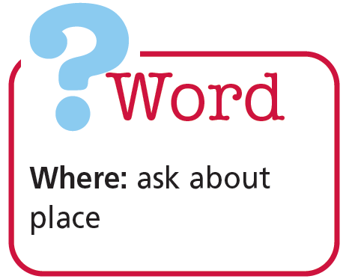
Look at the picture in Exercise 4. Ask and answer questions.
A: Where’s the bedside cabinet?
B: It’s next to the bed.

Slide 15
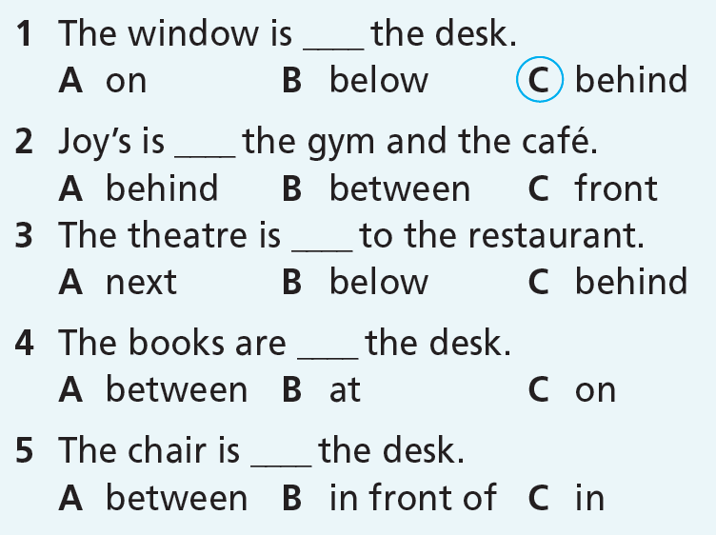
More Practice
GB p. 66
★ Circle the correct item.

Slide 16
More Practice
GB p. 66
★★ Look at the picture and fill in the gaps with the correct preposition.
This is Andy’s bedroom. There’s a bed 1) _________ the desk with pillows 2) ________ it. There’s a lamp 3) _________ to the desk. 4) _________ the desk, there is a bookcase with
books in it. 5) _________ the desk, there is a computer and a book. 6) _________ the desk, there’s a chair. 7) _________ the desk and the bed, there is a carpet. There are trees 8) _________ the garden outside his window.
opposite
on
next
Above
On
In front of
Under
in

Slide 17
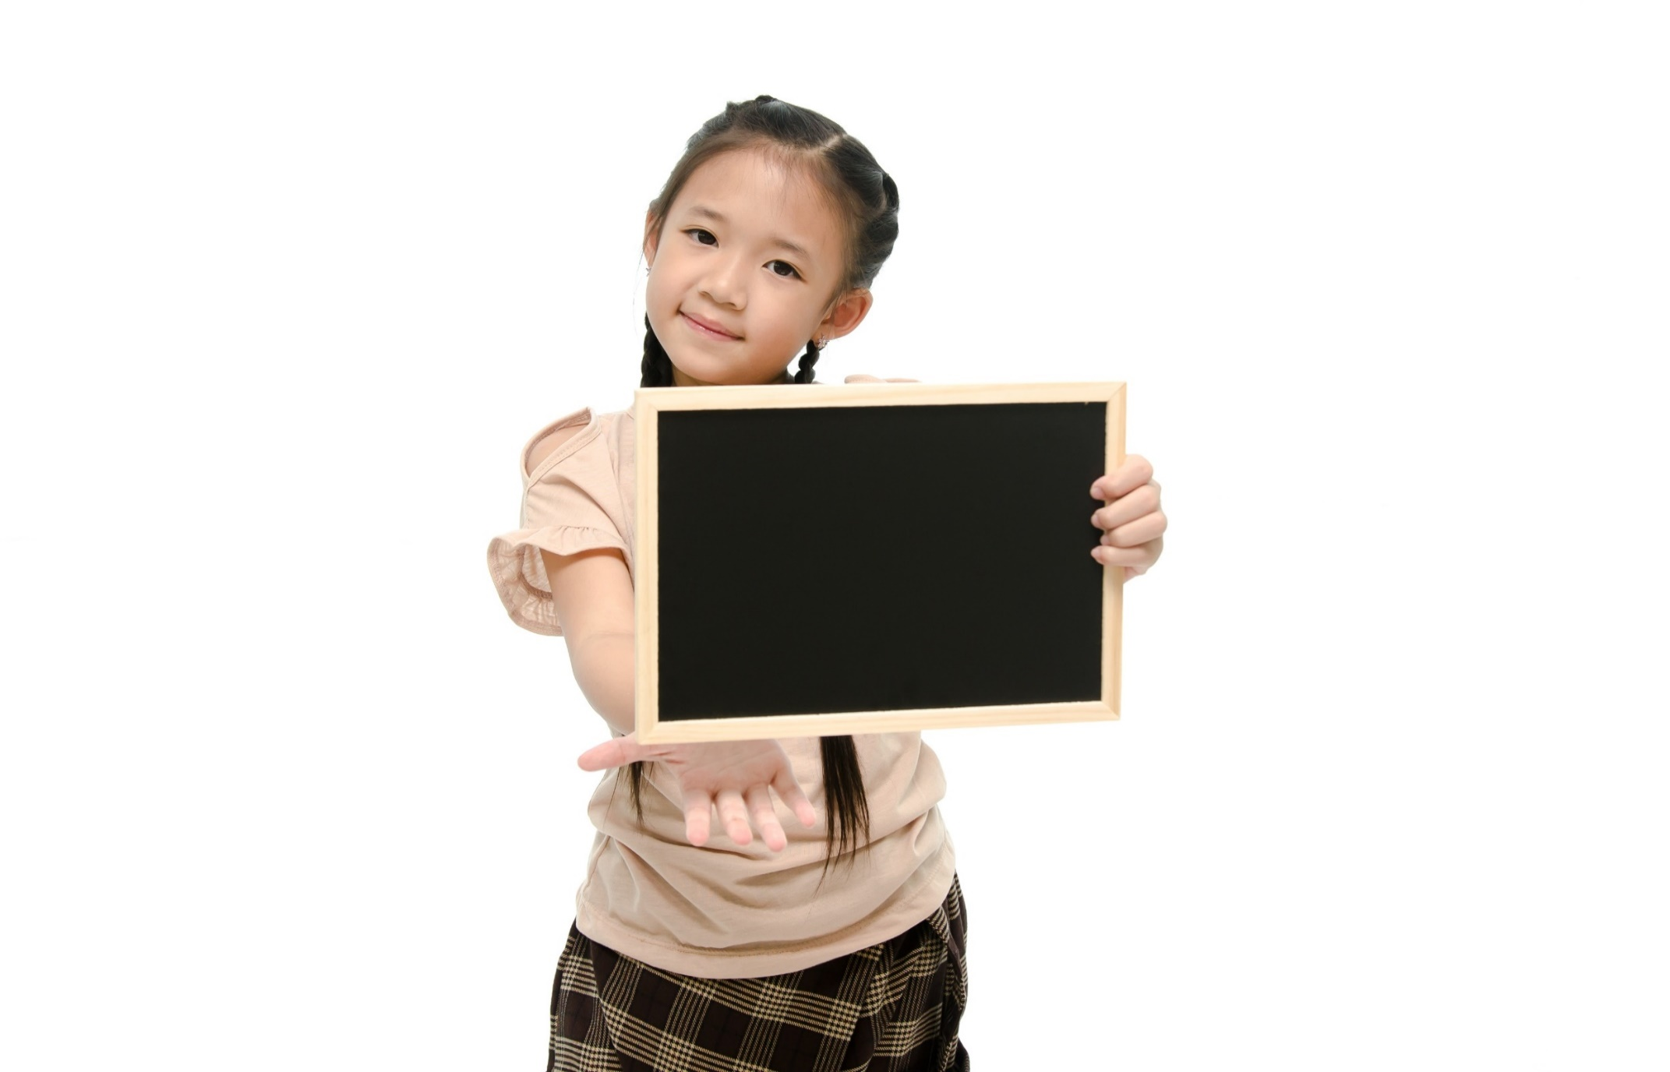
Production

Slide 18

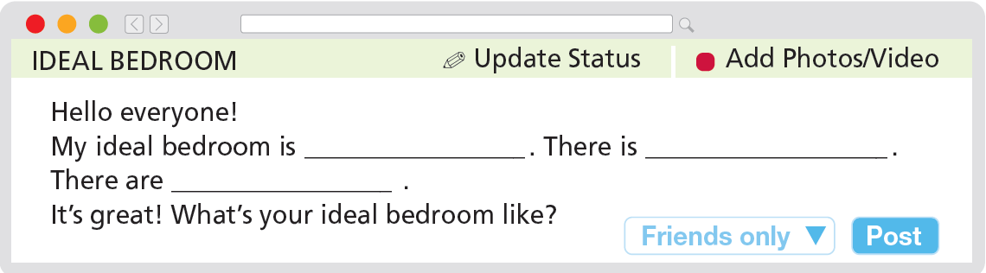
6. Post a description of your ideal bedroom (about 40-50 words). Use the text in Exercise 4 as a model.

Slide 19

CONSOLIDATION

Slide 20
Write a paragraph (about 40-60) words to describe your living room.

Slide 21

WRAP-UP

Slide 22
Today’s lesson
Grammar
Prepositions of place
Question word with Where

Slide 23
Homework
Practise grammar and make sentences using them.
Do the exercises in TA 6 Right on WB (p. 16).
Complete the grammar notes in TA 6 Right on Notebook (p. 16).
Prepare the next lesson (p. 30 SB).

Slide 24

Enjoy your day!

