Slide 1



Unit 1: Feelings
Lesson 1G: Speaking

Slide 2


HIDDEN PICTURES
GAME
www.phuongnam.edu.vn

Slide 3
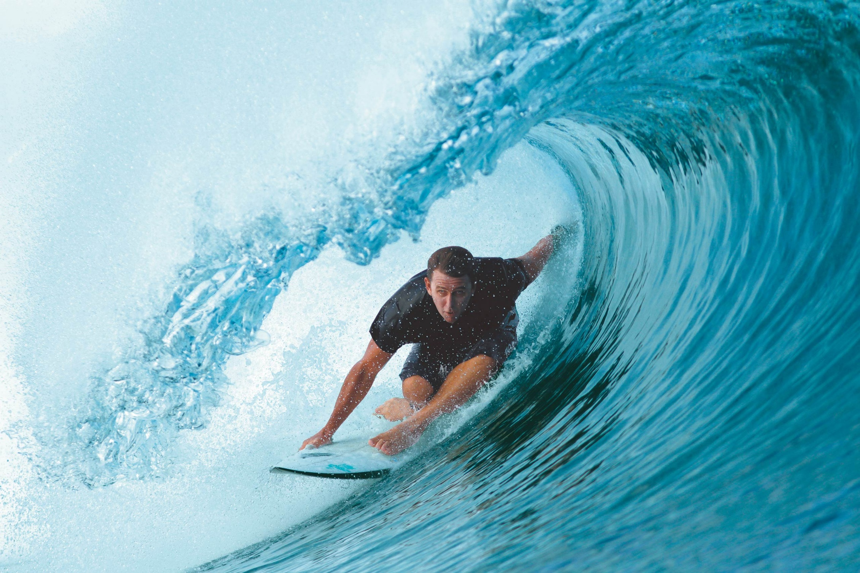
SURFING
SHOW

Slide 4
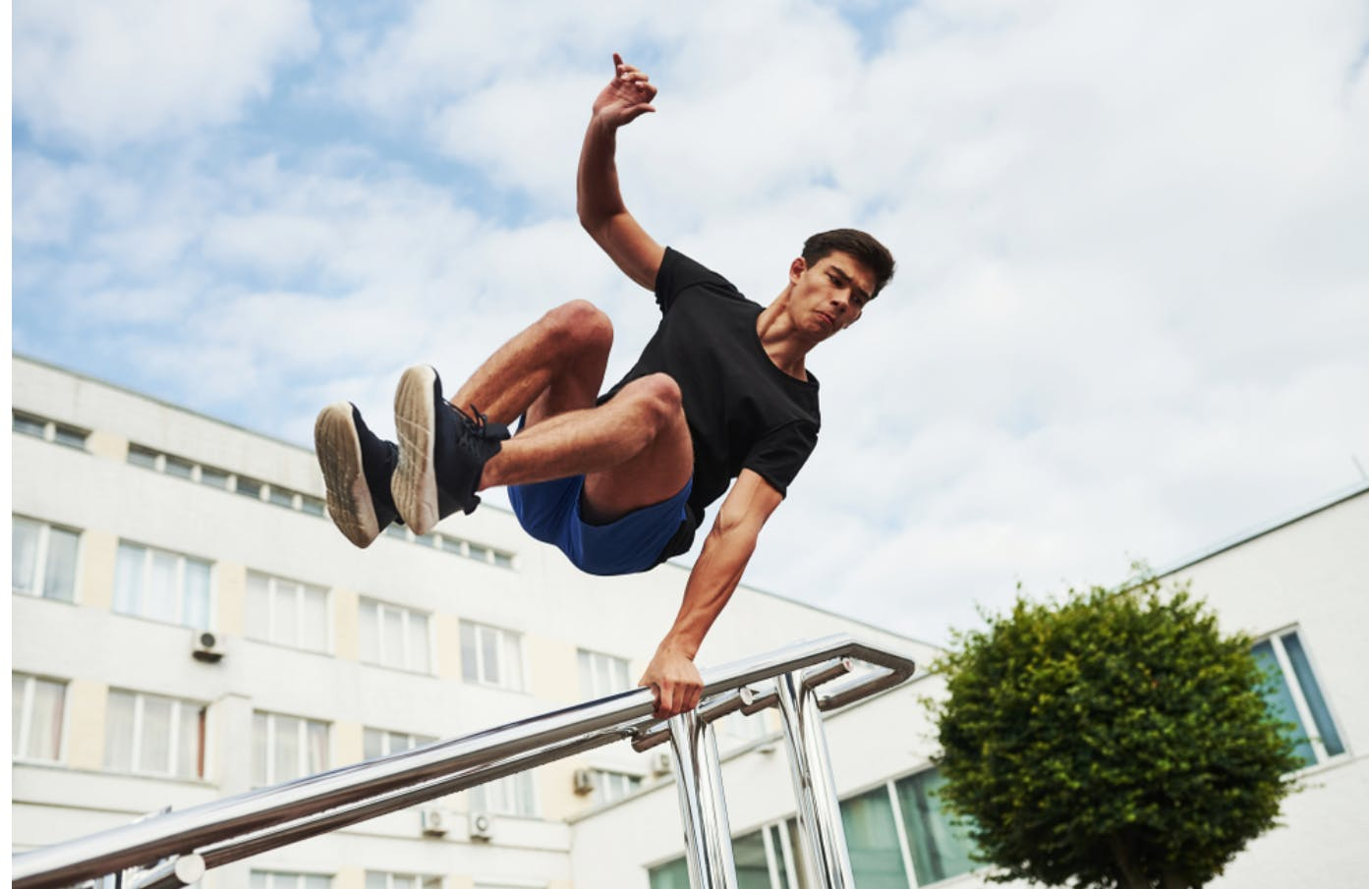
PARKOUR
SHOW

Slide 5
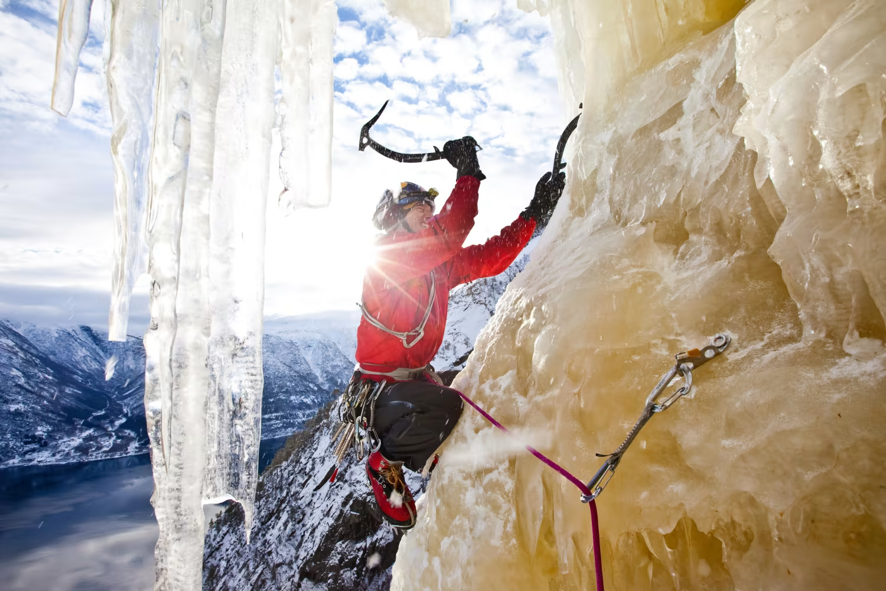
ICE CLIMBING
SHOW

Slide 6
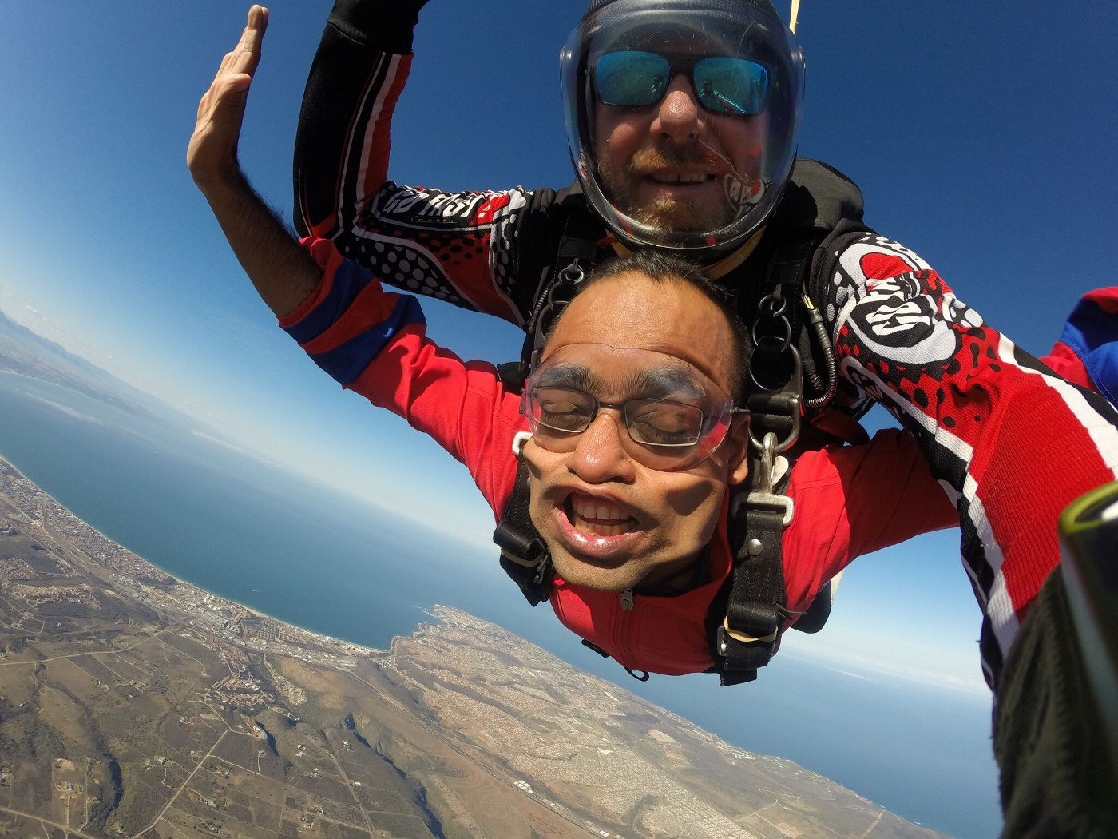
SKYDIVING
SHOW

Slide 7
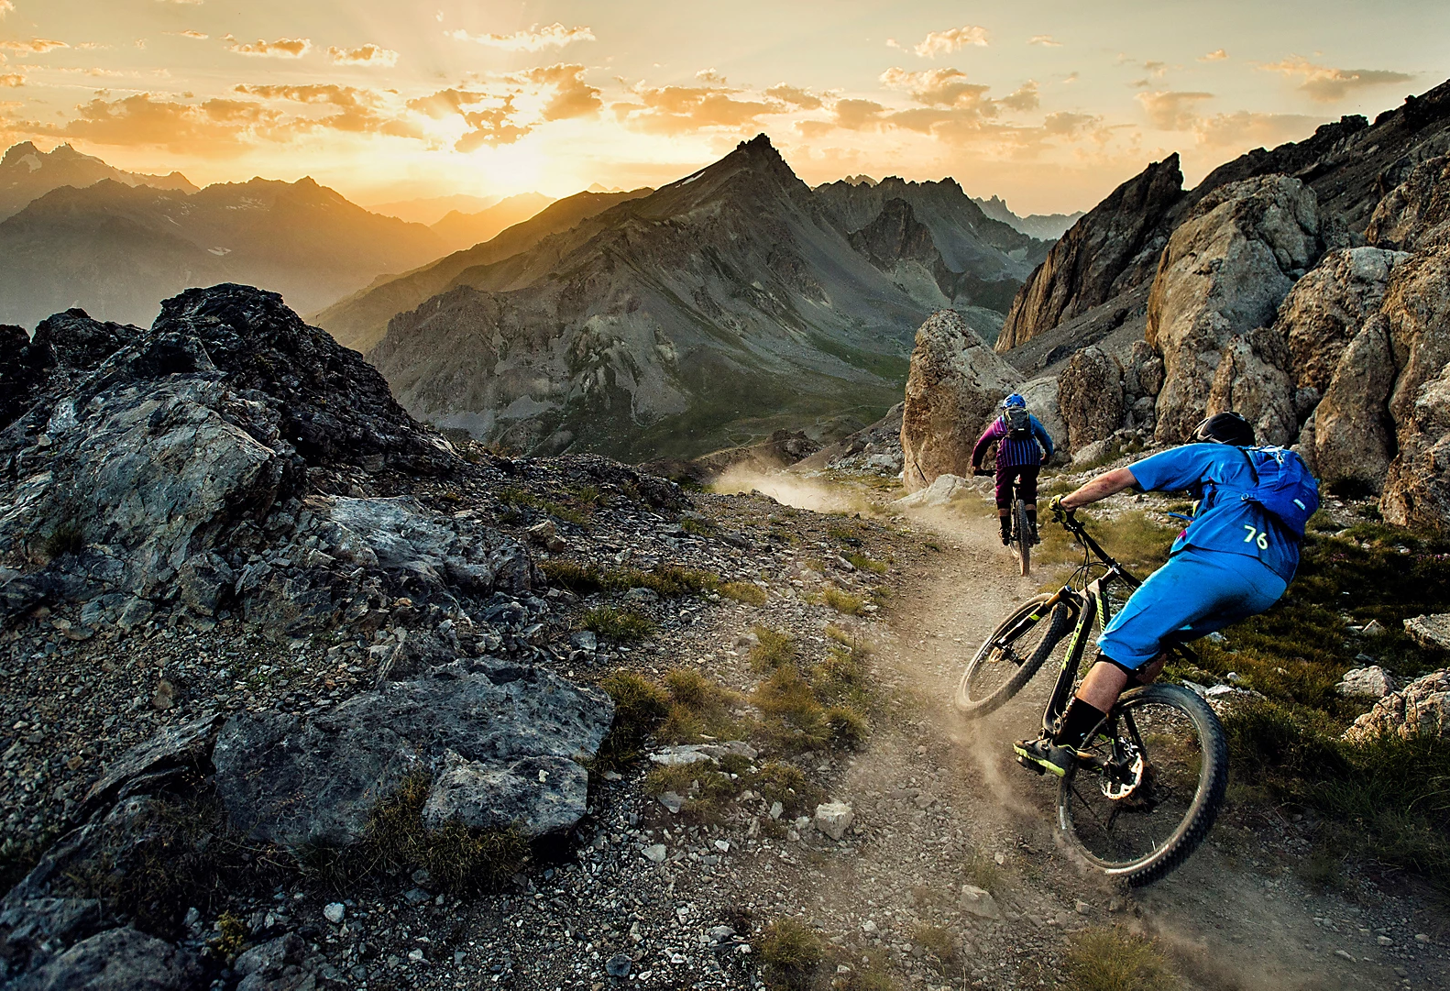
MOUNTAIN BIKING
SHOW

Slide 8
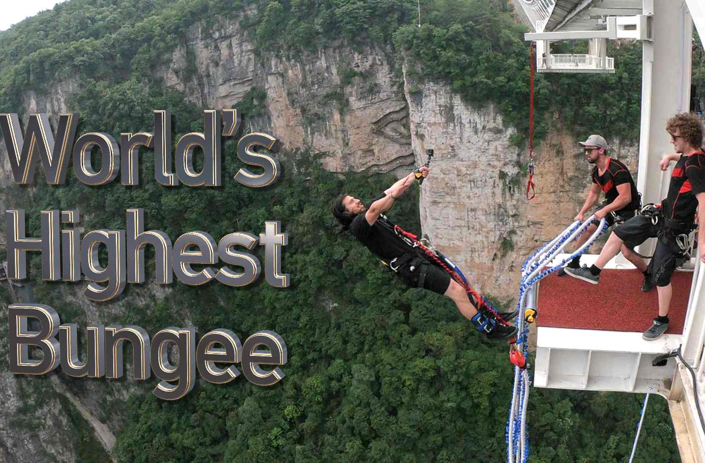
BUNGEE JUMPING
SHOW

Slide 9



UNIT 1:
FEELINGS
www.phuongnam.edu.vn

Slide 10
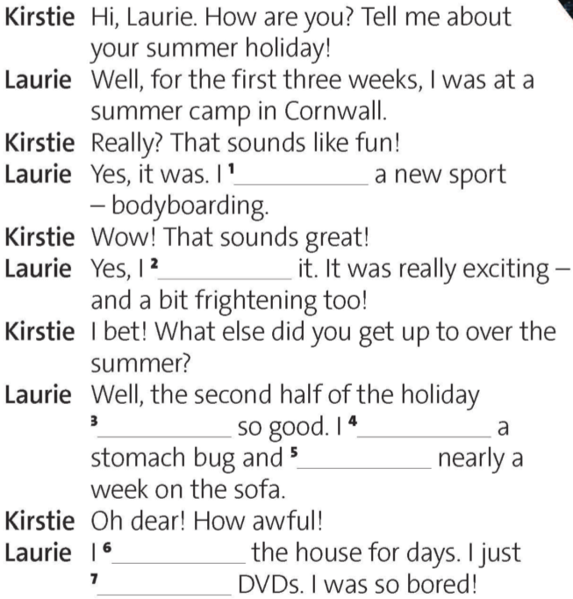

2. Complete the dialogue with the correct affirmative or negative past simple form of the verbs below.
learned
Affirmative
Regular + Irregular Verb | Verb be
S + V_{2/ed} + V | I/He/She/It + was + V You/We/They + were + V
loved
Negative
Regular + Irregular Verb | Verb be
S + did not + V₁ + V | I/He/She/It + was not + V You/We/They + were not + V
wasn’t
got
spent
didn’t leave
watched

Slide 11
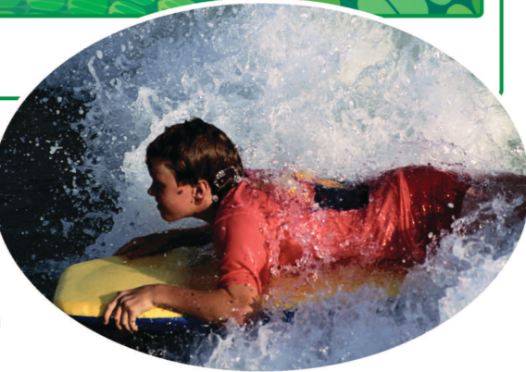

3. Does the photo go with the first or second half of the dialogue? How do you know?
The photo goes with the first half of the dialogue because it shows Laurie bodyboarding.
www.phuongnam.edu.vn

Slide 12

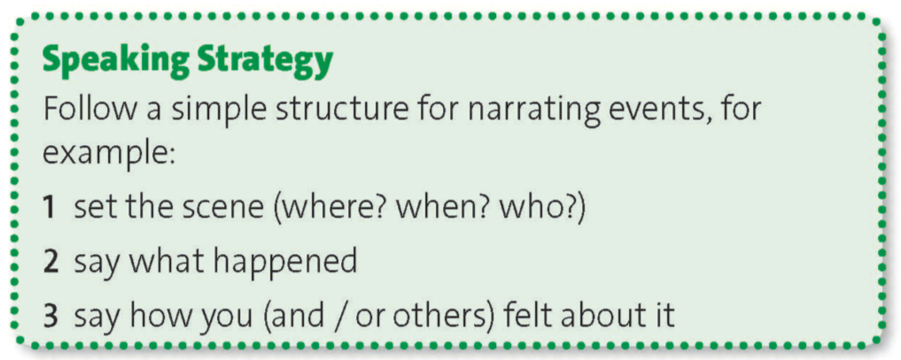
www.phuongnam.edu.vn

Slide 13

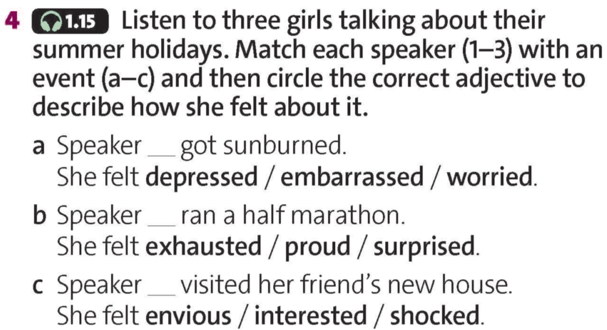
2
1
3
www.phuongnam.edu.vn

Slide 14


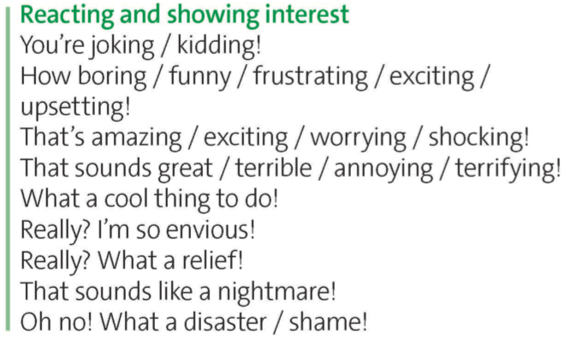



www.phuongnam.edu.vn

Slide 15
5. Find three more phrases for reacting and showing interest.
learned
6. Practice saying the phrases above and the dialogue. Try to sound interested!
loved
wasn’t
got
spent
didn’t leave
watched

Slide 16

Pair - Work
www.phuongnam.edu.vn

Slide 17
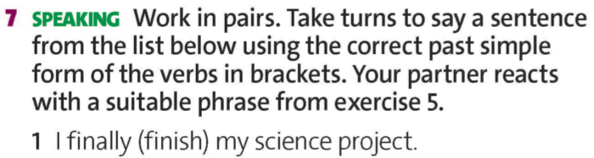
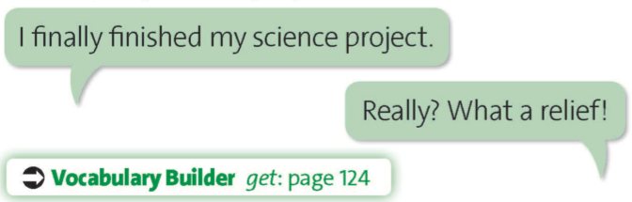
www.phuongnam.edu.vn

Slide 18
www.phuongnam.edu.vn

Slide 19

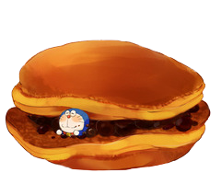
= Mystery
power-up
= points
www.phuongnam.edu.vn

Slide 20

A
B
C
D
E
F
G
H
I
www.phuongnam.edu.vn

Slide 21
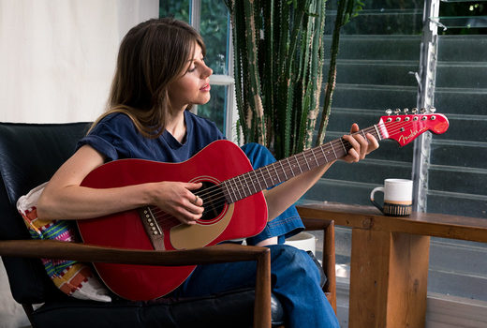


I (learn) to play a new song on the guitar.
I learnt to play a
new song on the guitar.

Slide 23
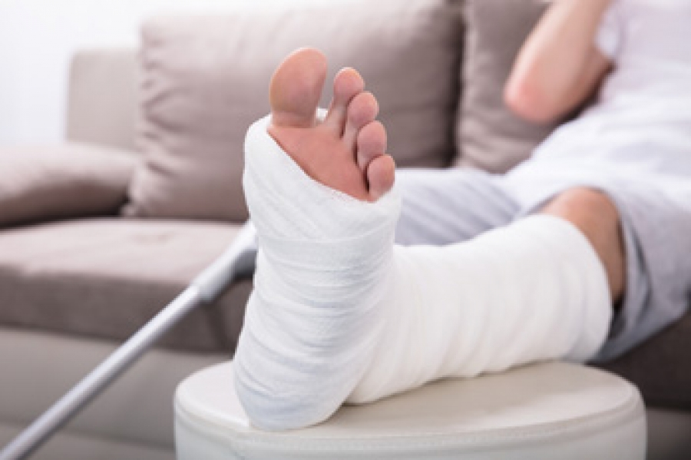

I (break) a bone in my foot.
I broke a bone
in my foot.

Slide 25


I (drop) my dad’s laptop.
I dropped my dad’s laptop.

Slide 27
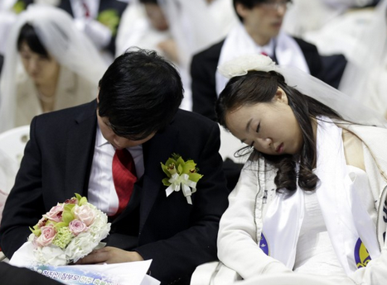

I (fall) asleep at my cousin’s wedding.
I fell asleep at
my cousin’s wedding.

Slide 29
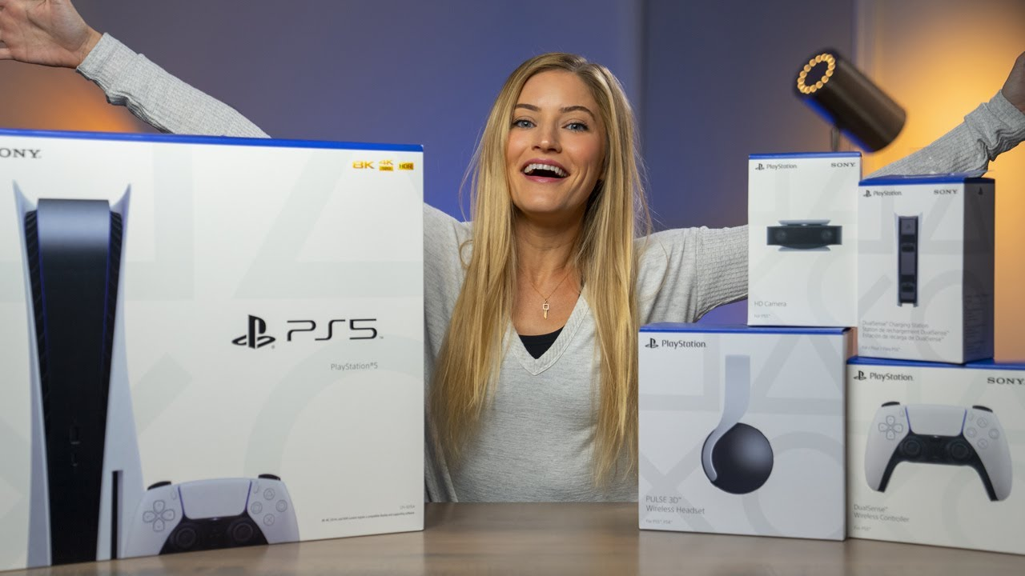
I (get) a brand new PS5 for my birthday.
I got a brand new PS5
for my birthday.

Slide 31
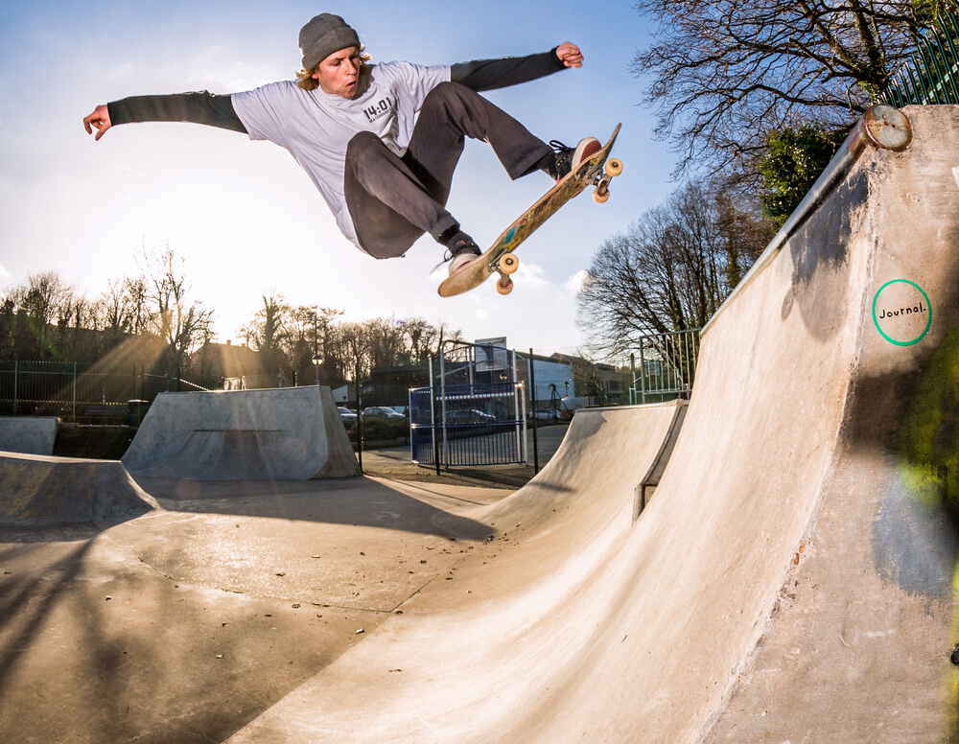

Would you like some noodles?
Sure. I like noodles.
No, thanks. I don’t like ….

Slide 32







Slide 33
Change points!

Slide 34
Steal 3 points!

Slide 35
7 points!

Slide 36


I (have) extremely slow internet yesterday.
I had extremely slow
Internet yesterday.

Slide 38
Change points!

Slide 39




Slide 40
8 points!

Slide 41
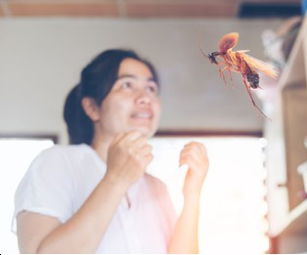
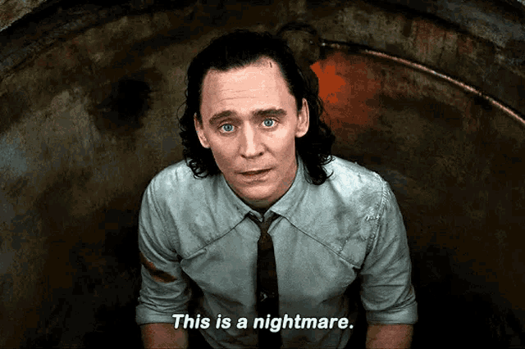
I (see) a flying cockroach last week.
I saw a flying
cockroach last week.

Slide 42
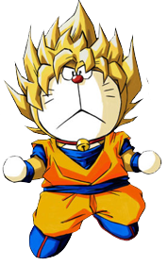
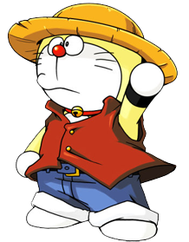


Slide 43
Steal 3 points!

Slide 45
9 points!

Slide 46
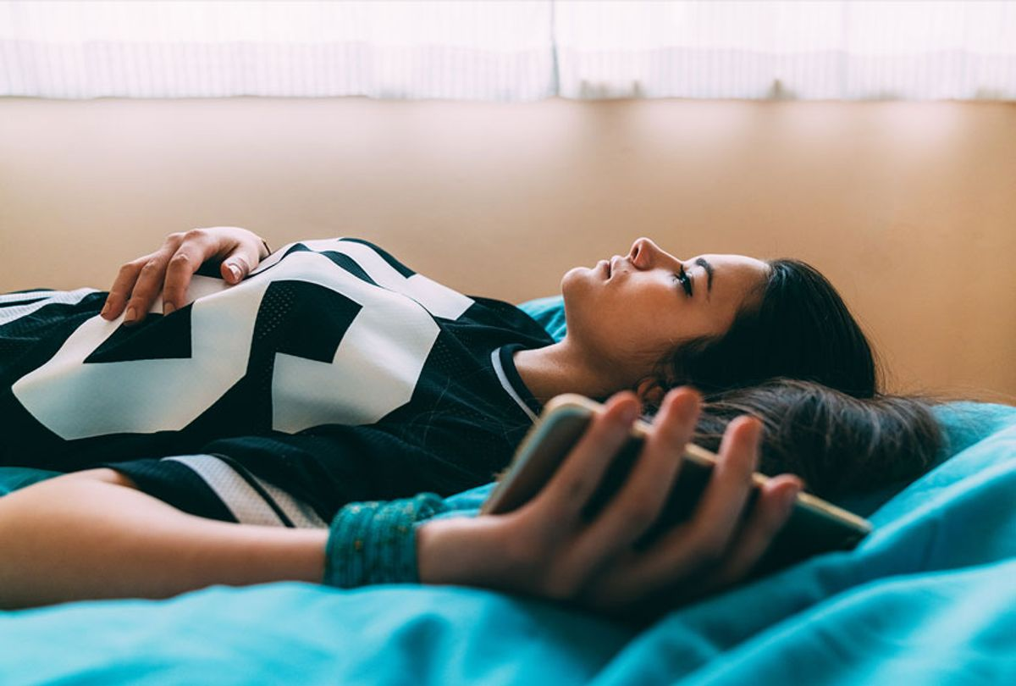

There (is) nothing for me to do for the whole day.
There was nothing for me
to do for the whole day.

Slide 47


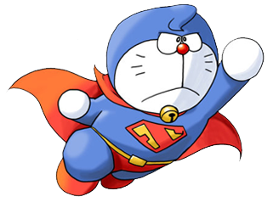

Slide 48
Change points!

Slide 49
Steal 3 points!

Slide 51



- Practice telling an event from your last summer and reacting to the story
- Prepare for next lesson – Writing
www.phuongnam.edu.vn

Slide 52

www.phuongnam.edu.vn

Slide 53



Thank you!
CTCP ĐẦU TƯ VÀ PHÁT TRIỂN GIÁO DỤC PHƯƠNG NAM

