Slide 1

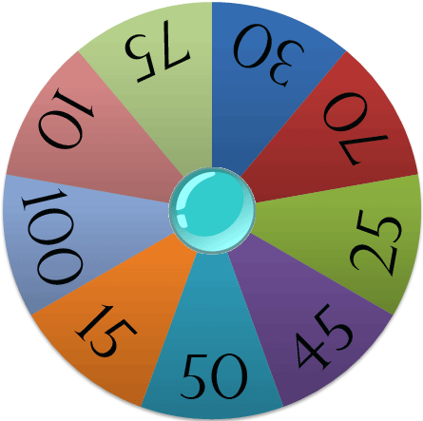
The Big Wheel
Play

Slide 2
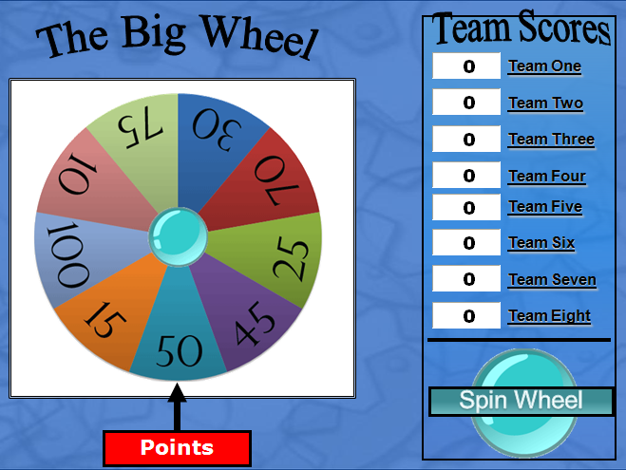
The Big Wheel
Instructions:
1) Divide into Teams
2) Ask a Question to a Team
3) If correct, click the
Spin Wheel Button to
choose the number of
points that team will
receive.
4) Type points from wheel into
Team Score Box
5) Continue until out of
questions.
4
3
Play

Slide 3

Team Scores
The Big Wheel
Team One
Team Two
Team Three
Team Four
Team Five
Team Six
Team Seven
Team Eight
Spin Wheel
Points

Slide 4

SƯU TẦM: ĐOÀN VĂN DOANH, NAM TRỰC, NAM ĐỊNH
LINK NHÓM DÀNH CHO GV BỘ MÔN VẬT LÝ TRAO ĐỔI TÀI LIỆU VÀ CHUYÊN MÔN CT 2018
https://www.facebook.com/groups/299257004355186

