Slide 1

Unit 1: My World
Lesson 1b: Grammar
Page 16

Slide 2
Lesson Outline
Warm-up
Grammar
Consolidation
Wrap-up

Slide 3
Objectives
By the end of this lesson, students will be able to…
- revise and practise Present Simple.
- revise and practise Adverbs of frequency & Preposition of time.

Slide 4

WARM-UP

Slide 5
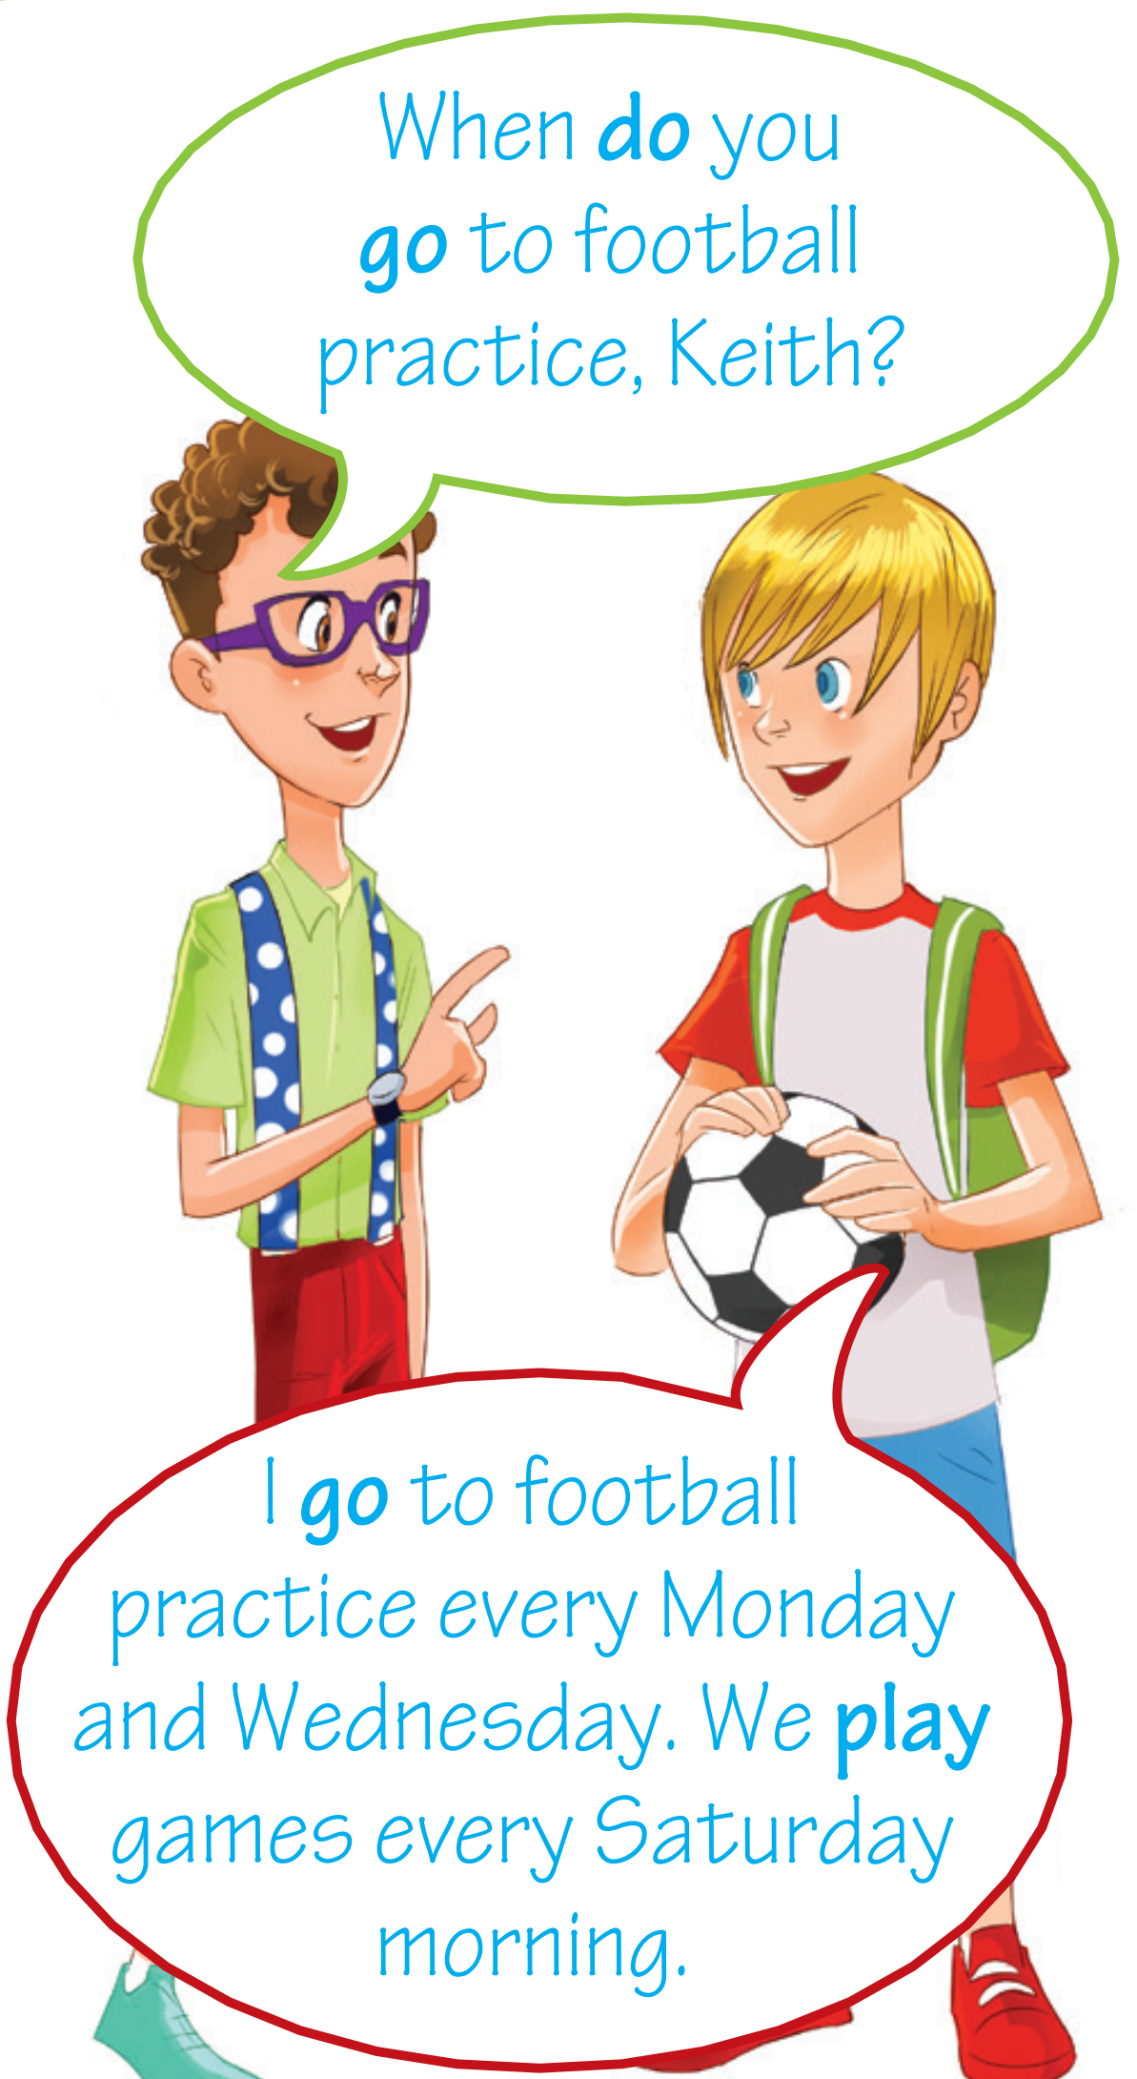
Look at the conversation, pay attention to the verbs in the sentences.
Which tense do people use in these sentences?
=> Present Simple

Slide 6

It’s time to learn …

Slide 7

Presentation

Slide 8

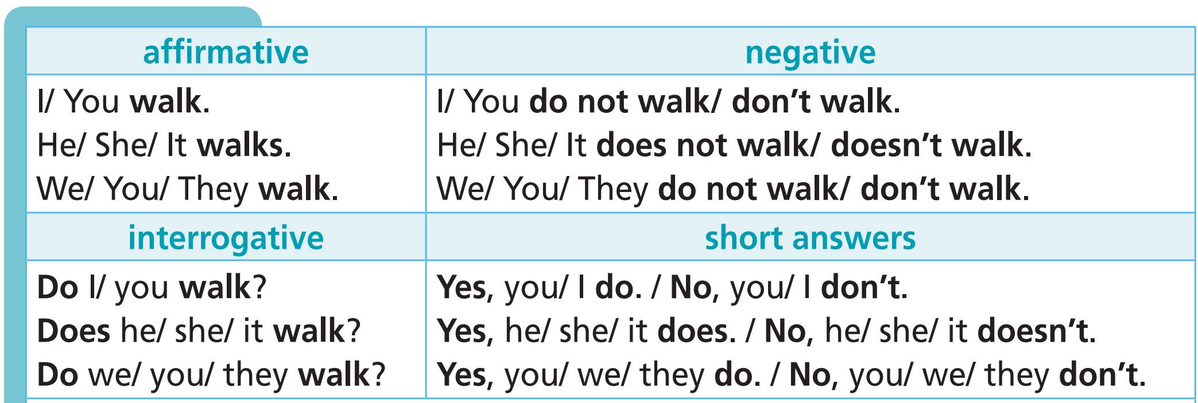
Grammar
Affirmative: S + V(s/es)
Negative: S + don’t/doesn’t + V-inf
Interrogative: Do/Does + S + V-inf?

Slide 9
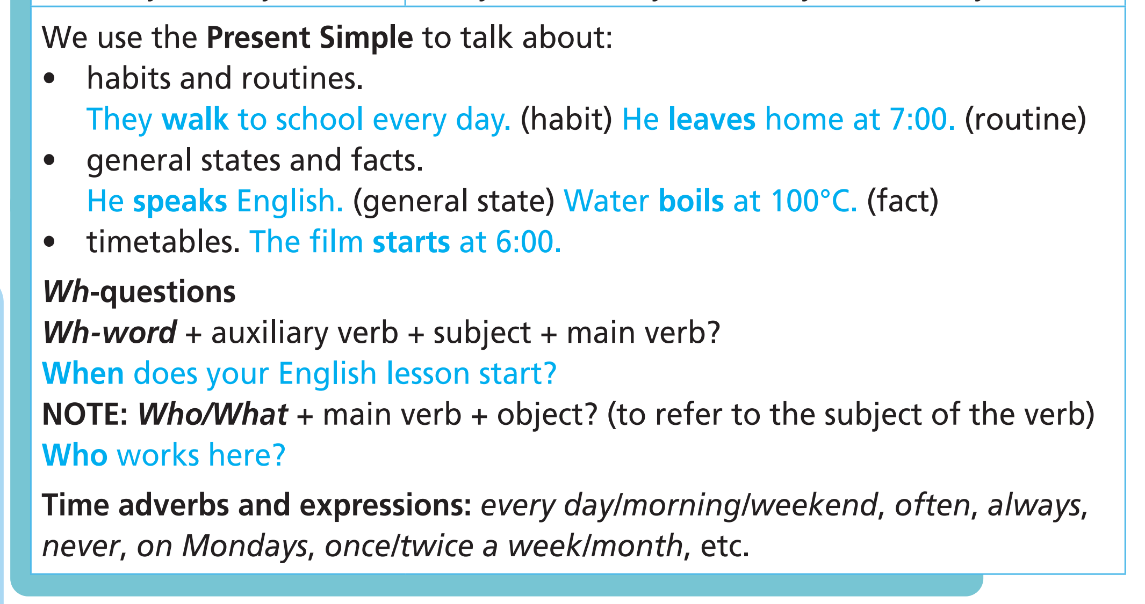
Usages

Slide 10


3rd person singular
• We form the third person singular (he/ she/ it) by adding -s to the end of most verbs.
I play – she plays
• verbs ending in -s, -sh, -ch, -x or -o: add -es
I kiss – he kisses,
I wash – he washes,
I watch – she watches,
I mix – she mixes,
I go – she goes
• verbs ending in a consonant + -y: drop the -y and take -ies
I study – she studies,
I try – she tries
• verbs ending in a vowel + -y: take -s
I play – she plays

Slide 11
Pronunciation
• /s/ after unvoiced sounds
cooks /kʊks/
• /z/ after voiced sounds
reads /riːdz/
• /iz/ after sounds like /s/, /ʃ/, /tʃ/, /dʒ/ or /z/
watches /wɒtʃiz/

Slide 12

Practice

Slide 13
1 miss __________
2 do __________
3 cry __________
4 rain __________
5 wait __________
6 ride __________
7 match __________
8 buy __________
/mɪsiz/
misses
does
/dʌz/
cries
/krɑɪz/
rains
/reɪnz/
waits
/weɪts/
rides
/raɪdz/
matches
/mætʃiz/
buys
/baɪz/

Slide 14
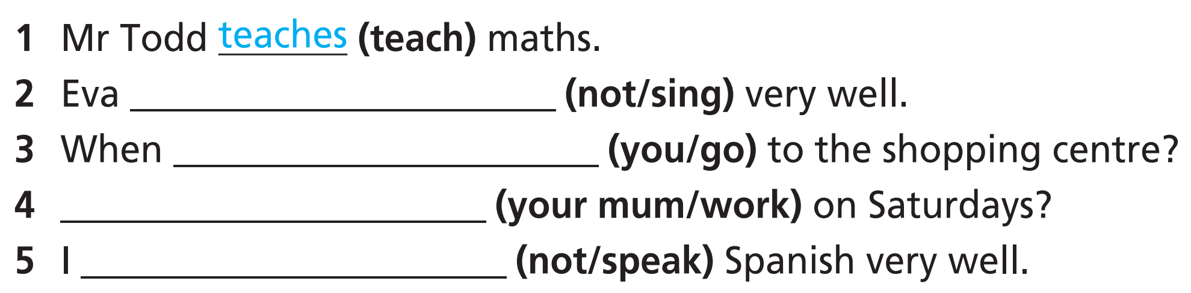
doesn’t sing
do you go
Does your mum work
don’t speak

Slide 15
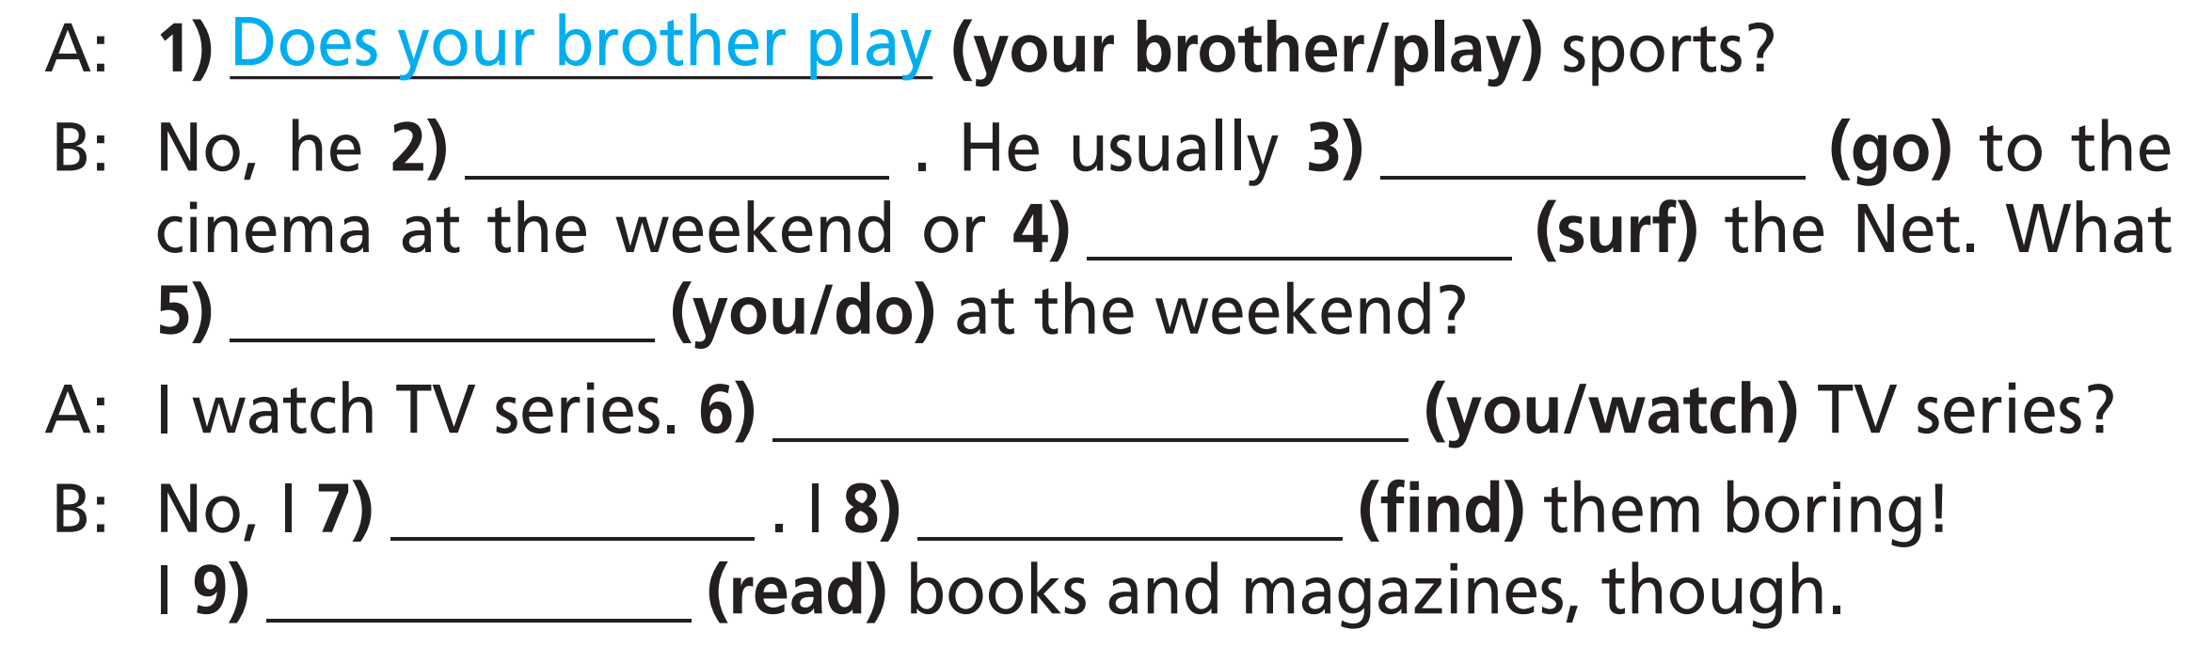
doesn’t
goes
surfs
do you do
Do you watch
don’t
find
read

Slide 16

Extra Practice
WB, Page 11
1 Tony go/goes to football practice after school.
2 I don’t/doesn’t like going shopping.
3 We play/plays computer games in the evenings.
4 Do/Does Alice speak English?
5 They doesn’t/don’t go to our school.

Slide 17
Extra Practice
WB, Page 11
Put the verbs in brackets into the Present Simple.
Do you play
1 A: ______________ (you/play) football in the afternoons?
B: No, I ______________ (not/like) playing it, but I ______________ (enjoy) watching it on TV.
2 A: ______________ (Lucy/walk) to school every day?
B: No, she ______________ (catch) the bus.
3 A: I ______________ (not/read) books. I’m only interested in magazines about computers.
B: Really? I love books! I ______________ (borrow) two or three from the
library every week.
4 A: ______________ (Tom/live) in Kensington?
B: No, his house is in Peckham, but he ______________ (visit) his grandparents in Kensington every weekend.
don’t like
enjoy
Does Lucy walk
catches
don’t read
borrow
Does Tom live
visits

Slide 18

Production

Slide 19

Work in pairs. One student makes five sentences using the Present Simple tense. The other will report the sentences.
For example:
Student 1: I often get up early in the morning.
Student 2: He (She) often gets up early in the morning.

Slide 20

CONSOLIDATION

Slide 21
Write a paragraph (60-80 words) about what you usually do in your typical day. Use the Present Simple tense.

Slide 22

WRAP-UP

Slide 23
Today’s lesson
Vocabulary
Verbs to describe daily activities/routine
Grammar
Present Simple
+ Affirmative: S + V(s/es)
+ Negative: S + don’t/doesn’t + V-inf
+ Interrogative: Do/Does + S + V-inf?
Spelling rules: 3rd person singular
Pronunciation

Slide 24
Homework
Practise the vocabularies and grammar and make sentences using them.
Do the exercises in TA 7 Right on WB (page 11)
Prepare the next lesson (page 17 SB)
Complete the grammar notes in TA 7 Right on Notebook (page 6)

Slide 25
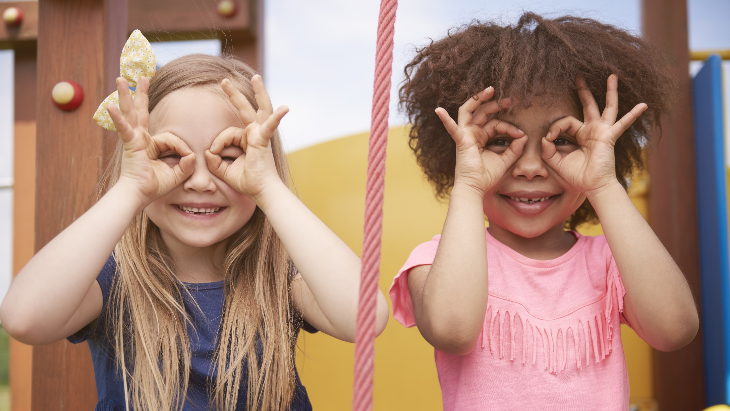
Enjoy your day!

