Slide 1


Slide 2
LANGUAGE
Review 4
REVIEW
FAMILY LIFE
Unit
LESSON I

Slide 3
LESSON 1
LANGUAGE
WARM- UP
Mini game: Catch a word
PRONUNCIATION
Mark the intonation. Then listen and check. Practise saying the sentences in pairs.
VOCABULARY
What are the missing letters? Complete the sentences using the pictures to help you.
1. Write one sentence using the linking words and phrases in brackets.
2. Circle the correct answers.
GRAMMAR

Slide 4

Catch a word

Slide 5
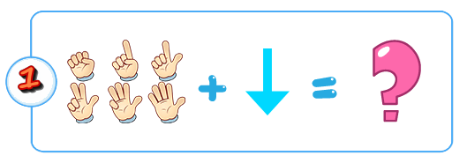

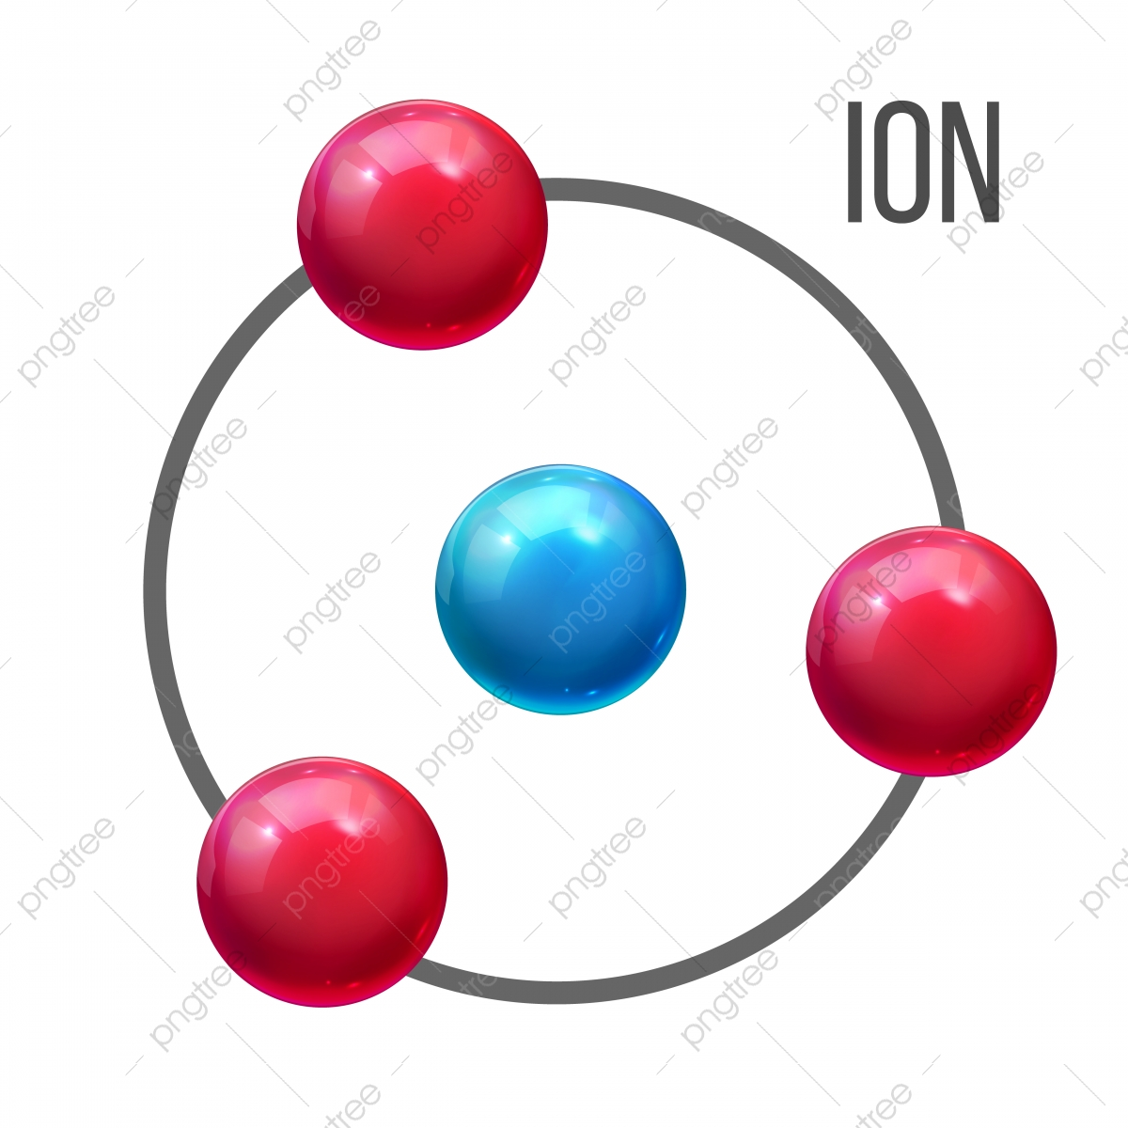
de
+
+
Depression

Slide 6
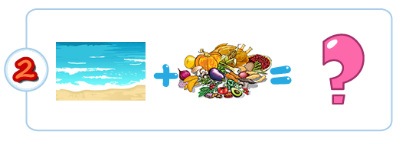

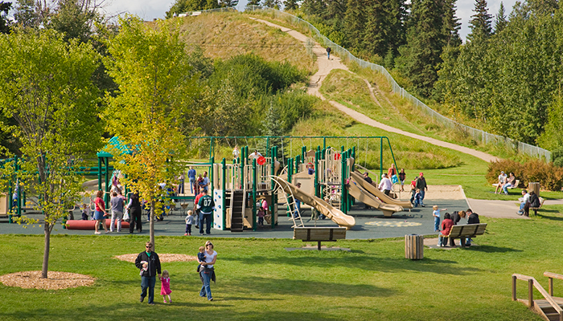
+
National Park

Slide 7
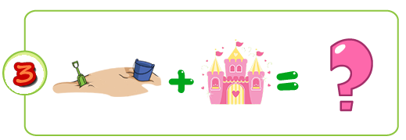

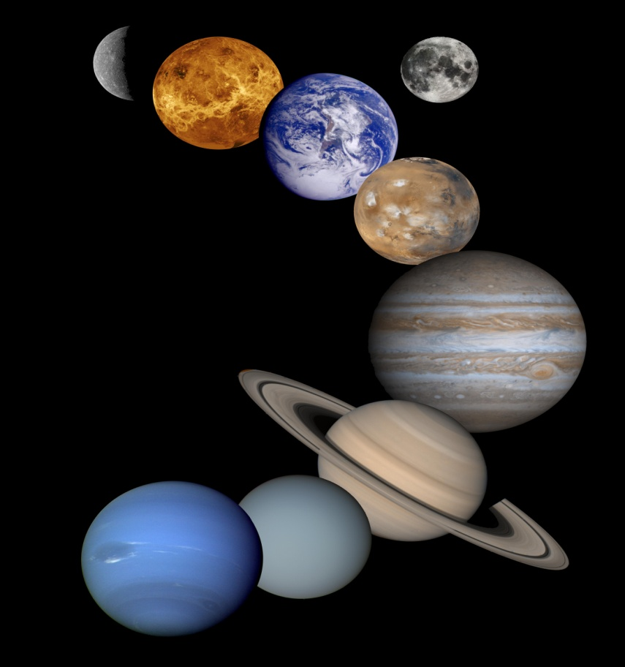
SOLAR
E +
-2
Ecosystem

Slide 8
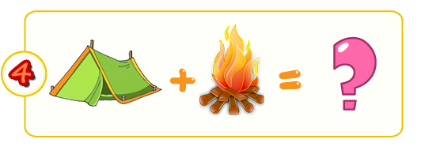

- L
Cr +
Crime

Slide 9
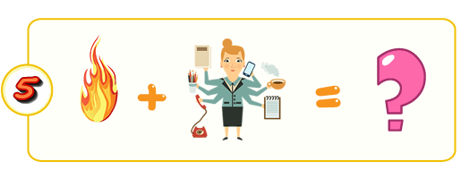

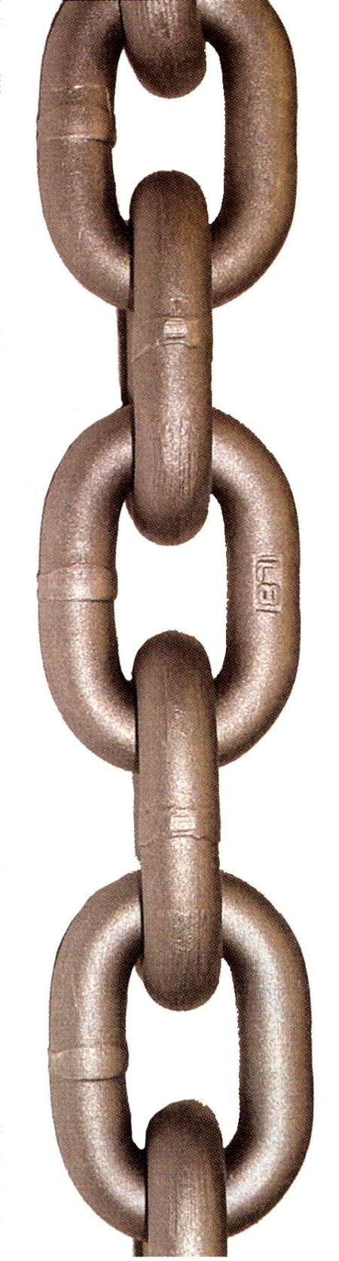
+
Food chain

Slide 10



+
x
Pressure

Slide 11

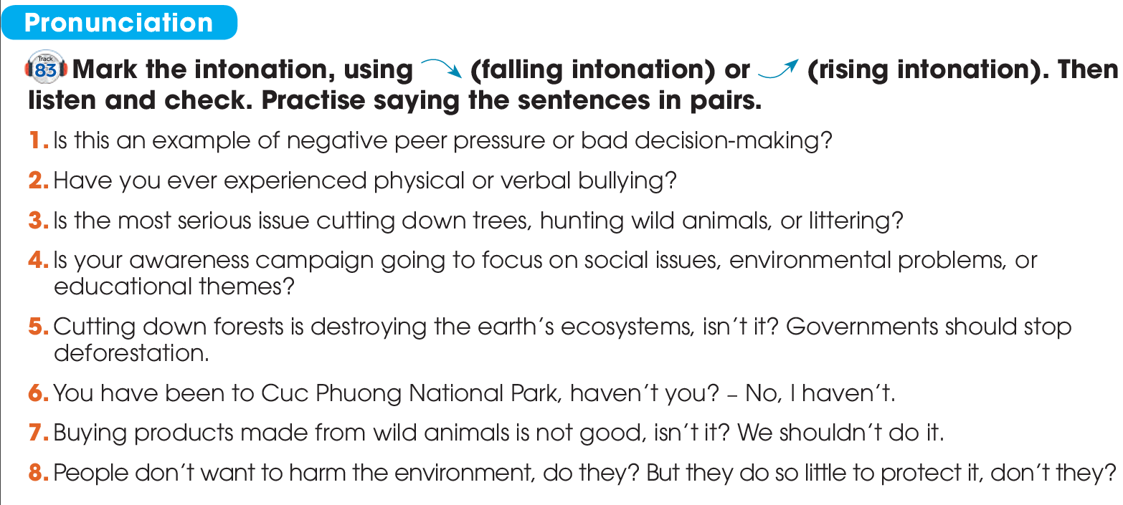


PRONUNCIATION

Slide 12
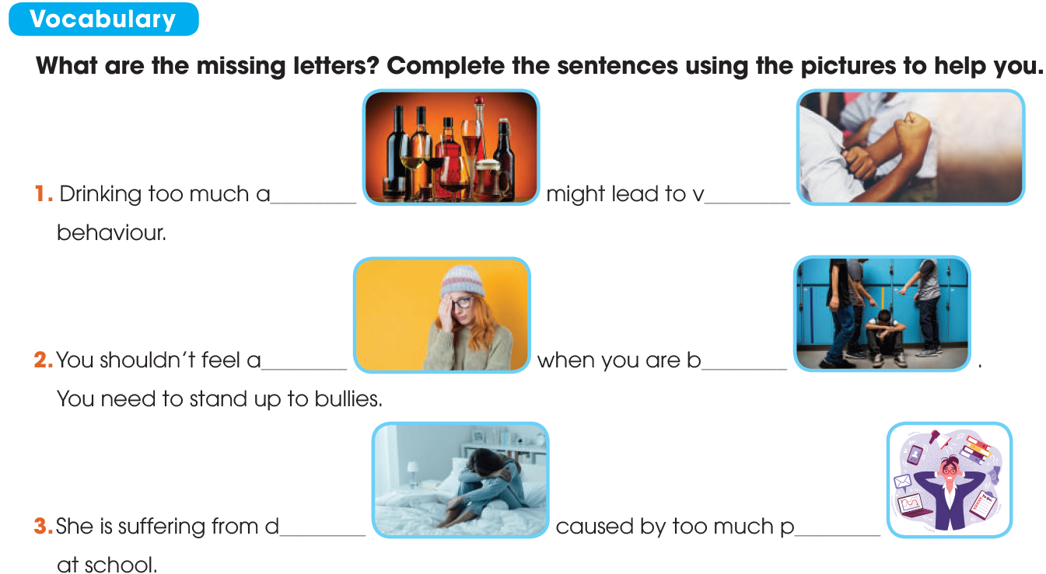
VOCABULARY
lcohol
iolent
shamed
ullied

Slide 13
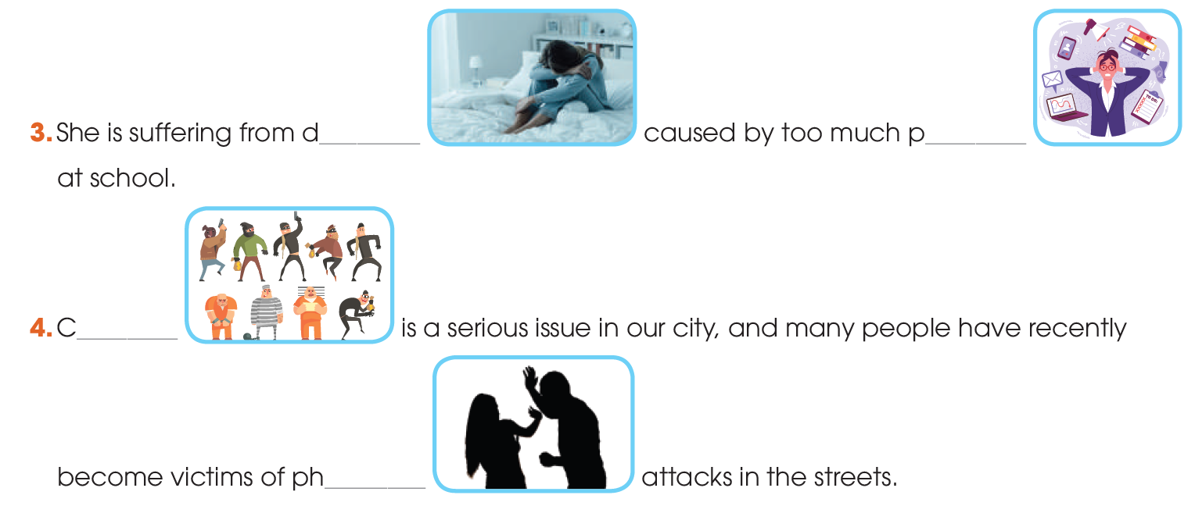
VOCABULARY
epression
ressure
rime
ysical

Slide 14
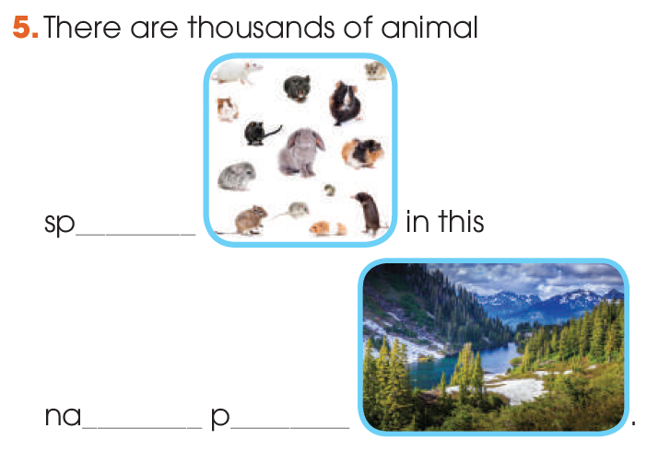
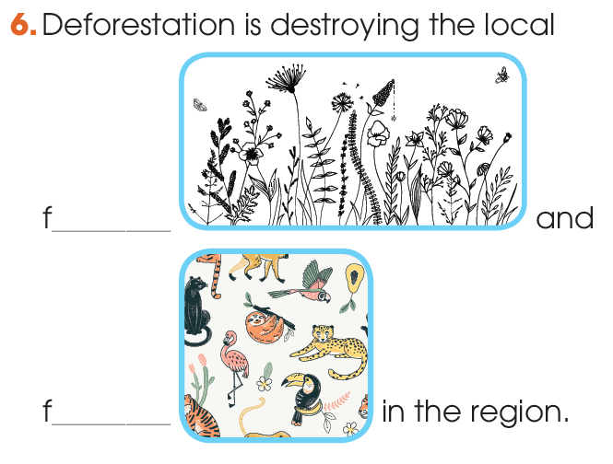
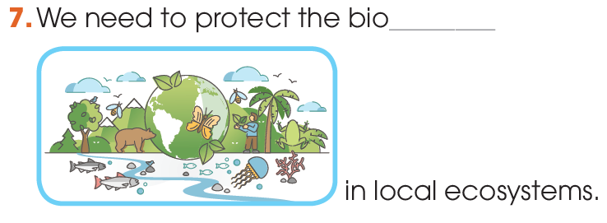
VOCABULARY
ecies
lora
tional
ark
auna
diversity

Slide 15
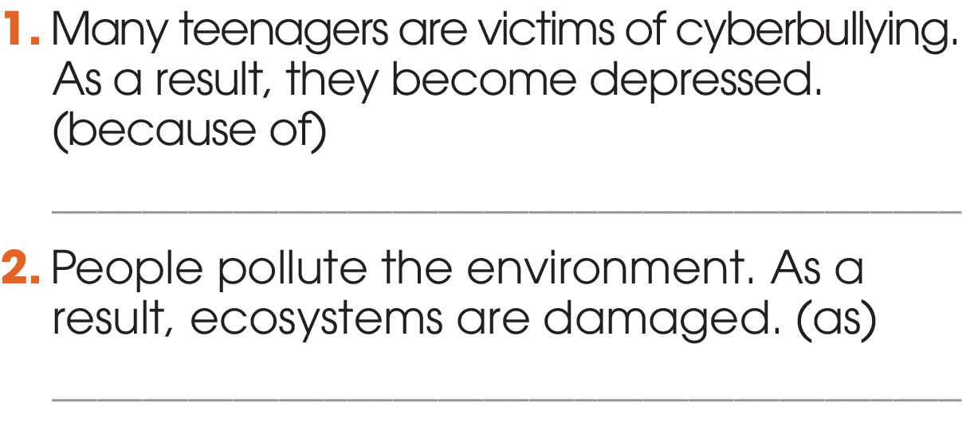
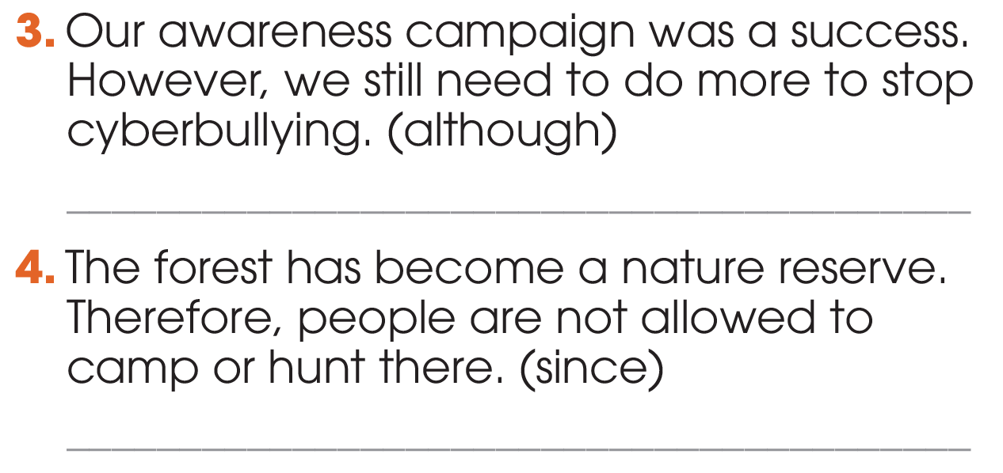
GRAMMAR
1
Write one sentence using the linking words and phrases in brackets. Do not change the meaning of the original sentences.
Because of cyberbullying, many teenagers become depressed. / Many teenagers become depressed because of cyberbullying.
Although our awareness campaign was a success, there are still a lot of things to do to stop cyberbullying. / There are still …
As people pollute the environment, ecosystems are damaged. / Ecosystems are damaged as people pollute the environment.
Since the forest has become ….

Slide 16
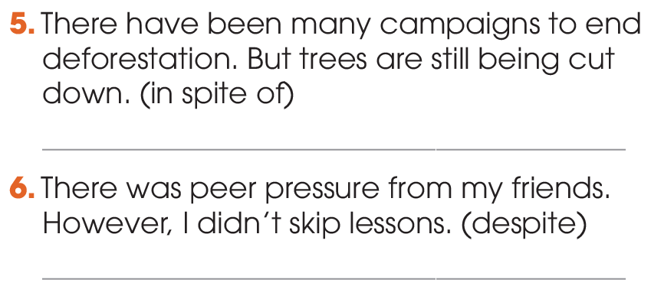
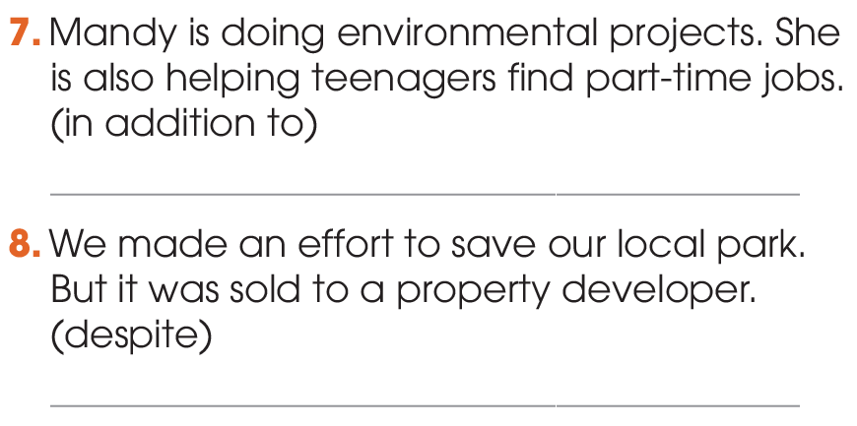
GRAMMAR
1
Write one sentence using the linking words and phrases in brackets. Do not change the meaning of the original sentences.
In spite of the many campaigns to protect the national park, some trees are still being cut down.
In addition to working on ….
Despite the peer pressure from my friends, I didn’t ….
Despite the/our effort to save our local park, it was sold to a property developer.

Slide 17
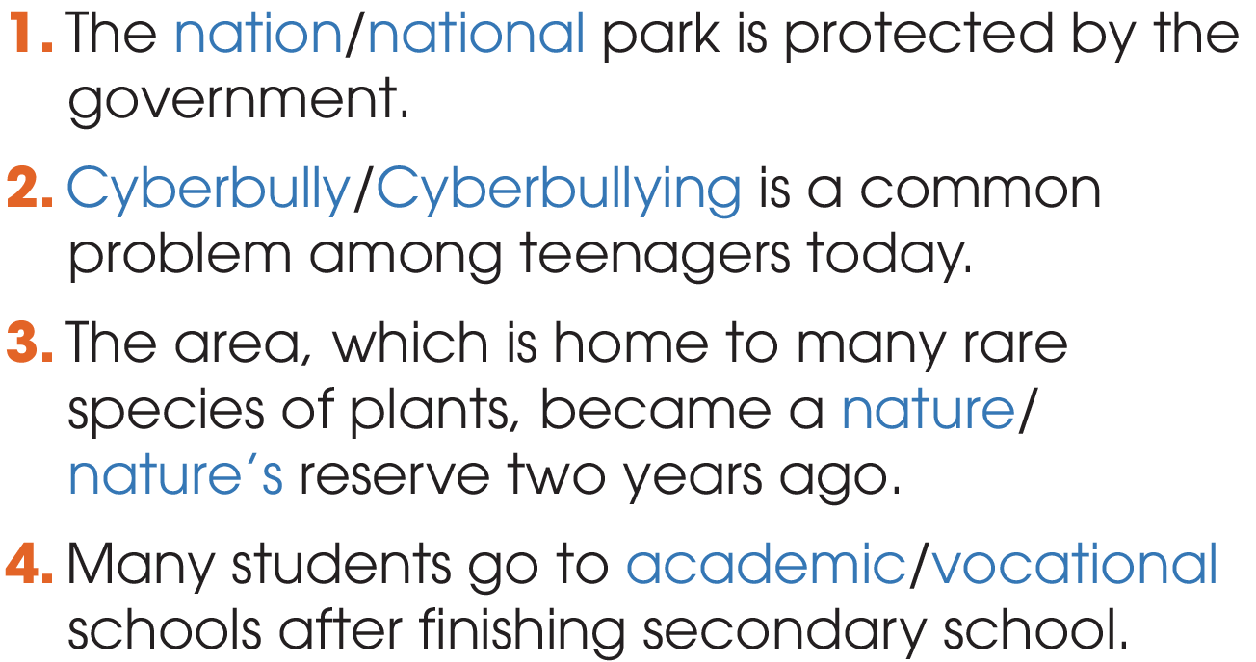
GRAMMAR
2
Circle the correct answers.

Slide 18
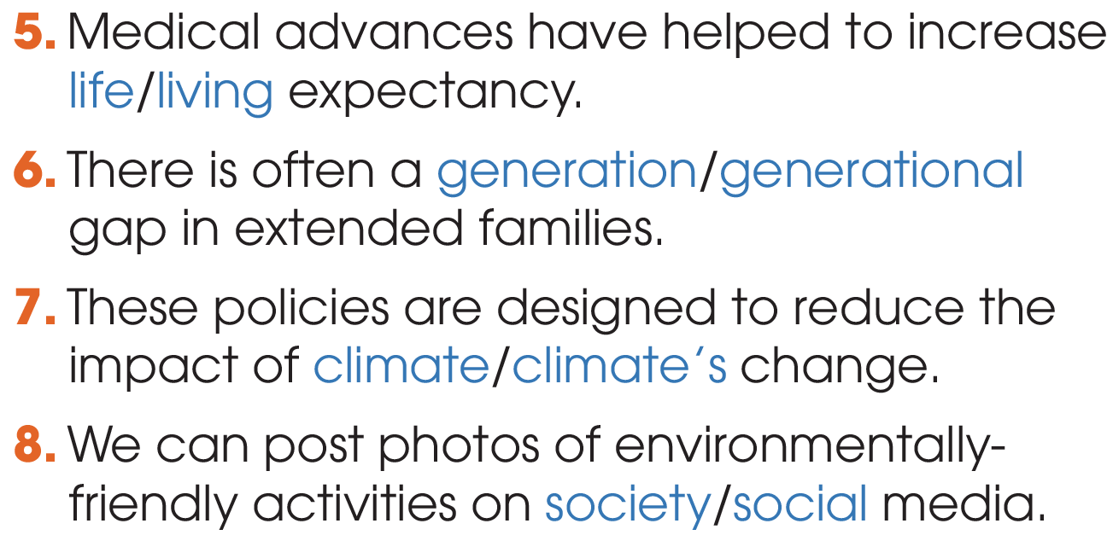
GRAMMAR
2
Circle the correct answers.

Slide 19
CONSOLIDATION
1
Wrap-up
What have you learnt today?
Review the vocabulary and grammar of Unit 9 & 10.
H
0

Slide 20

Website: hoclieu.vn
Fanpage: facebook.com/sachmem.vn/

