Slide 2
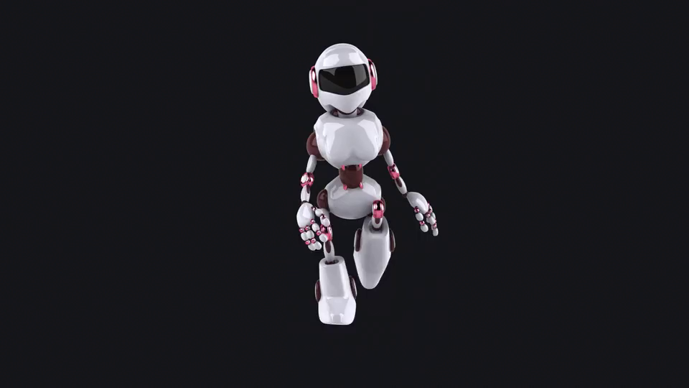


Unit
12
ROBOTS
LESSON 2: A CLOSER LOOK 1

Slide 3

LESSON 2: A CLOSER LOOK 1
LESSON 1: GETTING STARTED
Matching
WARM-UP
Vocabulary
Task 1: Match the verbs in column A to the words or phrases in column B.
(p. 60)
Task 2: Work in pairs. Tell your partner the activities in Task 1 you can or can’t do. (p. 60)
Task 3: Work in pairs. Read, ask and answer questions. (p. 60)
VOCABULARY
PRONUNCIATION
Task 4: Listen and repeat the sentences. (p. 60)
Task 5: Listen and practice saying the statements in the paragraph. (p. 60)
CONSOLIDATION
Wrap-up
Homework

Slide 4
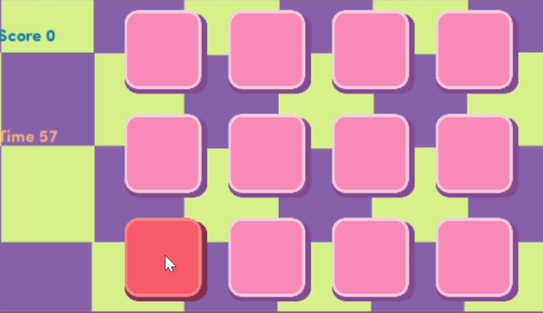
WARM-UP
MATCHING

Slide 5
WARM-UP
- Work in groups
- Match the names of daily activity with suitable picture
- The fastest group will say “Bingo” and stick your work on board.

Slide 6

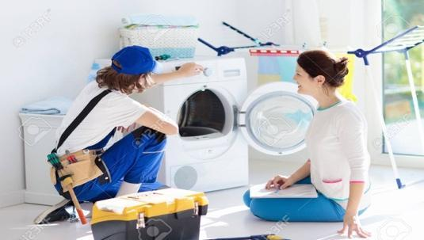
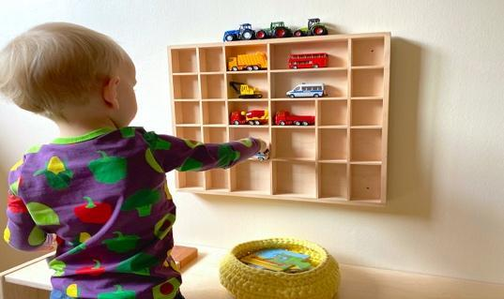
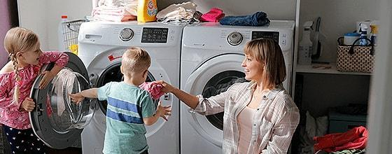
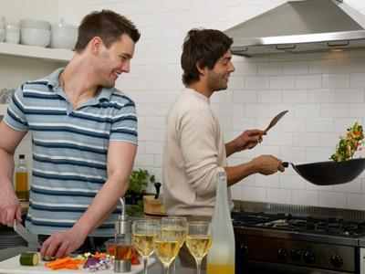
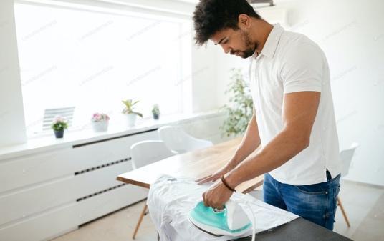
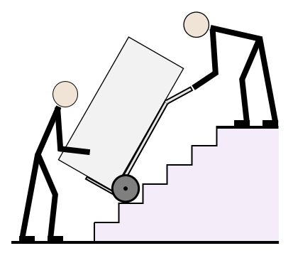
WARM-UP

Slide 7
WARM-UP

Slide 8
WARM-UP
make meals

Slide 9
WARM-UP
iron clothes

Slide 10
WARM-UP
repair a broken machine

Slide 11
WARM-UP
do the washing

Slide 12
WARM-UP
move heavy things

Slide 13
WARM-UP
put toys away

Slide 14
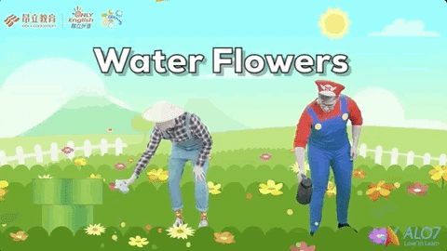
LESSON 2: A CLOSER LOOK 1
LESSON 1: GETTING STARTED
Matching
WARM-UP
Vocabulary
Task 1: Match the verbs in column A to the words or phrases in column B.
(p. 60)
Task 2: Work in pairs. Tell your partner the activities in Task 1 you can or can’t do. (p. 60)
Task 3: Work in pairs. Read, ask and answer questions. (p. 60)
VOCABULARY

Slide 15

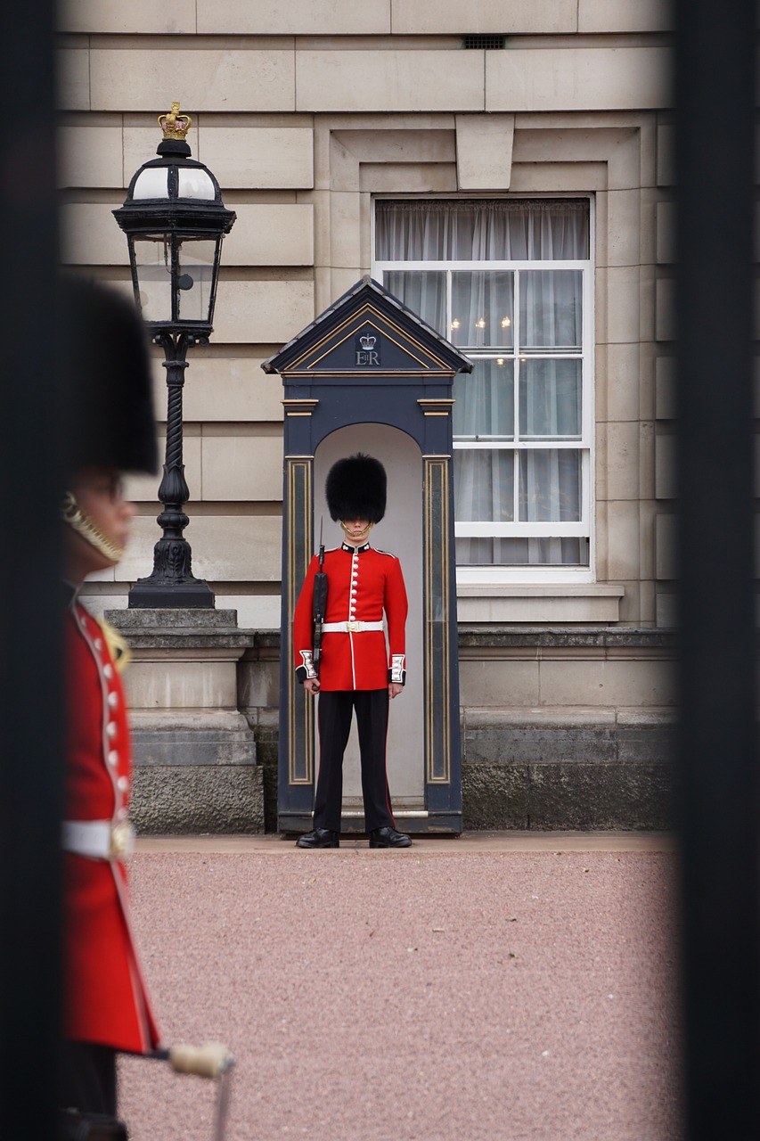
VOCABULARY
water (v)
to pour water on plants, etc.
/ˈwɔːtər/
tưới nước

Slide 16
VOCABULARY
a person, such as a soldier, a police officer or a prison officer, who protects a place or people.
guard (n)
/ɡɑːrd/
bảo vệ
Ex: He made several helpful suggestions.

Slide 17
VOCABULARY
helpful (adj)
willing to help, or useful:
/ˈhelpfl/
Ex: He made several helpful suggestions.
có ích
New words | Pronunciation | Meaning
1. water (v) | /ˈwɔːtər/ | tưới nước
2.guard (n) | /ɡɑːrd/ | bảo vệ
3.helpful (adj) | /ˈhelpfl/ | có ích

Slide 18
/ˈhelpfl/
helpful (adj)
willing to help, or useful:
VOCABULARY
New words | Pronunciation | Meaning
1. water (v) | /ˈwɔːtər/ | tưới nước
2.guard (n) | /ɡɑːrd/ | bảo vệ
3.helpful (adj) | /ˈhelpfl/ | có ích
Ex: He made several helpful suggestions.

Slide 19



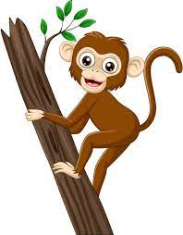
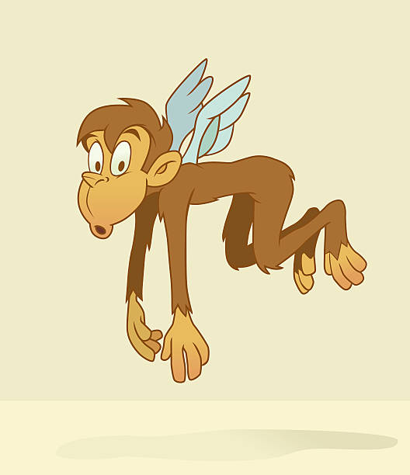

VOCABULARY
Match the verbs in column A to the words or phrases in column B. Then listen, check and repeat them.
A | B
1. understand | a. fruit
2. pick | b. the washing
3. do | c. our feelings
4. water | d. as a guard
5. work | e. plants
c
1.
2.
3.
4.
5.
a
b
e
d
CAN’T
The monkey can’t fly
CAN
The monkey can climb tree

Slide 20
VOCABULARY
Work in pairs. Tell your partner the activities in 1 you can or can’t do.
CAN
The monkey can climb tree
CAN’T
The monkey can’t fly

Slide 21
VOCABULARY
Work in pairs. Tell your partner the activities in 1 you can or can’t do.
Example:
I can pick fruit but I can’t understand your feelings.

Slide 22

VOCABULARY
Work in pairs. Read the information about what V10, a robot, can or can’t do. Ask and answer questions.
Skills of V10 | Can | Can’t
Repair a broken machine |  | 
Do the washing | 
Work as a guard | 
Read our moods |  | 
Water plants | 
Understand what we say |  | 
Example:
A: Can V10 do the washing?
B: Yes, it can.
A: Can V10 repair a broken machine?
B: No, it can’t.

Slide 23
LESSON 2: A CLOSER LOOK 1
LESSON 1: GETTING STARTED
Matching
WARM-UP
Vocabulary
Task 1: Match the verbs in column A to the words or phrases in column B.
(p. 60)
Task 2: Work in pairs. Tell your partner the activities in Task 1 you can or can’t do. (p. 60)
Task 3: Work in pairs. Read, ask and answer questions. (p. 60)
VOCABULARY
PRONUNCIATION
Task 4: Listen and repeat the sentences. (p. 60)
Task 5: Listen and practice saying the statements in the paragraph. (p. 60)

Slide 24


PRONUNCIATION
Falling tone in statements
Our voice often goes down at the end of a statement.
Example:
We go to school every morning.

Slide 25
PRONUNCIATION
Our voice often goes down at the end of a statement.
Example:
We go to school every morning.
Now, make some sentences
Suggested answers:
1. We go to school every morning.
2. I can do the washing.
3. My father repairs a broken machine

Slide 26


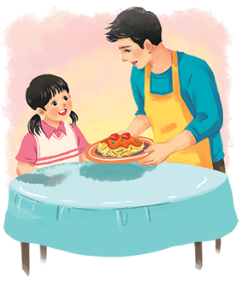
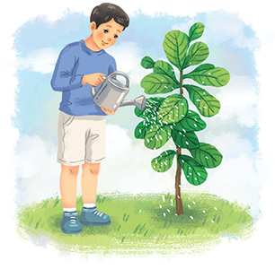
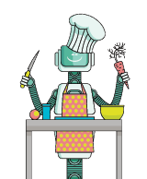
PRONUNCIATION
Listen and repeat the following sentences.
1.
I often water plants after school.
2.
Shifa can do many things like humans.
3.
My dad makes delicious meals at weekends.
4.
WB2 is the strongest of all the robots.
5.
H8 is a home robot.

Slide 27

PRONUNCIATION
Practise saying the statements in the following paragraph. Then listen and repeat.
My robot is Jimba. It’s a home robot. It’s very helpful. It can do the housework. It can also water plants and pick fruit. It can work as a guard. I love my robot very much.

Slide 28
LESSON 2: A CLOSER LOOK 1
LESSON 1: GETTING STARTED
Matching
WARM-UP
Vocabulary
Task 1: Match the verbs in column A to the words or phrases in column B.
(p. 60)
Task 2: Work in pairs. Tell your partner the activities in Task 1 you can or can’t do. (p. 60)
Task 3: Work in pairs. Read, ask and answer questions. (p. 60)
VOCABULARY
PRONUNCIATION
Task 4: Listen and repeat the sentences. (p. 60)
Task 5: Listen and practice saying the statements in the paragraph. (p. 60)
CONSOLIDATION
Wrap-up
Homework

Slide 29

CONSOLIDATION
1
Wrap-up
What have we learnt in this lesson?
use the lexical items related to the topic Robots;
use the vocabulary and structures to talk about what a robot can and cannot do;
pronounce and recognize the falling tone in statements.

Slide 30

CONSOLIDATION
2
Homework
Write a text to describe V10 using the sample in Exercise 5 and information in Exercise 3.

Slide 31






Website: hoclieu.vn
Fanpage: facebook.com/www.tienganhglobalsuccess.vn/

