Slide 1


Slide 2

Unit
6
1
Unit
FAMILY LIFE
GENDER EQUALITY
LESSON 7
COMMUNICATION AND CULTURE / CLIL

Slide 3

Unit
1
1
FAMILY LIFE
Family Life
Unit
OBJECTIVES
Knowledge
Use lexical items related to the topic Gender equality
Express agreement and disagreement
Learn about women's football
Core competence
Develop communication skills and creativity
Be collaborative and supportive in pair work and team work
Develop presentation skills
Personal qualities
Understand more about the gender equality in sports
Be respectful towards all genders and cultures.

Slide 4
LESSON 7
COMMUNICATION AND CULTURE / CLIL
Watch a video
WARM-UP
Task 1: Listen and complete a conversation with the expressions from the box. Then practise it in pairs.
Task 2: Work in pairs. Have similar conversations expressing agreement and disagreement about other jobs. Use the expressions below to help you.
COMMUNICATION
CLIL
Task 3: Read the text and fill the timeline about women’s football.
Task 4: Work in groups. Fill the timeline about women’s football in Viet Nam.
CONSOLIDATION
Wrap-up
Homework

Slide 5
LESSON 7
COMMUNICATION AND CULTURE / CLIL
Watch a video
WARM-UP

Slide 6
WARM-UP
Video: Agree To Disagree
https://www.youtube.com/watch?v=yEmgU9oX7ns
Watch the video and note down the language that the speakers use to agree/disagree.
After watching: What else could they say to express their views more clearly?

Slide 7
LESSON 7
COMMUNICATION AND CULTURE / CLIL
Watch a video
WARM-UP
Task 1: Listen and complete a conversation with the expressions from the box. Then practise it in pairs.
Task 2: Work in pairs. Have similar conversations expressing agreement and disagreement about other jobs. Use the expressions below to help you.
COMMUNICATION

Slide 8

COMMUNICATION
1
1
Listen and complete a conversation with the expressions from the box. Then practise it in pairs.
A. I’m afraid I disagree | B. Absolutely
C. You’re right | D. I’m sorry, but
Mum: Mai, Dad and I would like you to be a shop assistant.
Mai: (1) __________ that’s not possible. I want to go to medical school and become a surgeon.
Mum: (2) __________. It’s not easy to be a surgeon.
Mai: (3) __________. But I’m sure I can.
Mum: Besides medical knowledge, a surgeon must have physical and mental strength. Most
surgeons are also men ...
Mai: (4) __________. That’s why we need more women surgeons. We can be as good as men.

Slide 9
COMMUNICATION
1
1
Listen and complete a conversation with the expressions from the box. Then practise it in pairs.
A. I’m afraid I disagree | B. Absolutely
C. You’re right | D. I’m sorry, but
Mum: Mai, Dad and I would like you to be a shop assistant.
Mai: (1) _____D_____ that’s not possible. I want to go to medical school and become a surgeon.
Mum: (2) _____A_____. It’s not easy to be a surgeon.
Mai: (3) _____C_____. But I’m sure I can.
Mum: Besides medical knowledge, a surgeon must have physical and mental strength. Most
surgeons are also men ...
Mai: (4) _____B_____. That’s why we need more women surgeons. We can be as good as men.

Slide 10
COMMUNICATION
1
2
Work in pairs. Have similar conversations expressing agreement and disagreement about other jobs. Use the expressions below to help you.
Useful expressions
Agreement | Disagreement
• You’re right. • I couldn’t agree more. • Absolutely. | • That’s not true. • I’m afraid I disagree. • I’m sorry, but ...

Slide 11
LESSON 7
COMMUNICATION AND CULTURE / CLIL
Watch a video
WARM-UP
Task 1: Listen and complete a conversation with the expressions from the box. Then practise it in pairs.
Task 2: Work in pairs. Have similar conversations expressing agreement and disagreement about other jobs. Use the expressions below to help you.
COMMUNICATION
CLIL
Task 3: Read the text and fill the timeline about women’s football.
Task 4: Work in groups. Fill the timeline about women’s football in Viet Nam.

Slide 12
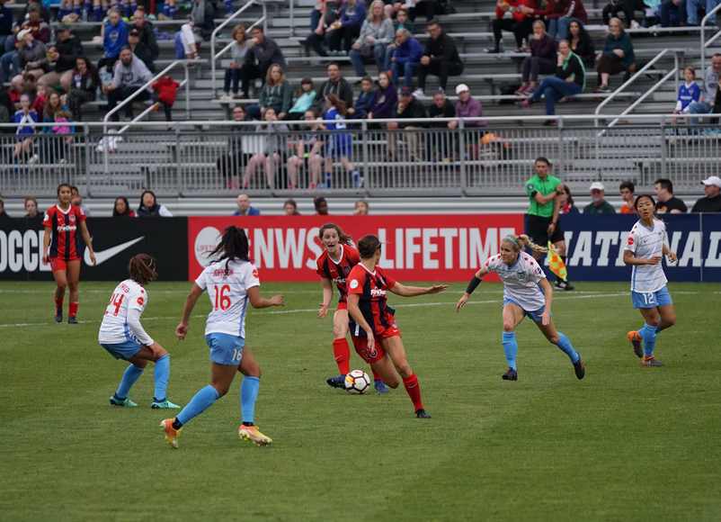
CLIL
Who are the women in the pictures? What sport do they play?

Slide 13
CLIL
1
1
Read the text and fill the timeline about women’s football.
Women's football
It is commonly thought that football is a sport for men. In fact, it is a sport for women, too.
The first recorded football matches between women took place in 1890s in Scotland and England.
Women’s football became very popular during the First World War when women started working in the factories. In 1921, however, the Football Association (FA) decided that the game was not suitable for women.
The ban lasted for 50 years until it was finally lifted in 1971. In the same year, France and the Netherlands played the first official women’s international football match. However, it took 20 years for the first FIFA Women’s World Cup to happen in 1991 in Asia. Since then, the competition has been held every four years.
Nowadays, like men’s football, women’s football is becoming more and more popular. Women’s professional football has developed significantly and the Women’s World Cup has drawn worldwide interests.
1. _____ | 2. _____ | 3. _____ | 4. _____ | 5. _____
First recorded matches | FA’s ban start | FA’s ban lift | First official women’s international football match | First FIFA Women’s World Cup

Slide 14
CLIL
1
1
Read the text and fill the timeline about women’s football.
Women's football
It is commonly thought that football is a sport for men. In fact, it is a sport for women, too.
The first recorded football matches between women took place in 1890s in Scotland and England.
Women’s football became very popular during the First World War when women started working in the factories. In 1921, however, the Football Association (FA) decided that the game was not suitable for women.
The ban lasted for 50 years until it was finally lift. In the same year, France and the Netherlands played the first official women’s international football matched in 1971.. However, it took 20 years for the first FIFA Women’s World Cup to happen in 1991 in Asia. Since then, the competition has been held every four years.
Nowadays, like men’s football, women’s football is becoming more and more popular. Women’s professional football has developed significantly and the Women’s World Cup has drawn worldwide interests.
1. 1890s | 2. 1921 | 3. 1971 | 4. 1971 | 5. 1991
First recorded matches | FA’s ban start | FA’s ban lift | First official women’s international football match | First FIFA Women’s World Cup

Slide 15
CLIL
The miracle journey of Vietnamese women's football team:
https://www.youtube.com/watch?v=9A-O_6A80a8

Slide 16
CLIL
1
2
Work in groups. Fill the timeline about women’s football in Viet Nam.
1. _____ | 2. _____ | 3. _____ | 4. _____ | 5. _____
Women’s football team establishment | First official match | First gold medal in the SEA Games | First AFF Women’s Championship | Most recent AFF Women’s Championship
Extra video: The miracle journey of Vietnamese women's football team
https://www.youtube.com/watch?v=9A-O_6A80a8

Slide 17
CLIL
1
2
Work in groups. Fill the timeline about women’s football in Viet Nam.
1. 1990 | 2. 1997 | 3. 2001 | 4. 2006 | 5. 2019
Women’s football team establishment | First official match | First gold medal in the SEA Games | First AFF Women’s Championship | Most recent AFF Women’s Championship
Extra video: The miracle journey of Vietnamese women's football team
https://www.youtube.com/watch?v=9A-O_6A80a8

Slide 18
LESSON 7
COMMUNICATION AND CULTURE / CLIL
Watch a video
WARM-UP
Task 1: Listen and complete a conversation with the expressions from the box. Then practise it in pairs.
Task 2: Work in pairs. Have similar conversations expressing agreement and disagreement about other jobs. Use the expressions below to help you.
COMMUNICATION
CLIL
Task 3: Read the text and fill the timeline about women’s football.
Task 4: Work in groups. Fill the timeline about women’s football in Viet Nam.
CONSOLIDATION
Wrap-up
Homework

Slide 19
CONSOLIDATION
1
Wrap-up
Communication: Expressing agreement and disagreement
Culture: Women’s football

Slide 20
CONSOLIDATION
2
Homework
Prepare for the next lesson: Project.

Slide 21


