Slide 1

Unit 5: London Was Great!
Lesson 5a – Vocab Expansion
Page 89

Slide 2
Lesson Outline
Warm-up
Vocabulary
Speaking
Writing
Consolidation
Wrap-up

Slide 3
Objectives
By the end of this lesson, students will be able to…
- learn words related to transport: plane, helicopter, bus, car, train, motorcycle, tram, taxi, ship, bike/bicycle and use adjectives: boring, exciting, cheap, fast, expensive, boring, relaxing to compare the means of transport.
- describe an imaginary situation.
- prepare a quiz about the London Transport Museum.

Slide 4

WARM-UP

Slide 5
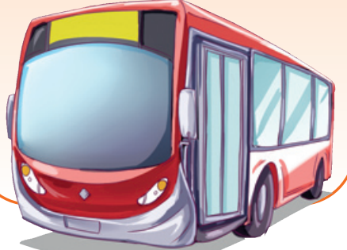
bus
Hidden picture
Notes:
Click vào từng ô màu để hình hiện ra từ từ

Slide 6
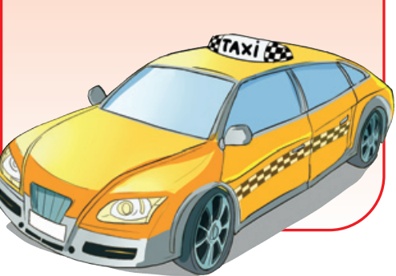
taxi
Hidden picture

Slide 7
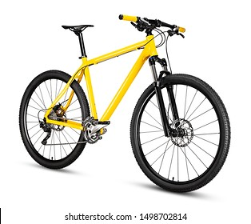
bike
Hidden picture

Slide 8
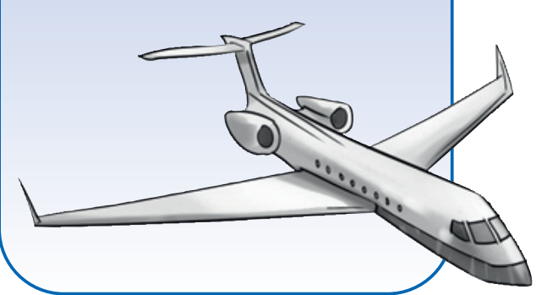
plane
Hidden picture

Slide 9

Work in pairs
How do you go to school?
Can you think of any transport around you?
Which transport do you like most?

Slide 10
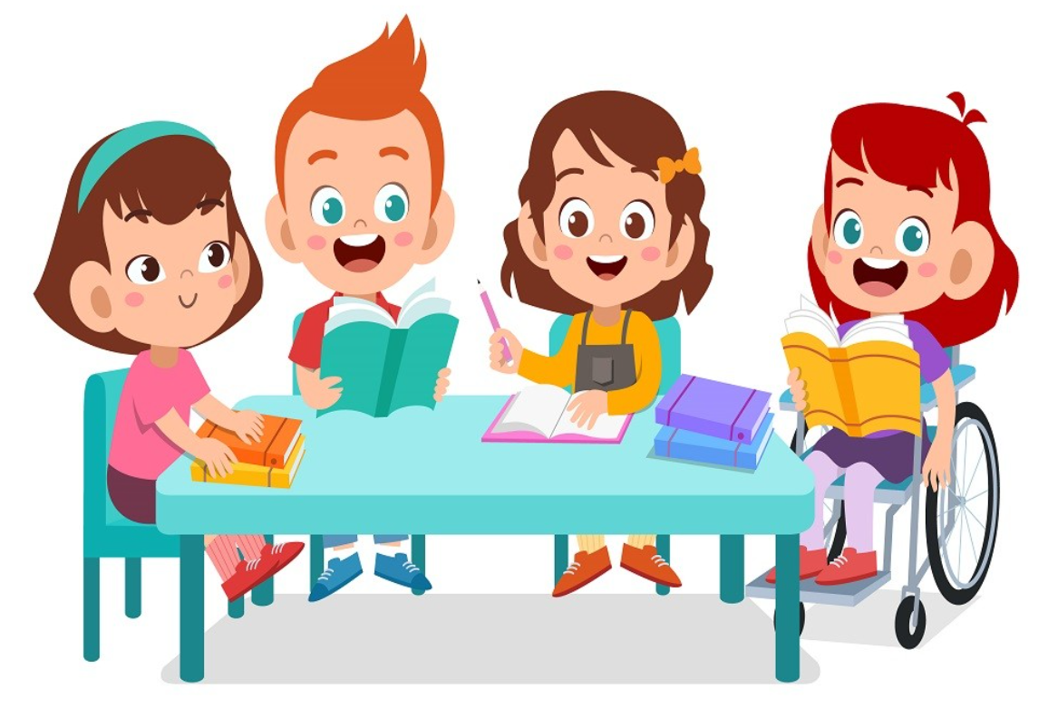
It’s time to learn …

Slide 11
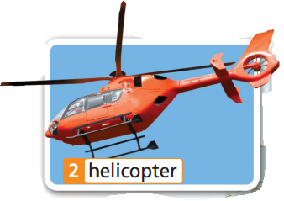
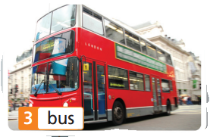

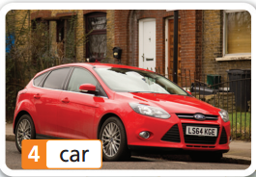
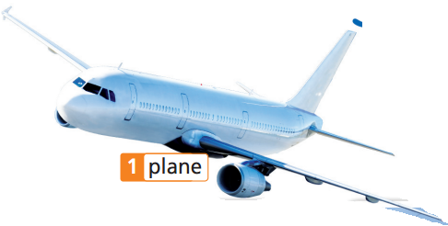
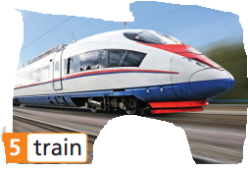

Match the word with the correct means of transport:
helicopter bike
bus taxi
tram ship
car motorcycle
train plane
Listen and check.

Slide 12
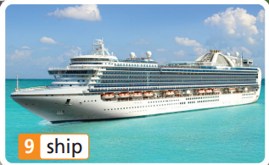
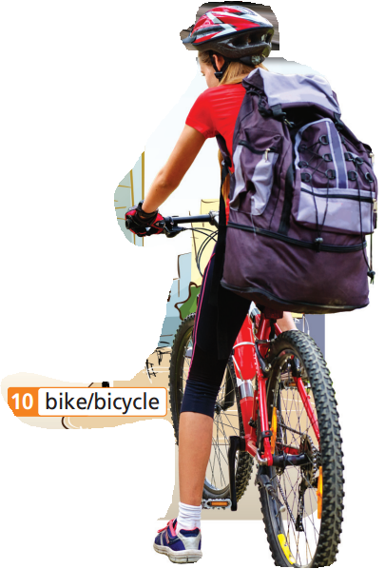
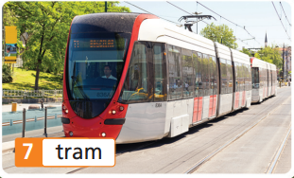
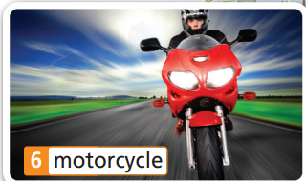
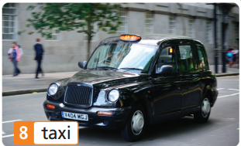
Match the word with the correct means of transport:
helicopter bike
bus taxi tram
ship car
motorcycle
train plane
Listen and check.

Slide 13

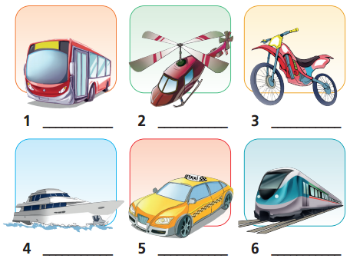
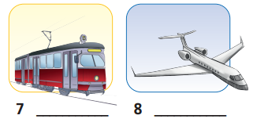
Extra Practice
WB page 44
bus
helicopter
motorcycle
tram
plane
ship
taxi
train

Slide 14
Extra Practice
Put each kind of transport in the right category.
helicopter bike bus taxi tram
ship car motorcycle train plane
Air | Land | Water
bike
bus
taxi
tram
car
motorcycle
train
helicopter
plane
ship

Slide 15


helicopter
bike
bus
taxi
tram
ship
car
motorcycle
train
plane
Notes:
Click vào mỗi text box để biết đúng sai

Slide 16
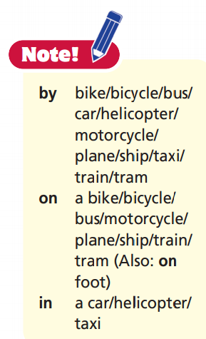

Slide 17

New words
fast >< slow
exciting >< boring relaxing >< tiring cheap >< expensive

Slide 18
Listen and repeat. Click each phrase to hear the sound.
slow (adj) /sləʊ/ chậm
fast (adj) /fɑːst/ nhanh
boring (adj) /ˈbɔːrɪŋ/ chán nản, buồn tẻ
exciting (adj) /ɪkˈsaɪtɪŋ/ thú vị, hứng thú, phấn khích
tiring (adj) /ˈtaɪərɪŋ/ mệt mỏi
relaxing (adj) /rɪˈlæksɪŋ/ thư giãn, giải trí
cheap (adj) /tʃiːp/ rẻ
expensive (adj) /ɪkˈspensɪv/ đắt, mắc tiền

Slide 19
Remember the opposite:
fast >< slow
exciting >< boring
relaxing >< tiring
cheap >< expensive

Slide 20
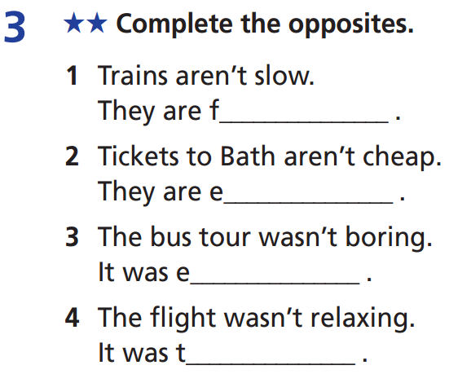
Extra Practice
WB-p. 44
ast
xpensive
xciting
iring

Slide 21
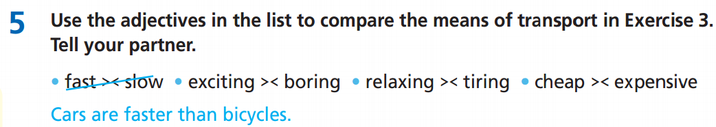
Suggested Answer
Trains are slower than planes.
Helicopters are more exciting than buses.
Trains are more relaxing than cars.
Bikes are more tiring than cars.
Ships are more boring than planes.
Buses are cheaper than taxis.
Planes are more expensive than trains.

Slide 22
Extra Practice
Choose the word whose main stress is different from the rest.
a. actor b. actress c. painter d. arrive
a. unhealthy b. difficult c. transport d. later
a. writer b. museum c. physicist d. station
a. exciting b. interesting c. parade d. stateswoman
a. singer b. boring c. island d. interactive
a. relaxing b. exciting c. expensive d. rainforest

Slide 23
Extra Practice
Choose the word whose main stress is different from the rest.
1. a. actor b. actress c. painter d. arrive
/ˈæktə/ /ˈæktrəs/ /ˈpeɪntə/ /əˈraɪv/
2. a. unhealthy b. difficult c. transport d. later
/ʌnˈhelθi/ /ˈdɪfɪkəlt/ /ˈtrænspɔːt/ /ˈleɪtə/
3. a. writer b. museum c. physicist d. station
/ˈraɪtə/ /mjuˈziːəm/ /ˈfɪzɪsɪst/ /ˈsteɪʃn/

Slide 24
Extra Practice
Choose the word whose main stress is different from the rest.
4. a. boring b. interesting c. parade d. stateswoman
/ˈbɔːrɪŋ/ /ˈɪntrəstɪŋ/ /pəˈreɪd/ /ˈsteɪtswʊmən/
5. a. singer b. boring c. island d. interactive
/ˈsɪŋə/ /ˈbɔːrɪŋ/ /ˈaɪlənd/ /ˌɪntərˈæktɪv/
6. a. relaxing b. exciting c. expensive d. rainforest
/rɪˈlæksɪŋ/ /ɪkˈsaɪtɪŋ/ /ɪkˈspensɪv/ /ˈreɪnfɒrɪst/

Slide 25

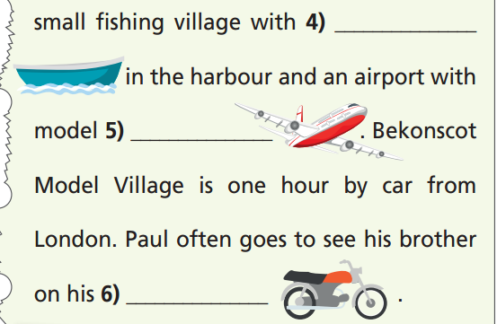
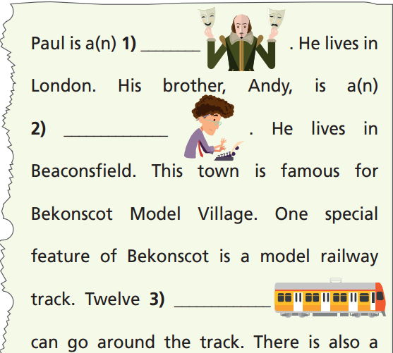
Extra Practice
WB-p. 44
ships
actor
planes
author/writer
motorcycle
trains

Slide 26

Speaking

Slide 27
Pre-speaking
Where is it?
It is in London.
It has over 450,000 items.
It first opened in the 1960s.
It has means of transport from London history.
London Transport Museum

Slide 28
Pre-speaking
Rearrange these words to make a complete sentence:
1. are / on / London / a / holiday / week / in / We / for
We are on holiday in London for a week.
2. transport / I / of / all / see / kinds / can
I can see all kinds of transport.
3. London / are / underground trains / there / buses / red / and
There are red London buses and underground trains.
4. I / train fan / I’m / excited / because / very / a / feel
I feel very excited because I’m a train fan.

Slide 29
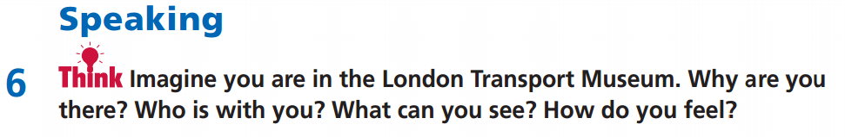
While-speaking
I am in the London Transport Museum with ………….
We are on holiday in London for …………… (time)
I can see ……………………………………………………………….
There are ………………………………………………………………
I feel very happy/excited/……… because ………………

Slide 30
Post-speaking
Present your idea with the class.
Suggested Answer Key
I am in the London Transport Museum with my family. We are on holiday in London for a week, so we are tourists. I like going to museums. I can see all kinds of transport, both old and new. There are red London buses and underground trains. I feel very excited because I’m a train fan.

Slide 31
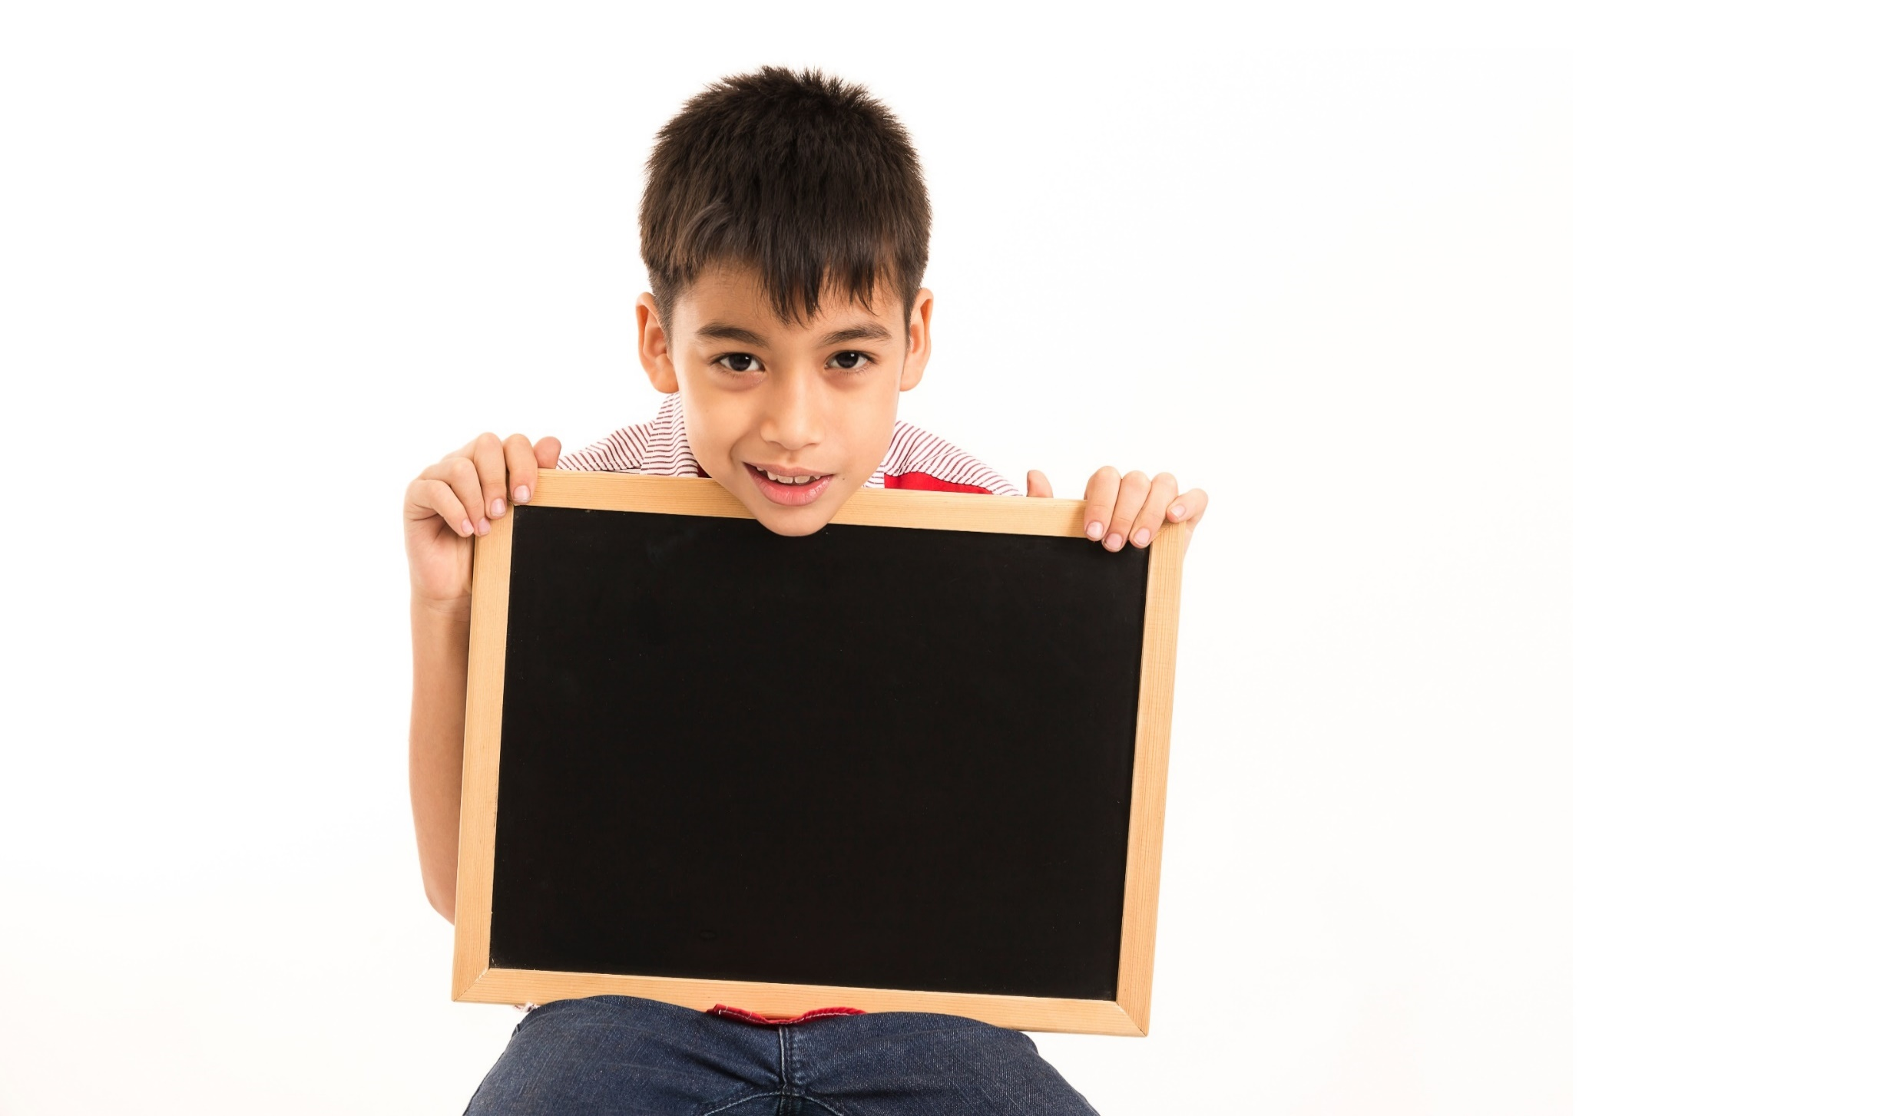
Writing

Slide 32
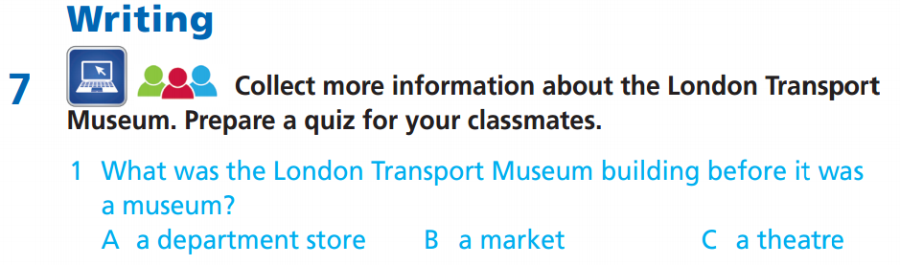
- Ask students to work in small groups for 20 minutes.
Research online and prepare a quiz on the London Transport Museum for their classmates.
Review the text on p. 88 again if necessary.
Read your quiz aloud for your friends to guess the answer.

Slide 33
Suggested Answer Key
1 Where is the London Transport Museum?
A) near the River Thames
B) far from the River Thames
2 How old are the exhibits in the museum?
A) over 100 years old
B) less than 100 years old
3 What was the Covent Garden site first used as?
A) a vegetable, fruit and flower market
B) a train station

Slide 34
4 On which day is the museum closed?
A) the International Day of Free Public Transport
B) Christmas Day
5 Where was the Museum first opened?
A) in a market
B) in a garage

Slide 35

CONSOLIDATION

Slide 36
Imagine you are in London Transport Museum. Write some sentences about it. Try to answer the following questions:
Who do you go with?
What do you know about the museum? (first opened? Where? It first opened …)
What do you see there?
How do you feel?

Slide 37

WRAP-UP

Slide 38
Today’s lesson
Vocabulary
Nouns: plane, helicopter, bus, car, train, motorcycle, tram, taxi, ship, bike/bicycle
Adjectives: boring, exciting, cheap, fast, expensive, boring, relaxing
Speaking
Describe an imaginary situation.
Writing
Prepare a quiz about the London Transport Museum.

Slide 39
Homework
Practise the vocabulary and make sentences using them.
Do the exercises in TA 6 Right on WB (p. 44).
Do the exercises in TA 6 Right on Notebook (pp. 46 & 47).
Prepare for the next lesson (p. 90 SB).

Slide 40
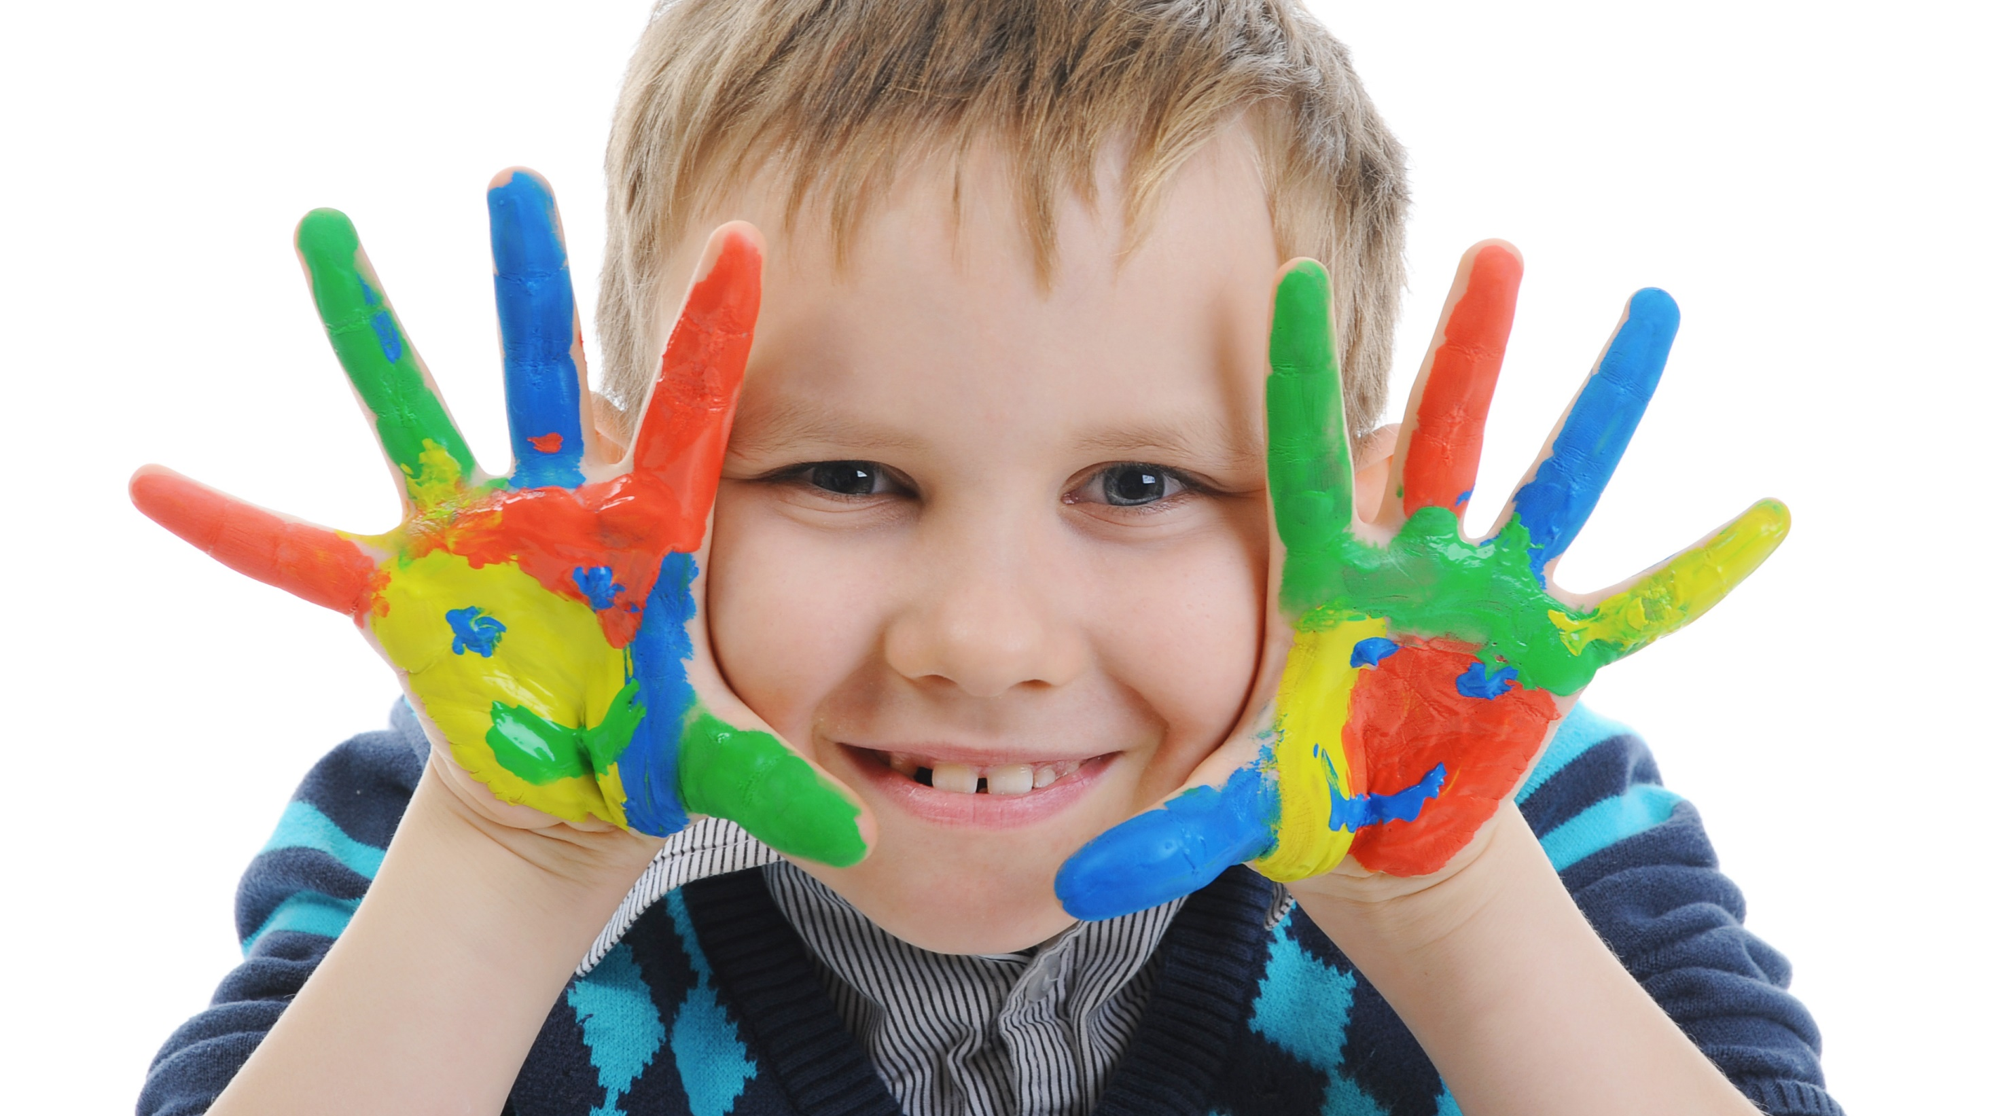
Enjoy your day!

