Slide 1
Unit 2: Humans And The Environment Lesson 3: Reading

Slide 2
Unit
1
1
FAMILY LIFE
Family Life
Unit
OBJECTIVES
By the end of this lesson, Ss will be able to:
read for main ideas and specific information in a text about green living;
guess the meaning of words/phrases in context;
talk about ways to live green.

Slide 3
TABLE OF CONTENTS
01
02
03
04
05
Warm-up
Pre-reading
While-reading
Post-reading
Consolidation

Slide 4
01
Warm-up
Crossword

Slide 6
WARM-UP
CROSSWORD
Rules:
Choose a random number.
Read the clue and guess the word.
The number of the letters is the point you gain.
40 points for the DOWN word.
The winner is the team with the most points.

Slide 7
WARM-UP
KEY WORD
1
L | I | T | T | E | R
2
E | C | O | F | R | I | E | N | D | L | Y
3
C | A | R | B | O | N | F | O | O | T | P | R | I | N | T
4
E | N | E | R | G | Y
5
H | O | U | S | E | H | O | L | D
6
A | D | O | P | T
Clue: rubbish lying in an open or public place
Clue: all the people living together in a house or flat
Clue: Causing no harm to the environment.
Clue: The amount of carbon dioxide produced by the activities of a person or an organisation.
Clue: start to use a particular method
Clue: Power used for driving machines, providing heat and light, etc.
Clue: interest in and concern about a particular situation or area of interest
Clue: put plants, seeds, etc. in the ground to grow
Clue: the time of life when a person is young, especially the time before a child becomes an adult
7
Y | O | U | T | H
8
P | L | A | N | T
9
A | W | A | R | E | N | E | S | S

Slide 8
02
Pre-reading

Slide 9
VOCABULARY
explosion (n)
/ɪkˈspləʊʒn/
A violent burst, often with a loud noise
Vụ nổ

Slide 10
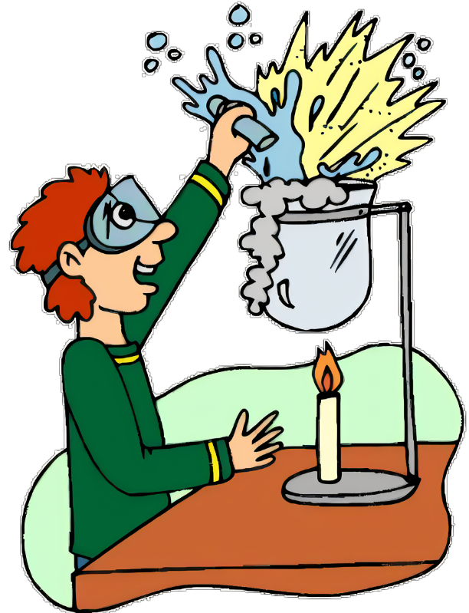
VOCABULARY
method (n)
/ˈmeθəd/
a way of doing st
phương pháp

Slide 11
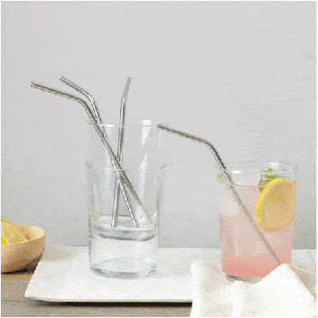
VOCABULARY
refillable (adj)
/ˌriːˈfɪləbl/
that can be filled again after being empty
có thể làm đầy lại

Slide 12
VOCABULARY
raw material (n.phr.)
/ˌrɑː məˈtɪəriəl/
any material, such as oil, cotton, or sugar in its natural condition, before it has been processed for use
nguyên liệu thô

Slide 13
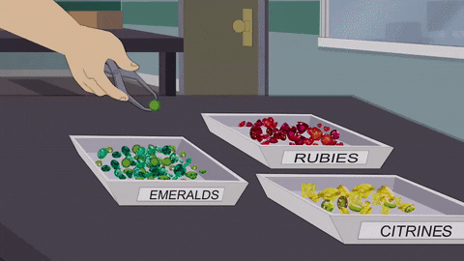
VOCABULARY
sort (v)
/sɔːt/
put a number of things in an order or to separate them into groups
phân loại

Slide 14
VOCABULARY
New words | Pronunciation | Meaning
explosion (n) | /ɪkˈspləʊʒn/ | a violent burst, often with a loud noise a bomb/nuclear/gas explosion
method (n) | /ˈmeθəd/ | a way of doing something
refillable (adj) | /ˌriːˈfɪləbl/ | that can be filled again after being empty
raw material (n.phr.) | /ˌrɔː məˈtɪəriəl/ | any material, such as oil, cotton or sugar in its natural condition, before it has been processed for use
sort (v) | /sɔːt/ | put a number of things in an order or to separate them into groups

Slide 15
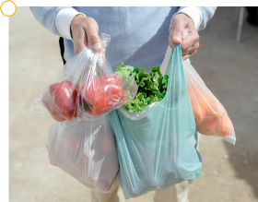
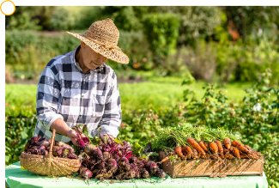
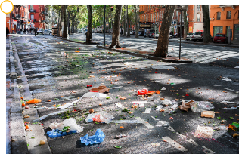
PRE-READING
1
Work in groups. Look at the pictures and answer the questions.
Which pictures show a green lifestyle? Why?
a
b
c
d

Slide 16
PRE-READING
1
Work in groups. Look at the pictures and answer the questions.
a
In this picture, a man goes shopping with lots of plastic bags. It doesn’t show a green lifestyle. Plastic bags pollute the environment since they take time to decay.

Slide 17
PRE-READING
1
Work in groups. Look at the pictures and answer the questions.
b
In this picture, we can see fresh food, which looks organic and is better for our health.
It shows a green lifestyle.

Slide 18
PRE-READING
1
Work in groups. Look at the pictures and answer the questions.
c
In this picture, we can see a lot of litter on the ground. Dropping litter makes the streets very dirty and pollutes the air and water. It doesn’t show a green lifestyle.

Slide 19
PRE-READING
1
Work in groups. Look at the pictures and answer the questions.
d
In this picture, the sign advises people to turn off lights when they are not in use. This can save electricity and shows a green lifestyle.

Slide 20
03
While-reading

Slide 21
WHILE-READING
2
Read the following text and choose the best title for it.
Green living
Green issues
Green products
Tips
When you choose the best title, you should:
Read through the whole text.
Pay attention to the opening paragraph
Choose the title that best represents the idea of the whole text, not just part of it.

Slide 24
Choose the correct meanings of the words and phrases.
sustainable
causing little or no damage to the environment
bringing no benefits to the environment

Slide 25
Choose the correct meanings of the words and phrases.
organic
without the use of chemicals
without the use of animal organs

Slide 26
Choose the correct meanings of the words and phrases.
cutting down on
reusing
reducing

Slide 27
Choose the correct meanings of the words and phrases.
natural resources
materials supporting life
materials harmful to life

Slide 28
WHILE-READING
4
Read the text again and decide whether the following statements are true (T) or false (F).
1. Green living is now compulsory for many people.
2. Turning off electrical appliances is an easy way to save energy.
3. It takes a long time for plastic waste to break down.
4. The use of refillable water bottle is not encouraged.
F; compulsory -> a choice
More and more people adopt a green lifestyle. It is a choice we make ….
T
Turning off your appliances when they are not in use. This is one of the easiest way to save energy ….
T
Cutting down on plastic use. This really helps the environment because it takes
many years for plastic waste to break down into small pieces.
F: not encouraged-> encouraged
Bring a reusable bad when you go shopping, and your own refillable bottle instead of buying bottled water.

Slide 29
04
Post-reading

Slide 30
POST-READING
PRACTICE
5
Work in pairs. Discuss the following question.
In your opinion, which of the suggestions in the text is the easiest way to live green?
Suggested answer: In my/ our opinion, turning off household appliances when they are not in use is the easiest way to live green because we can do this right at home. We don’t need any equipment or training for this.

Slide 31
05
Consolidation

Slide 32
CONSOLIDATION
1
Wrap-up
WHAT HAVE WE LEARNT TODAY?
The ways to live green.
2
Homework
- Search for more ways to live green on the Internet, take note some and post them on the Facebook/Zalo of your class.
- Prepare for Speaking lesson.

Slide 33
SEE YOU NEXT TIME !!

